Slide 1
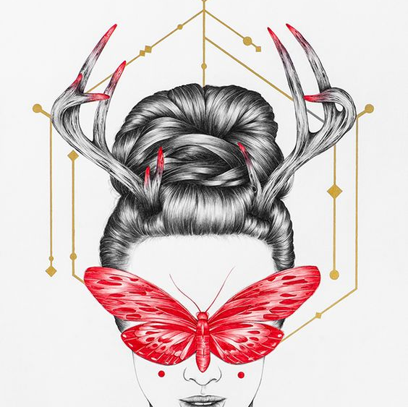
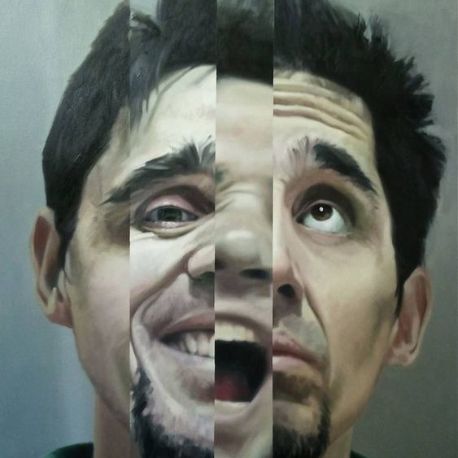
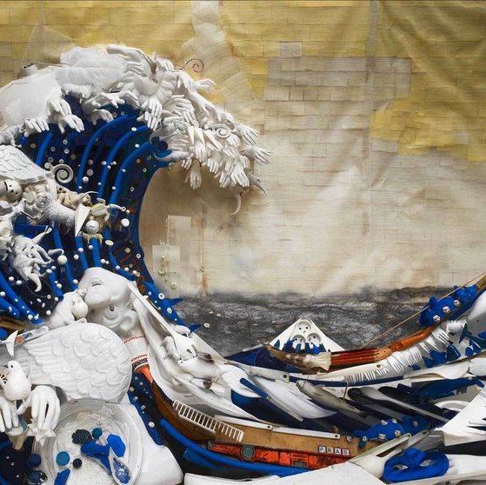
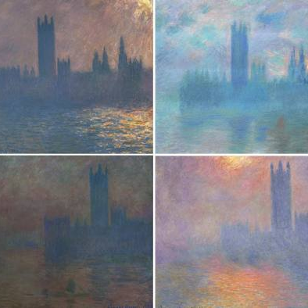
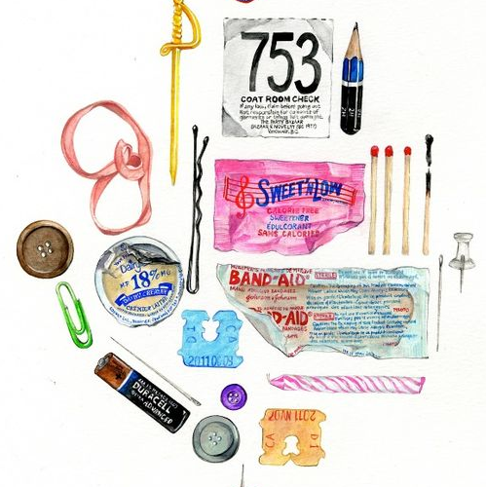
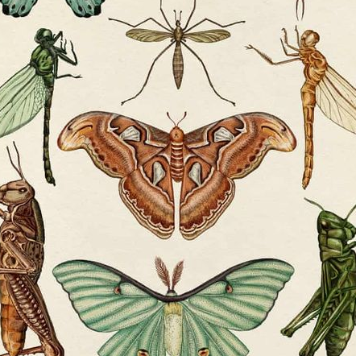
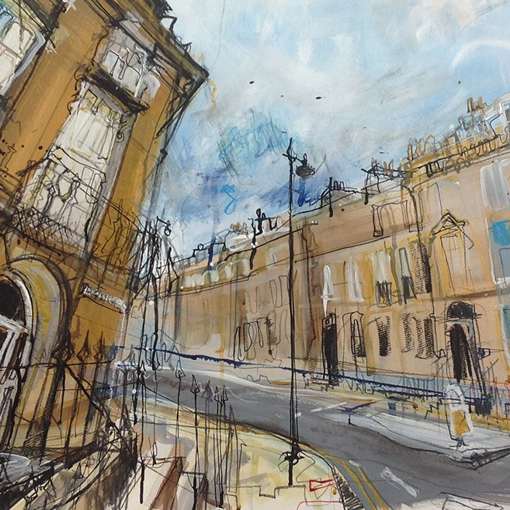
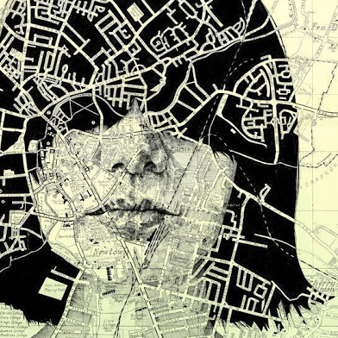


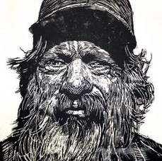
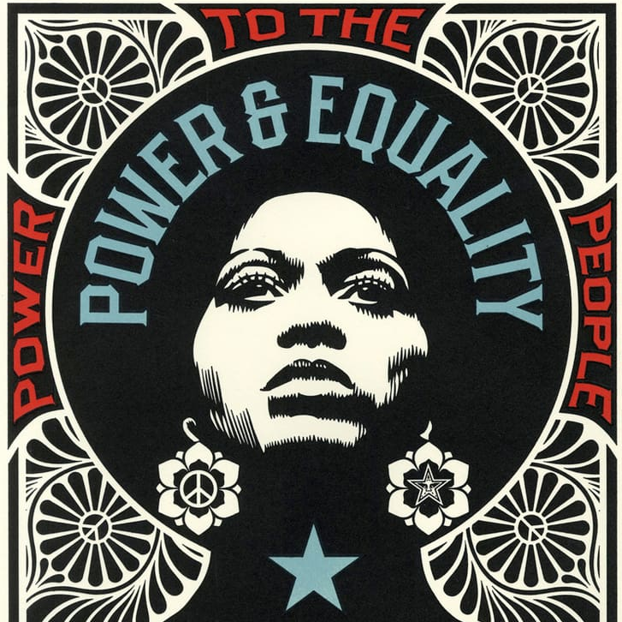
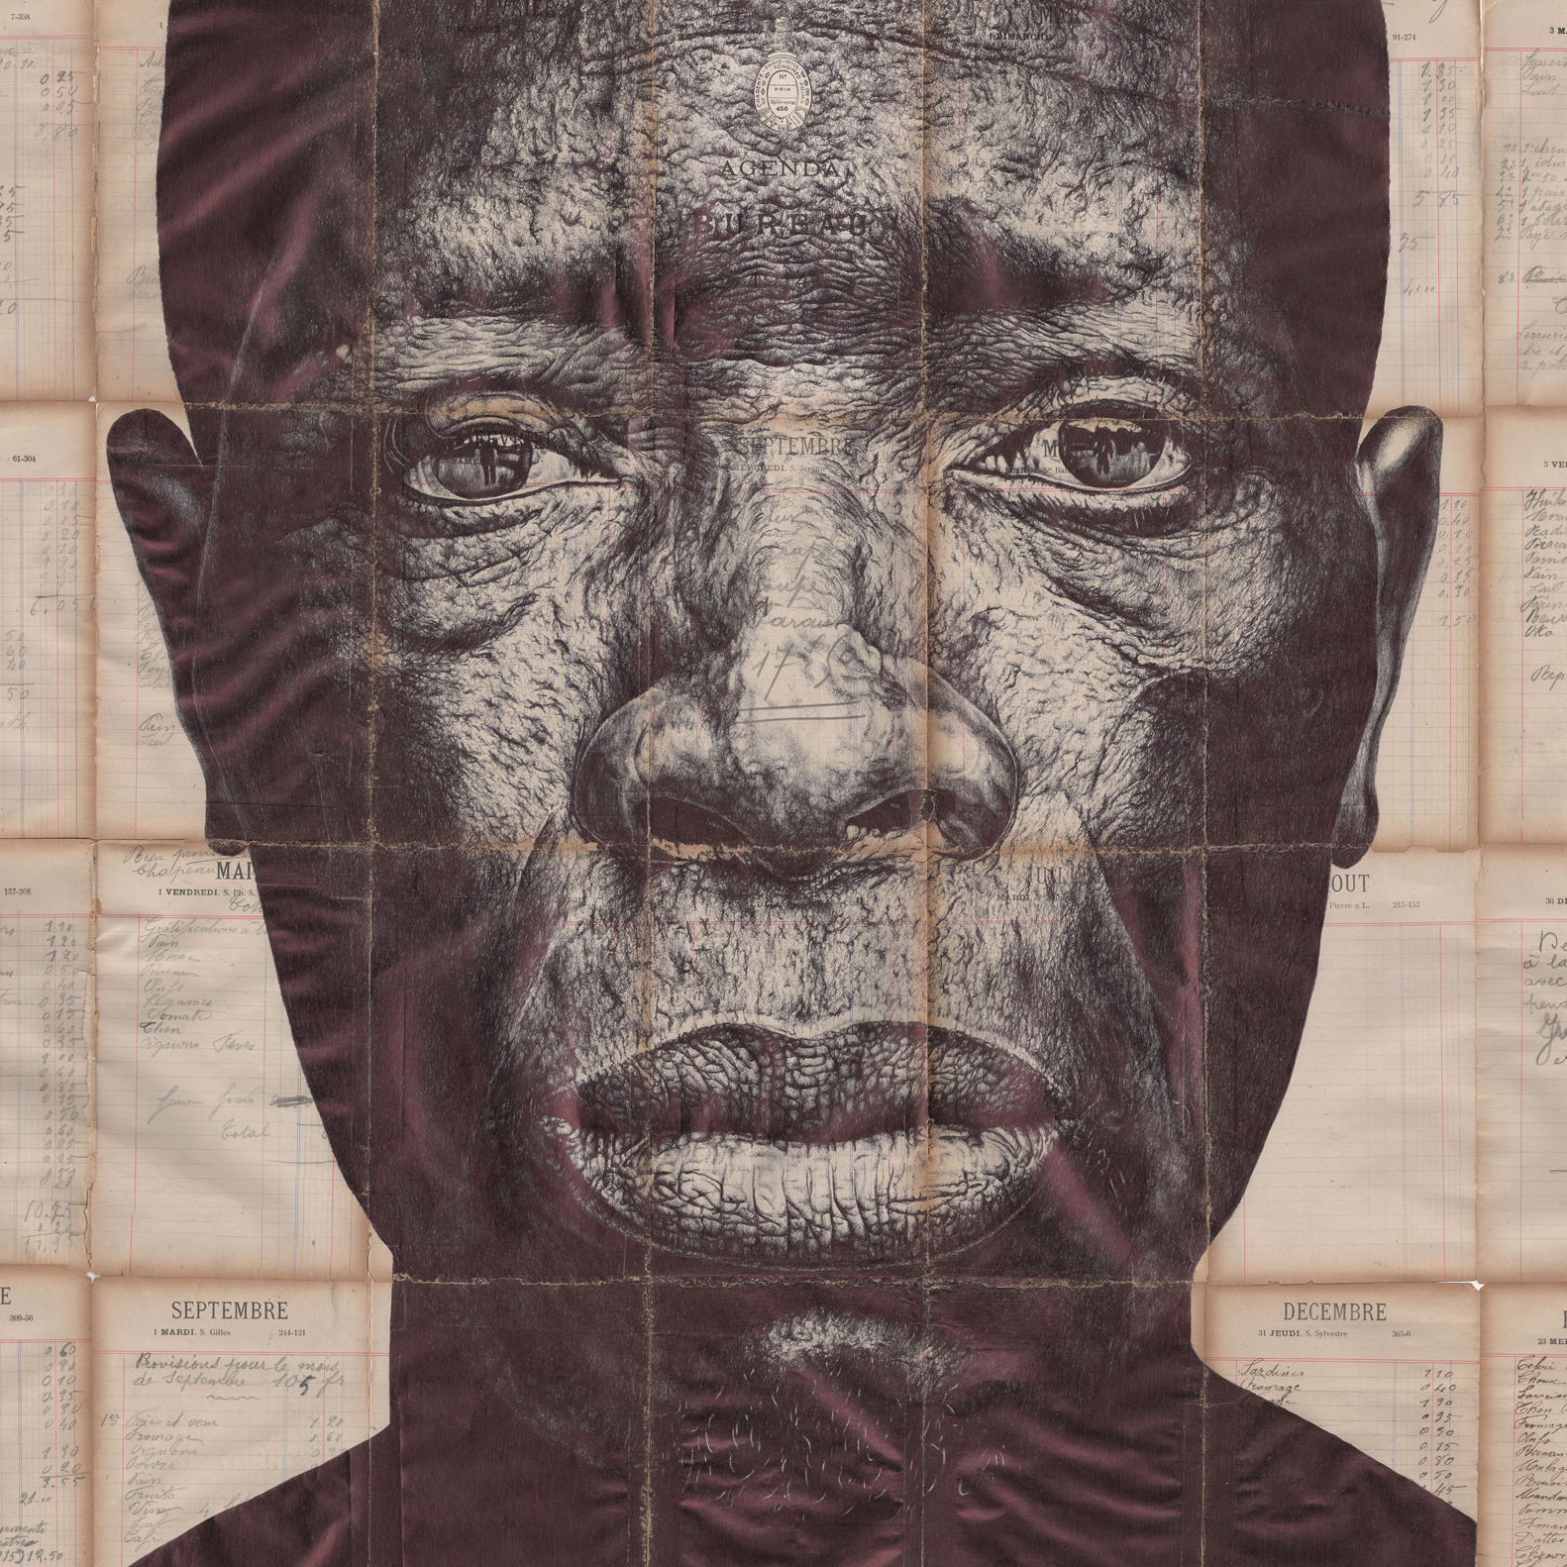
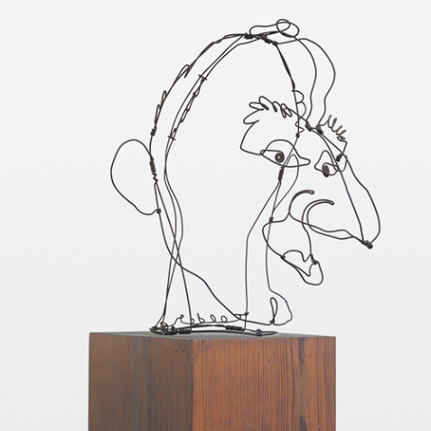


YR 10
ART & DESIGN
Peony Yip
Bernard Pras
Beauty, Masking, animals and Insects
Collage, environment, pollution, plastics
Year 11
Juan Gallego
Claud Monet
Cycle 3
Portraiture, mental health, emotion
Colour theory, landscapes, seasons, environment
Janice Wu - Groups
Lucy Jones - Places
Portraiture and Skills/ Groups, Types, Places
Still Life, observational drawing, photoshoots.
Landscapes, observational drawing, photoshoots
Skills and Inspiration overview
Learn how to apply and experiment with the Visual Elements through a variety of skills, techniques and processes
Cycle 2
Katie Scott - Types
Ed Fairburn
Natural forms, observational drawings, photoshoots
Drawing, Collage, Mixed media
Developing how to talk and write about your own and other’s work
Neil Shigley
Mark Powell
Mark making, Lino cutting, print making
Observational drawing, proportion, recording, mark making
Cycle 1
Learning how to create original artwork inspired by the work of others
Learning how to evaluate your own and others work
Shepard Fairey
Alexander Calder
Photoshop, Colour theory, gridded drawing Painting techniques
Observational drawing, recording, line, abstract drawing

