Slide 1



Maths Calculations Year 1
Methods for teaching the four calculations at St. David’s.

Slide 2
Year 1 National Curriculum objectives.
Addition, Subtraction, Multiplication and Division
Read, write and interpret mathematical statements involving addition (+), subtraction (−) and equals (=) signs
represent and use number bonds and related subtraction facts within 20
add and subtract one-digit and two-digit numbers to 20, including 0
solve one-step problems that involve addition and subtraction, using concrete objects and pictorial representations, and missing number problems such as 7 = ? − 9
solve one-step problems involving multiplication and division, by calculating the answer using concrete objects, pictorial representations and arrays with the support of the teacher

Slide 3
Vocabulary related to the four calculations for Year EYFS – Year 6
EYFS/Year 1
more (than) less (than) total
fewer (than) equal (to) most
least
sum difference between total
first
plus add(ition) subtract(ion)
minus ones tens
ones
column(s) multiples
Year 2
multiple commutative
>as ‘greater than’
< as ‘less than’ partition
place holder
place value estimate
estimation
inverse
array
calculate
multiplication division
times tables
Year 3
multiple(s) inverse operations integer(s) decimal(s) remainder
Year 4
round rounding
negative
operation
Factor
factor pairs distributive associative derive remainder
odd
even double halve pair
how much how many larger smaller estimate compare together
Year 5
power(s) prime complement
composite prime factor square(d)2 cube(d)3 equivalence
Year 6
long division Multi-step common factors common multiple

Slide 4
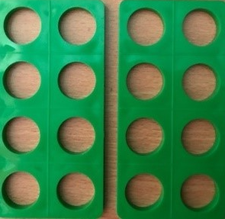


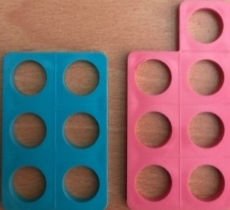





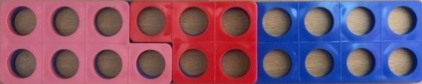
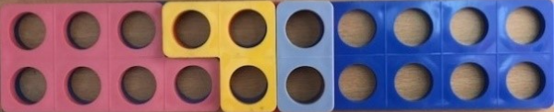
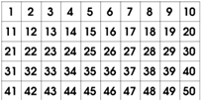
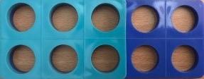
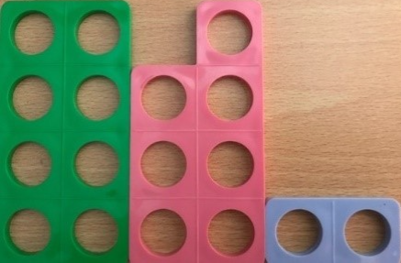
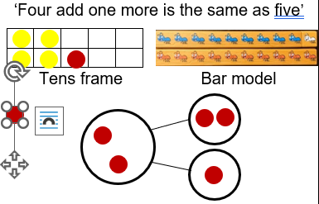
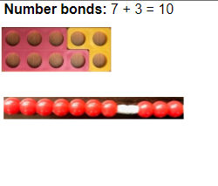
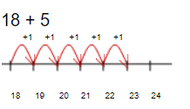

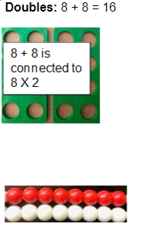
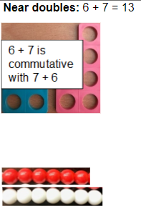
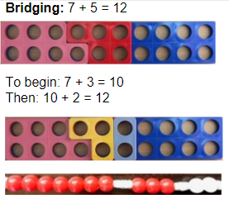
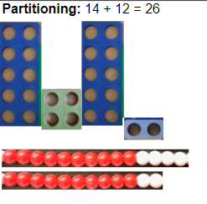
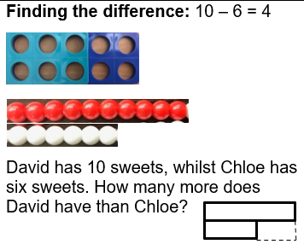
Strategies for Addition and subtraction
Counting on

Slide 5
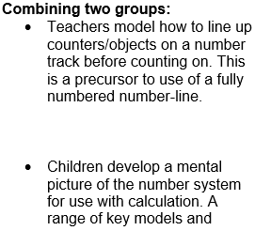
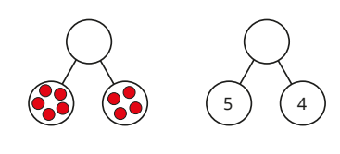
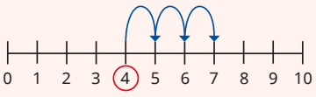
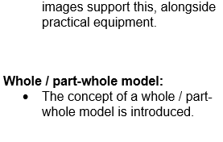
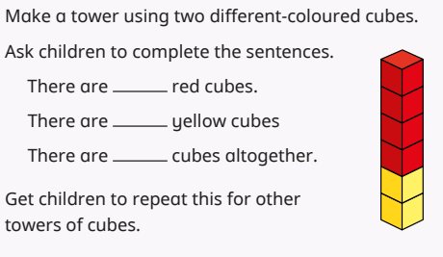
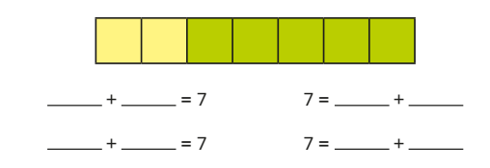
Addition
Part whole
Number line
4 + 3 = 7
5 + 4 = 9
Circle start number 4, jump on 3 and finish on 7. 4+3=7
One part 5 + one part 4 = whole 9 altogether
Combining 2 groups
Bar model – fact family
2 yellow + 5 green = 7 altogether

Slide 6
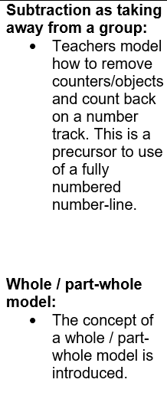
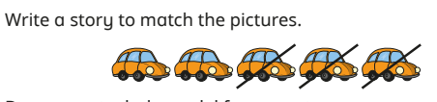
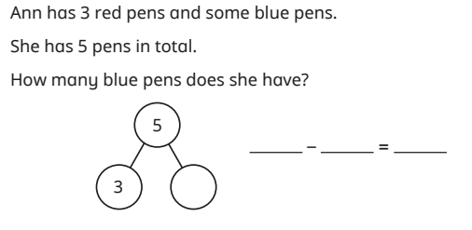
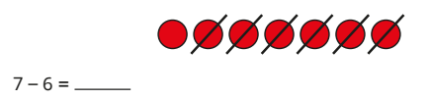
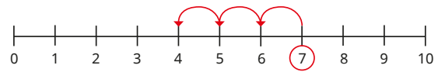
SUBTRACTION
Subtraction by crossing out
Finding a missing part (link with addition)
First there were 5 cars
Then 3 drove away
Now there are 2
Jumping back on a number line
Start on 7, jump back 3 spaces and land on 4. 7-3=4

Slide 7
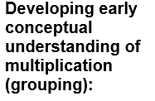
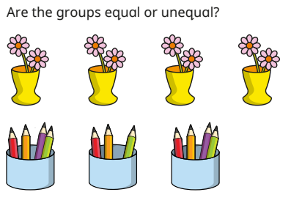
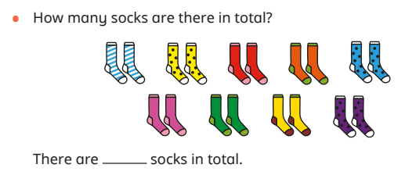
Multiplication
To recognise equal groups
To count in 2’s, 5’s and 10’s
- To add equal groups

Slide 8
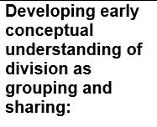
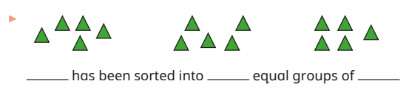
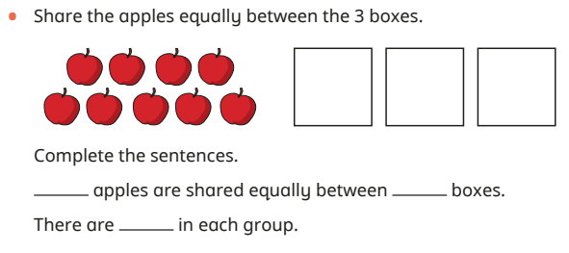
division
To make equal groups - grouping
To make equal groups - sharing

