Slide 1

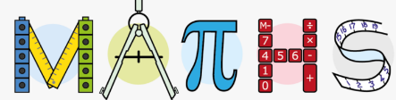

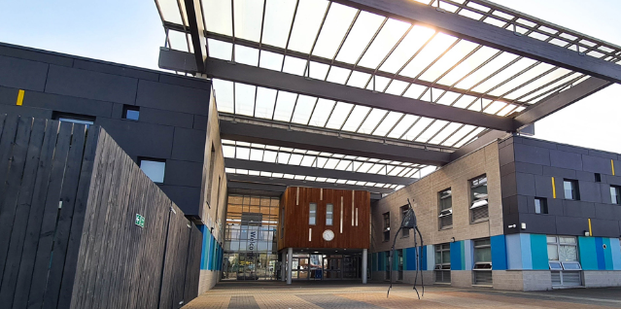
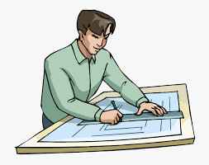
Welcome to Holte School
DEPARTMENT
Maths Teachers:
Mr Nur
Mr Aziz
Mrs Birdi
Mrs Sandhu
Mr Madourie
Mrs Whelan
Mr Ajmal
Mr Miah
Miss Aden
Miss Bibi
Mr Rahman
Mr Tsighe
Mr Sohal
When designing houses architects must ensure their measurements are correct so that the house doesn’t fall down!

Slide 2

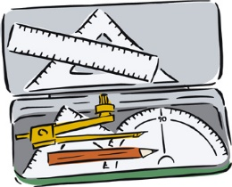

What will I need for Maths lessons?
Black or blue pen (plus a spare in case it runs out!)
Pencil
Ruler
Rubber
(recommend optional)
Highlighters
Geometry set
Calculator (scientific)
Your teacher will provide a blue exercise book for classwork.
There are many types of scientists, all of which use Maths daily! For example, chemists measure the exact amount of each chemical when completing experiments.

Slide 3
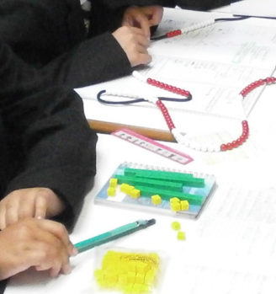
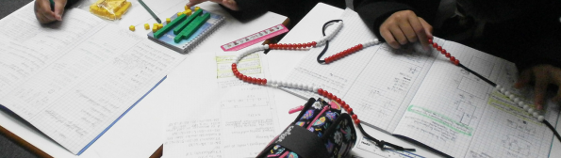

What will I learn ?
Topics covered during year 7:
Basics of number
Types of number
Calculations
Algebra
Fractions
Equations
Angles
Area and perimeter
Data and averages
Graphs and charts
Homework
encourages self-development and self-discipline.
Video game developers need to be good at maths as mathematics are the foundation of every video game design.

Slide 4

Extra curricular activities
World Maths Day in March
UKMT Junior Mathematical Challenge in May
Maths breakfast and lunch time clubs
Mathematical reward trips – Cadburys world and Thinktank Birmingham.
Many of these events will depend on what covid restrictions are still in place next academic year.
Electricians need to be able to measure and plan how much wire they need when rewiring a house.

Slide 5
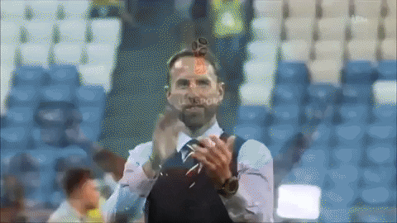
How can I prepare for September?
Completing all transition work sent to you
https://myminimaths.co.uk/year-6-to-7-mini-mathsold/
https://www.teachitmaths.co.uk/transition
You mays also with to cover some of the topics mentioned on slide 3 using websites such as:
https://www.bbc.co.uk/bitesize/subjects/zqhs34j
https://mathsmadeeasy.co.uk/ks3-revision/
Football managers like Gareth Southgate use maths to analyse the data from matches including possession, goals and stamina of players.

