Slide 1
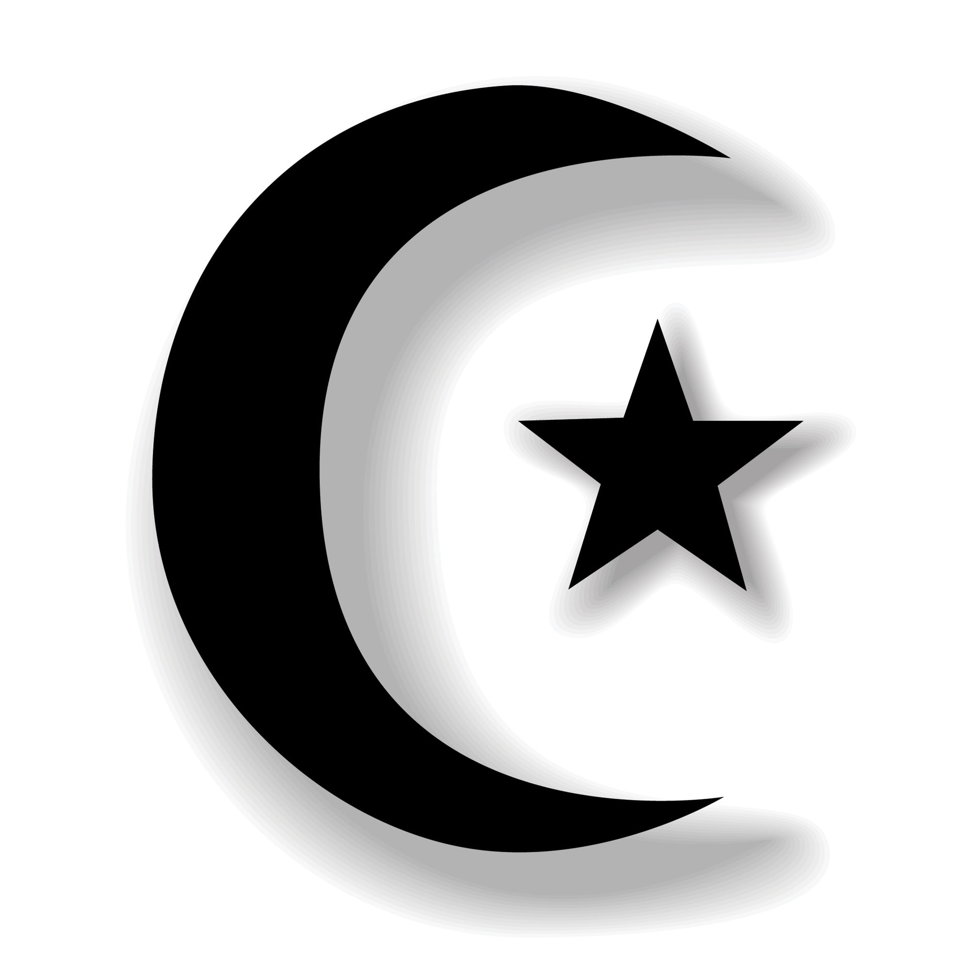
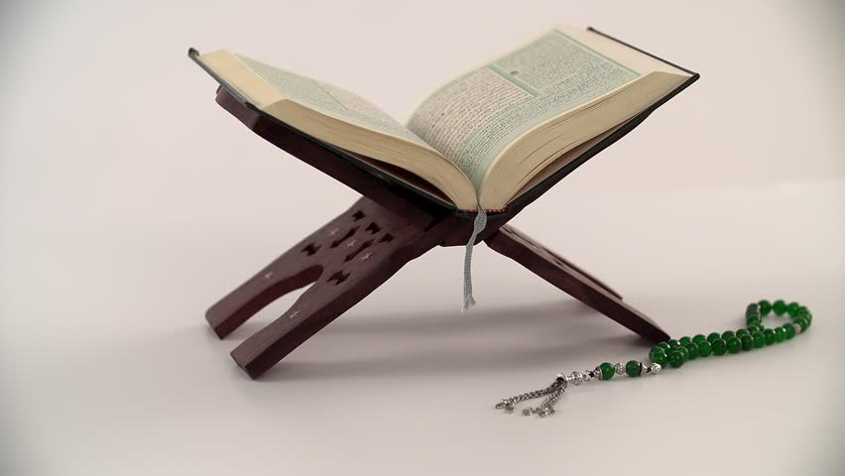
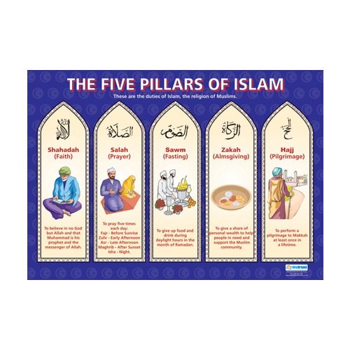
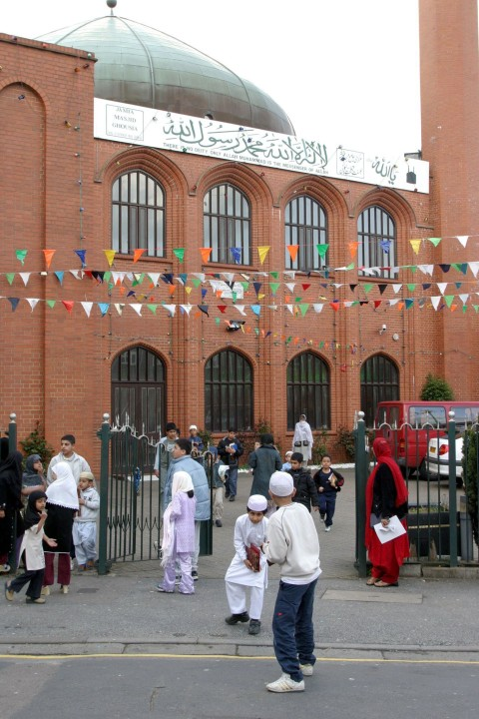
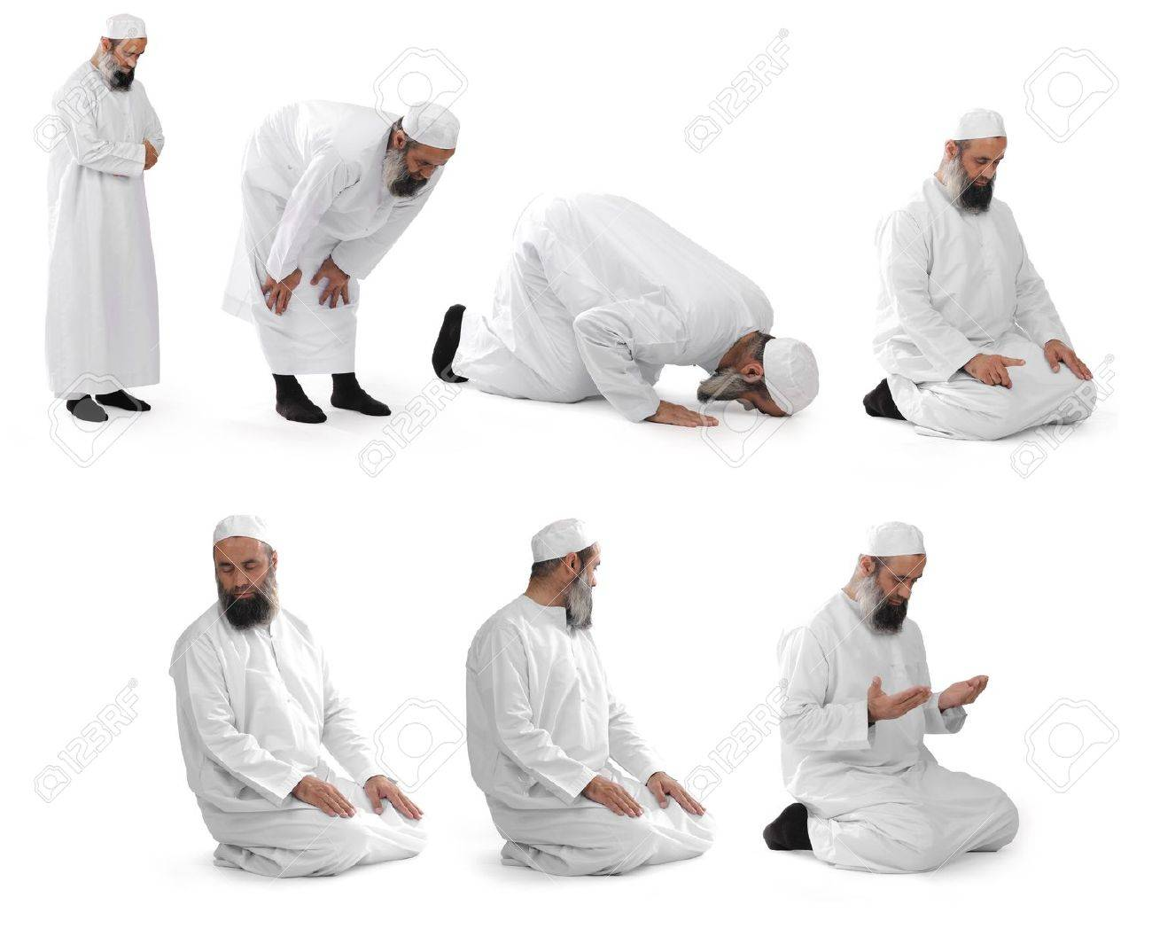
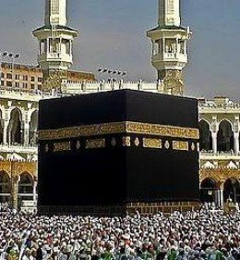
Vocabulary
Muslim – a person who practices the religion of Islam
Qur’an – the sacred text.
Mosque – place of worship.
Five Pillars – rules that hold up the religion.
Kaaba – sacred building in Mecca visited by Muslims as a pilgrimage known as The Hajj.
Mecca – City in Saudi Arabia where Islam began.
Prophet – messenger of God.
Ramadan – month of fasting
Fasting – Not eating.
Hajj – pilgrimage to Mecca
Pilgrimage – a holy journey to a sacred place.
Ummah – is the Islamic community.
Islam Y5/6
Where Islam Began: Mecca, Saudi Arabia
Moon and star is the symbol of Islam.
Sacred Text: The Qur’an which is written in Arabic. Muslims believe it is the actual word of God.
God and Mohammad his messenger
Islam began with an ordinary man named Muhammad who was born in 570 AD in Mecca. He became a prophet as he was given lot of messages by the angel Jibril who came from God.
The messages were about how God wanted people to live a good life. All the messages were put into the holy book called the Qur’an.
The first time the angel appeared to Muhammad is known as ‘The Night of Power’. The angel revealed his messages so it is also known as ‘The Revelation’.
Muhammad became the founder of Islam.
Muslims think so highly of Muhammad that they say ‘Peace be upon him’ whenever they say his name. So you may see the initials pbuh after his name.
Ramadan (usually April/May time)
This is a special month of fasting which means Muslims do not eat or drink during daylight hours but then can eat after dark which is known as Iftar. Children under 14, pregnant women and the elderly do not have to fast. People who are ill or travelling also do not have to fast.
Muslims fast so they can concentrate on their faith and do charitable deeds.
On the 27th day of fasting, ‘The Night of Power’ is celebrated – it is considered to be the Holiest eve.
At the end of the festival Muslims have a big celebration known as Eid al-Fitr.
Main Beliefs
Muslims believe in one God named Allah
Muhammad was the final prophet sent by God.
Muslims must follow the 5 Pillars of Islam.
An English Mosque
The Kaaba in Mecca is visited by Muslims on a pilgrimage. This is known a ‘The Hajj’ and must be completed at least once in a lifetime.
Muslims perform special prayer movements
Main Festivals
Ramadan, Eid-Ul-Adha, Milad-Al-Nabi
The Shahada
The Shahada is a phrase that Muslims say aloud every time they pray. They say ’there is no God but Allah and Muhammad was his messenger’.

