Slide 1
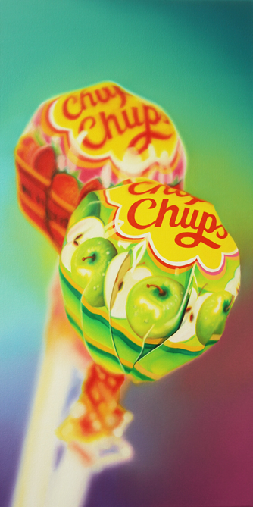
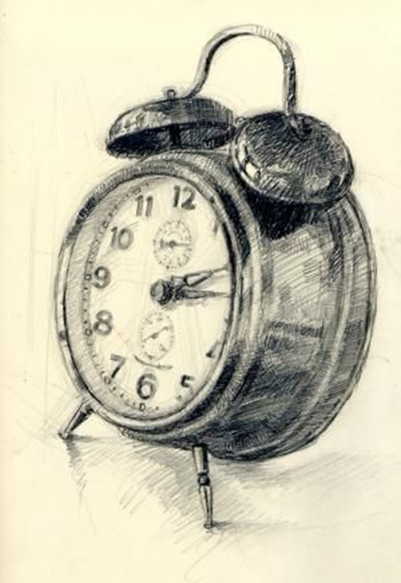
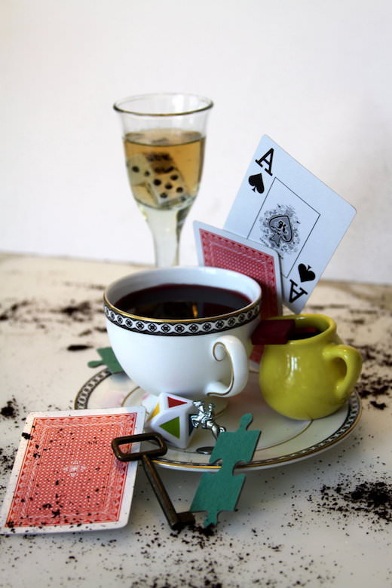
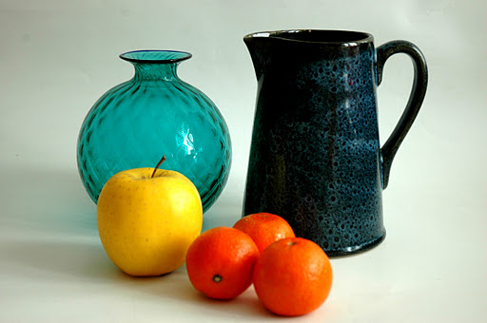
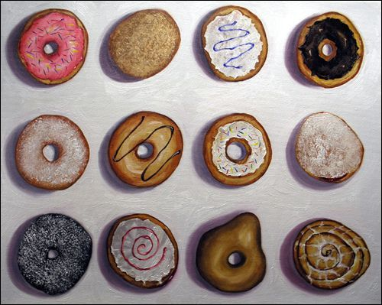
Name ___________________________________ Class____________________
Yr7 Cycle 1
Mark Making
Still life
Homework and Knowledge Organiser
Booklet.
Refer to epraise for homework deadline.
Complete tasks in booklet and hand in on deadline date.

Slide 2

GOLDEN WORDS
Line - is a mark made on a surface that joins different points. Lines can vary in length, width, direction and shape.
Tone-Is the lightness or darkness of a shape or form. Minimum 5 tones dark to white. Tone helps create form.
Shape - is a flat area surrounded by edges or an outline
Texture-refers to the surface quality of an object. ... Some things feel just as they look.
Mark making- describes the different lines, dots, marks, patterns, and textures we create in an art.
Proportion- is the accuracy and the sizes of one object to another.
Detail- is what you see and then record in an accurate , clear and precise way.
Colour blending-Two or more colours are mixed/ worked together or on top of each other.
Mood - is the atmosphere in a painting, or the feeling expressed. Is the art tranquil, or is it dark and disturbing?
Photo montage- is the process by cutting, gluing, rearranging and overlapping two or more photographs into a new image
Mono Print - is a form of printmaking where the image can only be made once, unlike most printmaking which allows for multiple originals.
Expressionism - refers to art in which the image of reality is distorted in order to make it expressive of the artist's inner feelings or ideas.

Slide 3
Homework 1- Key words revision
1. Revise the key words and their meaning.
Line - is a mark made on a surface that joins different points. Lines can vary in length, width, direction and shape.
Tone-Is the lightness or darkness of a shape or form. Minimum 5 tones dark to white. Tone helps create form.
Shape - is a flat area surrounded by edges or an outline
Texture-refers to the surface quality of an object. ... Some things feel just as they look.
Mark making- describes the different lines, dots, marks, patterns, and textures we create in an art.
Proportion- is the accuracy and the sizes of one object to another.
Detail- is what you see and then record in an accurate , clear and precise way.
Colour blending-Two or more colours are mixed/ worked together or on top of each other.
Mood - is the atmosphere in a painting, or the feeling expressed. Is the art tranquil, or is it dark and disturbing?
Photo montage- is the process by cutting, gluing, rearranging and overlapping two or more photographs into a new image
Mono Print - is a form of printmaking where the image can only be made once, unlike most printmaking which allows for multiple originals.
Expressionism - refers to art in which the image of reality is distorted in order to make it expressive of the artist's inner feelings or ideas.
2. Next - Complete a photoshoot of still life objects.
Take a series of photographs of everyday objects such as kettles, mugs, lamps, food items etc. take the photos close up and print them ready for the next lesson.

Slide 4
Revision Key Words-
Line - .
Tone-
Shape –
Texture-
Mark making-
Proportion-
Detail-
Colour blending
Mood -
Photo montage-
Mono Print –
Expressionism -
REVISION NOTES ON THIS PAGES PLEASE

Slide 6
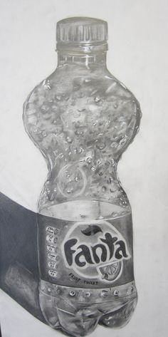
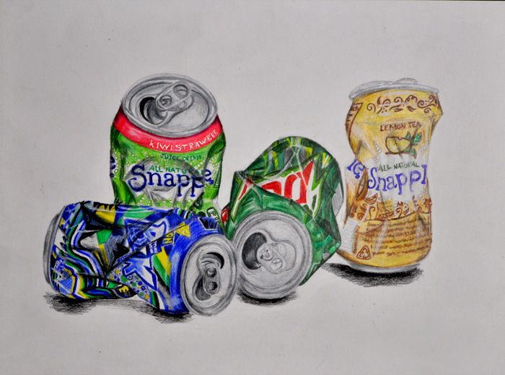
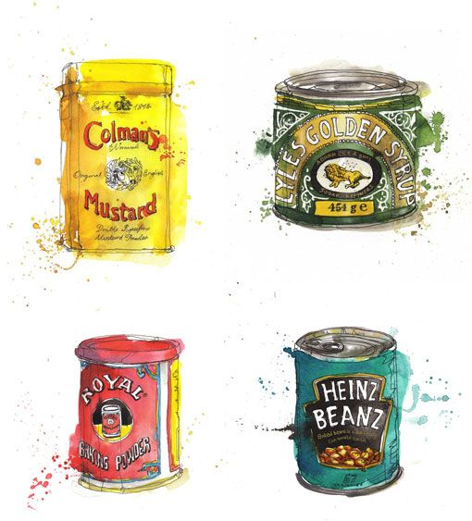
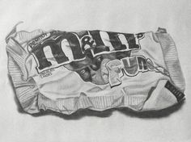
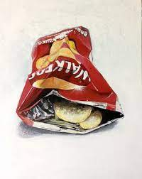
Learning Outcome
Find a food item / packaging to draw.
You could work from
A real life object or from a picture. Or
Draw one of the examples accurately adding Colour or tone.
Focus on
detail, really look at letter .
Focus on colour blending and tone of colour. For a tonal drawing focus on using a minimum of 5 tones dark to light.
Homework Task 2 : Observational drawing of food packaging:
PROGRESSION STEPS- Grid technique
              1) Grid the image you have chosen and grid the page.
              2)Plot the parts using the On the grid line.
              3)Sketch the basic shape
              4) Add the detail
5) Add colour blending – select all the colours you can see.
Apply darkest colours first lightly, dark to light and vary pressure to get different tones.
for tonal drawing vary the pressure you put on your pencil to get lighter and darker tones.

Slide 7
Draw your homework task 2 here – (observational drawing of food packaging in colour or tone)

Slide 8
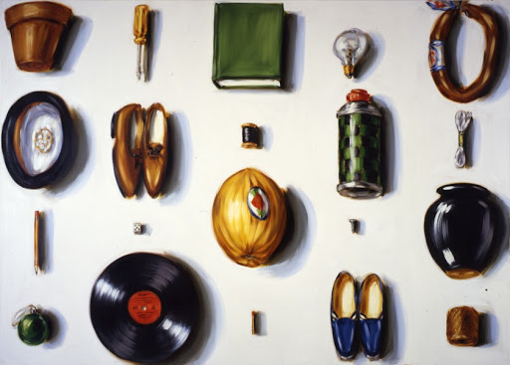
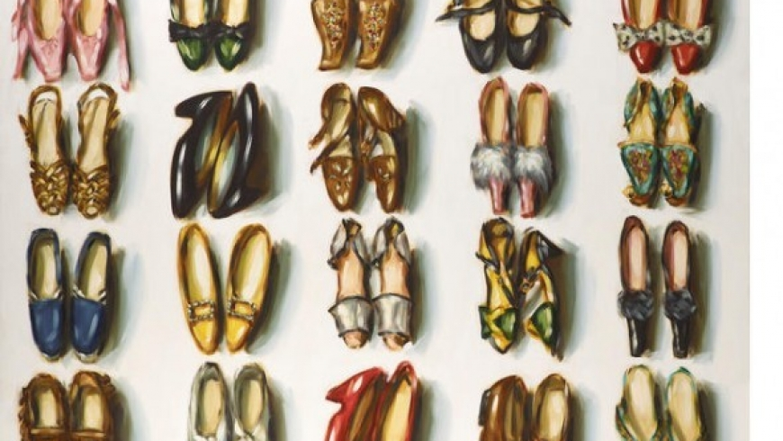
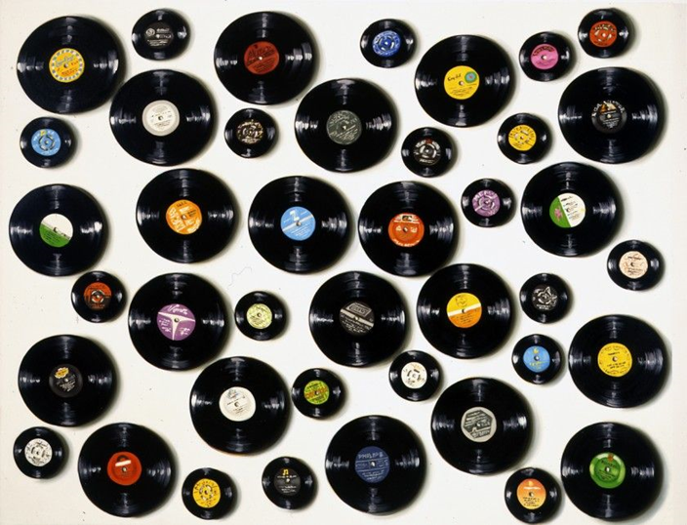
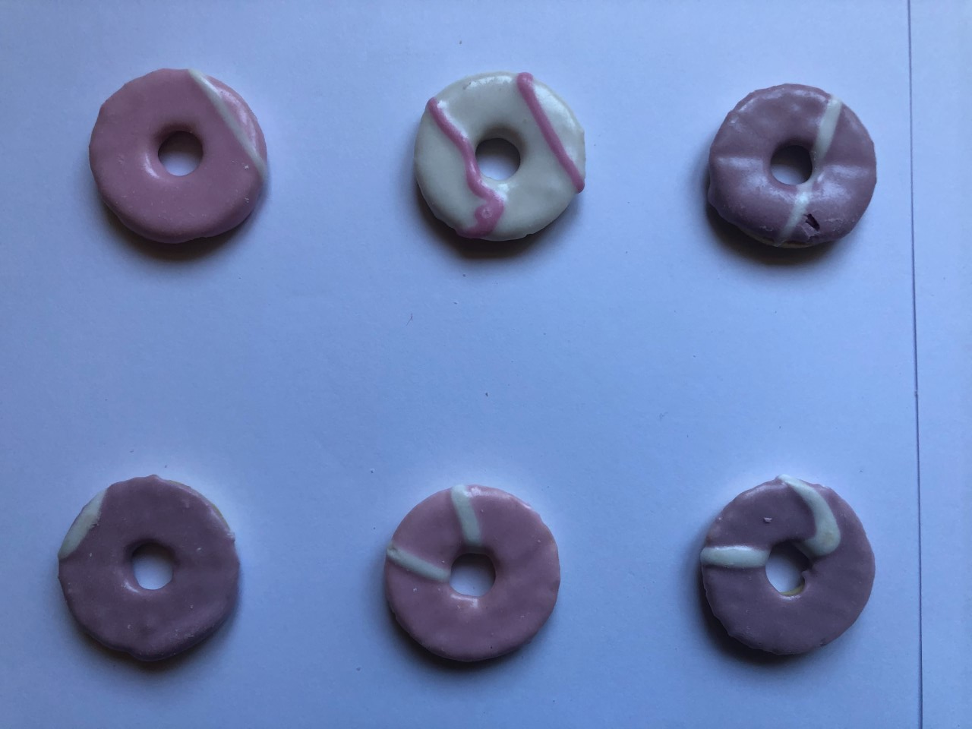
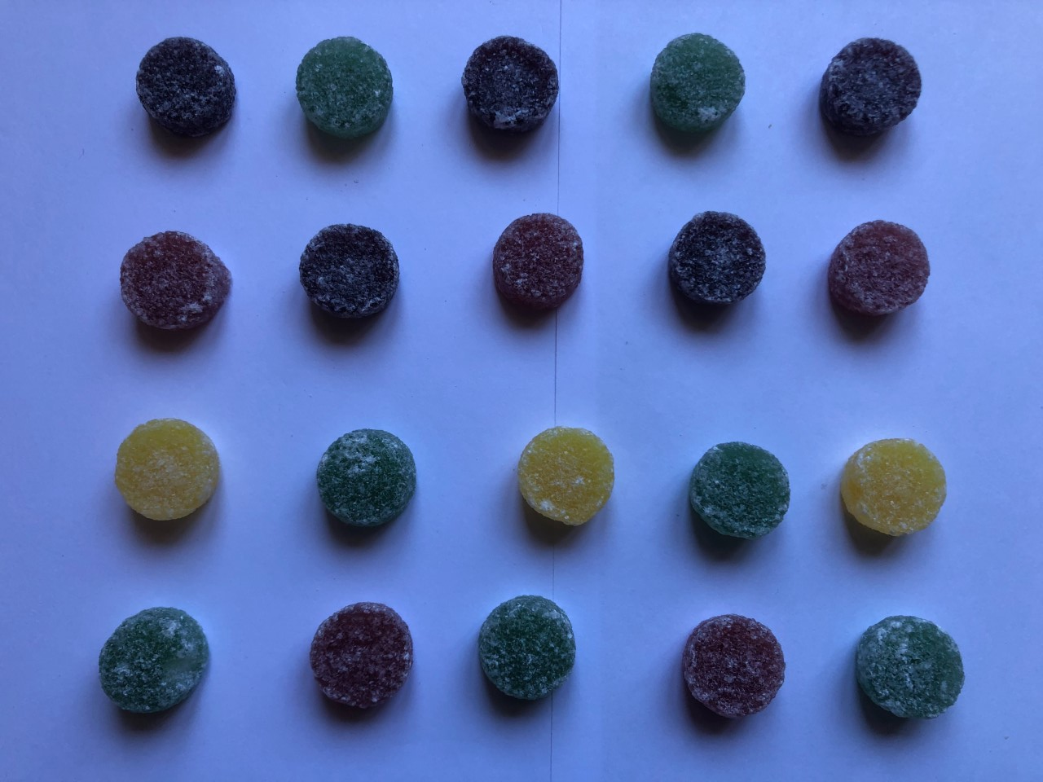
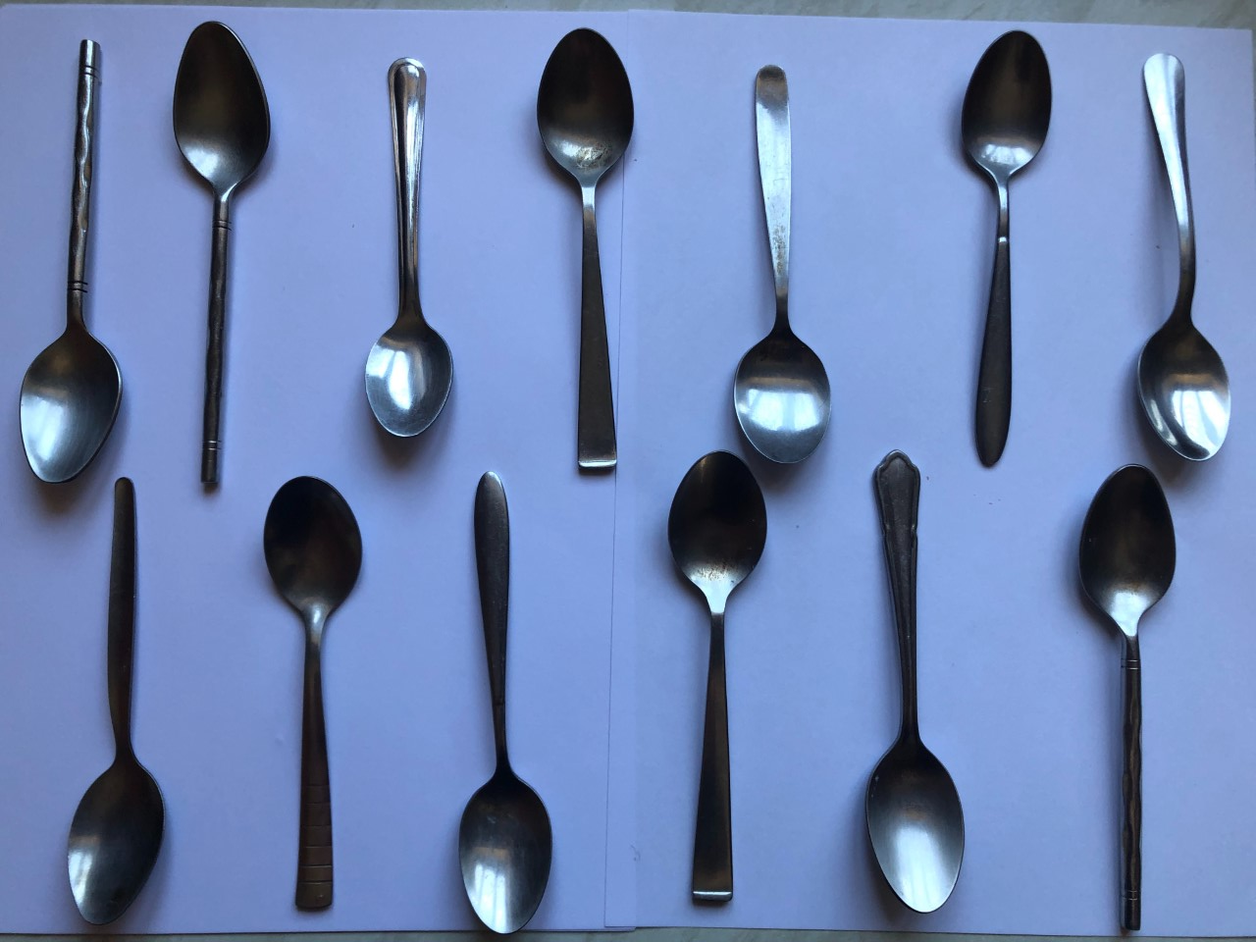
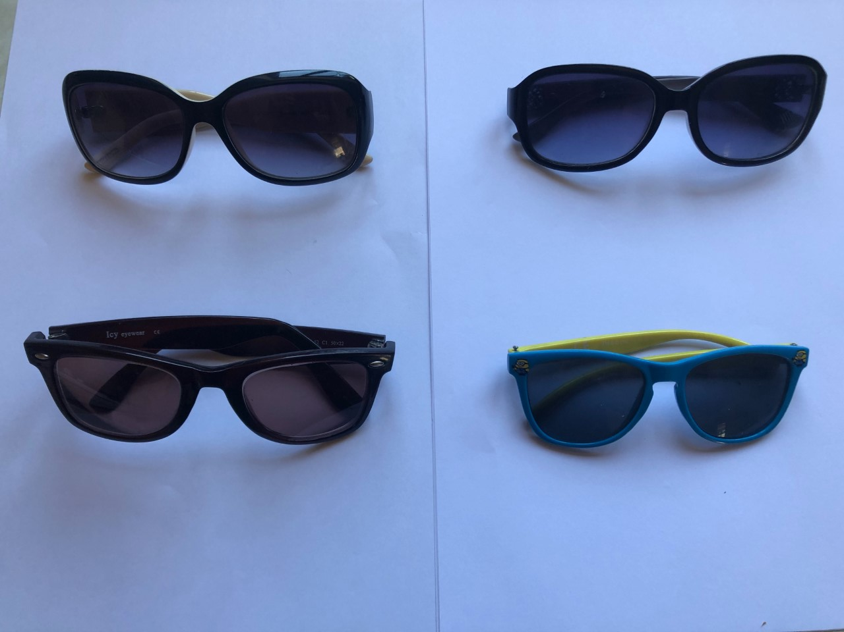
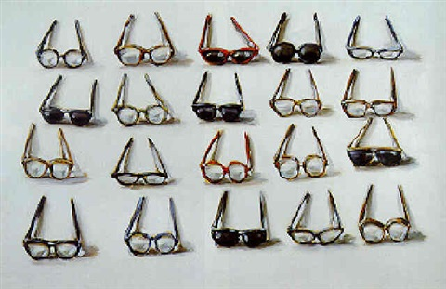
Homework Task 3 : Contemporary Artist Study - Lisa Milory
Learning outcome-
Create a Lisa Milroy inspired photograph. Use similar objects to create a repeating pattern.
Progression Steps
1) Look at the examples of Lisa Milory’s art
work.
2) Now find several objects from around your home
That are the same or similar .Place them together on a plain background to form a repeating pattern.
(see my example photographs below)
3) Take several photographs
*Send me your photograph or print.
My Examples
Lisa Milroy (born 16 January 1959 in Vancouver, British Columbia)^{[1]} is an Anglo-Canadian artist known for her still life paintings of everyday objects placed in lines or patterns. She has also produced a number of different series including landscapes, buildings, portraits and geishas in incongruous settings.^{[1]}

Slide 9
Present your task 3 homework on here (Artist Lisa Milroy inspired photograph)

Slide 10
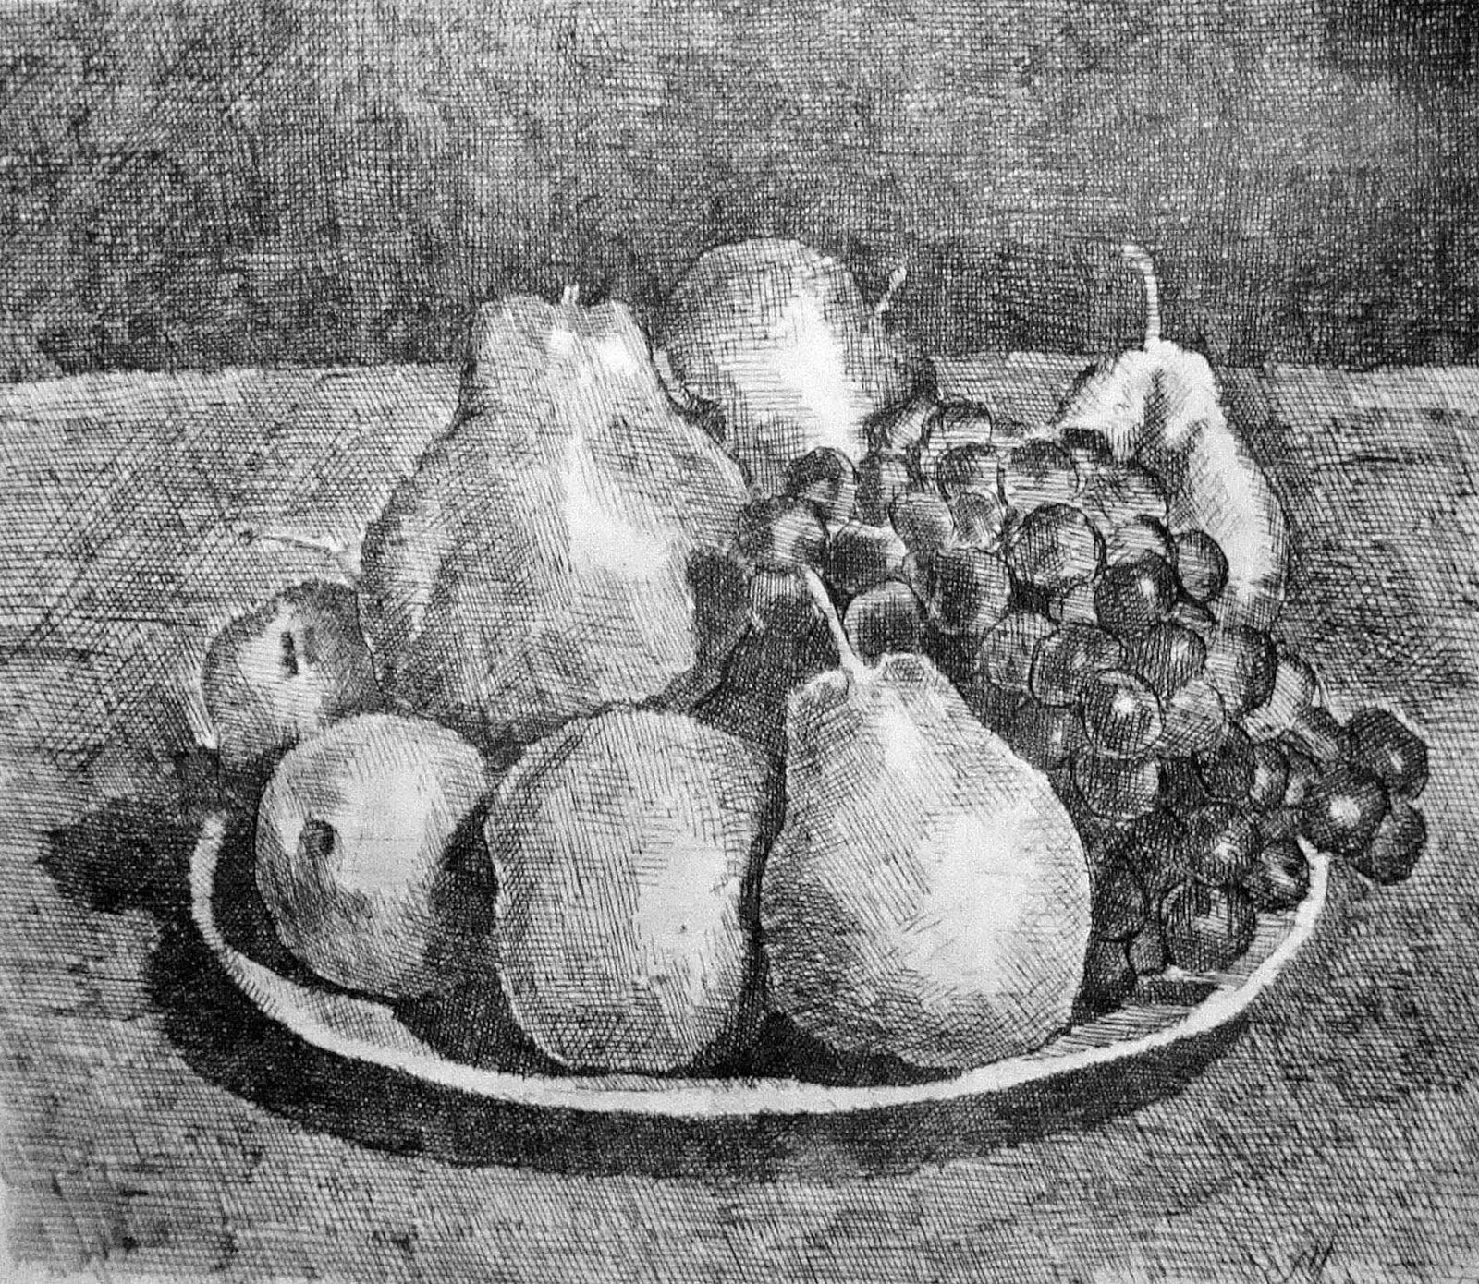
Homework task 4: Modern Artist Study - Georgio Morandi Still life drawing task
Learning Outcome-
Complete a drawing of the Morandi still life, draw carefully the shapes, focus on proportion and add crosshatching and tone. Use grid technique to help with proportion, include the background.
PROGRESSION STEPS
1)Grid the image you have chosen and grid the
page.
2)Plot the key parts using the On the grid line.
3)Sketch the basic shape
4) Add the detail
5) Add colour blending – select all the colours you can See. Apply darkest colours first lightly, blend dark to light and vary pressure to get different tones.

Slide 11
Present your task 4 homework on here (Artist Georgio Morandi)

Slide 12
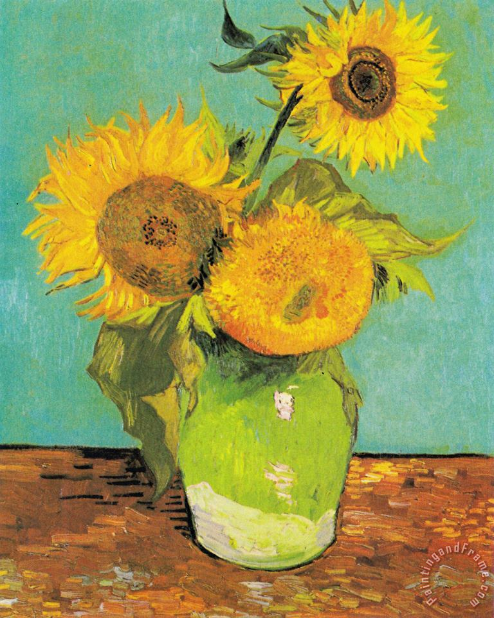
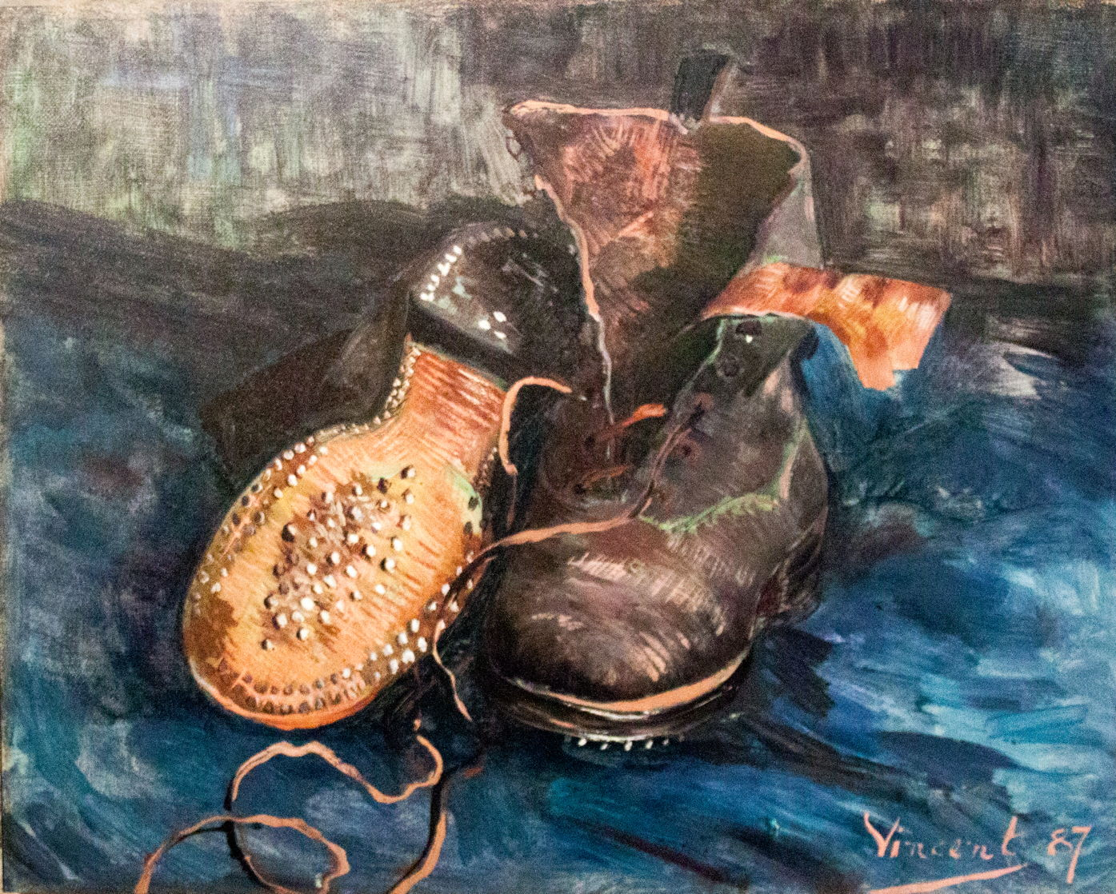
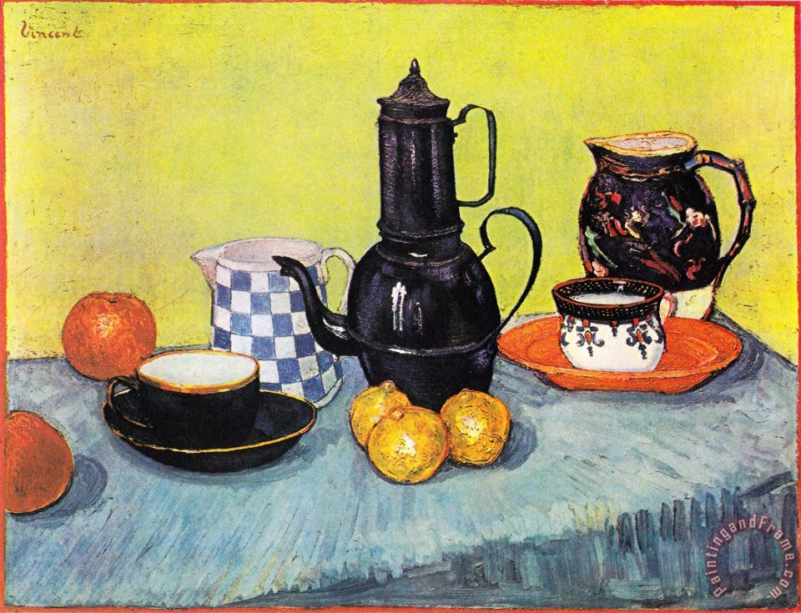
Homework 5 : - Historical Artist Study and Research of Vincent Van Gogh
Vincent Van Gogh was a Dutch artist who lived 1853 -1890, and worked almost
exclusively in oil on canvas.
Learning Outcome-
Research Artist Vincent Van Gogh
and present your Findings in a power point or Print images and present creatively on the next page.
Write in your own words
PROGRESSION STEPS-
Use the internet to research artist Vincent Van Gogh. Put his name into the search engine
Choose 5 images of his art work, copy and paste them into word ( if printing ) or power point if doing a presentation.
Find some key facts about him and write in own words.
4) Present your research consider back ground, a title, layout of page, have 5 images and key facts in own words.

Slide 13
Present your task 5 homework on here (Artist research Vincent Van Gogh)

Slide 14
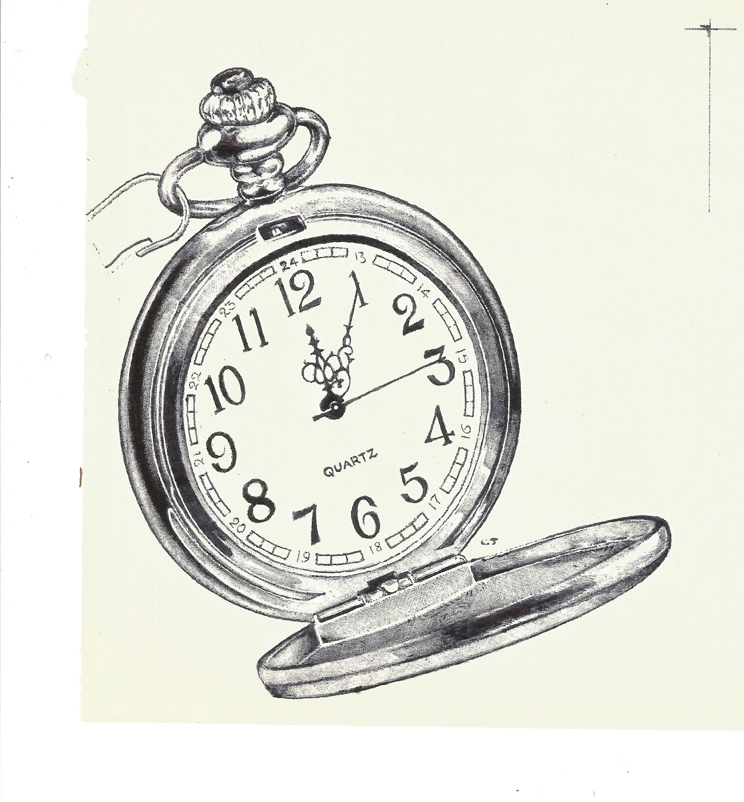
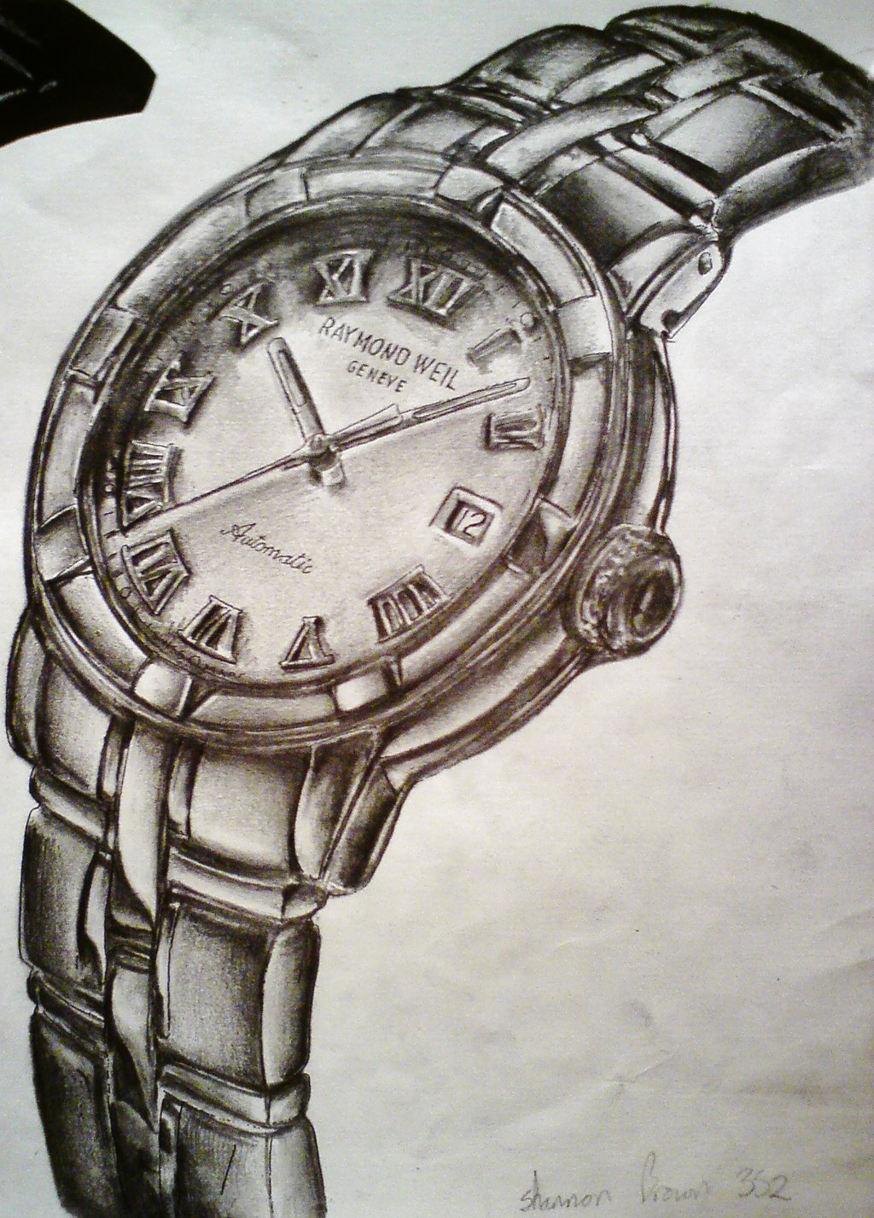
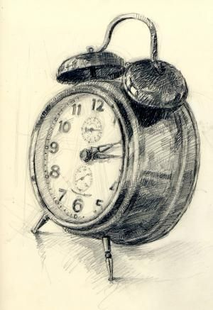
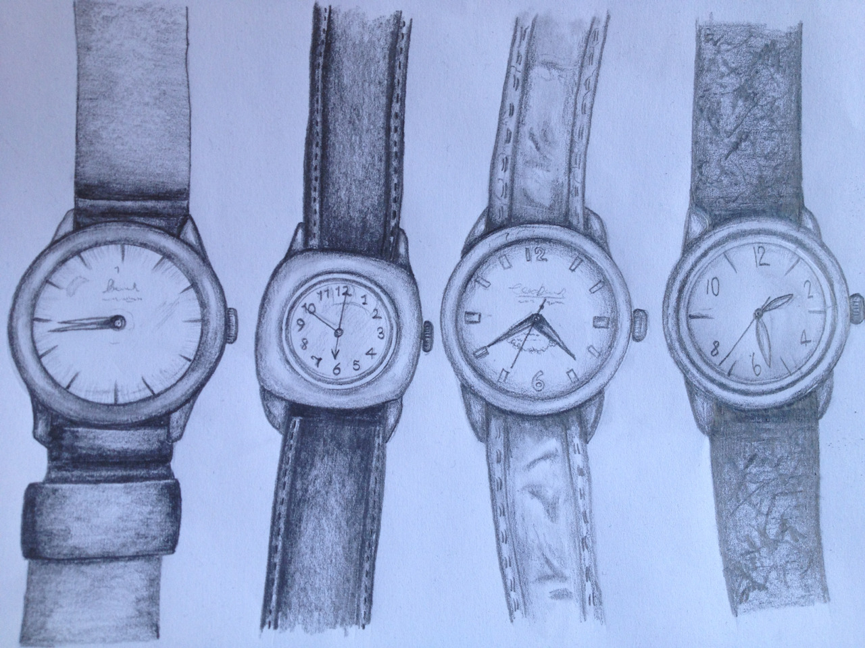
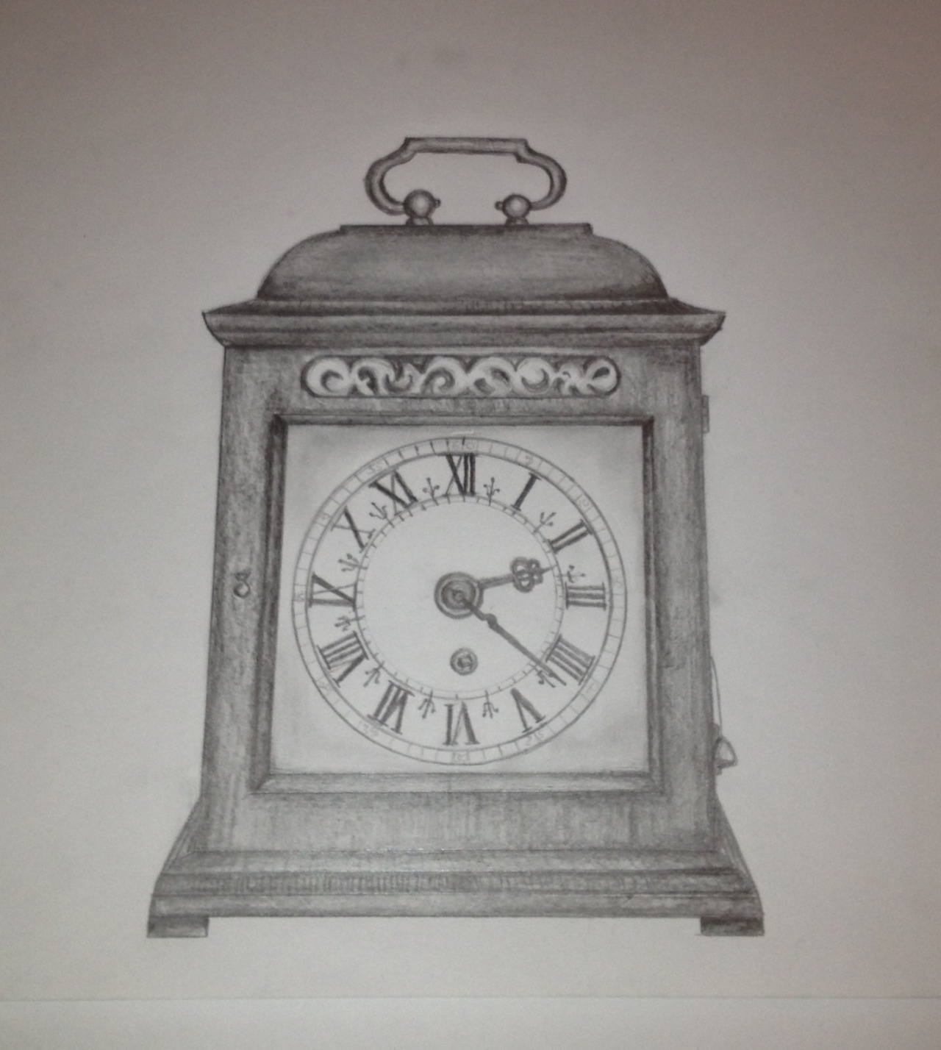
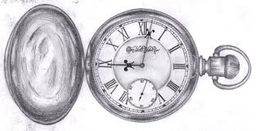
Homework 6: Observational drawings
of Clocks
Learning outcome
Choose one of the clocks or find your own on the internet or a clock or watch you have at home.
Draw the clock accurately and add tone.
Focus on proportion, shape,
Form, detail and tone – min 5 tones dark to
light smooth tonal changes.
PROGRESSION STEPS- Grid technique
1) Use the grid technique by dividing the
Drawing into 4 . Draw a box
At least 20x15cm and grid the box.
2)Plot the object on the grid line
3) Sketch the basic shape.
4) Add the detail and firm up the
Outline.
5) Add tone , min 5 tones black to white

Slide 15
Draw your task 6 homework on here (observational drawing of a clock or watch in tone)

Slide 16
TASKS | SELF ASSESSMENT GRADES 1-5 * | DATE
Task 1 – REVISION OF KEY WORDS AND PHOTOSHOOT LEARNING OUTCOME Key word definition Complete a photoshoot of still life objects. | 1- NOVICE 2-DEVELOPING 3-MODERATE * ** *** 4-SECURE 5- ADVANCED **** *****
Task 2 - Observational drawing of food packaging in colour or tone Learning Outcome-Find a food item / packaging to draw. You could work from a real life object or from a picture. Or Draw one of the examples accurately adding Colour or tone. Focus on detail, really look at letter . Also focus on colour blending and tone of colour. For a tonal drawing focus on using a minimum of 5 tones dark to light. | 1- NOVICE 2-DEVELOPING 3- MODERATE * ** *** 4-SECURE 5- ADVANCED **** ******
Task 3 - Contemporary Artist Lisa Milroy. CRITICAL STUDY Learning outcome Create a Lisa Milroy inspired photograph. Use similar objects to create a repeating pattern. In colour or black and white | 1- NOVICE 2-DEVELOPING 3- MODERATE * ** *** 4-SECURE 5- ADVANCED **** *****
Task 4 - Modern Artist Georgio Morandi. CRITICAL STUDY Learning Outcome- Complete a drawing of the Morandi still life, draw carefully the shapes, focus on proportion and add crosshatching and tone. Use grid technique to help with proportion, include the background. | 1- NOVICE 2-DEVELOPING 3- MODERATE * ** *** 4-SECURE 5- ADVANCED **** *****
Task 5 -Historical Artist Vincent Van Gogh. CRITICAL STUDY Learning Outcome- Research Artist Sarah Graham and present your findings in a power point or print images and present creatively. Write in your own words. Think about title, back ground and layout. | 1- NOVICE 2-DEVELOPING 3- MODERATE * ** *** 4-SECURE 5- ADVANCED **** *****
Task 6 - Observational drawing of clocks Learning outcome-Choose one of the clocks or find your own on the internet or a clock or watch you have at home. Draw the clock accurately and add tone. Focus on proportion, shape, form and detail. | 1- NOVICE 2-DEVELOPING 3- MODERATE * ** *** 4-SECURE 5- ADVANCED **** *****
TEACHER FEEDBACK PASS 1-2 MERIT 3-4 DESTINCTION 5 | OVERALL HOMEWORK GRADE: 1 – 2 – 3 – 4 – 5

