Slide 1
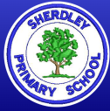
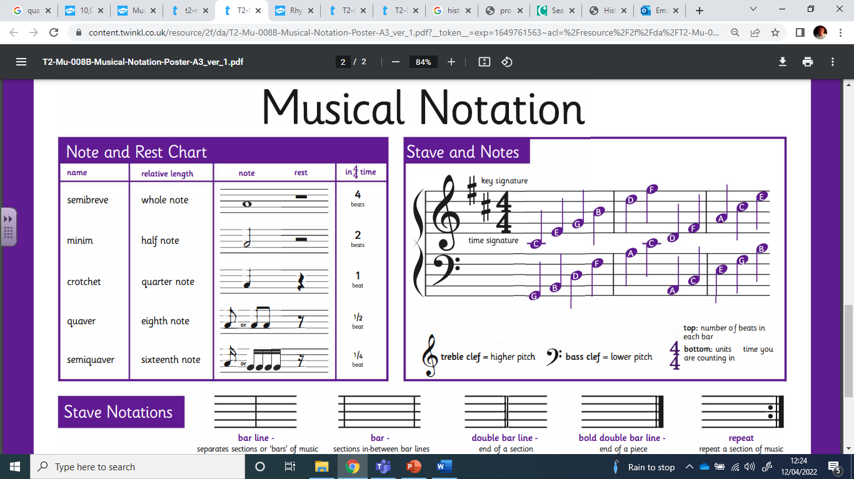
Music Knowledge Organiser – Year 4
Other useful vocabulary
Ostinato | A repeating pattern.
Melody | A sequence of notes – a tune.
Harmony | Two or more pitches played or sung together.
Structure | The order the different parts of a piece of music are played.
Unison | All parts sung at the same pitch.
Chord | Three or more notes played together at the same time (A dyad is a two-note chord).
Key Vocabulary – can you give an example to explain each word?
Pulse | A steady beat. Does the beat change?
Rhythm | What types of notes do you hear? Crotchets/quavers? Are there any rests?
Pitch | How high or low a note is. How does this change in a piece of music?
Tempo | Speed the music is played at – fast or slow? Does this change?
Dynamics | Levels of sound. Use some of the vocabulary on the back to describe.
Timbre | The character of the sound – is it wooden, metallic, breathy?
Texture | How the different sounds and instruments work together. Thick or thin? How many layers can you hear?

Slide 2
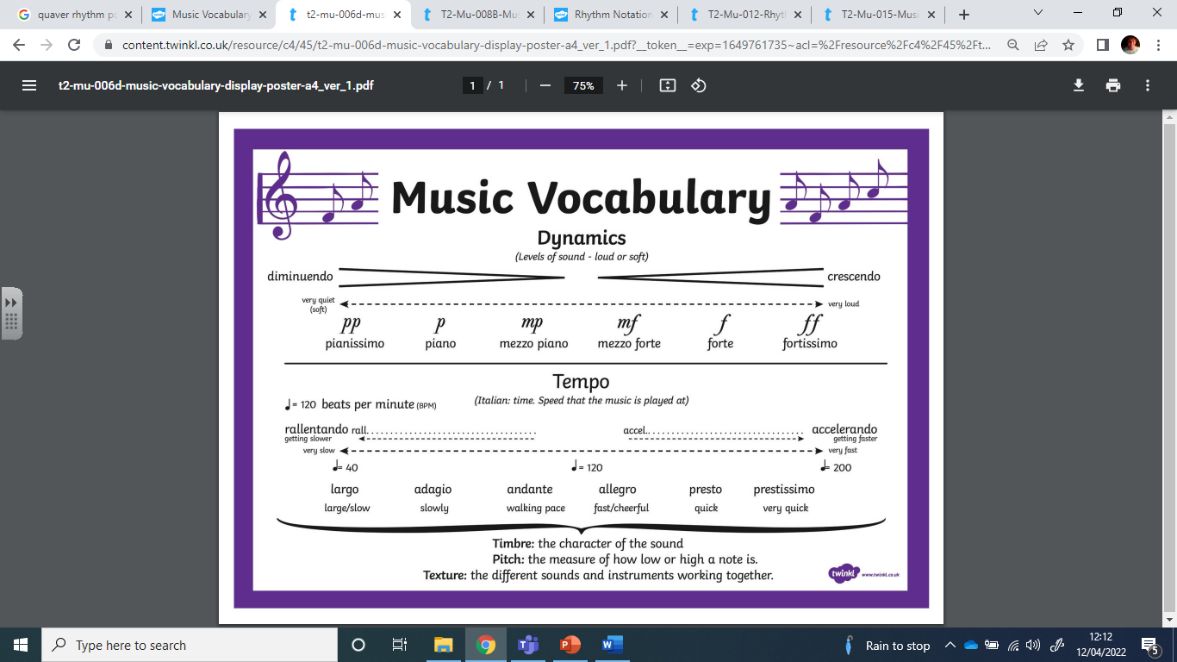
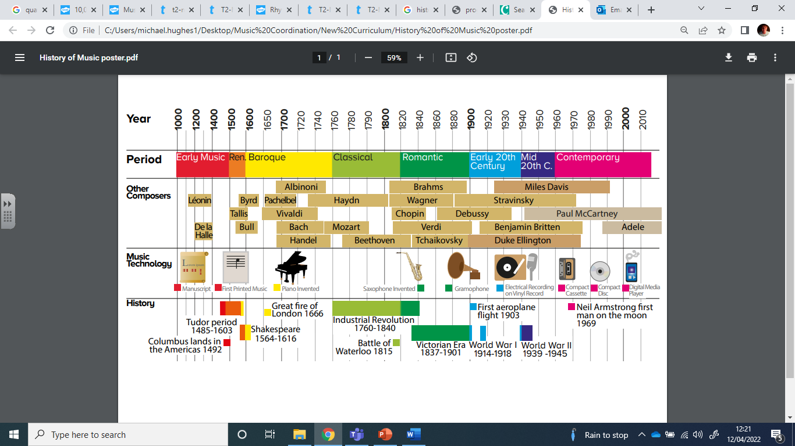
Music Knowledge Organiser – Year 4

