Slide 1


Internet Safety

Slide 2
Who has heard of the internet?

Slide 3
Who can explain what it is?

Slide 4
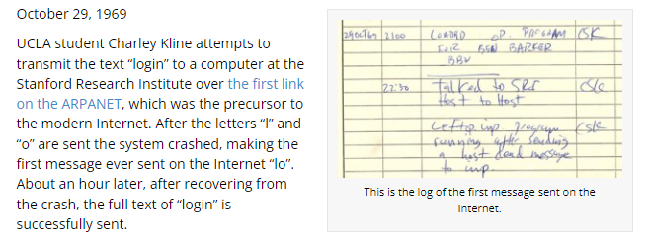
LO

Slide 5
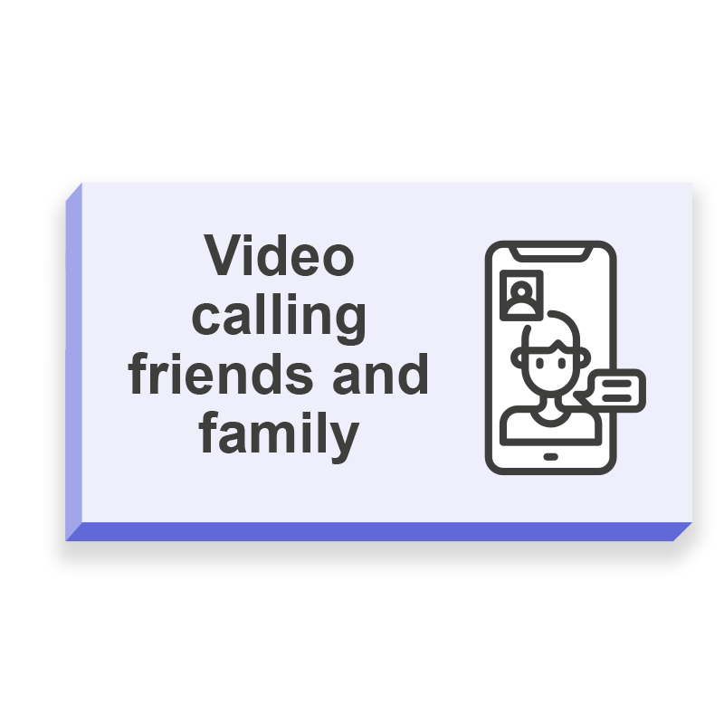
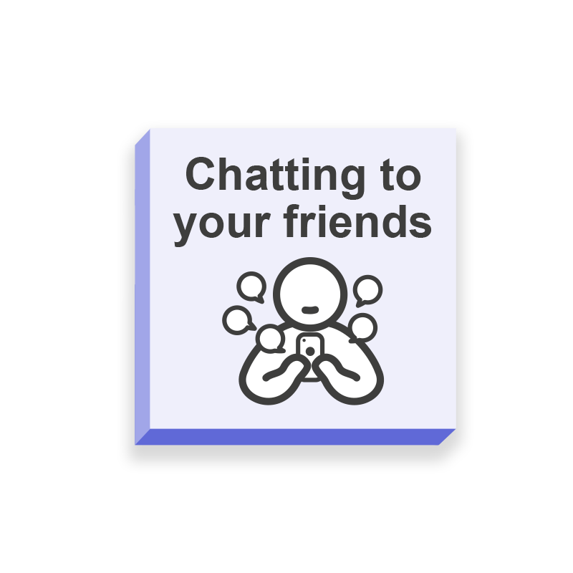
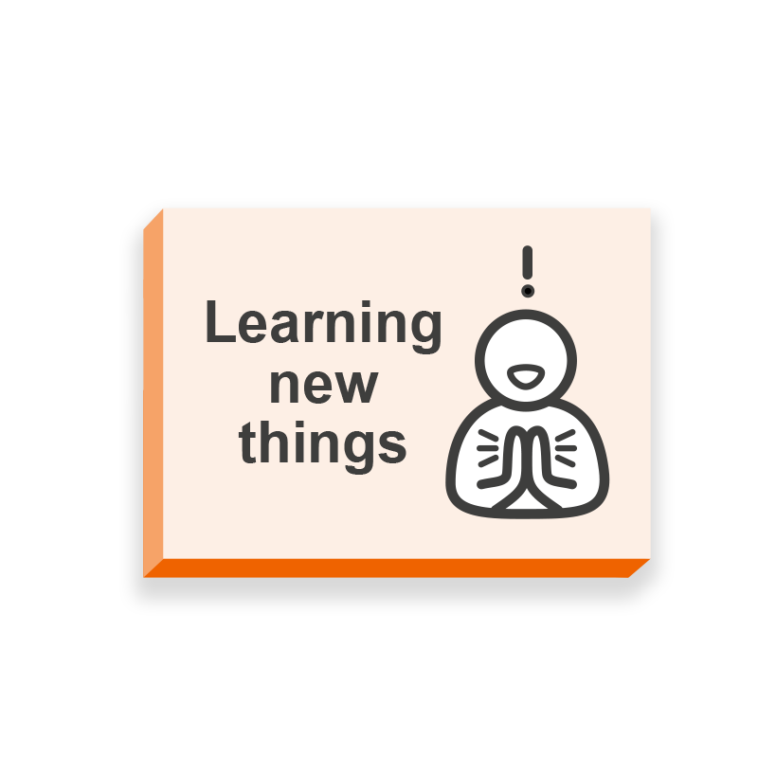
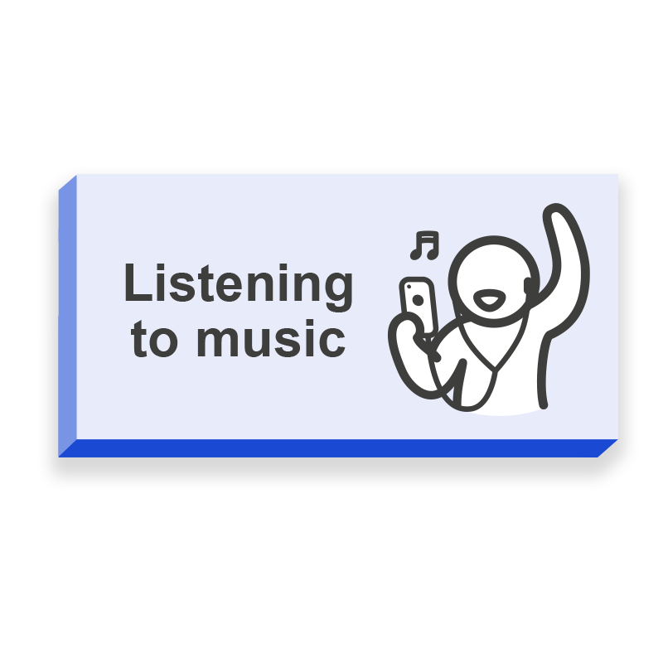
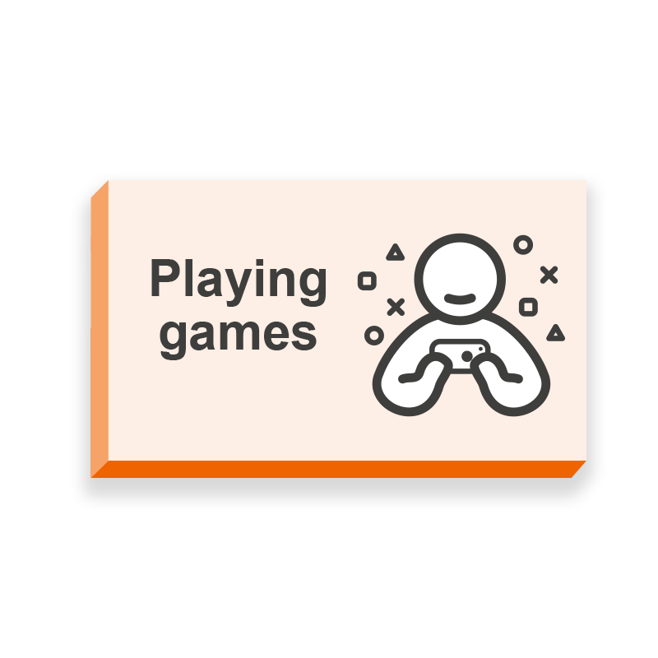

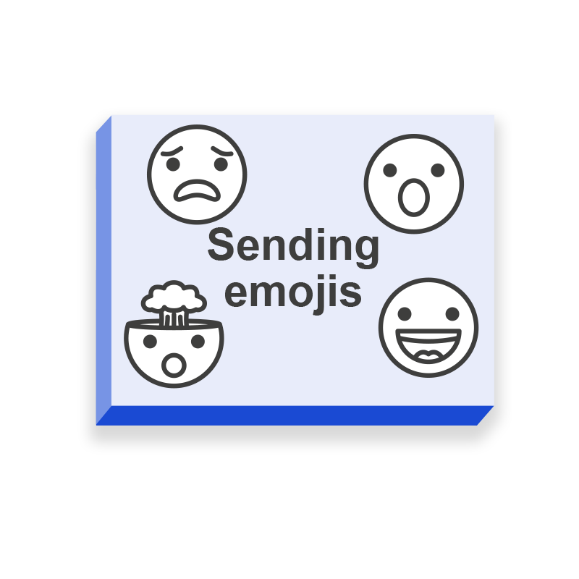
How do you have fun online?

Slide 6
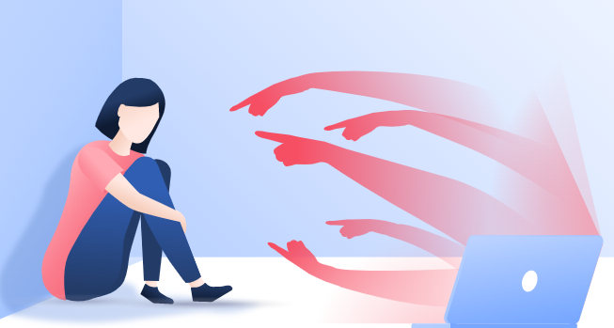
What are the dangers of being online?
Cyberbulling
Scams and Spoofs
Internet Addiction
Predators
Lack of Exercise
Indentity Theft
Inappropriate Content
Password Security

Slide 7
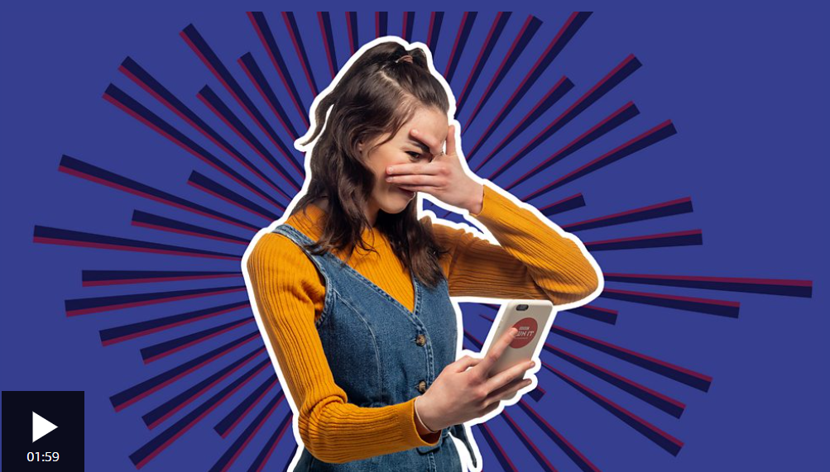
Right, I'm never going online again!

Slide 8



How do we keep you safe at Kings Road?

Slide 9
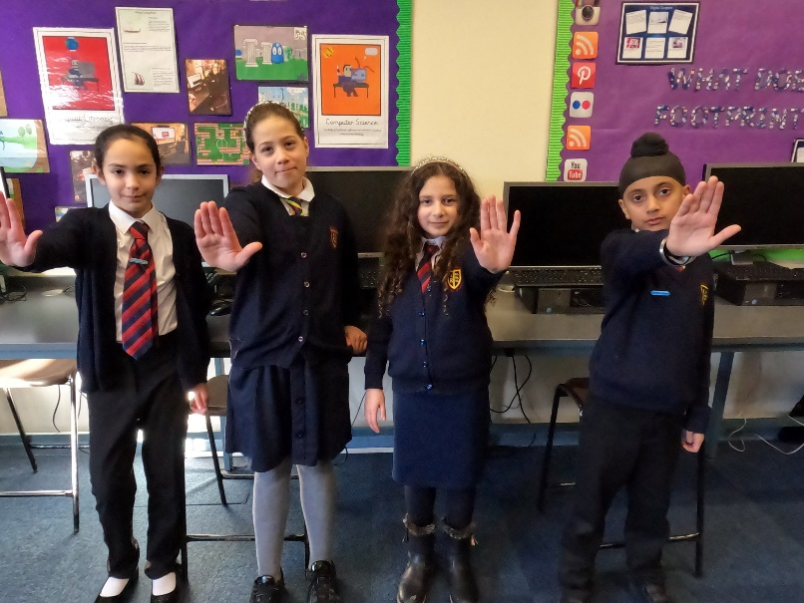
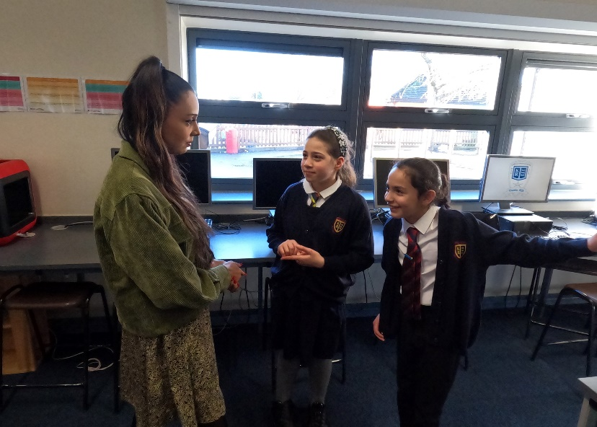
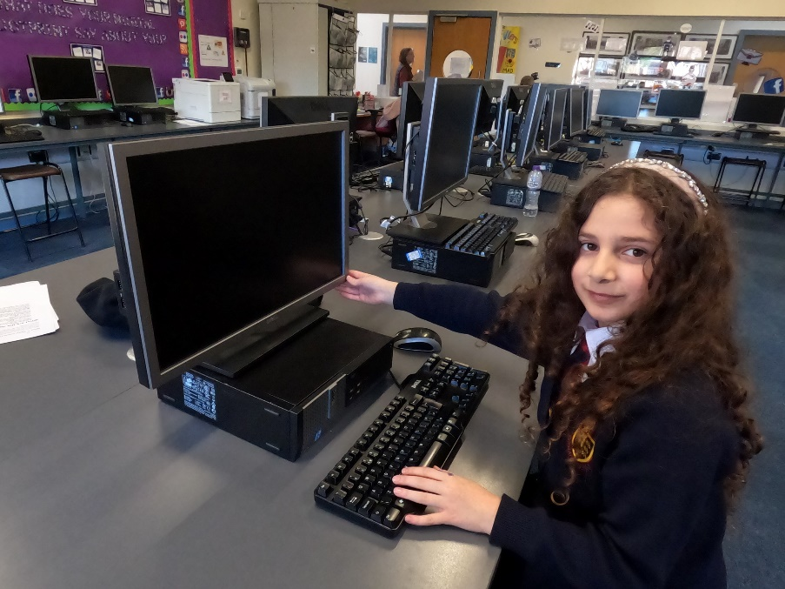
What to do if you see something upsetting online
OFF
STOP
SAY
Close your device or turn it off.
Stop what you are doing. Do not click on the page or reply to any message.
Say something to a grown up immediately.
S.O.S

Slide 10
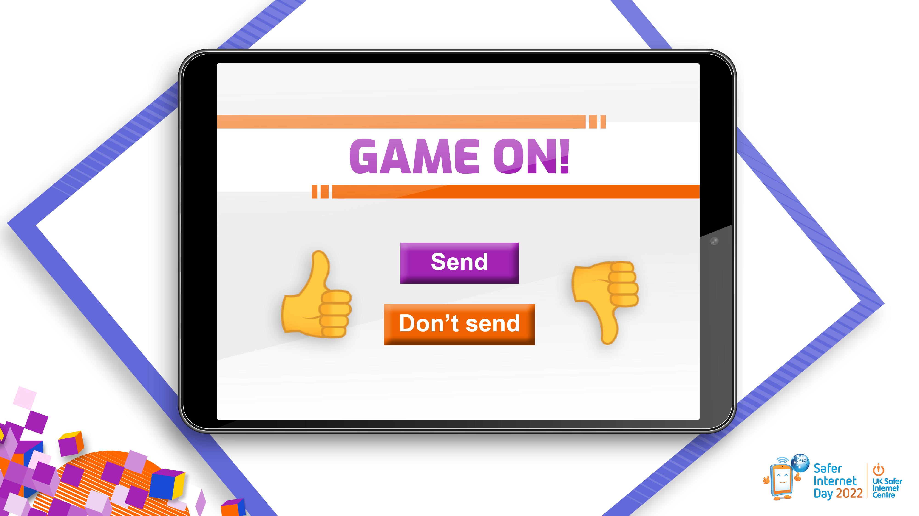
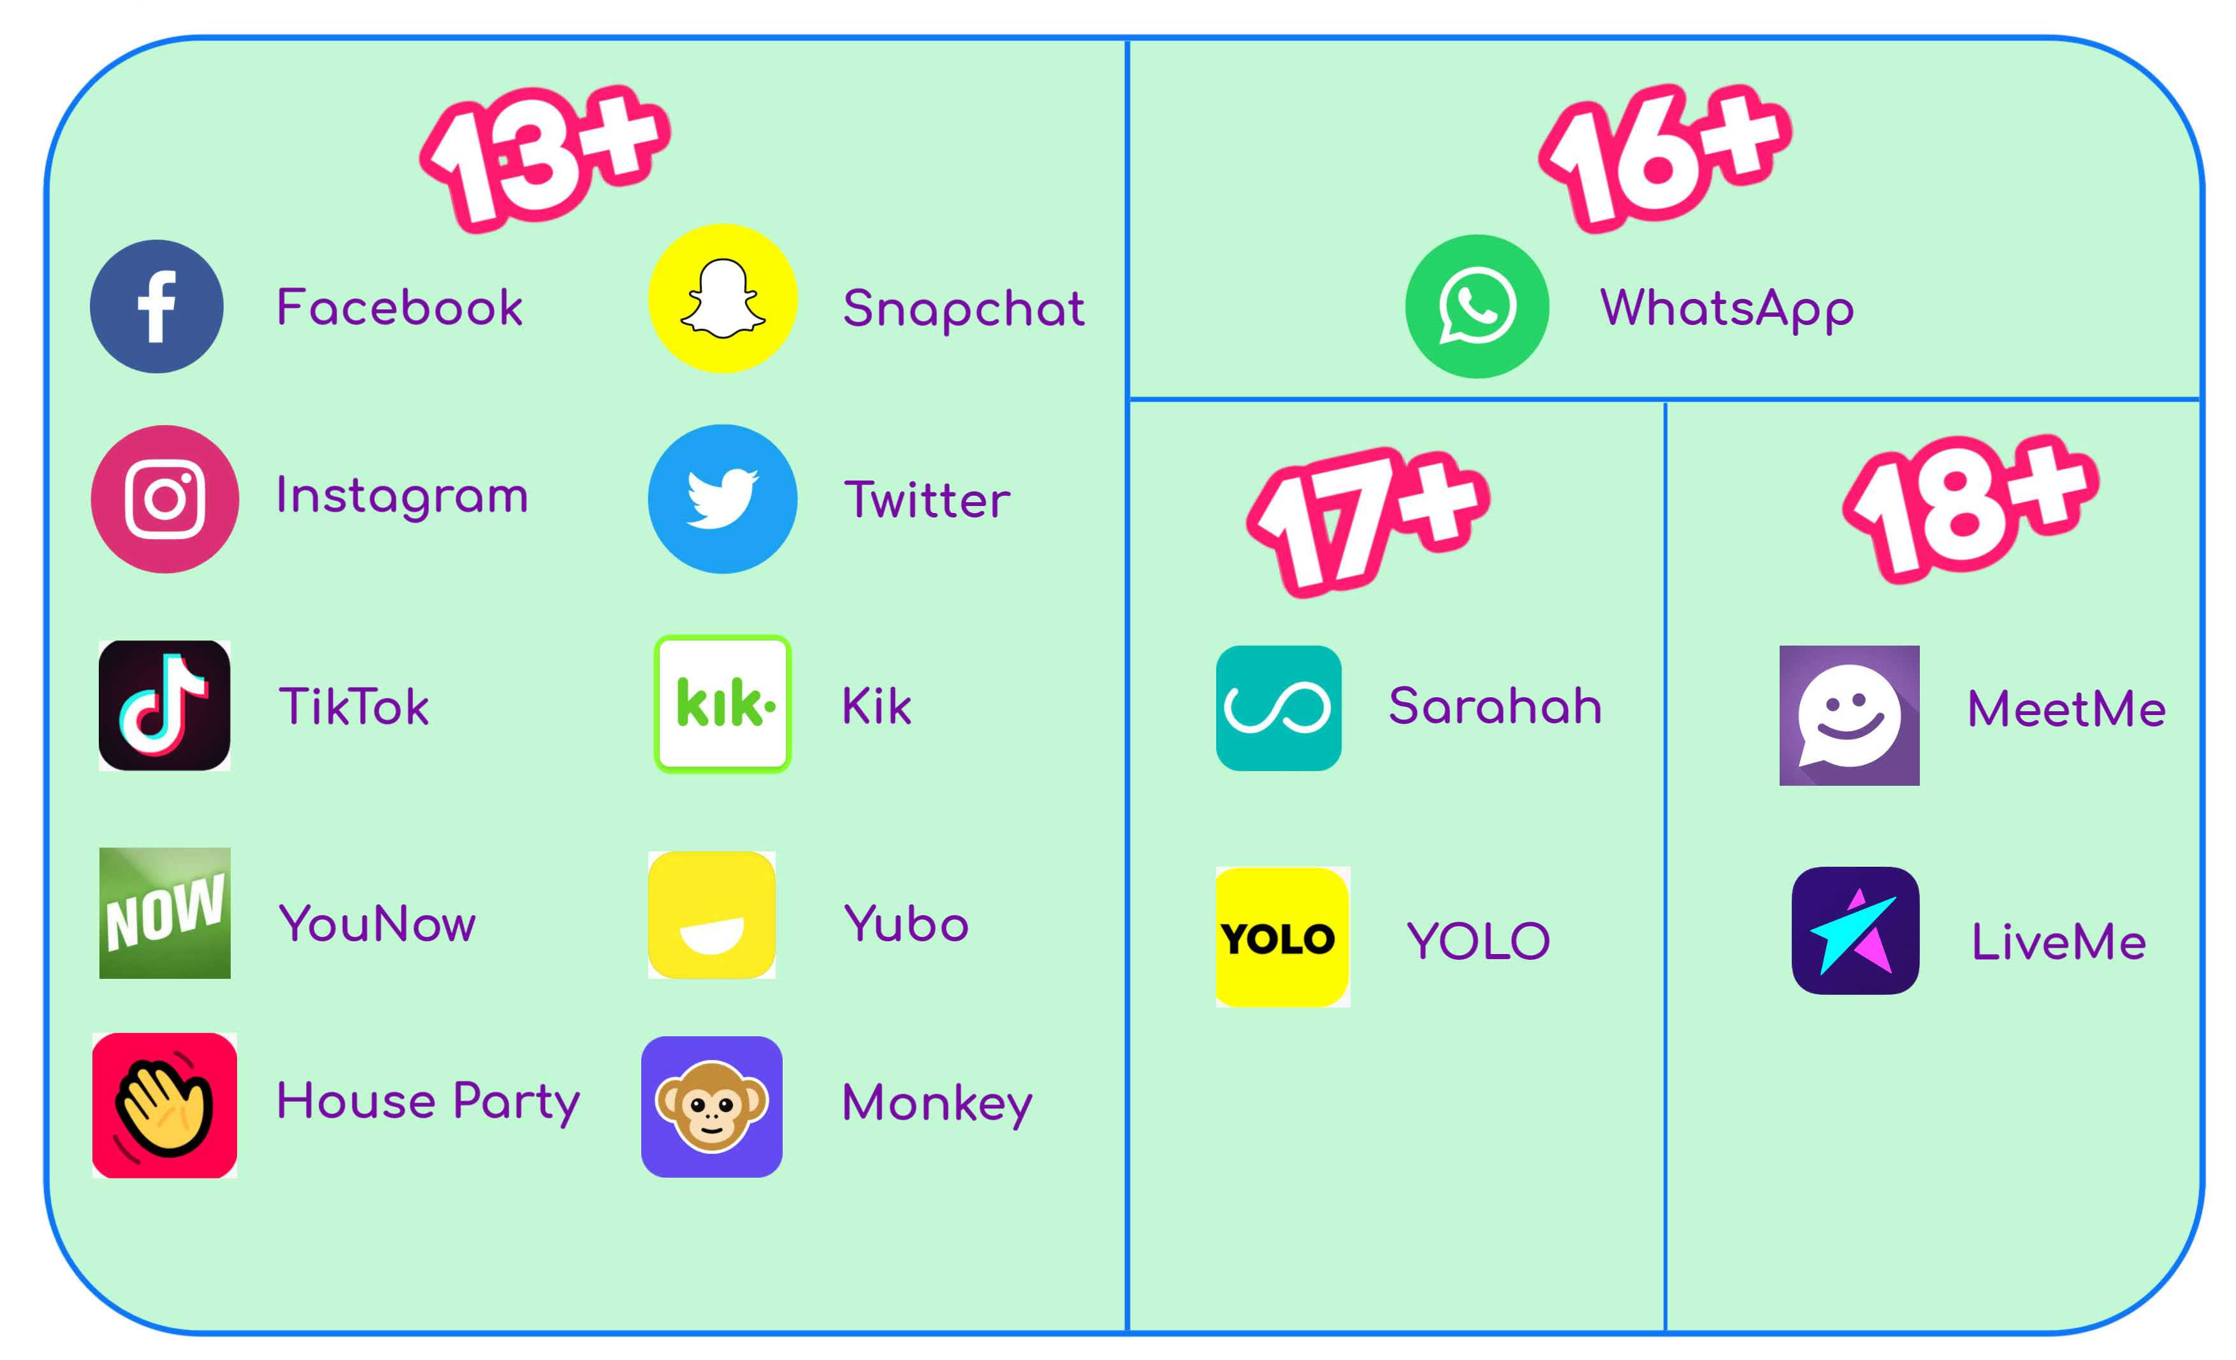

Slide 11
What are the risks of social media?
What is consent?

Slide 12
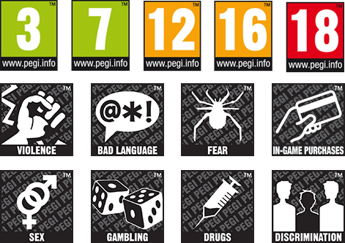

https://saferinternet.org.uk/blog/education-pack-for-7-11s

Slide 13

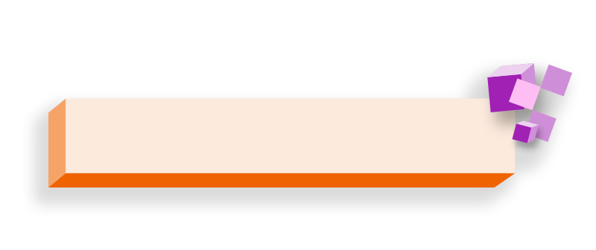


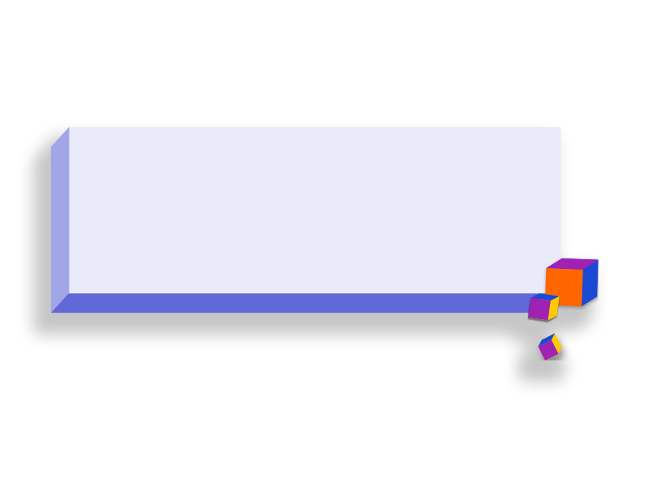

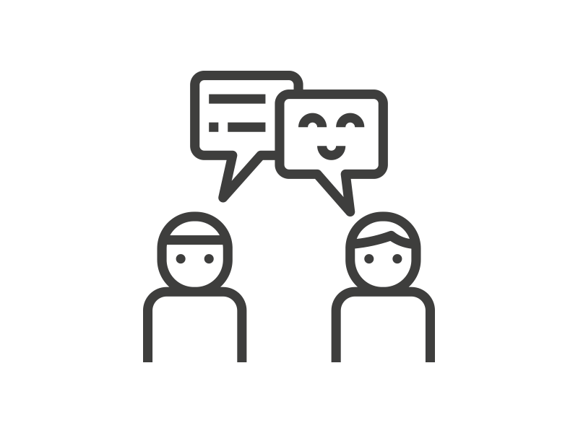




Being respectful online means:
Including people
when they want Listening to other people to be included
Understanding that someone might not want the same things as you
Being kind and supportive
Thinking about how your words and actions make other people feel
Not putting pressure on someone and accepting their boundaries

Slide 14
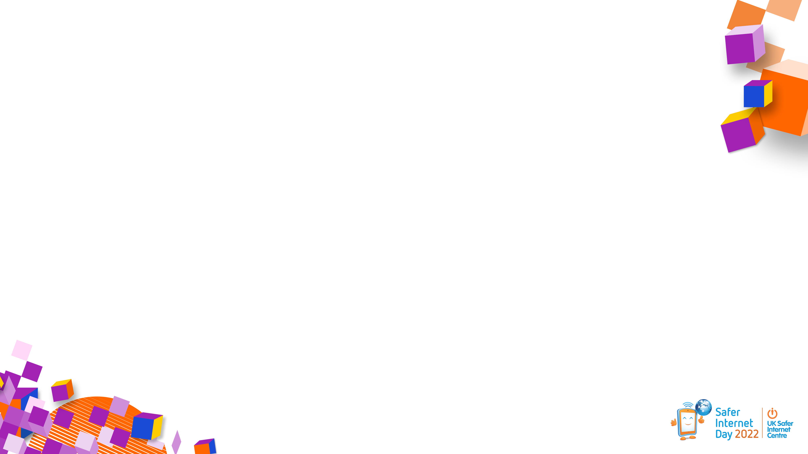



Take a screenshot
If someone is being
disrespectful you can…
Tell them how you feel or ask them to stop politely
Block
Report

Slide 15







but if anything online makes you feel…
Upset
Scared
Curious
Angry
Worried
Confused
What can you do?

Slide 16
What to do if you see something upsetting online
OFF
STOP
SAY
Close your device or turn it off.
Stop what you are doing. Do not click on the page or reply to any message.
Say something to a grown up immediately.
S.O.S

