Slide 1

Rights Respecting Schools
Rights Respecting Overview

Slide 2
What is rights respecting?
UN Children’s Rights Charter. There are 54 children’s rights in the UNCRC.
At Bridgelea we have picked 10 to focus on.
Please watch the video below to recap on children’s Rights.
A Rights Respecting School is a school where Rights are learnt, lived and
https://mail.google.com/mail/u/0/#search/rights+respecting/KtbxLvhNSqgFrPnZwKWJkKxBCthdBFdcgV?projector=1

Slide 3
Bridgelea 10 key Articles

Slide 4
Bridgelea 10 Key articles

Slide 5
Bridgelea 10 Key articles

Slide 6
Bridgelea 10 key articles

Slide 7
Bridgelea 10 key articles

Slide 8
Bridgelea 10 key articles

Slide 9
Bridgelea 10 key articles

Slide 10
Bridgelea 10 key articles

Slide 11
Bridgelea 10 key articles

Slide 12
Brdigelea 10 key articles

Slide 13
How do we use these articles?
Children must have planned opportunities to learn and link memorable experiences to the Rights.
Children must be able to talk about the 10 Articles and how they are important to their lives.
Raffle tickets – when children are respecting each other’s Rights, scripts are used “you are respecting Cody’s Right to be safe.” “You have the right to learn / play etc”. See attached sheet for some more examples of scripts.
Special Breakfast – on a Friday there must be a discussion about Rights Respecting. Certificates linked to children’s Rights must be shared each week.

Slide 14
Floor / class charter
Collectively on each floor children should vote between 3 and 5 Articles from the Bridgelea 10 key Articles to focus on for their Charters.
The same Articles will be reflected in the class charter so that consistency across the floor is apparent.
These Articles will link to weekly certificates & raffle tickets.
These must be displayed in class & in Retreat and referred to throughout the day so that children are familiar with them.

Slide 15
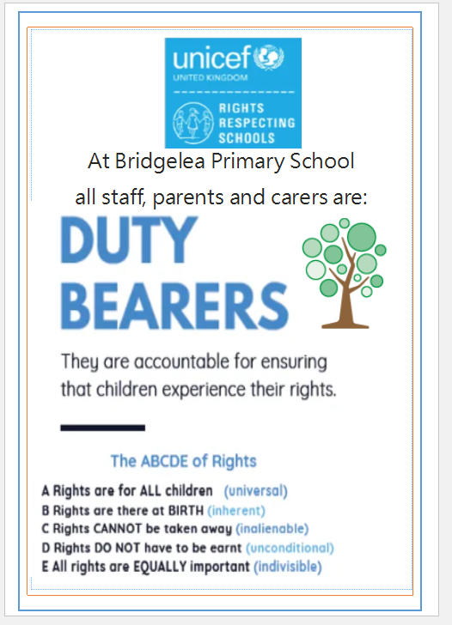
dutybearers
Dutybearers uphold the Rights of children.
https://www.youtube.com/watch?v=CFi3w7ozIGY
There is a visual display in your classroom to print off pictures of the Dutybearers in your room. Please ensure that the language of dutybearers is used regularly to support the children to have a wider understanding of the roles of dutybearers.
Can your children identify some dutybearers?

Slide 16
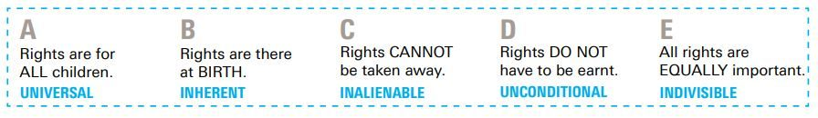
ABCDE of Rights
All children must be taught about the ABCDE of Rights.
They must be able to name some or all of the ABCDE. You may want to display these in your classrooms and general areas so that children can be reminded of these.

Slide 17
Article 12 squad
The Article 12 Squad has been effective this year.
In September, we will relaunch this and have votes for new children to come and join.
The children meet on a Thursday afternoon in Middle Floor Retreat.
Their main goal is to be the voice of the children, support the children with the Rights concepts and to put into practice the Smart School Council votes.

Slide 18
Rights respecting week 2020
There will be a focus week of activities linked to Rights Respecting.
The date of this will be confirmed as we learn more about school opening but this will be in September 2020.
This gives you the opportunity to relaunch Rights Respecting with your class and to ensure this is fresh in the children’s minds.

Slide 19
Opportunities for our children
When planning vehicles, please consider opportunities for children to learn about Rights, Sustainable Goals and Eco Schools.
This will include opportunities for children to learn about the community they live in, fundraise, parental engagement across the Curriculum offer.

Slide 20
Non negotiables in classes
Rights Respecting Display in each classroom (there are some fab examples around school which include the children’s work) :
Visuals of the 10 Bridgelea key articles alongside Class / Floor Charter.
Dutybearers displayed
Raffle tickets linked to Rights Respecting
Scripts and language of Rights to be used within the classroom / school environment
ABCDE of Rights

Slide 21
Next steps
Please work hard to embed the information in this powerpoint with your children.
If you are working in school with the children until Summer, this could start to be reintroduced but the main focus and relaunch will be when we are all back together.
Please continue to do all the fantastic things you do
I will be in touch about our next steps linked specifically to our Gold Award in the Autumn Term.

