Slide 1
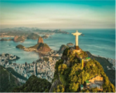
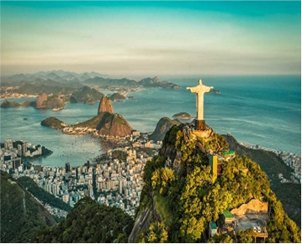
Curriculum Overview
William Gilbert Endowed Primary School and Nursery
Curriculum Overview For Parents
Term: Summer 2 2025 |  | Year 1 Mrs Reed
Rio de Janeiro
Curriculum Overview
Mathematics | English | History
Position and Direction Describe position, direction and movement, including whole, half, quarter and three-quarter turns. Numbers to 100 Count, read and write numbers to 100 in numerals Identify and represent numbers using objects and pictorial representations including the number line, and use the language equal to, more than, less than (fewer), most, least. Fractions Sharing equally and solving word problems using division Finding ½ and ¼ of shapes and amounts Solving word problems using halves and quarters | Non-Fiction Features of non-fiction texts: headings, labels, captions, contents page, photographs, index, glossary, text boxes Information texts about Brazil, leaflets, posters, information booklets. Fiction The Great Kaypok tree by Lynne Cherry Jabuti the Tortoise by Gerald McDermott Poetry Animal riddles | Brazil is in South America. The coast of Brazil is on the Atlantic Ocean. Rio de Janeiro has a tropical climate, which means most of the year it is warm and humid. In the summer there can be rapid, heavy rainfall. Physical features of Rio de Janeiro include mountains, beach, and coast. Human features include harbour, hotels, shops, and cable cars. The cities of London and Rio de Janeiro have similarities and differences.

Slide 2

Curriculum Overview
William Gilbert Endowed Primary School and Nursery
Curriculum Overview For Parents
Term: Summer 2 2025 |  | Year 1 Mrs Reed
Rio de Janeiro
Curriculum Overview
Design Technology | R.E.
Explore wheel mechanisms and design of a fairground wheel. Select materials with appropriate properties to make a fairground wheel. Build and test a moving wheel. Complete a final structure with a rotating wheel. Evaluate the final structure according to the original design. | Jewish people have special objects in their homes. A Mezuzah contains a special prayer. It is written in Hebrew, and it is put on their outside door post. Jewish people have a holy day each week (Friday) called Shabbat. Chanukah is a festival of light and the story about it is found in the Torah. Chanukah reminds Jews about God’s miracles and standing up for what you think is right.
Music | Computing | P.E (Football)
Explore tempo changes through movement. Explore how dynamics can be represented by different symbols. Clap simple rhythmic patterns while keeping the pulse. Interpret symbols to demonstrate a pitch pattern. Perform as part of a group to demonstrate dynamics, pitch and rhythm. | Create pictures by drawing, painting, photographing and computers. Using different tools on the computer can create different lines, shapes, and colours. | Control the ball with both feet. Dribble to ball with both feet. Pass the ball using the inside of the foot. Accurately shoot the ball towards the goal. Tackle an opponent to gain possession of the ball. Follow the rules of the game to play a match.
Things to look for and do at home: Please choose an activity from the list below to complete as a piece of creative homework, please can it be brought into school by Monday 23rd June. Research sports in Brazil (footballers, stadiums, the Olympics) produce an information poster using facts, headings, bullet points and photographs. What language do people speak in Brazil? Make a list of simple words and phrases to teach the class. Research landmarks in Brazil, make a tourist information booklet, some headings that you could include: ‘Places of Interest’ or ‘Things to do’. Use a globe or an atlas to locate Brazil. Which continent is it in? Which ocean is it close to? Make a list of five cities found in Brazil. Any Other Information: Please ensure your child has their water bottle and a sun hat in school each day. PE days are Tuesdays and Thursdays Practice spellings in preparation for our spelling test on a Monday. Achieve three blue gems and three red gems on Maths Whizz each week to receive pennies and free stars each Monday. Thursday – change over day for phonics books and library books.

