Slide 1
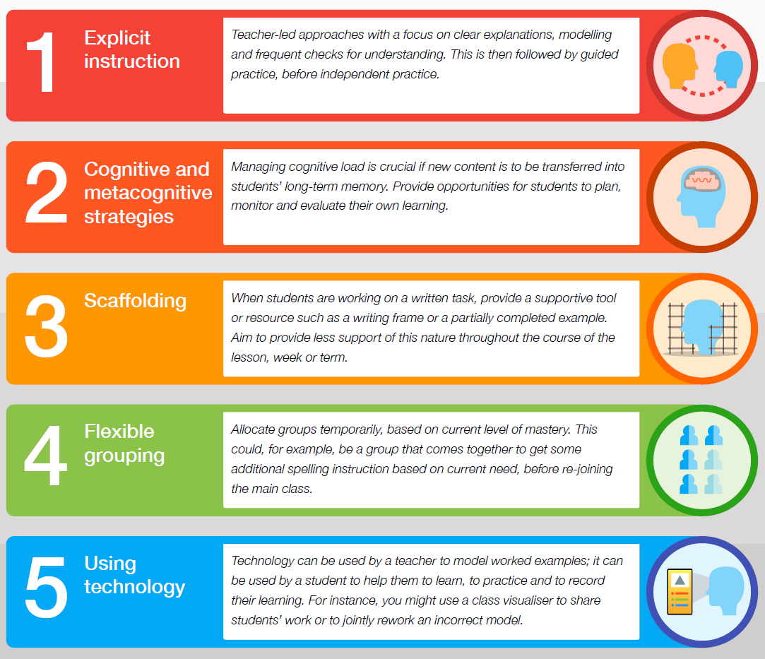
The EEF 5-a-day principle: High quality teaching benefits students with SEND
High quality teaching, benefits pupils with SEND
SEND abbreviations
The EEF’s guidance report ‘Special Educational Needs in Mainstream Schools’ indicates that supporting high quality teaching improves outcomes for pupils with SEND.
Five specific approaches—the ‘Five-a-day’ indicated below—are particularly well-evidenced as having a positive impact.
There are 4 areas of need in the SEND Code of Practice
C&I: Communication & Interaction
ASC – Autistic Spectrum Condition incl high-functioning autism (previously Aspergers)
DLD – Developmental Language Disorder
SLCN – Speech, Language & Communication Needs
C&L: Cognition & Learning
GD – Global Delay
SpLD – Specific Learning Difficulties e.g. dyslexia, strong dyslexic traits NB – formal diagnosis not needed for support, dyscalculia, dysgraphia, dyspraxia (medical diagnosis)
MLD – Moderate Learning Difficulties
SEMH: Social, Emotional & Mental Health
ADD – Attention Deficit Disorder
ADHD – Attention Deficit Hyperactivity Disorder
OCD – Obsessive Compulsive Disorder
PS: Physical or Sensory
HI – Hearing Impairment
PD – Physical Disability
SPD – Sensory Processing Disorder
VI – Visual Impairment
Med - medical needs, e.g. Signficant individual medical condition impacting learning
NSA – No statutory assessment (e.g. may be waiting for a referral / on the waiting list)

Slide 2
We plan Ordinarily Available Inclusive Provision (OAIP) to support all learners in the classroom
Cognition & Learning: this can include dyslexia, dyscalculia, dyspraxia, dysgraphia and similar traits; memory & retention needs | Physical & Sensory: this can include hearing / visual impairment, multi-sensory needs, colour-blind
What behaviours might I see? Difficulties with sequencing or ordering Increasingly low self-esteem Low levels of resilience with ‘difficult’ tasks, reading aloud or articulating thought processes Limited comprehension and/or vocabulary Difficulty with handwriting or misformed letter shapes ‘Dyslexia-type’ difficulties; difficulty grasping number concepts Reluctant reader, refusal to work, disengagement from learning Doesn’t write in full sentences Difficulty retaining information over time and/or remembering steps during tasks Difficulty starting independent tasks and/or completing tasks fully High levels of effort not matched by the outcome achieved Inability to focus on a task in an age-appropriate way Main strategies Provide visuals: dual-coding, colour-coding, images to support concepts Pre-teaching and precision teaching of key concepts and knowledge Explicit teaching of key vocabulary: pre-teaching; short topic word-lists; Frayer models Chunking: using short and simple sentences and careful word choice; now & next; whiteboard/post-it mini-tasks; animation to chunk reading Use alternative methods of recording information / supporting sequencing e.g. graphic organisers; dictation incl opportunities within home-learning; touch typing Provide handouts: print the DiN & key slides from PPT; photo of notes; laptop Plan tasks which support extra time within class Read questions & texts aloud as standard or offer use of IT (laptop, audiobook) Adapted questioning: hinge-questions, team talk, oracy scaffolds Include planned think-time: cold-calling, inviting responses, writing, reading Check students' understanding: students narrate their response - first/next/finally Provide context to tasks – relate to the world around us where possible Provide success | What behaviours might I see? Hearing impairment & visual impairment: Inattentive behaviour – student moving around in their seat, looking around Talking to other students Poor spelling; difficulty reading / decoding Difficulty forming sounds and words Inappropriate volume when speaking Not following instructions Poor visual tracking particularly in busy environments Wider sensory behaviours: Uniform discrepancies Avoidant behaviours in response to sound, light, movement, heat, smell, fabric Requirement for personal space / misreading personal space Higher levels of fatigue than peers Poor attendance and discernible patterns of absence Sensory seeking behaviours Main strategies Cue pupils in with name Make sure pupils can see & hear from their seat in the class. Which side is better/worse? Do the windows help or hinder? Are you facing them? Provide copies of texts & print-outs of slides; check font size on printed materials and on whiteboards (From back of classroom) Explicit modelling with key points highlighted on the page or screen Check in with pupils during the lesson to identify any gaps in learning Check individual preferences with pupils and/or their parents e.g. Outcomes from sensory assessments, use of coloured backgrounds etc Accept alternative forms of recording – dictation instead of writing? Provide rest breaks during activities and assessments Offer an alternative venue for assessments and activities – smaller room? Label colours where this is critical for reading a resource, e.g. electrical circuits, maps Promote clutter-free environment, esp around board & front of room

Slide 3
We plan ordinarily-available provision (O-P) to support all learners in the classroom
Communication & Interaction: social communication needs including autism (ASC) & demand avoidance (PDA) | Communication & Interaction: speech, language & communication needs (SLCN) including DLD & stammering
What behaviours might I see? Struggles with group work and/or adult directed tasks Prefers to talk to adults or younger children Difficulties making / maintaining friendships; may misjudge social responses Anxiety in busy / unfamiliar places Struggles with unstructured social time, change to routine (planned or unplanned) Low self-esteem Does not understand or use facial expressions or tones of voice May perceive injustice or give literal answers / blunt questions Stimming incl vocal tics, repeated gestures / actions Avoidant eye contact or body language Strong personal interests and difficulty engaging with others' agendas; Obsessive interests May struggle with receptive and expressive language Dysregulation (freeze/fight/flight response) incl non-verbal responses Overly controlling in relationships Masking during school time followed by extreme dysregulation once home at the end of the day Main strategies​ Have clear consistent routines. Use visual timetables. Use visual prompts for instructions.​ Pre-warn children about changes e.g. room changes, planned absence, Unknown visitors; trips; practicals; set new seating plans at the end of the previous lesson​ Use social stories to support understanding of human behaviours, feelings, changes to routine and transitions.​ Use clear and concise language at all times​ Present the plan for the lesson using now & next – create predictability​ Cue with name​ In-class supervised rest breaks/re-sets, incl during longer tasks / tests​ Provide written prompts / instruction cards for group roles​ Maintain a calm, tidy, low-stimulus learning environment​ Positively phrase corrections / avoid criticism / positive redirection​ Provide alternative individual tasks instead of pair/group work; tap into child's personal interests​ Use de-escalation strategies, provide time & space, avoid questions to demand a response ​ Adaptive questioning rephrase 'why' to 'what (what might the writer be...?') | What behaviours might I see? Finds it difficult to listen / short attention span Difficulty in processing instructions esp when there are multiple steps Doesn’t start tasks independently; refusal to work; avoidant, disruptive or masking behaviours Asks a friend ‘so what are we doing?’ Unclear speech, muddled syntax, abstract word choice when tired Reluctant to ask for help Struggles with everyday organisation, including sequencing and/or retelling events in order Misapplies language or misjudges language for situations Struggles with recall of information, inference, comprehension skills Poor or sporadic attendance; possible emotionally-based school non-attendance Main strategies Individual tasks chunked into 1. 2. 3. on post-it/whiteboard Scaffolded responses with explicit modelling (sentence starters, modelled written sentences) Visuals and pre-teaching to support new vocabulary incl homophones or similar words (e.g. vocab mats, mind maps) Language is modelled back ignoring pronunciation / stammer / unclear speech – avoid long speeches or drawing attention to errors Plan extra time to process information & respond Accept alternative forms of answers incl mini whiteboard / gap-fills Prepare sentence starters for written tasks / give choice of answers Always use the pupil’s name to gain attention Prepare questions in advance to support student responses Guided reading for decoding, comprehension & inference Model correct sentences Check understanding of tasks/explanations – RAG cards/wrist bands, pupil explains Use of Colourful Semantics approach Offer a forced choice of alternatives

Slide 4
We plan ordinarily-available provision (O-P) to support all learners in the classroom
Social, emotional & mental health (SEMH): this can include anxiety, depression, etc., insecure attachment profile, trauma | Social, emotional & mental health (SEMH): this can include ADHD, ADD, aspects of OCD, Tourettes
What behaviours might I see? Sporadic attendance Disengagement in lessons, incl body language or avoidant/ambivalent/disorganised behaviours/unable to stay in the classroom/hiding in a safe or quiet space Self-harm Tearful presentation / Withdrawn ‘Stressed’ answers / tone / abrupt responses, may be hypervigilant Unexpected responses to topics – easily escalated, easily upset, takes longer to calm Behaviours that disrupt learning of peers Decreasing quality of work – classwork, homelearning – ‘don’t care’ attitude Sense of distrust towards adults; friendship deterioration; testing reactions from others – constantly seeing if the reaction will change Misreading social situations – others’ intent / judging own reactions Difficulty maintaining relationships, including trying to control others Erratic or spontaneous/unexpected behaviour, including seeking to control situations Main strategies Positive thresholding & consistent routines to build warm predictability Planned de-escalation to reduce conflict, e.g. extra time to remove coat Seek students getting it right early-on; meaningful & specific recognition Check any patterns in absence – tests? Active lessons? Reading? Other? Maintain warmth & sense of liking / valuing the student Avoid drawing public attention to areas of concern, e.g. attendance Find a connection & identify with students' interests Find opportunities to praise Use a restorative approach Actively seek to maintain an invisible thread – student interests, asking about the weekend/holidays (don’t presume it was good), sports etc Explicitly show pupil is being kept in mind, e.g. 'I saw this and I thought of you!' etc. Identify why you want the student in your lesson, at 1:1 level, e.g. as check in at start of learning task Use of scaling (e.g. 5-point scales, Zones of Regulation) Give advance warning of questions, new topics or seating changes – time to think, process & raise any queries without fear of criticism * See wider strategies under relational planning & pre-emptive de-escalation strategies | What behaviours might I see? Restlessness & fidgeting; difficult to sit still, impulsivity, racing/overactive mind Fiddling with small items; broken pens Missing equipment & sense of disorganisation Literal responses to questions, calling out, interrupting Difficulty expanding on answers Multiple trains of thought / talking on a tangent Can find it hard to get started May 'zone out', hyperfocus Presentation – extremes (hyper-organised/disorganised) - be aware of overlap with other areas of neurodivergence and mental health needs Main strategies Verbal explanations / instructions are supported visually Distraction-free environment where possible including seating plan supporting need for movement or to minimise distraction. When hyper-focused, do not interrupt Support discreet use of fidget tools Chunk tasks – list, number – to avoid feeling overwhelmed Encourage brief planning – 3 bullet points to support memory for longer written responses Use of visual timers Plan opportunities for unobtrusive movement breaks within class routines, eg. handing out resources, opening the window, etc Trial wordprocessing – allows students to brain-dump then reorganise Offer rest-breaks during prolonged responses, plus extra time Praise – recognise strong answers, use work as example for visualiser Pre-teach new topics – YouTube clip, Knowledge Organiser work, mind maps Set explicit revision tasks – don’t expect pupils to automatically infer Support responses on whiteboards/post-its to reduce shouting out

