Slide 1
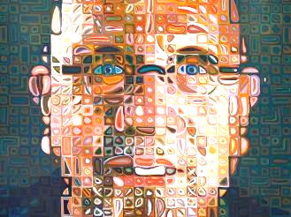
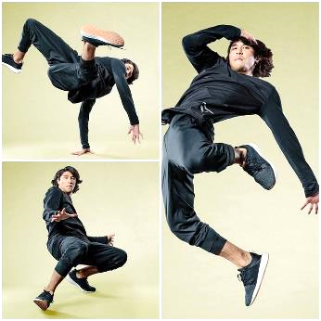
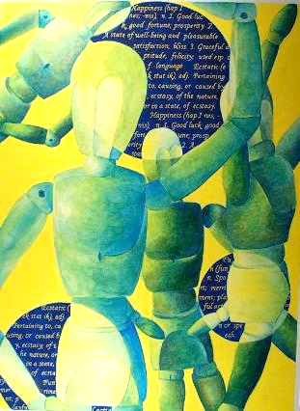
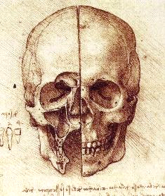
Name ___________________________________ Class____________________
Yr8 Cycle 1
Human Figure
Tradition and Innovation
Homework and Knowledge Organiser
Booklet.
Refer to epraise for homework deadline.
Complete tasks in booklet and hand in on deadline date.

Slide 2

GOLDEN WORDS
Line - is a mark made on a surface that joins different points. Lines can vary in length, width, direction and shape.
Tone-Is the lightness or darkness of a shape or form. Minimum 5 tones dark to white. Tone helps create form.
Shape - is a flat area surrounded by edges or an outline
Mark making- describes the different lines, dots, marks, patterns, and textures we create in an art.
Proportion- is the accuracy and the sizes of one object to another.
Colour blending-Two or more colours are mixed/ worked together or on top of each other.
Photo montage- is the process by cutting, gluing, rearranging and overlapping two or more photographs into a new image
Overlapping - is when shapes are in front of other shapes. If one shape overlaps another it communicates an illusion of depth.
Fragmentation - an interest in manipulating a structure's surface and shape which appears to distort and dislocate.
Collage - the technique in which pieces of paper, photographs, fabric and other materials are arranged and stuck down onto a supporting surface.
Scale - the principle of scale refers to the relative size of one object compared to another, typically the size of the artwork
Composition - is the term given to a complete work of art and, more specifically, to the way in which all its elements work together to produce an overall effect.

Slide 3
Human Form – For artists, representing the human figure this means more than simply reproducing a likeness of a person.
Innovation – Is the introduction of something new or different.
Traditional Art - are skills and knowledge of art which are passed down through generations.
Chuck Close – Charles Thomas Close was an American painter, visual artist, and photographer (July 5, 1940 – August 19, 2021) who made massive-scale photorealist and abstract portraits of himself and others.
Hannah Höch - was a German Dada artist. She is best known for her work of the Weimar period, when she was one of the originators of photomontage.
Leonardo Da Vinci – (15 April 1452 – 2 May 1519) was an Italian polymath of the High Renaissance who was active as a painter, draughtsman, engineer, scientist, theorist, sculptor, and architect.
Vitruvian Man – The drawing represents Leonardo's concept of the ideal human body proportions.
Experimentation – is exploring new and different ideas using a range of media and materials.
Distortion – is a change of a reality's depiction, altering it in a way that one is able to still recognize the item itself, but notices it is changed in some manner.
Mixed Media - is a term used to describe artworks composed from a combination of different media or materials.

Slide 4
Homework 1- Key words revision
1. Revise the key words and their meaning.
REVISION NOTES ON THIS PAGES PLEASE

Slide 5
Homework 1- Key words revision
1. Revise the key words and their meaning.
2. Next - Complete a photoshoot of human figures in action.
Take a series of photographs of friends or family, mugs, etc. take the photos from different view points and print them ready for the next lesson.

Slide 6
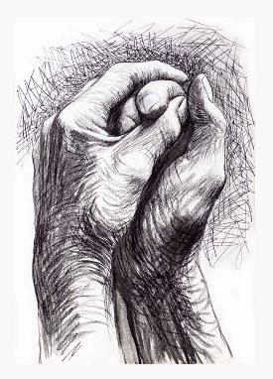
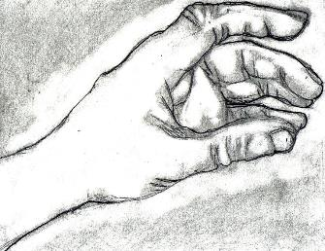
Learning Outcome
Draw your own hand accurately adding Shading and tone.
Focus on
detail, really look at shape and form of fingers and hand.
Focus on tonal blending. For a tonal drawing focus on using a minimum of 5 tones dark to light.
Homework Task 2 : Observational drawing of your own hand

Slide 8
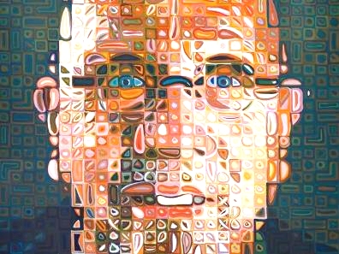
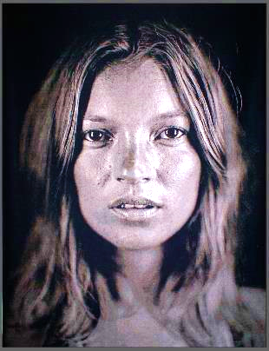
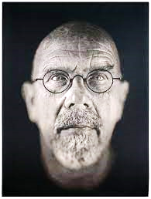
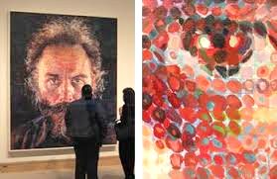
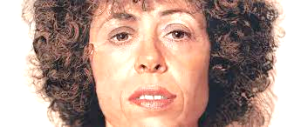
Homework Task 3 : Contemporary Artist Study – Chuck Close
Learning outcome-
Create a Chuck Close inspired photograph
Progression Steps
1) Look at the examples of Chuck Close art work.
2) Take several photographs of faces close up.
3) Edit the best photo in black and white and print and present on the next page.
Charles Thomas Close was an American painter, visual artist, and photographer (July 5, 1940 – August 19, 2021) who made massive-scale photorealist and abstract portraits of himself and others. Close also created photo portraits using a very large format camera

Slide 9
Present your task 3 homework on here (Artist Chuck Close inspired photograph)

Slide 10
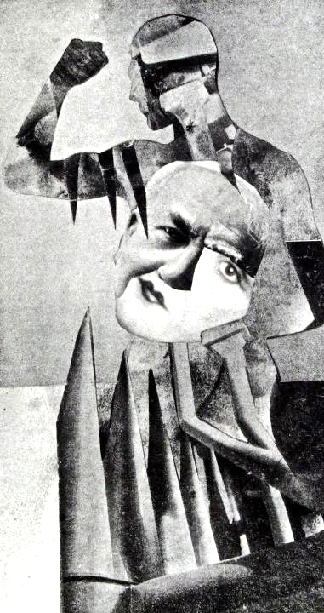
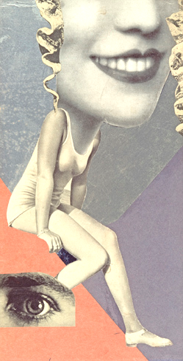
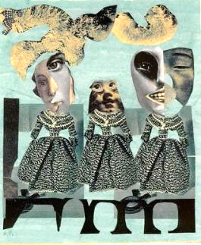
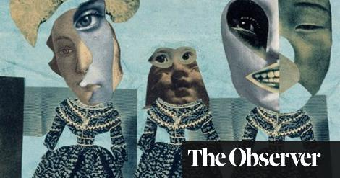
Homework task 4:
Modern Artist Study – Hannah Hoch Collage
Learning Outcome-
Complete a Hannah Hoch Collage, cut and fragment the shapes, focus on overlapping include a background.
PROGRESSION STEPS
Collect and print a range if images
Cut and arrange the shapes of fragmented figures and faces.
Overlap the shapes
Glue the composition on the next page

Slide 11
Present your task 4 photomontage homework here (Artist Hannah Hoch)

Slide 12
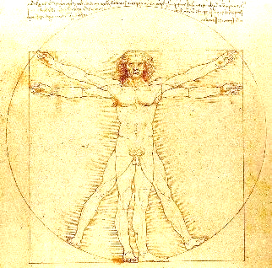
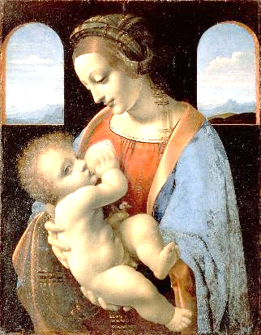
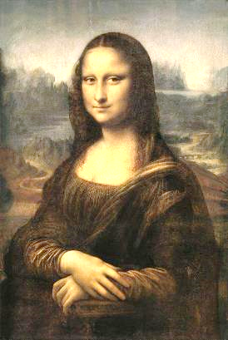
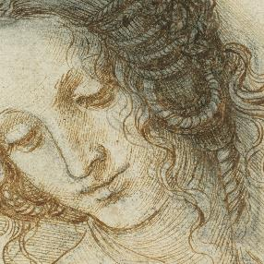
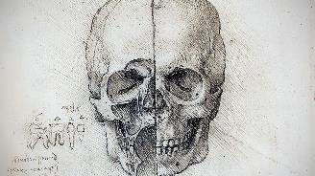
Homework 5 : - Historical Artist Study and Research of Leonardo Da Vinci
Leonardo Da Vinci ( 15 April 1452 – 2 May 1519)
Was an Italian polymath of the High Renaissance who was active
as a painter, draughtsman, engineer, scientist,
theorist, sculptor, and architect.
Learning Outcome & PROGRESSION STEPS-
Use the internet to research artist Leonardo Da Vinci. Put his name into the search engine
Choose 5 images of his art work, copy and paste them into word ( if printing ) or power point if doing a presentation.
Find some key facts about him and write in own words.
4) Present your research consider back ground, a title, layout of page, have 5 images and key facts in own words.

Slide 13
Present your task 5 homework on here (Artist research Vincent Van Gogh)

Slide 14
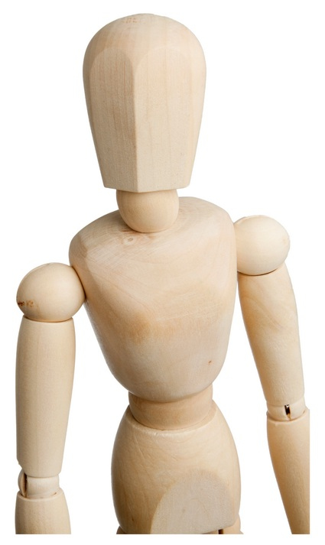
Homework 6: Observational drawings
of wood manakin
Learning outcome
Draw the wood manakin accurately and add tone.
Focus on proportion, shape,
Form, detail and tone – min 5 tones dark to
light smooth tonal changes.
PROGRESSION STEPS- Grid technique
1) Use the grid technique by dividing the
Drawing into 4 . Draw a box
At least 20x15cm and grid the box.
2)Plot the object on the grid line
3) Sketch the basic shape.
4) Add the detail and firm up the
Outline.
5) Add tone , min 5 tones black to white

Slide 15
TASKS | SELF ASSESSMENT GRADES 1-5 * | DATE
Task 1 – REVISION OF KEY WORDS AND PHOTOSHOOT LEARNING OUTCOME Key word definition. Revise the Key Words! Complete a Photoshoot of figures in action. | 1- NOVICE 2-DEVELOPING 3-MODERATE * ** *** 4-SECURE 5- ADVANCED **** *****
Task 2 - Observational drawing of your own hand in line and tone Learning Outcome - You could work from a real life or from a photo of your own hand. Draw the hand accurately adding tone. Focus on detail, really look at the shape and form . For a tonal drawing focus on using a minimum of 5 tones dark to light. | 1- NOVICE 2-DEVELOPING 3- MODERATE * ** *** 4-SECURE 5- ADVANCED **** ******
Task 3 - Contemporary Artist Chuck Close. CRITICAL STUDY Learning outcome Create a black and white Chuck Close inspired portrait photograph. | 1- NOVICE 2-DEVELOPING 3- MODERATE * ** *** 4-SECURE 5- ADVANCED **** *****
Task 4 - Modern Artist Hannah Hoch. CRITICAL STUDY Learning Outcome- Complete a photomontage of figures and faces, cut carefully the shapes, focus on overlapping and fragmentation. | 1- NOVICE 2-DEVELOPING 3- MODERATE * ** *** 4-SECURE 5- ADVANCED **** *****
Task 5 -Historical Artist Leonardo Da Vinci. CRITICAL STUDY Learning Outcome- Research Artist Leonardo Da Vinci and present your findings in a power point or print images and present creatively. Write in your own words. Think about title, back ground and layout. | 1- NOVICE 2-DEVELOPING 3- MODERATE * ** *** 4-SECURE 5- ADVANCED **** *****
Task 6 - Observational drawing of a wood manakin Learning outcome-Complete a tonal drawing of the wood manakin. Draw the clock accurately and add tone. Focus on proportion, shape, form and detail. | 1- NOVICE 2-DEVELOPING 3- MODERATE * ** *** 4-SECURE 5- ADVANCED **** *****
TEACHER FEEDBACK PASS 1-2 MERIT 3-4 DESTINCTION 5 | OVERALL HOMEWORK GRADE: 1 – 2 – 3 – 4 – 5

