Slide 1

Good morning and welcome

Slide 2
Today’s info
Update and information
Direct Payment advice and support (Vicky and Pauline from Down Syndrome Cheshire)

Slide 3


Slide 4
School Development Plan Priorities 2026
Evaluation Area 2 - Inclusion
To effectively meet the needs of new and future cohorts (i.e. the ever-changing face of consultations)
Evaluation Area 3 – Curriculum and Teaching
To ensure that the quality of teaching and learning is outstanding
To ensure that there is a sustained focus on functional literacy and reading across the curriculum
To successfully use technology to support students make progress.
To develop an effective assessment strategy that drives improvement through high quality, impactful feedback for all students (new policy development)
Evaluation Area 8 – Leadership and Governance
To strengthen the quality of education by embedding a cohesive approach to professional development

Slide 5
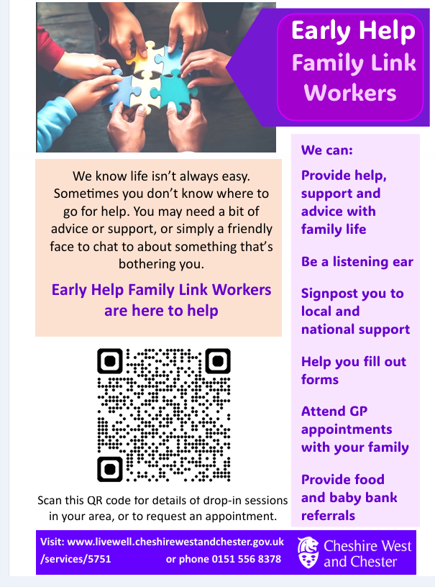

Slide 6
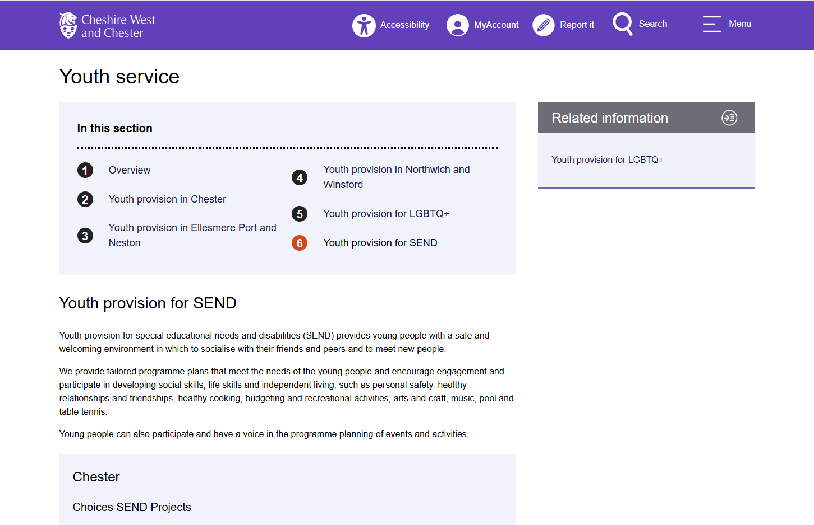

Slide 7
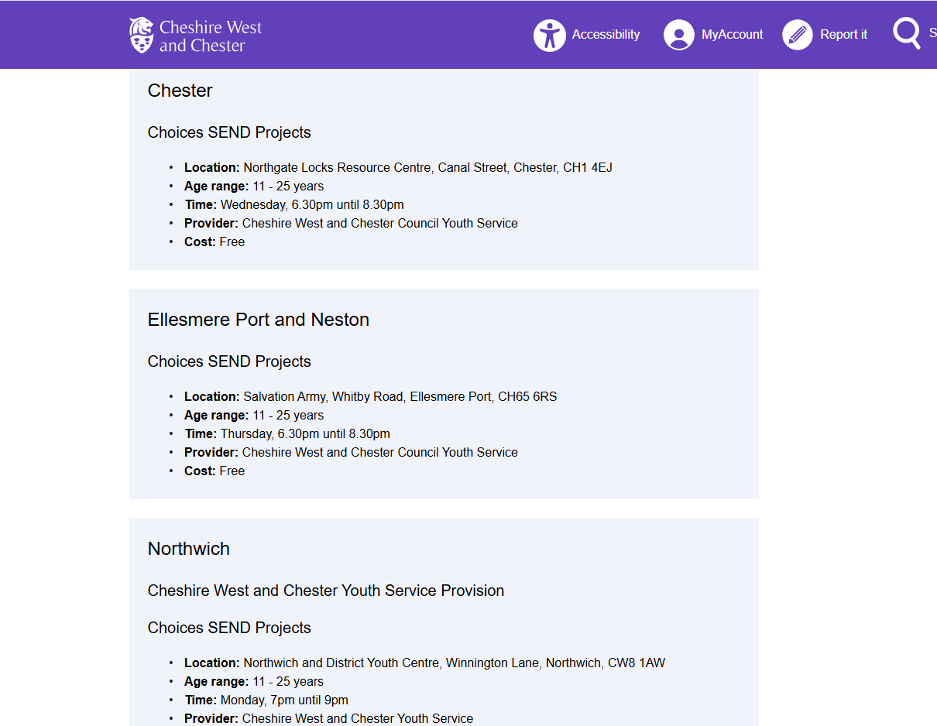

Slide 8
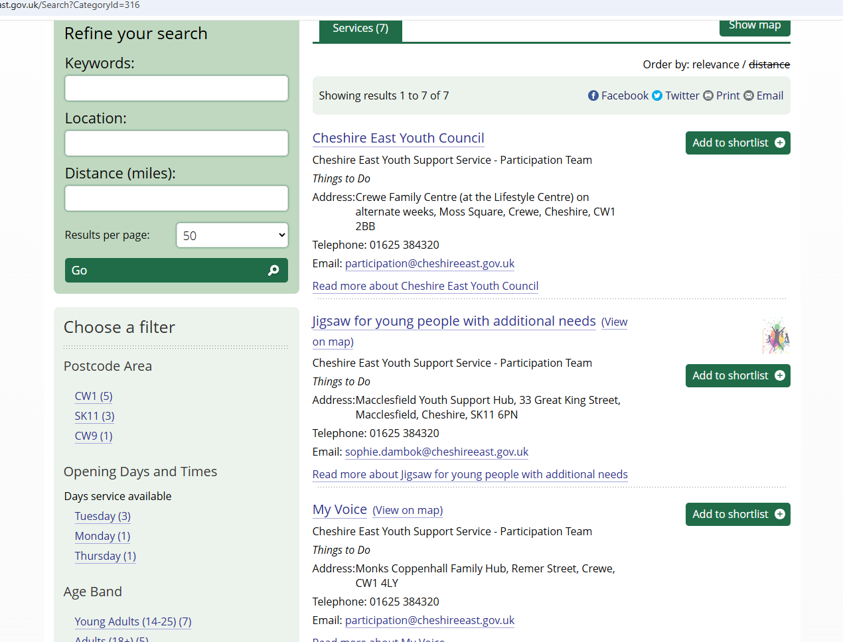

Slide 9
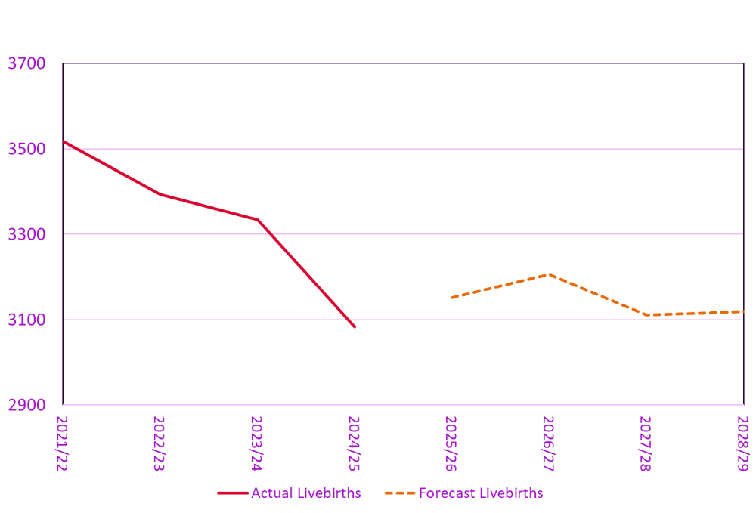

Slide 10
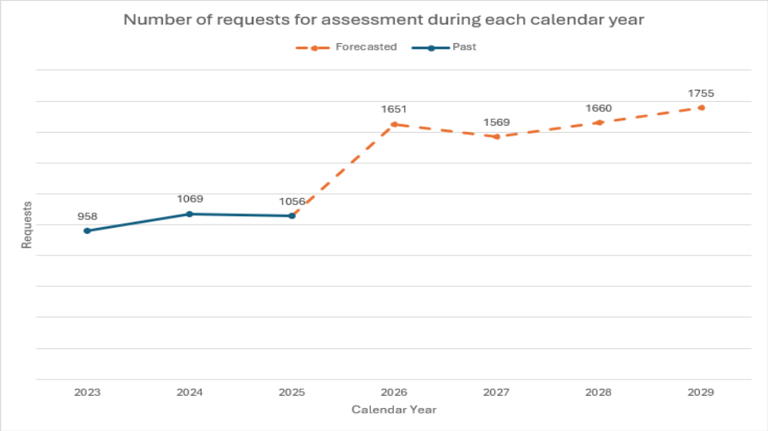

Slide 11
