Slide 1

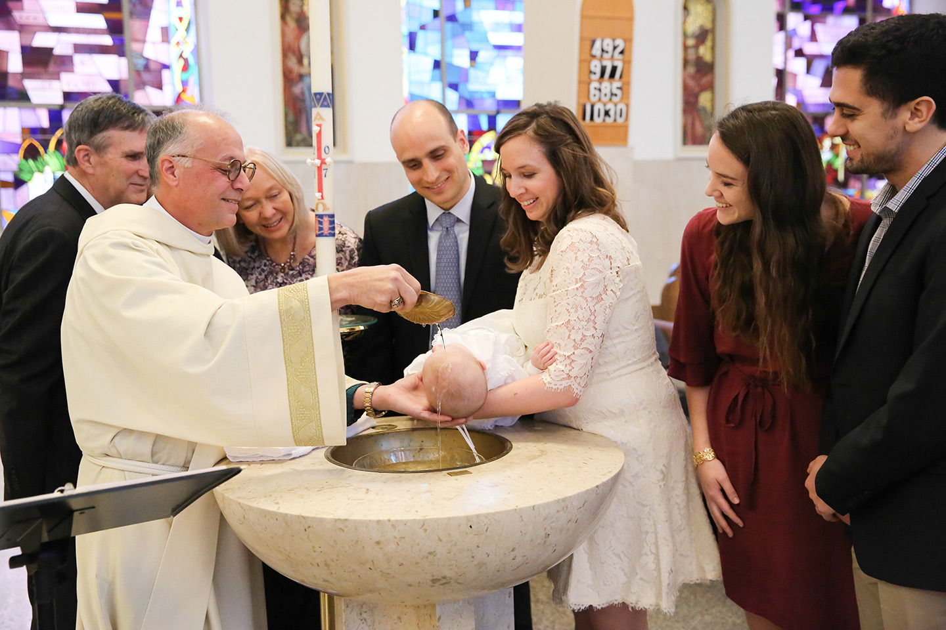
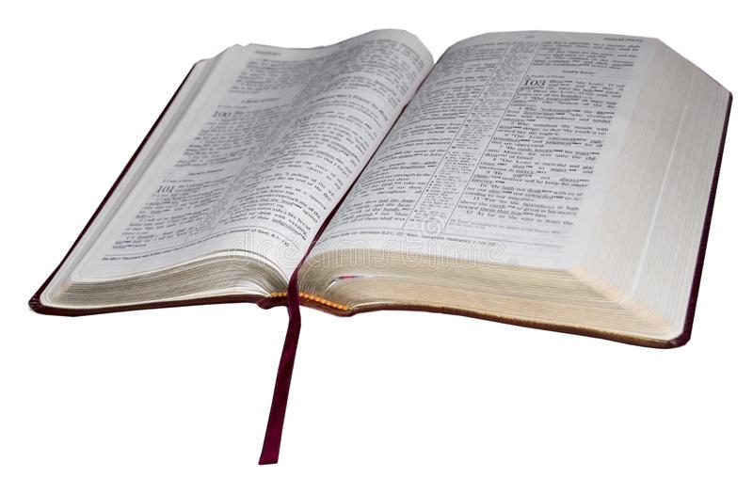
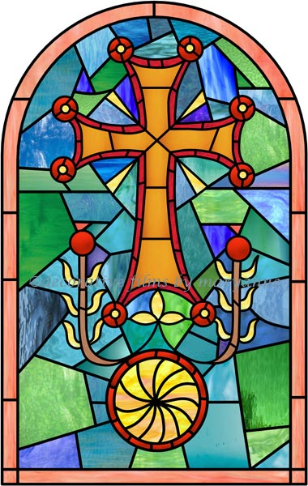
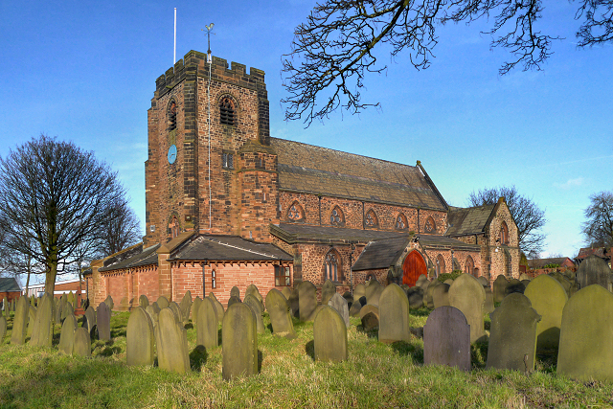
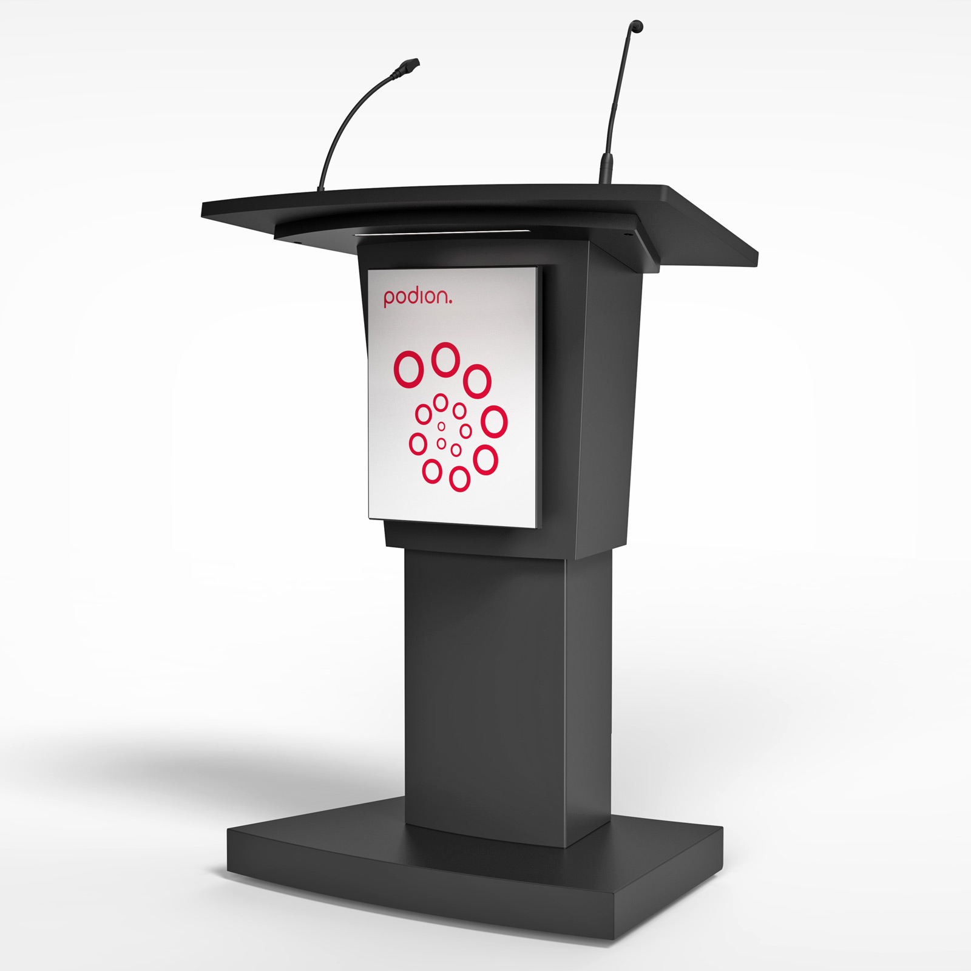
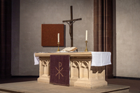
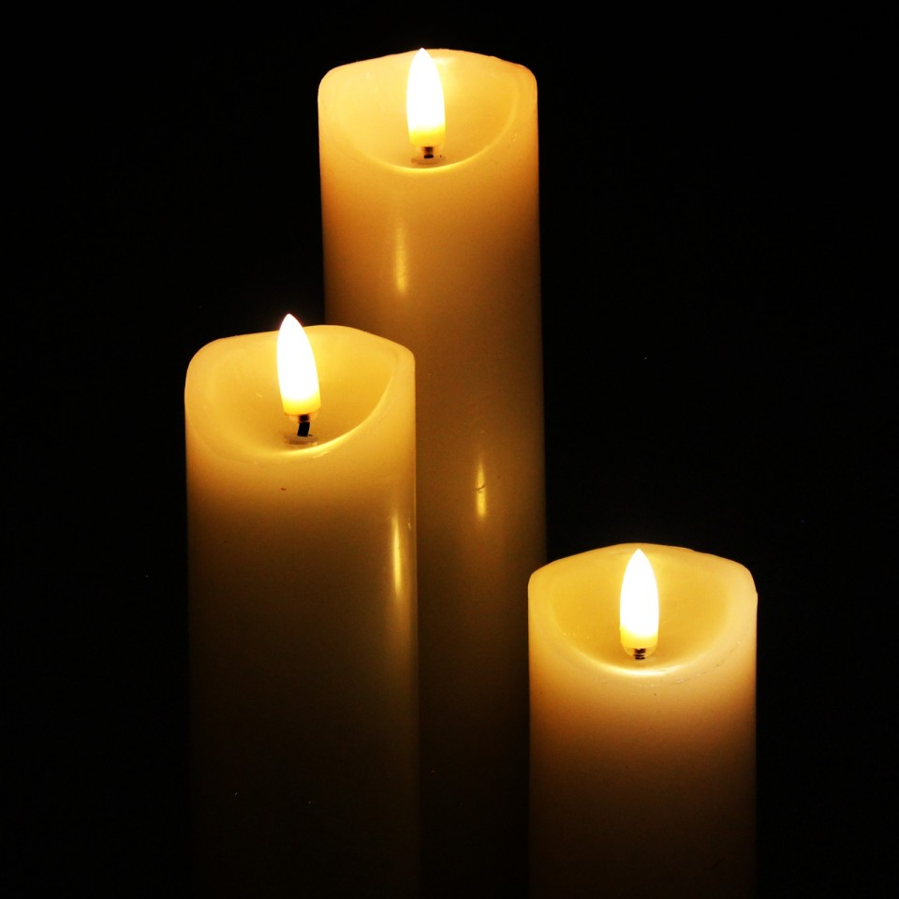
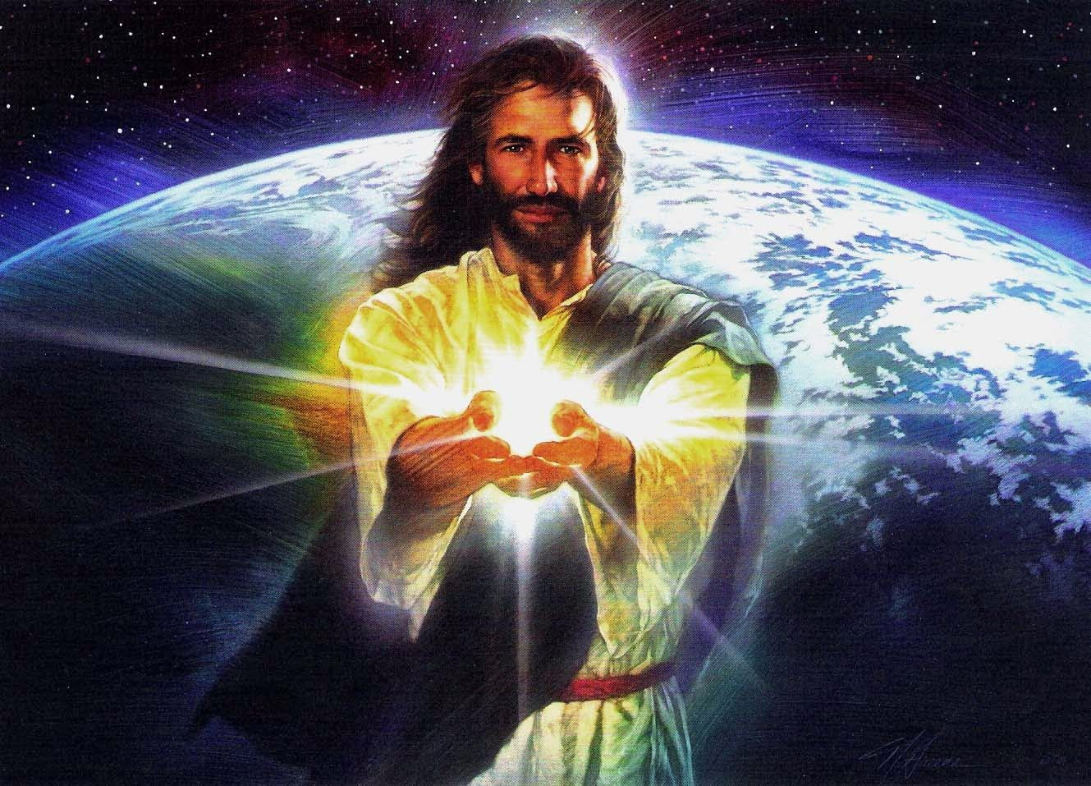
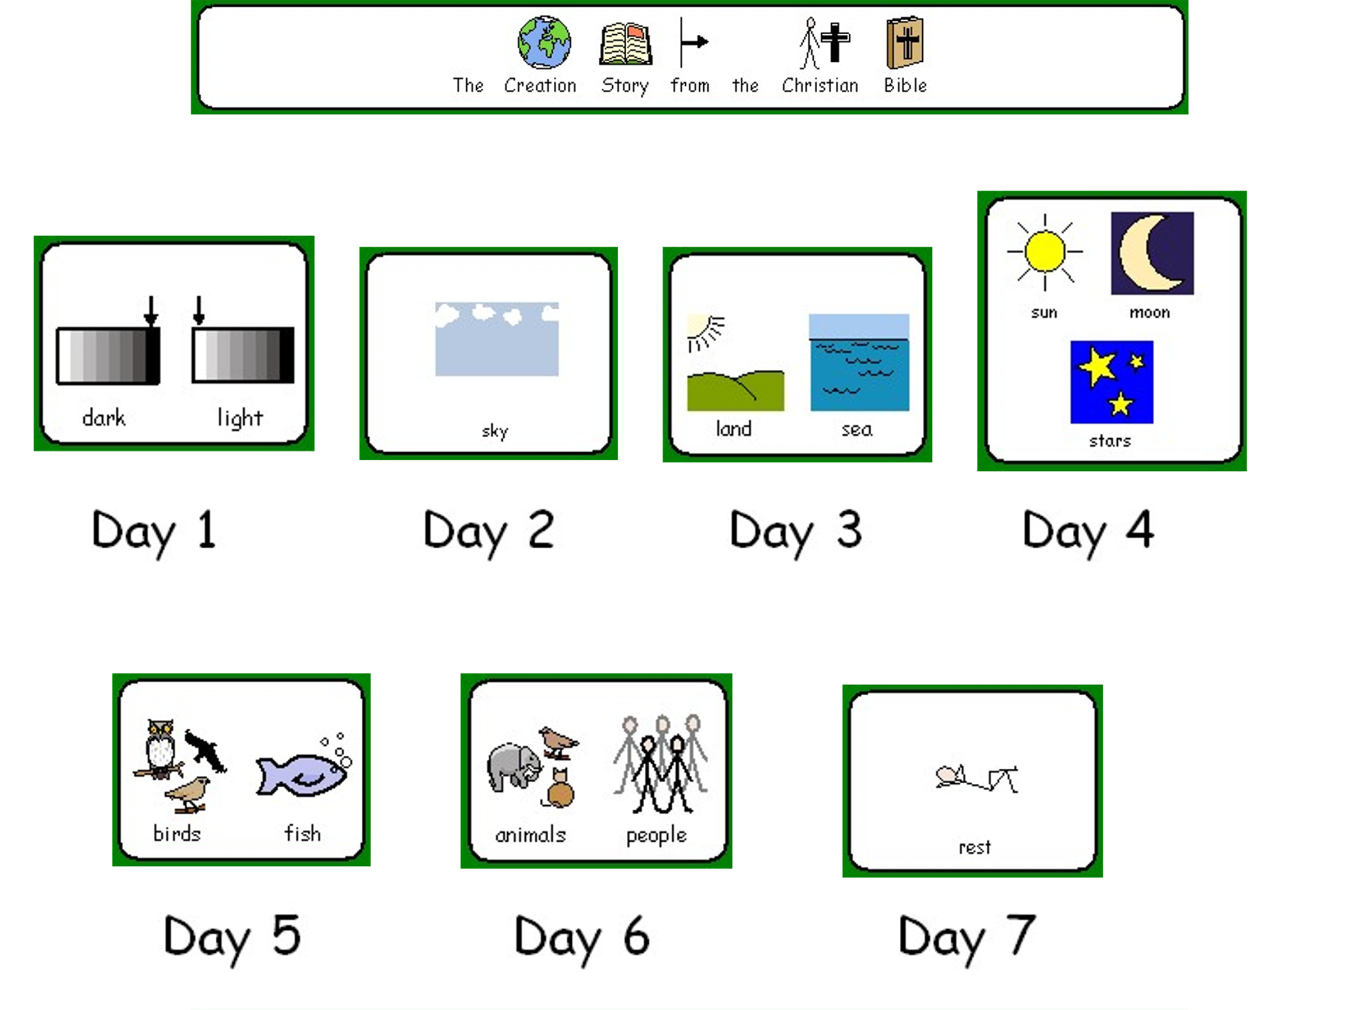
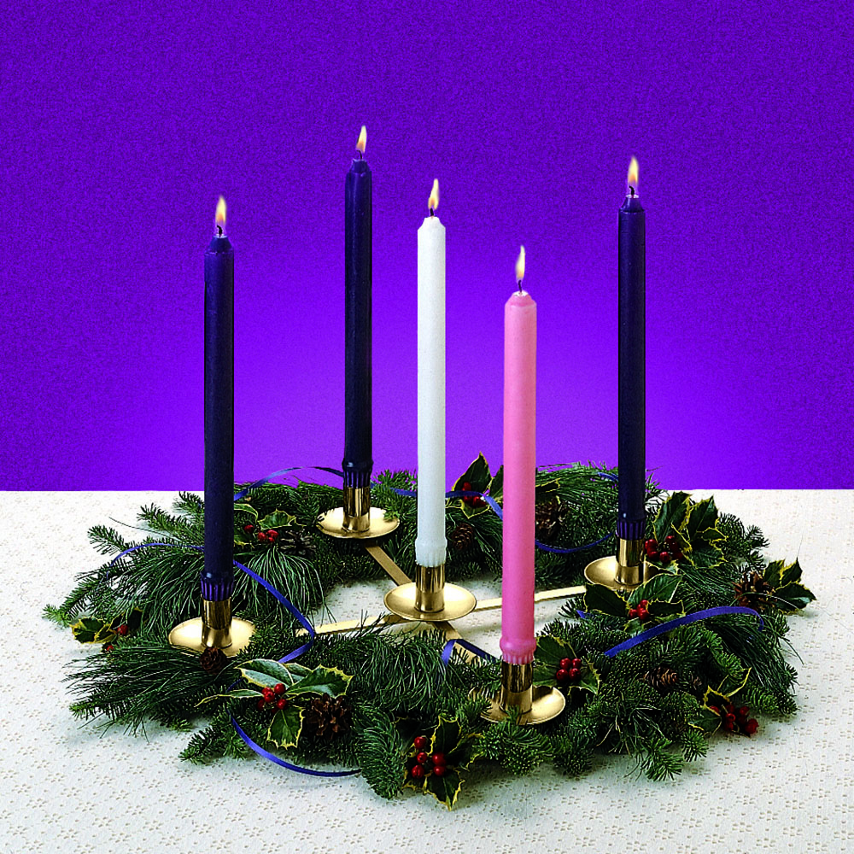
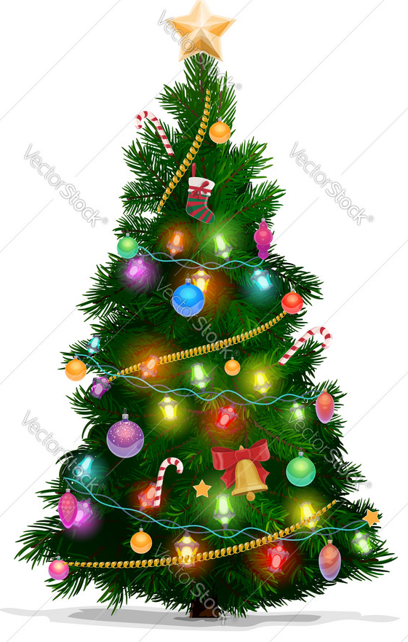
Vocabulary
Advent – Special time leading up to Christmas, Christians light special candles in church for each week.
Baptism – This is a special ceremony when a person is welcomed into the church and often when a person is just a baby. It is also known as a Christening.
Bible – Holy Book of Christianity
Christmas – Jesus’s birthday that Christians celebrate.
Church/Chapel/Cathedral – Christian places of worship.
Creation – The creation story is how God created the world.
Prayer – when a Christian speaks to God.
Worship – to say prayers or sing to God.
Christianity - KS1
Some Holy Ceremonies and practices may include baptism, funerals and weddings.
The cross is the symbol of Christianity as Jesus died on the cross.
Holy Book: The Bible
A Christening (Baptism) ceremony in a church using a font.
Churches often have stained glass windows.
Place of worship
The Christian place of worship is called a Church or a chapel or a cathedral.
St. Nicholas’s Church, Sutton, St.Helens
Light is important in Christianity as well as other religions. Jesus was often called the light of the world as light is considered good like Jesus.
A lectern is a feature in a church. The vicar or minister often reads from here.
An altar is a main feature of the church. It usually has candles on it and sometimes the bread and wine.
Main Festivals
Christmas, Easter, Lent
Main Beliefs
Christians believe there is only one God and he is often called the father. Jesus Christ was God’s Son. God sent his Son to earth to teach people good ways to live, to love God and to look after one another.
Prayer
Christians believe that praying is a way of speaking with God. People can pray to give thanks, ask for help or to ask for forgiveness.
Advent wreath with candles at Christmas
Festival of Christmas
Christmas is the celebration of Jesus’s birthday and is the 25th December. It is a time of giving and receiving presents and cards. Christians sing carols and send cards. Families get together and have a special meal. The tradition of Santa Claus bringing presents is celebrated.

