Slide 1
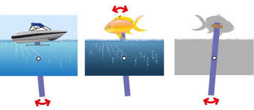
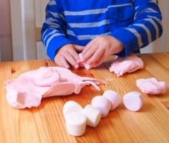
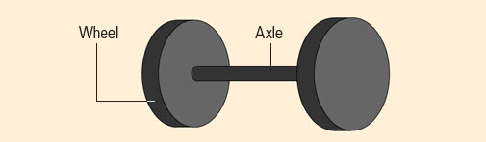
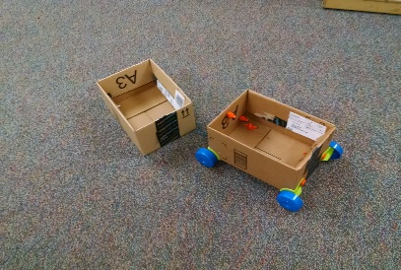
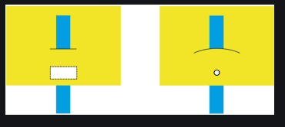
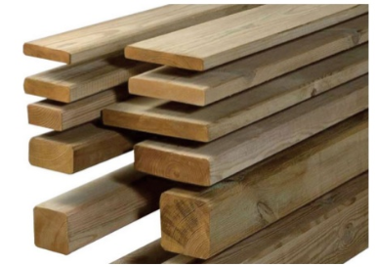
Research
Evaluate
Design
Make
Sherdley Primary School: DT Knowledge Organiser.
Form: KS1
Fabulous form vocabulary!
Year 1
Year 2
C
malleable | A material that is easily shaped or changed. This can be done by stretching, squashing and bending for example.
rigid | A material that is unable to be shaped or changed. Something solid.
natural forms | An object which has not been altered or manipulated and it’s original form can be found in nature. For example flowers, fossils, rocks and trees.
man-made forms | An object which has been created by human hands. For example a statue, building or product.
media | The materials used in the DT work.
constructions | A piece of work which is assembled in 3D form using a range of materials.
Make simple constructions with a range of materials. Create these products for a purpose using a range of techniques = WHEELS AND AXELS.
Use materials to make a known object for purpose.
Carve, pinch and roll coils and slabs using modelling media.
Make simple joins on a product using cutting, shaping, joining and finishing.
Shape and form from direct observation using rigid and malleable materials.
Replicate patterns and textures in 3D form using the inspiration of artists and sculptors.
Make simple constructions with a range of materials. Create these products for a purpose using a range of techniques = LEVERS AND SLIDERS.
Develop and awareness of natural and man-made forms.
Levers
&
Sliders
Malleable materials!
C
C
Wheels & Axels
Rigid materials!
C
C

Slide 2
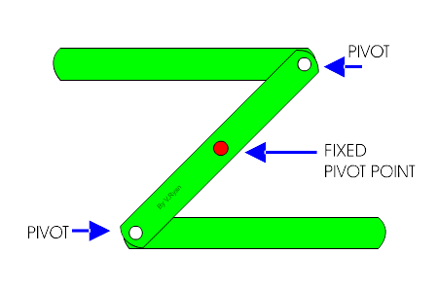
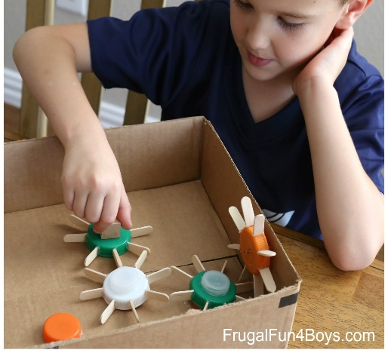
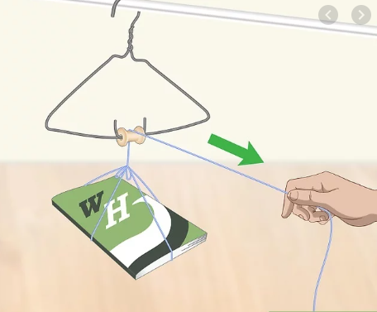
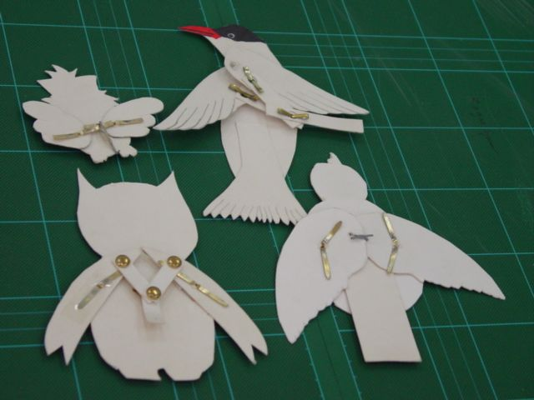
Research
Evaluate
Design
Make
Sherdley Primary School: DT Knowledge Organiser.
Form: LKS2
C
Fabulous form vocabulary!
Year 3
Year 4
malleable | A material that is easily shaped or changed. This can be done by stretching, squashing and bending for example.
rigid | A material that is unable to be shaped or changed. Something solid.
environmental patterns | An pattern which has not been altered or manipulated and it’s original form can be found in nature. For example flowers, fossils, rocks and trees.
man-made patterns | An pattern which has been created by human hands. For example the patterns made on a statue, building or product.
adhesives | A substance used for sticking objects and materials together.
sculptor | An artist who creates sculptures.
Shape and form more complex work from direct observation using malleable and rigid materials. Creating products for purpose using LINKAGES, LEVERS AND PULLEYS.
Plan and develop products by sketching, cutting, attaching and adding simple adjustments.
Develop and use a range of adhesives and methods for construction.
Discuss and record own work and the work of other famous sculptors.
Analyse and interpret environmental and man made patterns of construction.
Create products for a purpose using GEARS and PULLEYS to create movement and transfer media.
Levers and linkages!
Gears
C
C
Pulleys

Slide 3
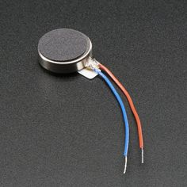
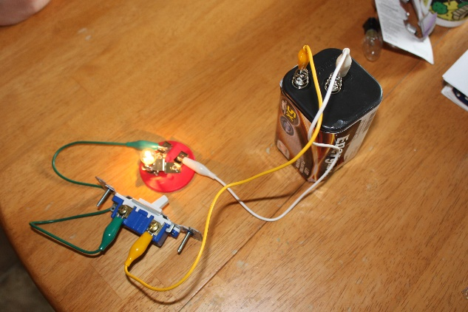
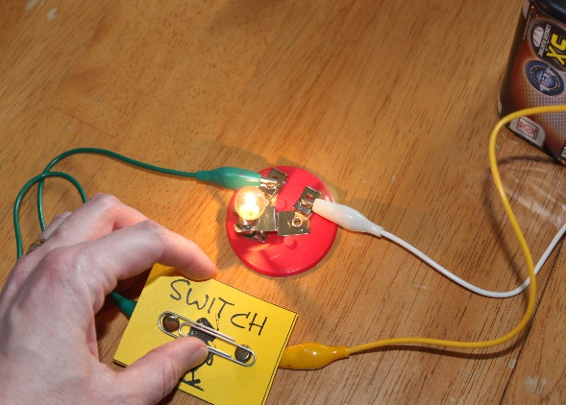
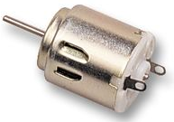
Research
Evaluate
Design
Make
Sherdley Primary School: DT Knowledge Organiser.
Form: UKS2
C
Fabulous form vocabulary!
Year 5
Year 6
inspiration | A feeling of enthusiasm on a subject/object/person/piece of music etc. This prompts a piece of artwork.
drafting | The process before a final piece is completed. This can include rough sketches, annotations and evaluations.
evaluate | Discussing work to assess its particular strengths and weaknesses.
sculptor | An artist who creates sculptures.
Plan and develop ideas using shape, form, model and joins to create a final piece. Incorporate SWITCHES and BULBS into the final product.
Discuss and evaluate their own work and that of other sculptors. (Use various media including ICT).
Plan and develop ideas using modelling. Use ICT to plan and draft ideas.
Discuss, interpret and evaluate the work of other sculptors and use this as inspiration for their own work.
Create products incorporating BUZZERS and MOTORS into the final piece.
Buzzers!
Switches and bulbs!
C
C
C
Motors!

