Slide 1

Holte School summer reading challenge!
Notes:
NOTE:
To change the image on this slide, select the picture and delete it. Then click the Pictures icon in the placeholder to insert your own image.

Slide 2
Top 50 books to read!
Over the summer your challenge is to read as many of the books as possible over the next few slides.
You can enter a competition online at https://theweekjunior.co.uk/summerofreading and be in with a chance to win a:
Book bundle worth £200 plus a £50 National Book Token for the winner OR
A £50 National Book Token each for three runners up
There will be a competition in school for the pupil that can read the most books from the list. All you have to do is write a short 50 word review of each book you read!

Slide 3





Books to inspire you.

Slide 4
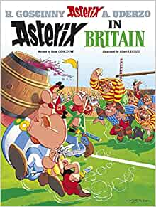



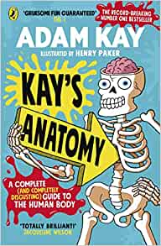
Books to make you laugh out loud

Slide 5





Books you’ll want to talk about

Slide 6





Books with characters you’d like to meet.

Slide 7


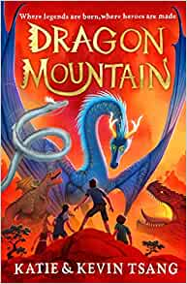


Books with amazing adventures

Slide 8





Books to make you think like a detective

Slide 9

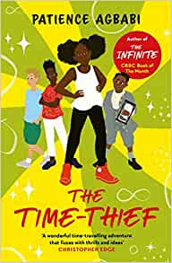



Books packed with superpowers

Slide 10
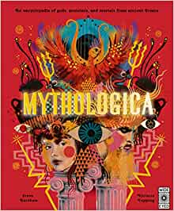




Books that transport you into the past

Slide 11





Books that take you around the world

Slide 12





Books about fantastic friends and families

