Slide 1
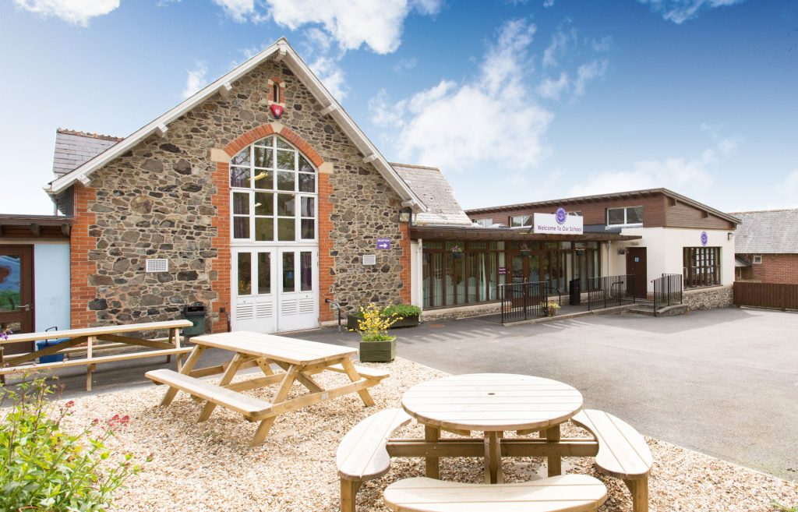

Christow Community Primary School

Slide 2
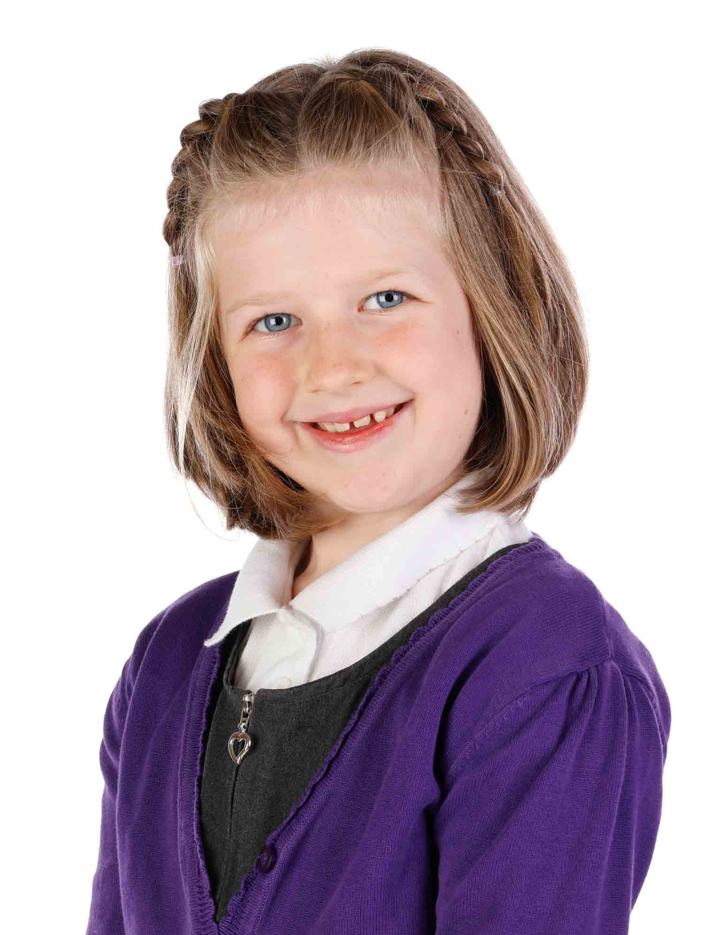
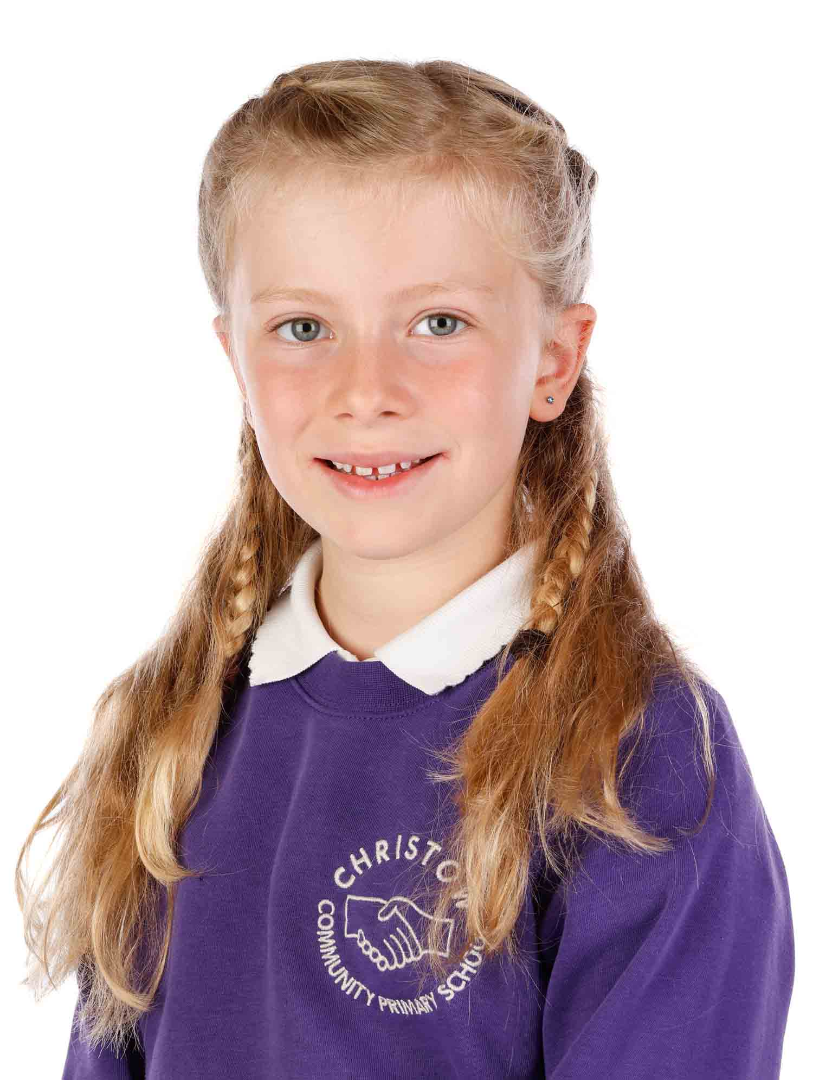
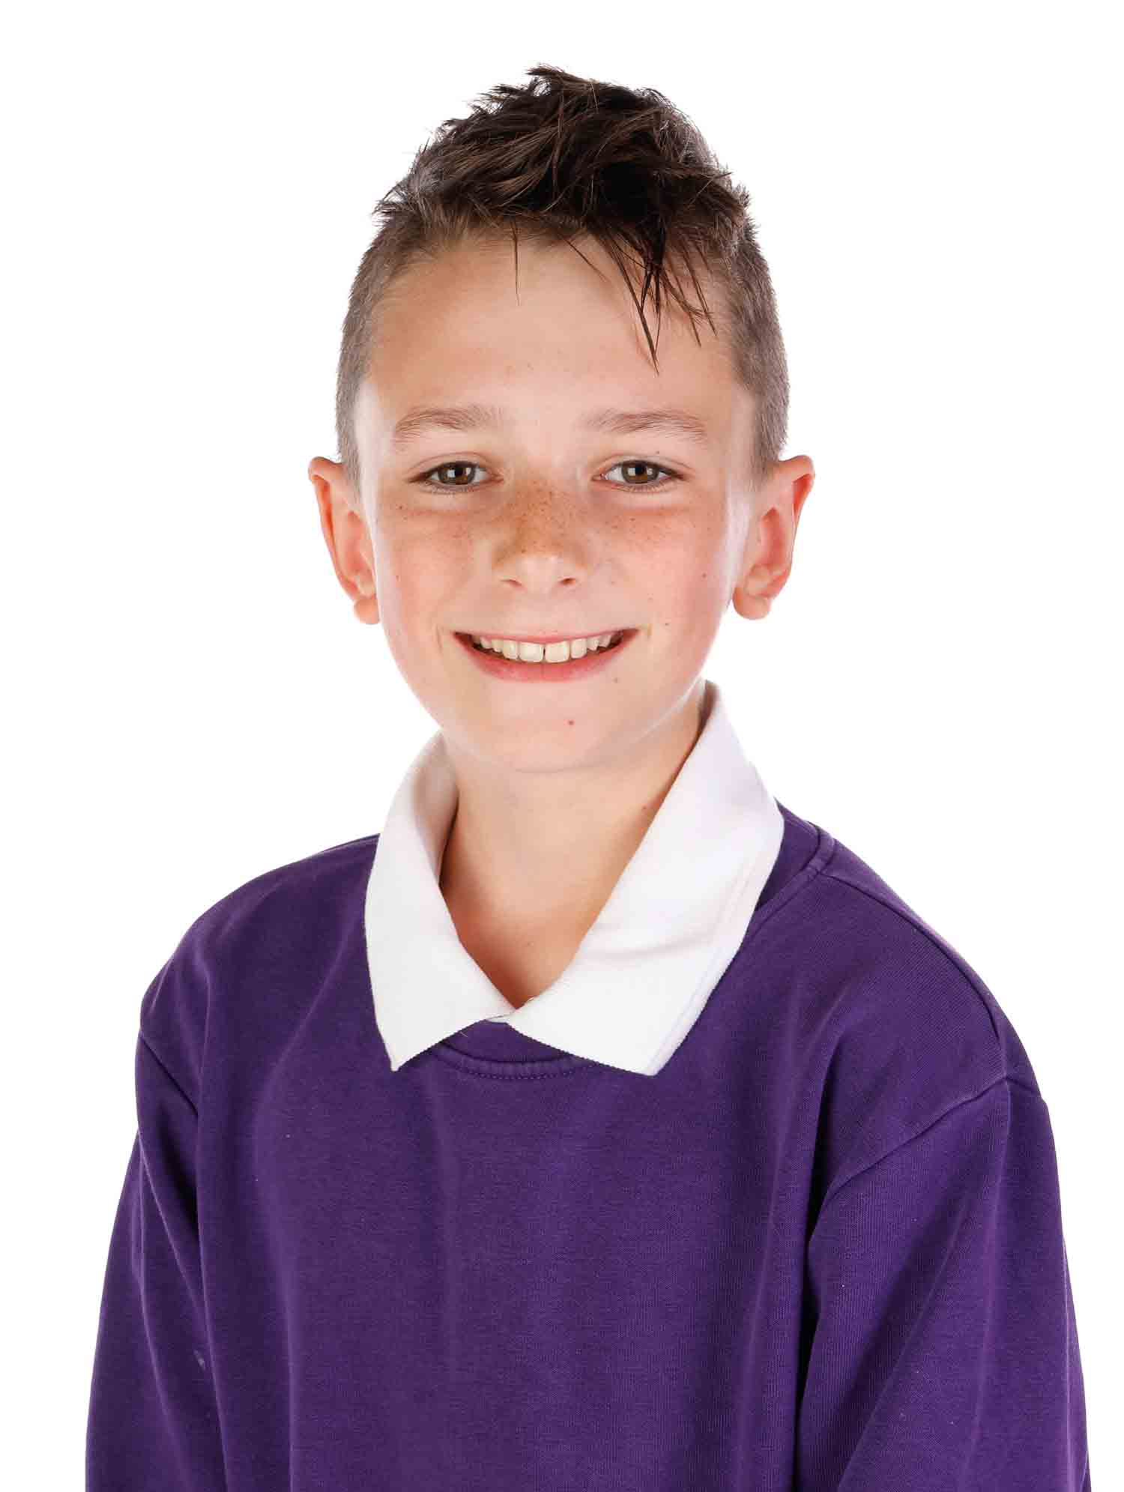
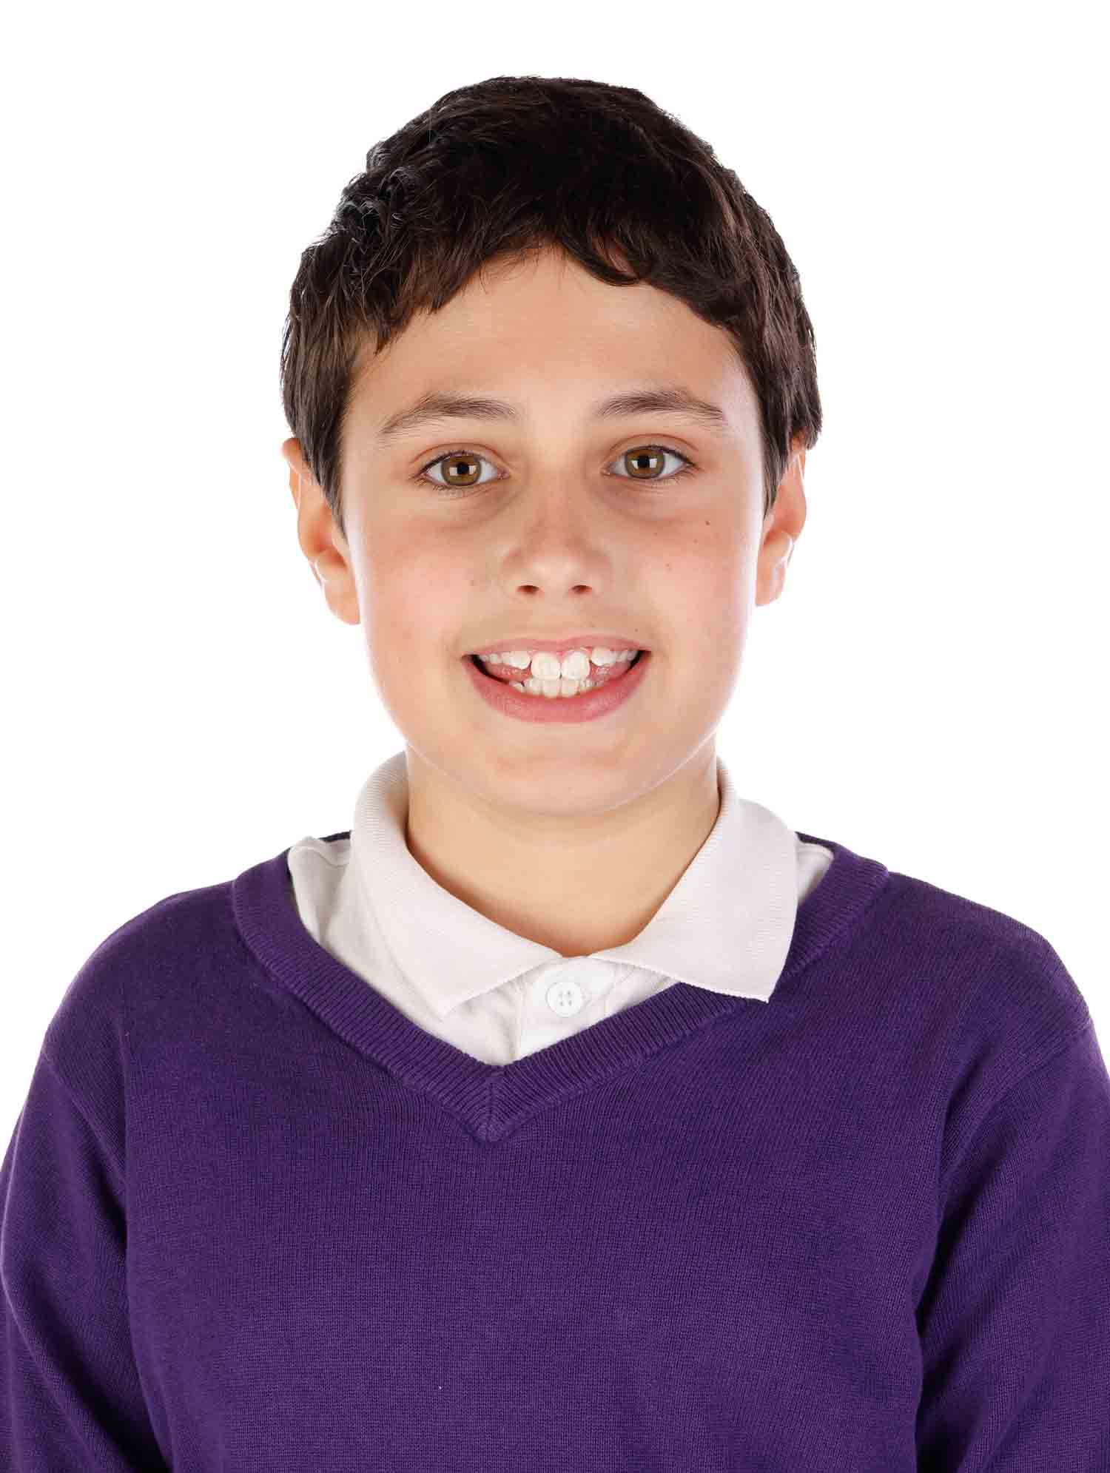
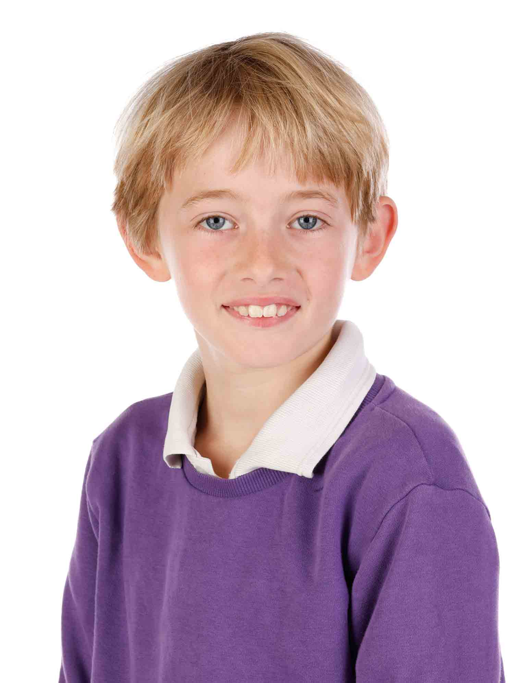
Leadership at Christow Primary School
School Council
House Captains
Rights Respecting Ambassador
Play Leaders
Community Council
Ophelia
Rights Respecting Ambassador
Etta
House Captain/ Play Leader
Ben
House Captain/ Play Leader
Fraser
School Councillor/ Play Leader
Rowan
School Councillor
Notes:
Ophelia – Hello we are from Christow Primary School. We have lots of leadership opportunities at our school including our school council….
Etta – being a house captain ….
Ben – being a play leader …..
Rowan – being a member of the community council …..
Fraser – We are going to tell you about these roles and what we do

Slide 3





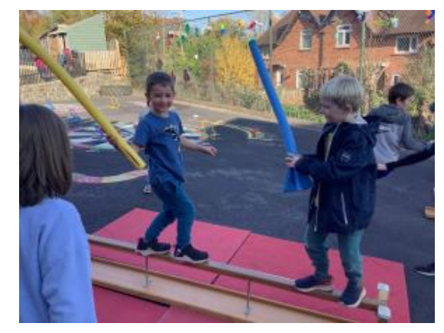
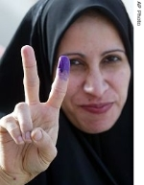

Notes:
Ophelia – I am a Rights Respecting Ambassador. This means I help teach children in our school about the UN Convention on the Rights of the Child. I support our Headteacher in assemblies each week explaining what each article means and how we can work together to make sure every child’s rights are met across the World.
For example, I talked to the school about the right to the best possible health care and the global efforts to end Polio. This then lead to our Community Council planting purple crocuses in the school grounds to raise awareness of the Purple4Polio campaign.
For Children in Need we organised a Gladiator event at playtime. The money we raised went to help children with disabilities in the UK.

Slide 4
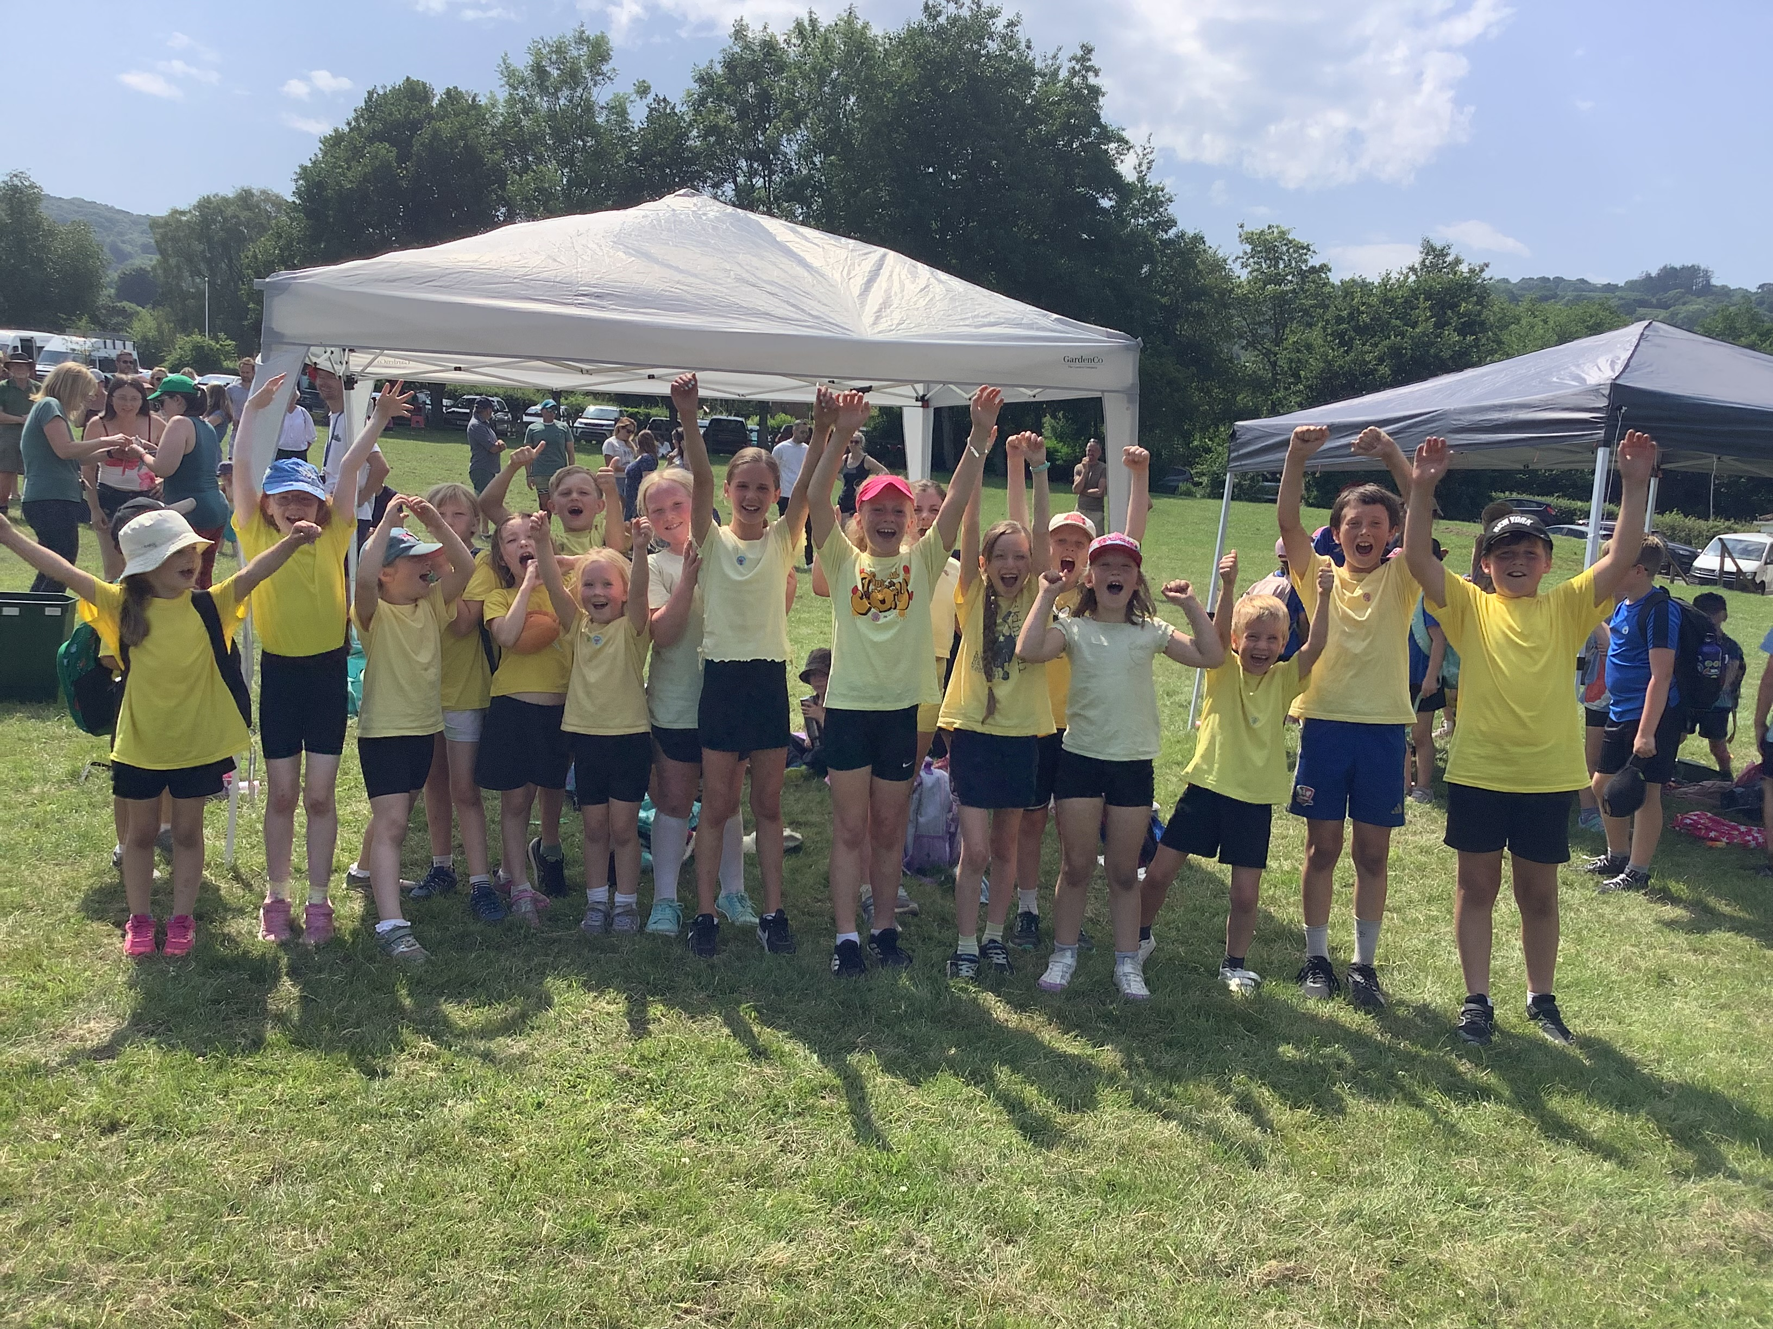
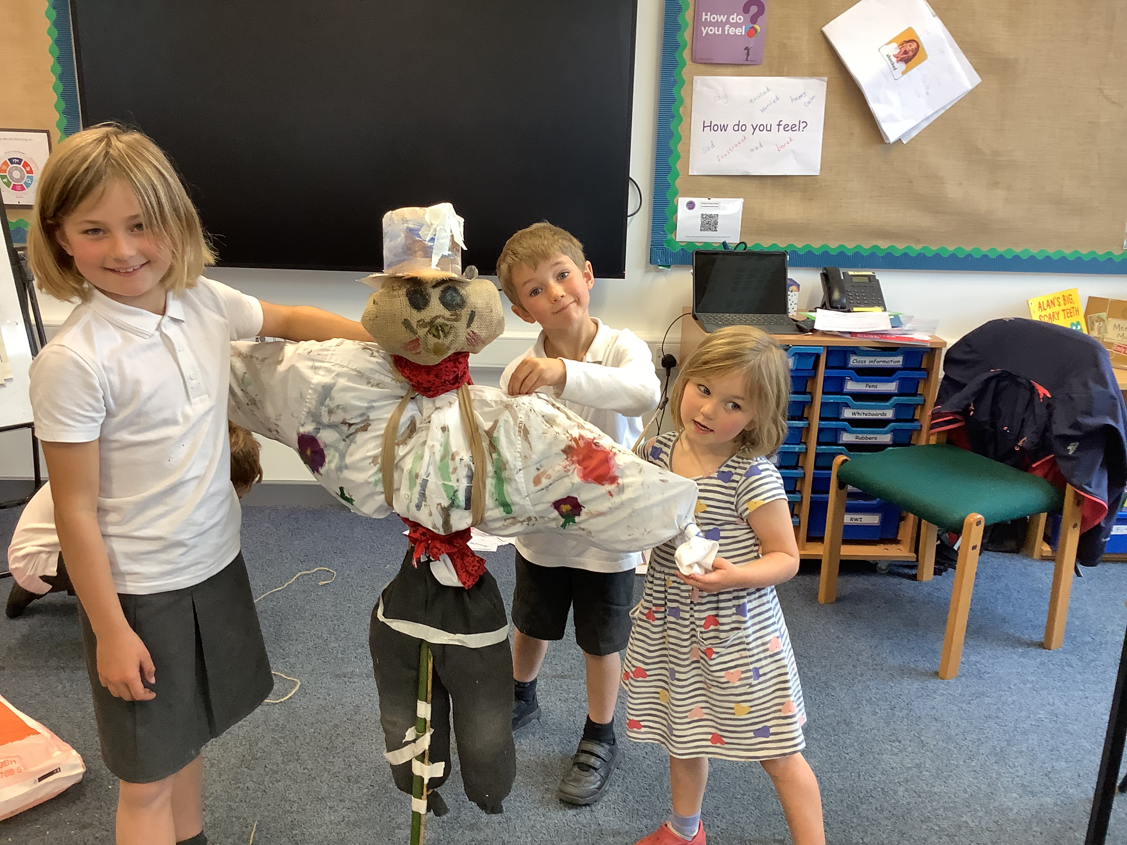
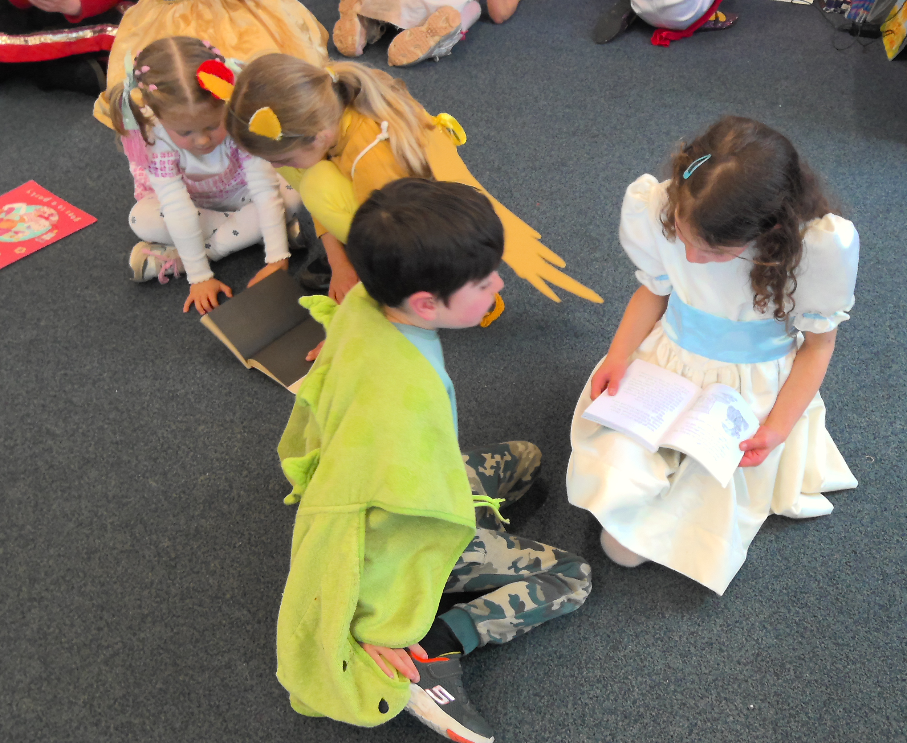
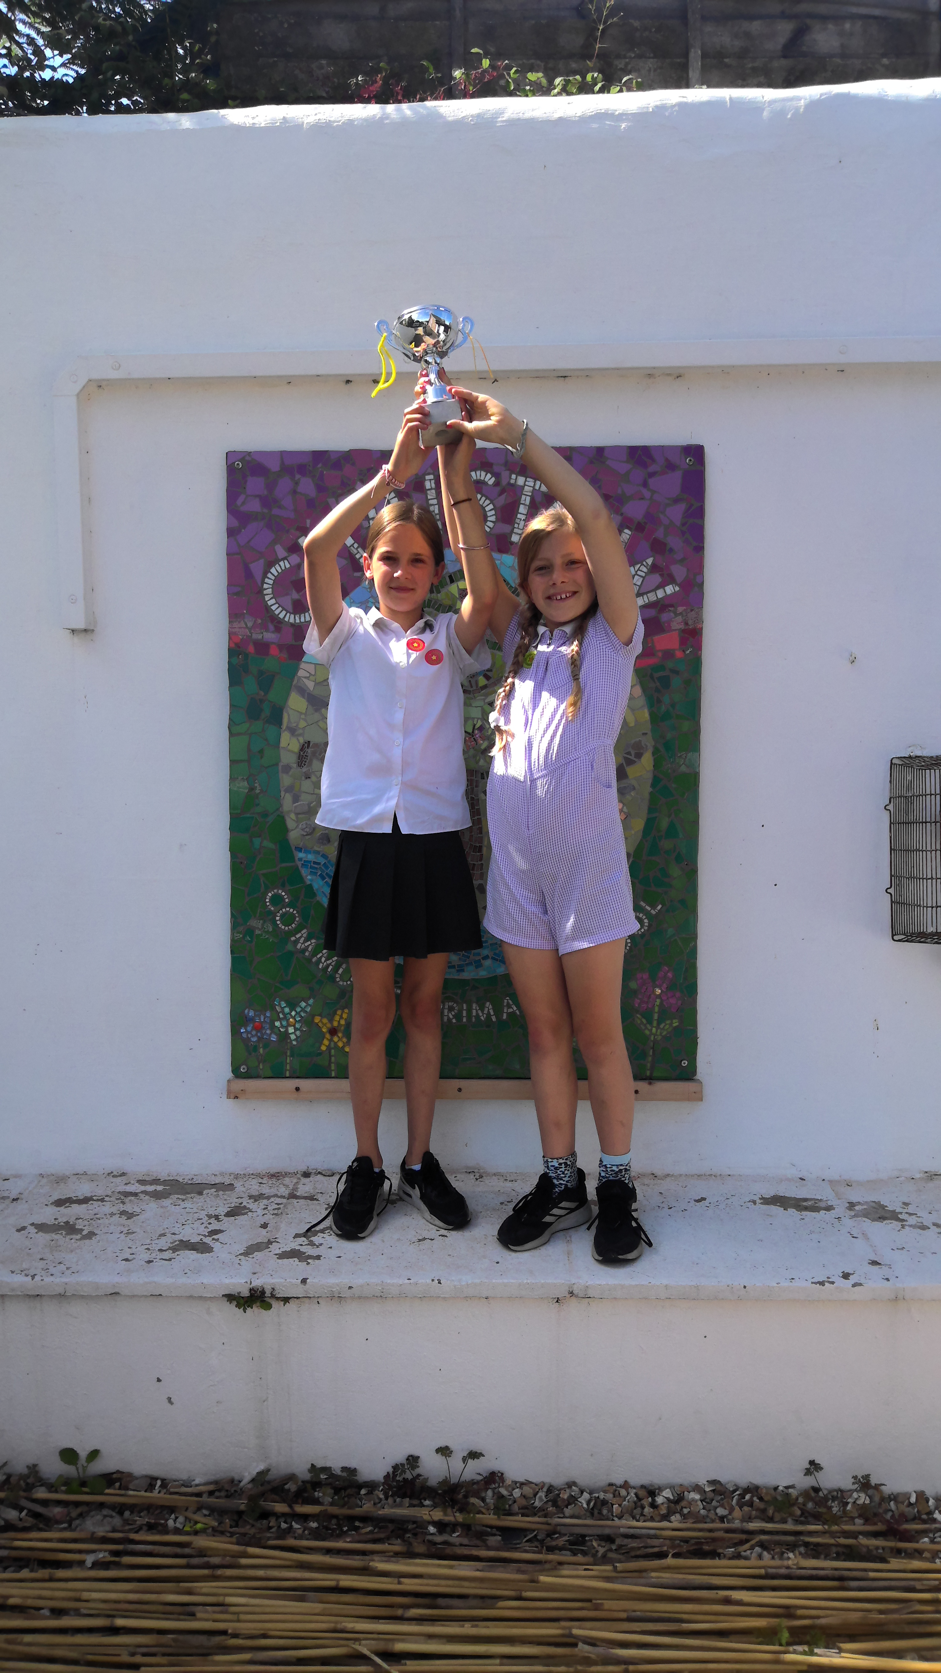
Notes:
Etta – Every child has the right to an education which develops their personalities, talents and abilities.
As a year 6 there are lots of leadership opportunities for us to take on in school. I am a House Captain and Play Leader.
In September I wrote a speech as part of my election campaign. I was voted in to become the Captain of Exe House – the yellow team.
We hold lots of events throughout the year where our Houses can work together. This has a positive impact as it allows older children to support younger ones and parents to come in and work with all their children. For example hosting a Scarecrow making afternoon for Harvest and Buddy Reading on World Book Day.

Slide 5
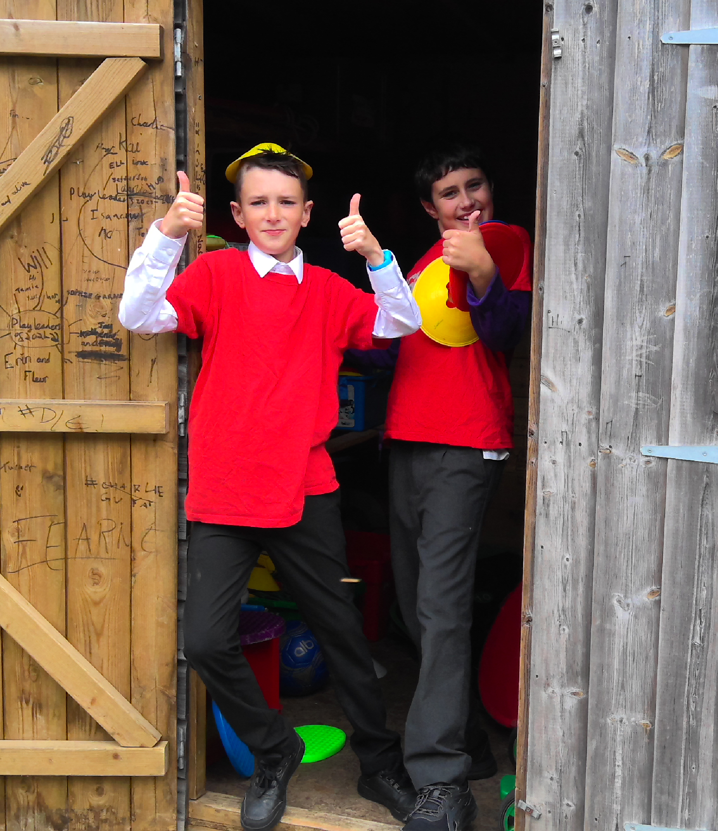
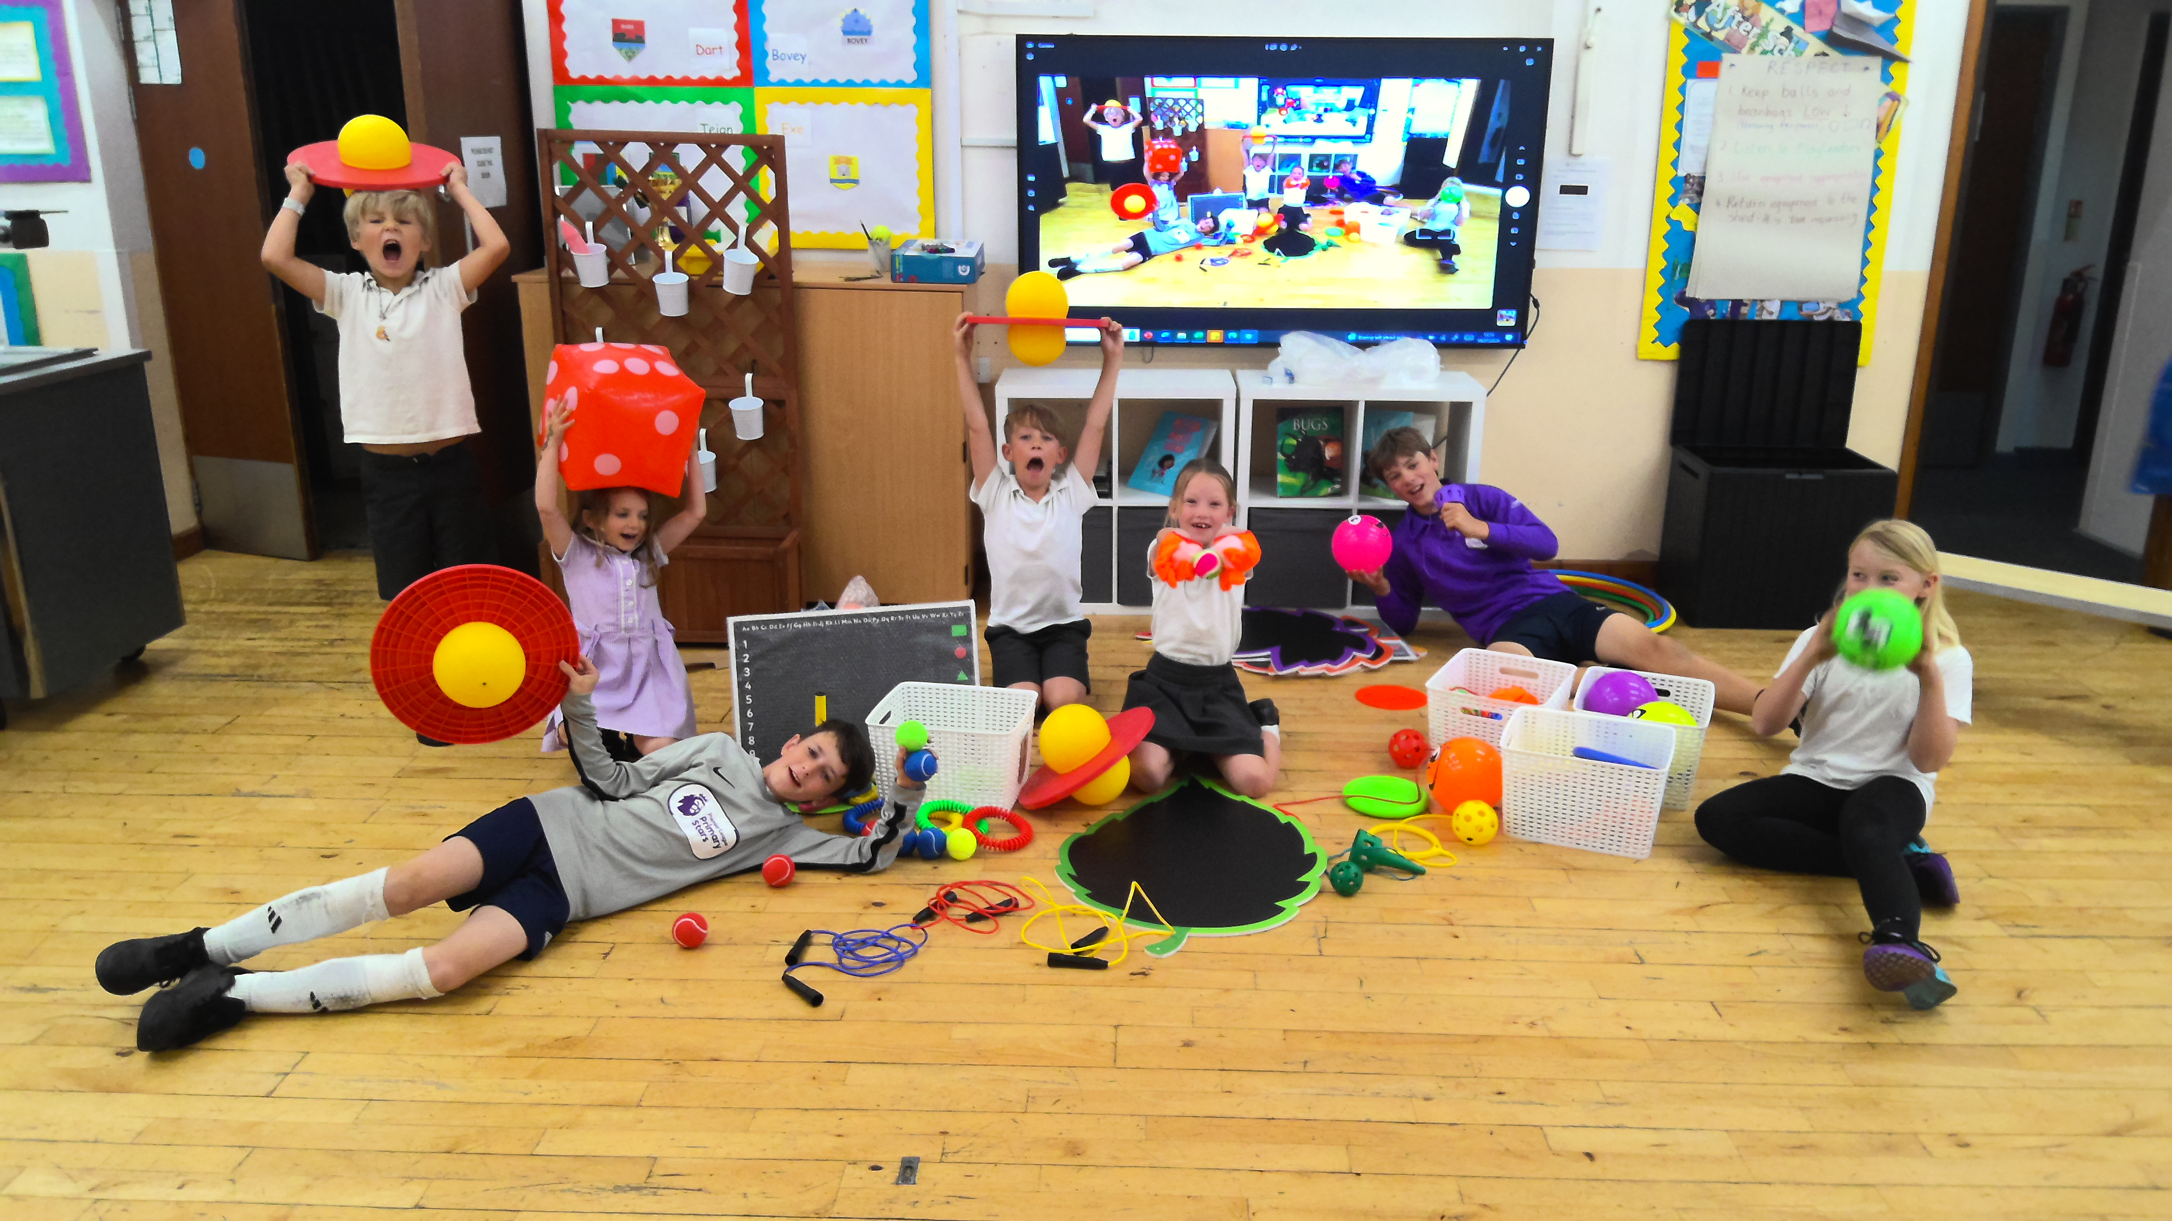
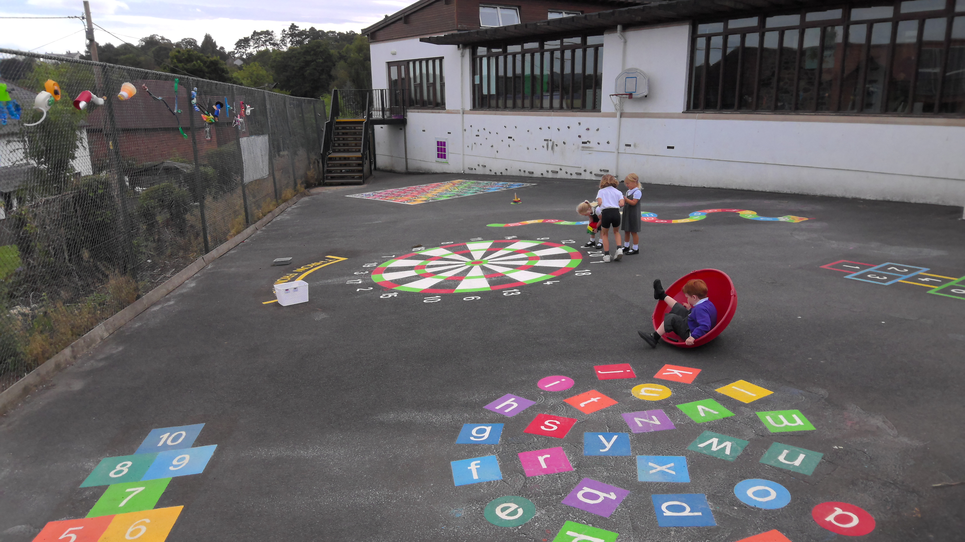
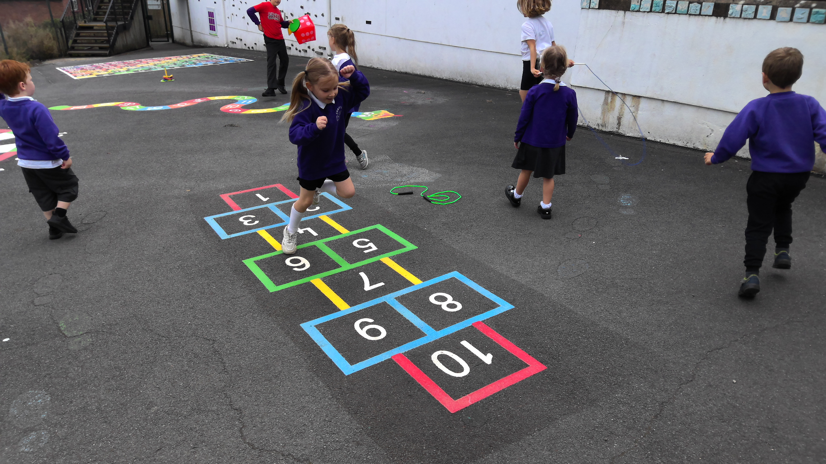
Notes:
Ben – Every child has the right to play.
As a play leader it is my job to ensure children have access to a range of games and equipment to make lunchtimes a fun and safe place to be.
Last year, we bought £500 of new equipment for the play shed and chose new marking for the bottom playground. We worked with Mr Wylie from Teign school to improve our skills as play leaders – learning new games and creating posters to ensure everyone knew the rules.

Slide 6
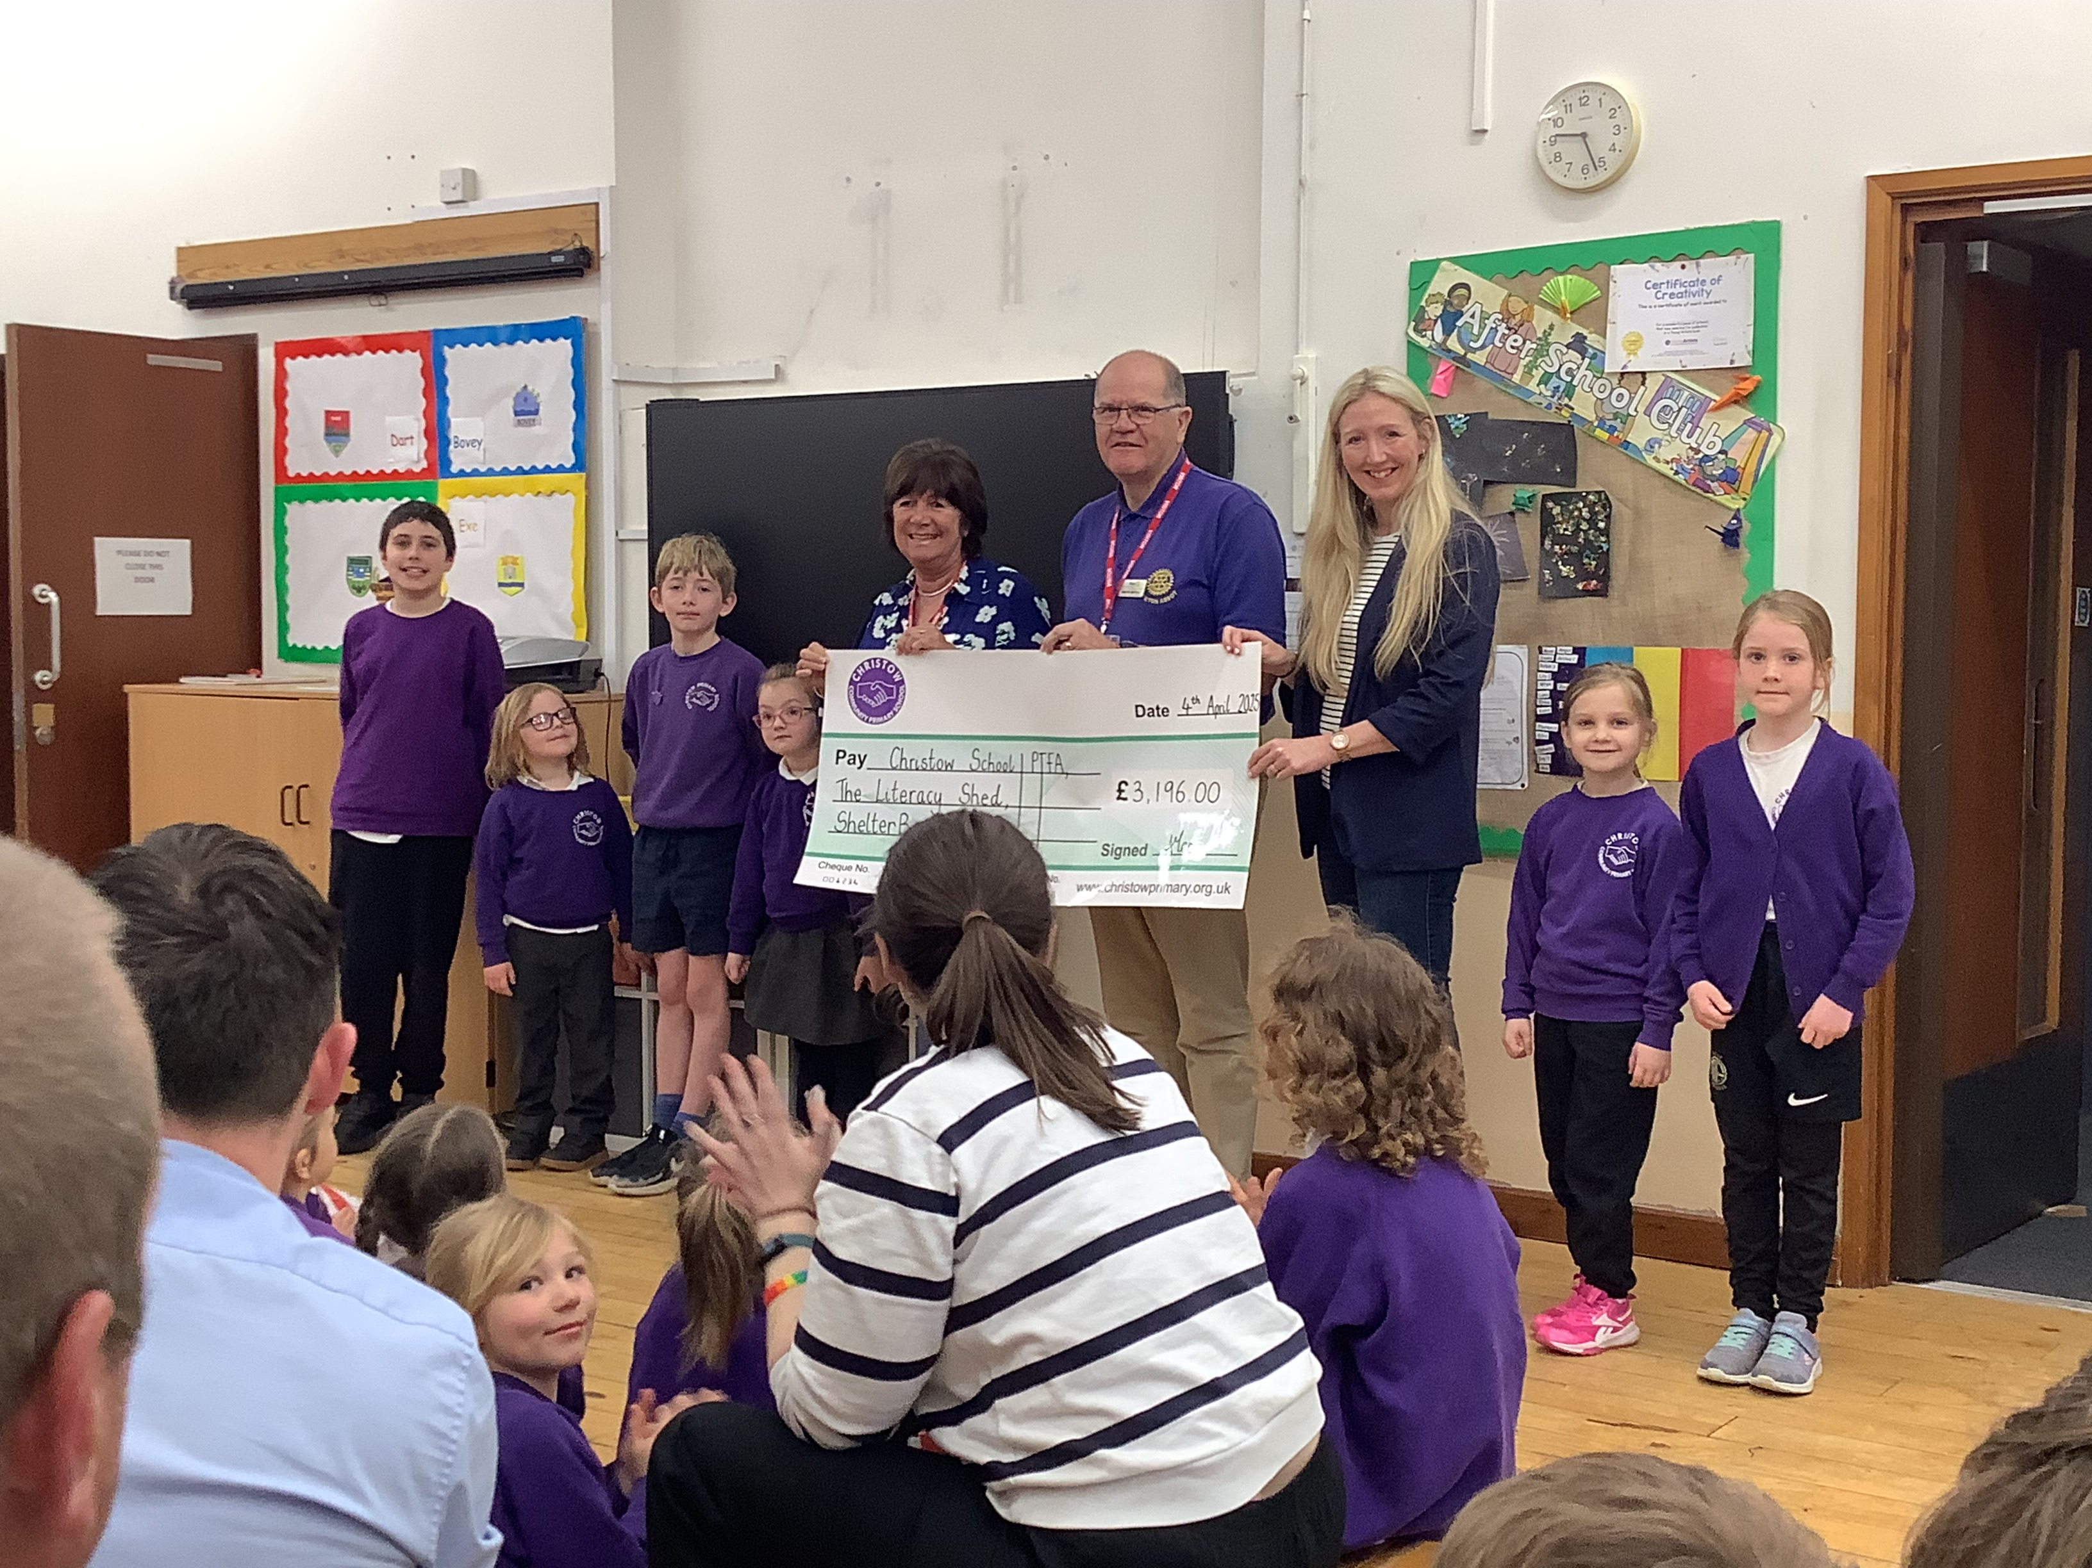
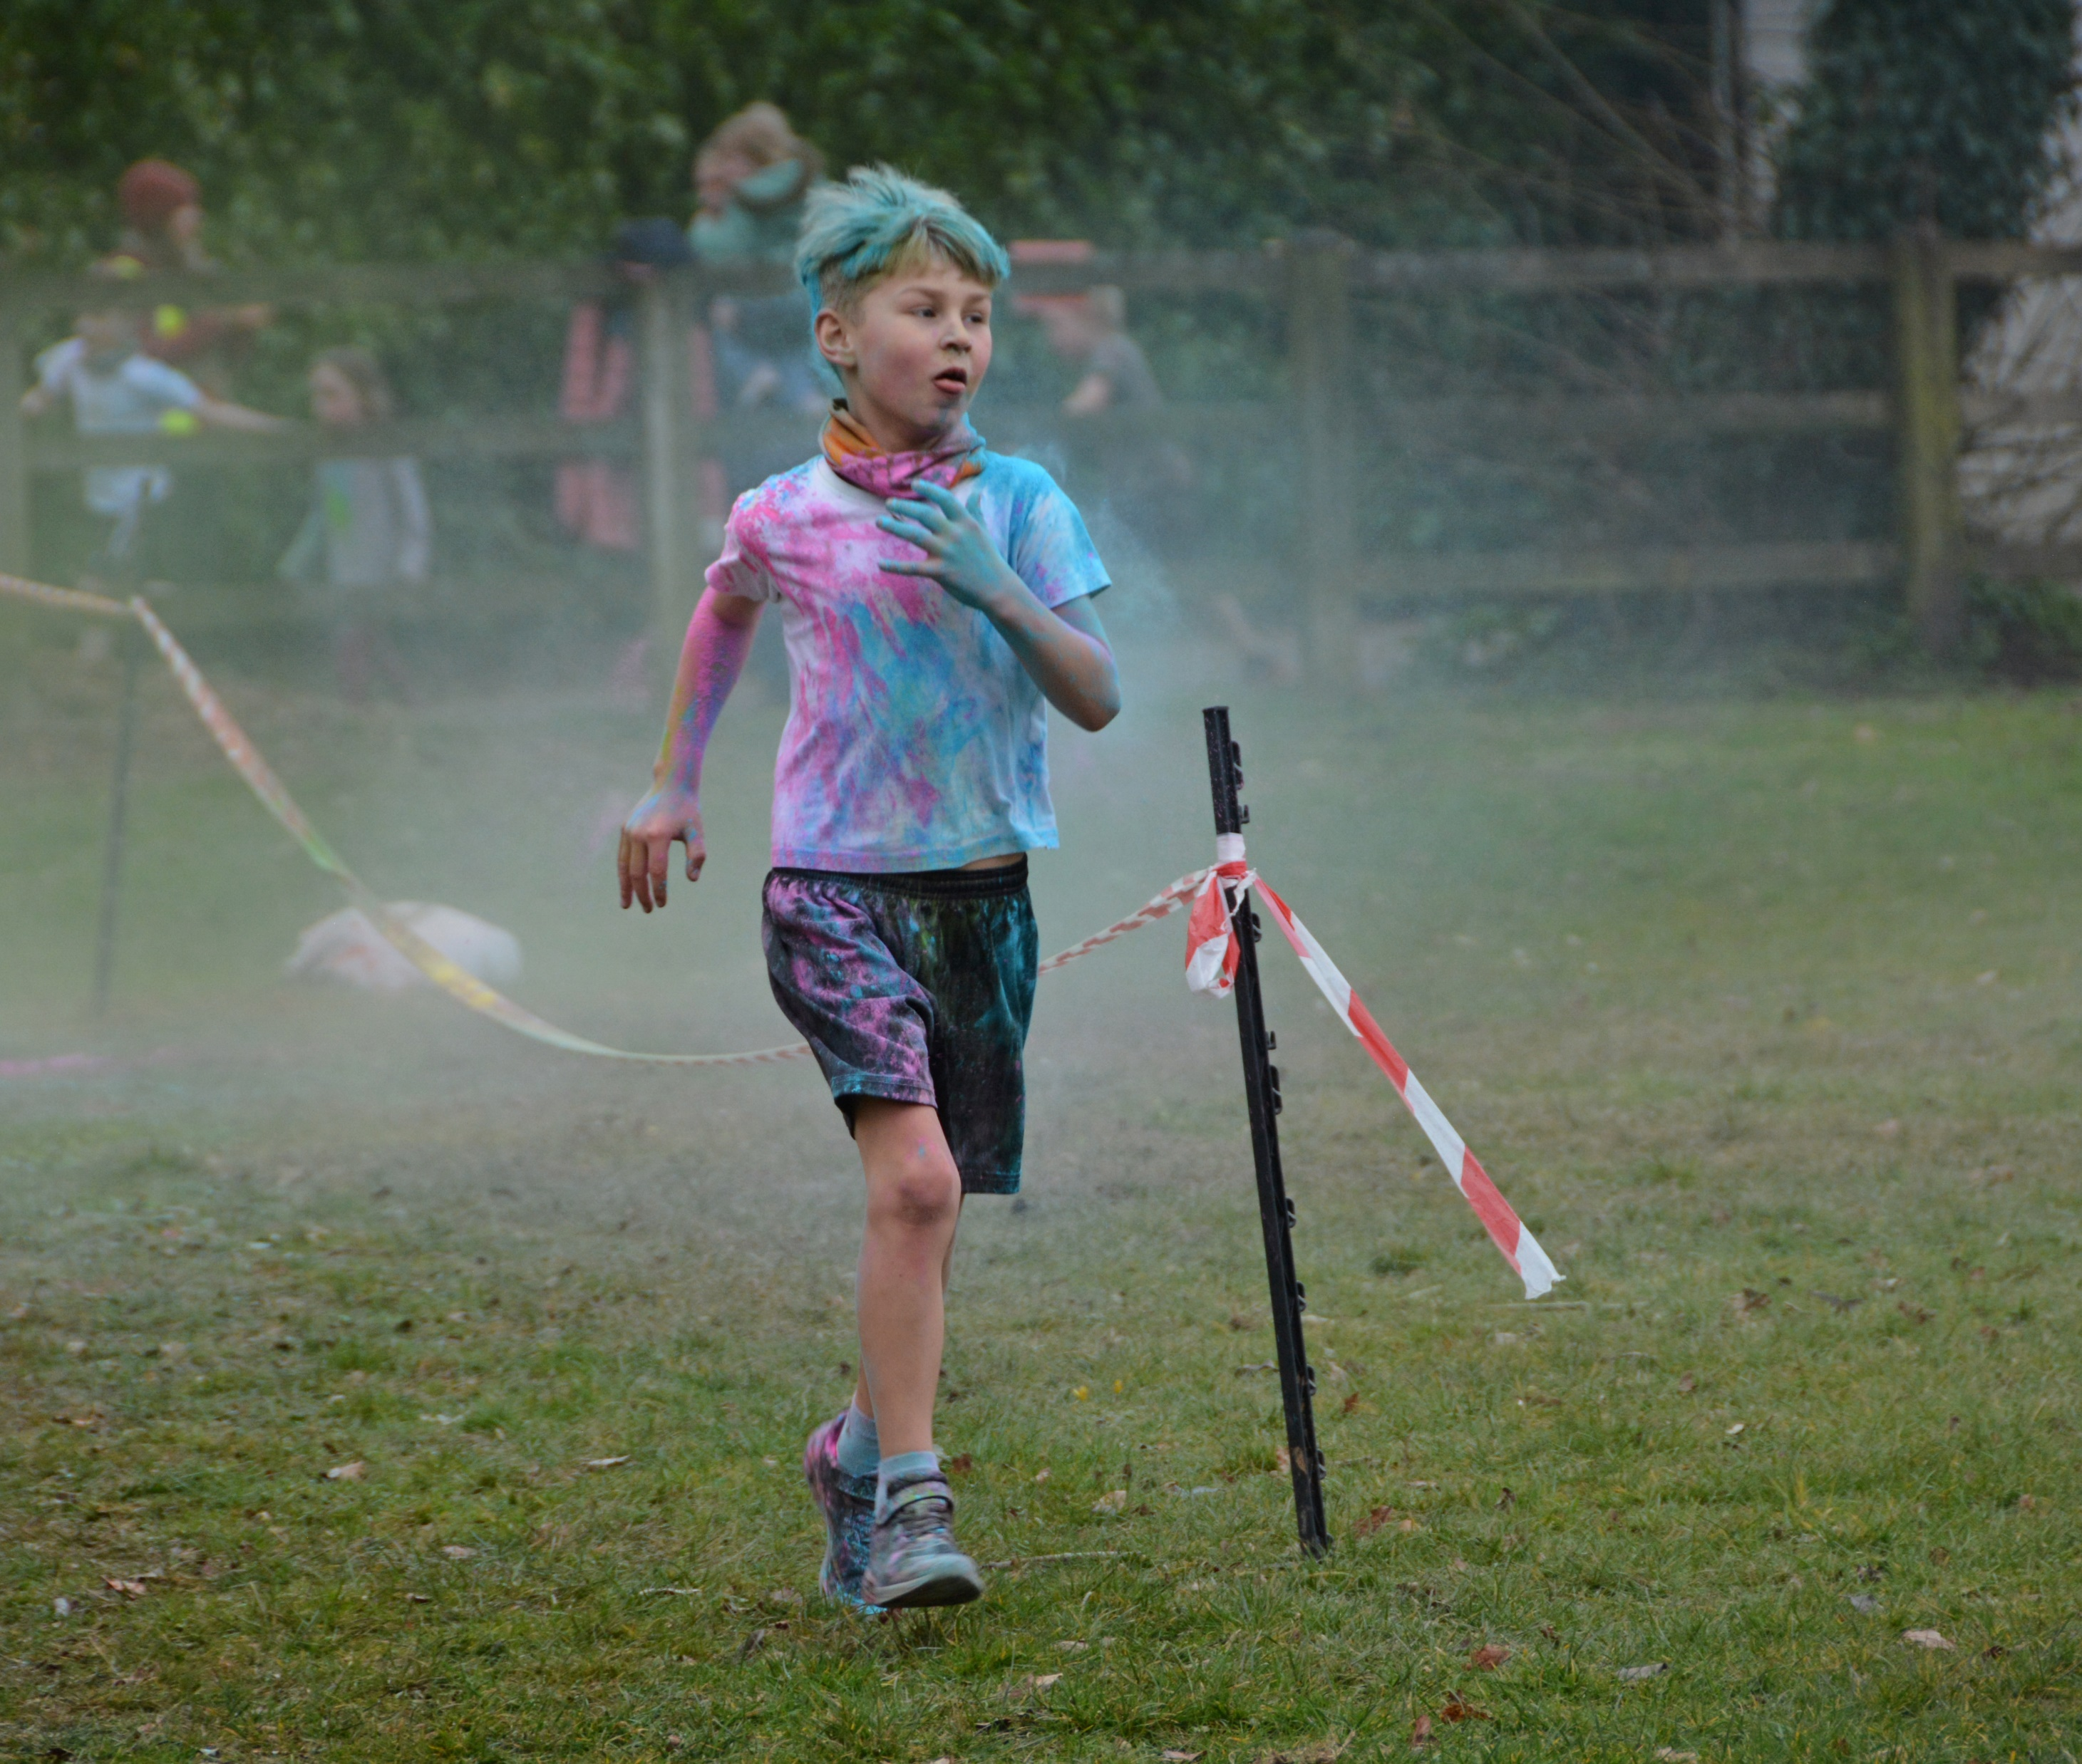
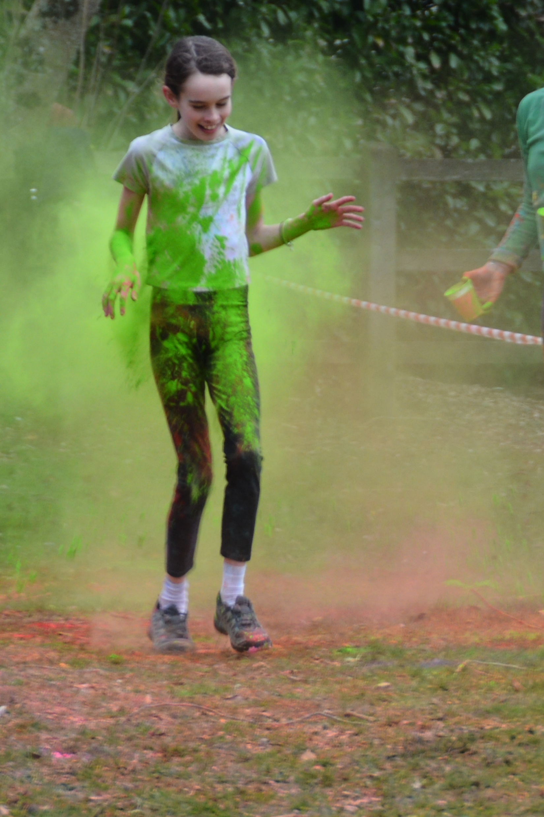
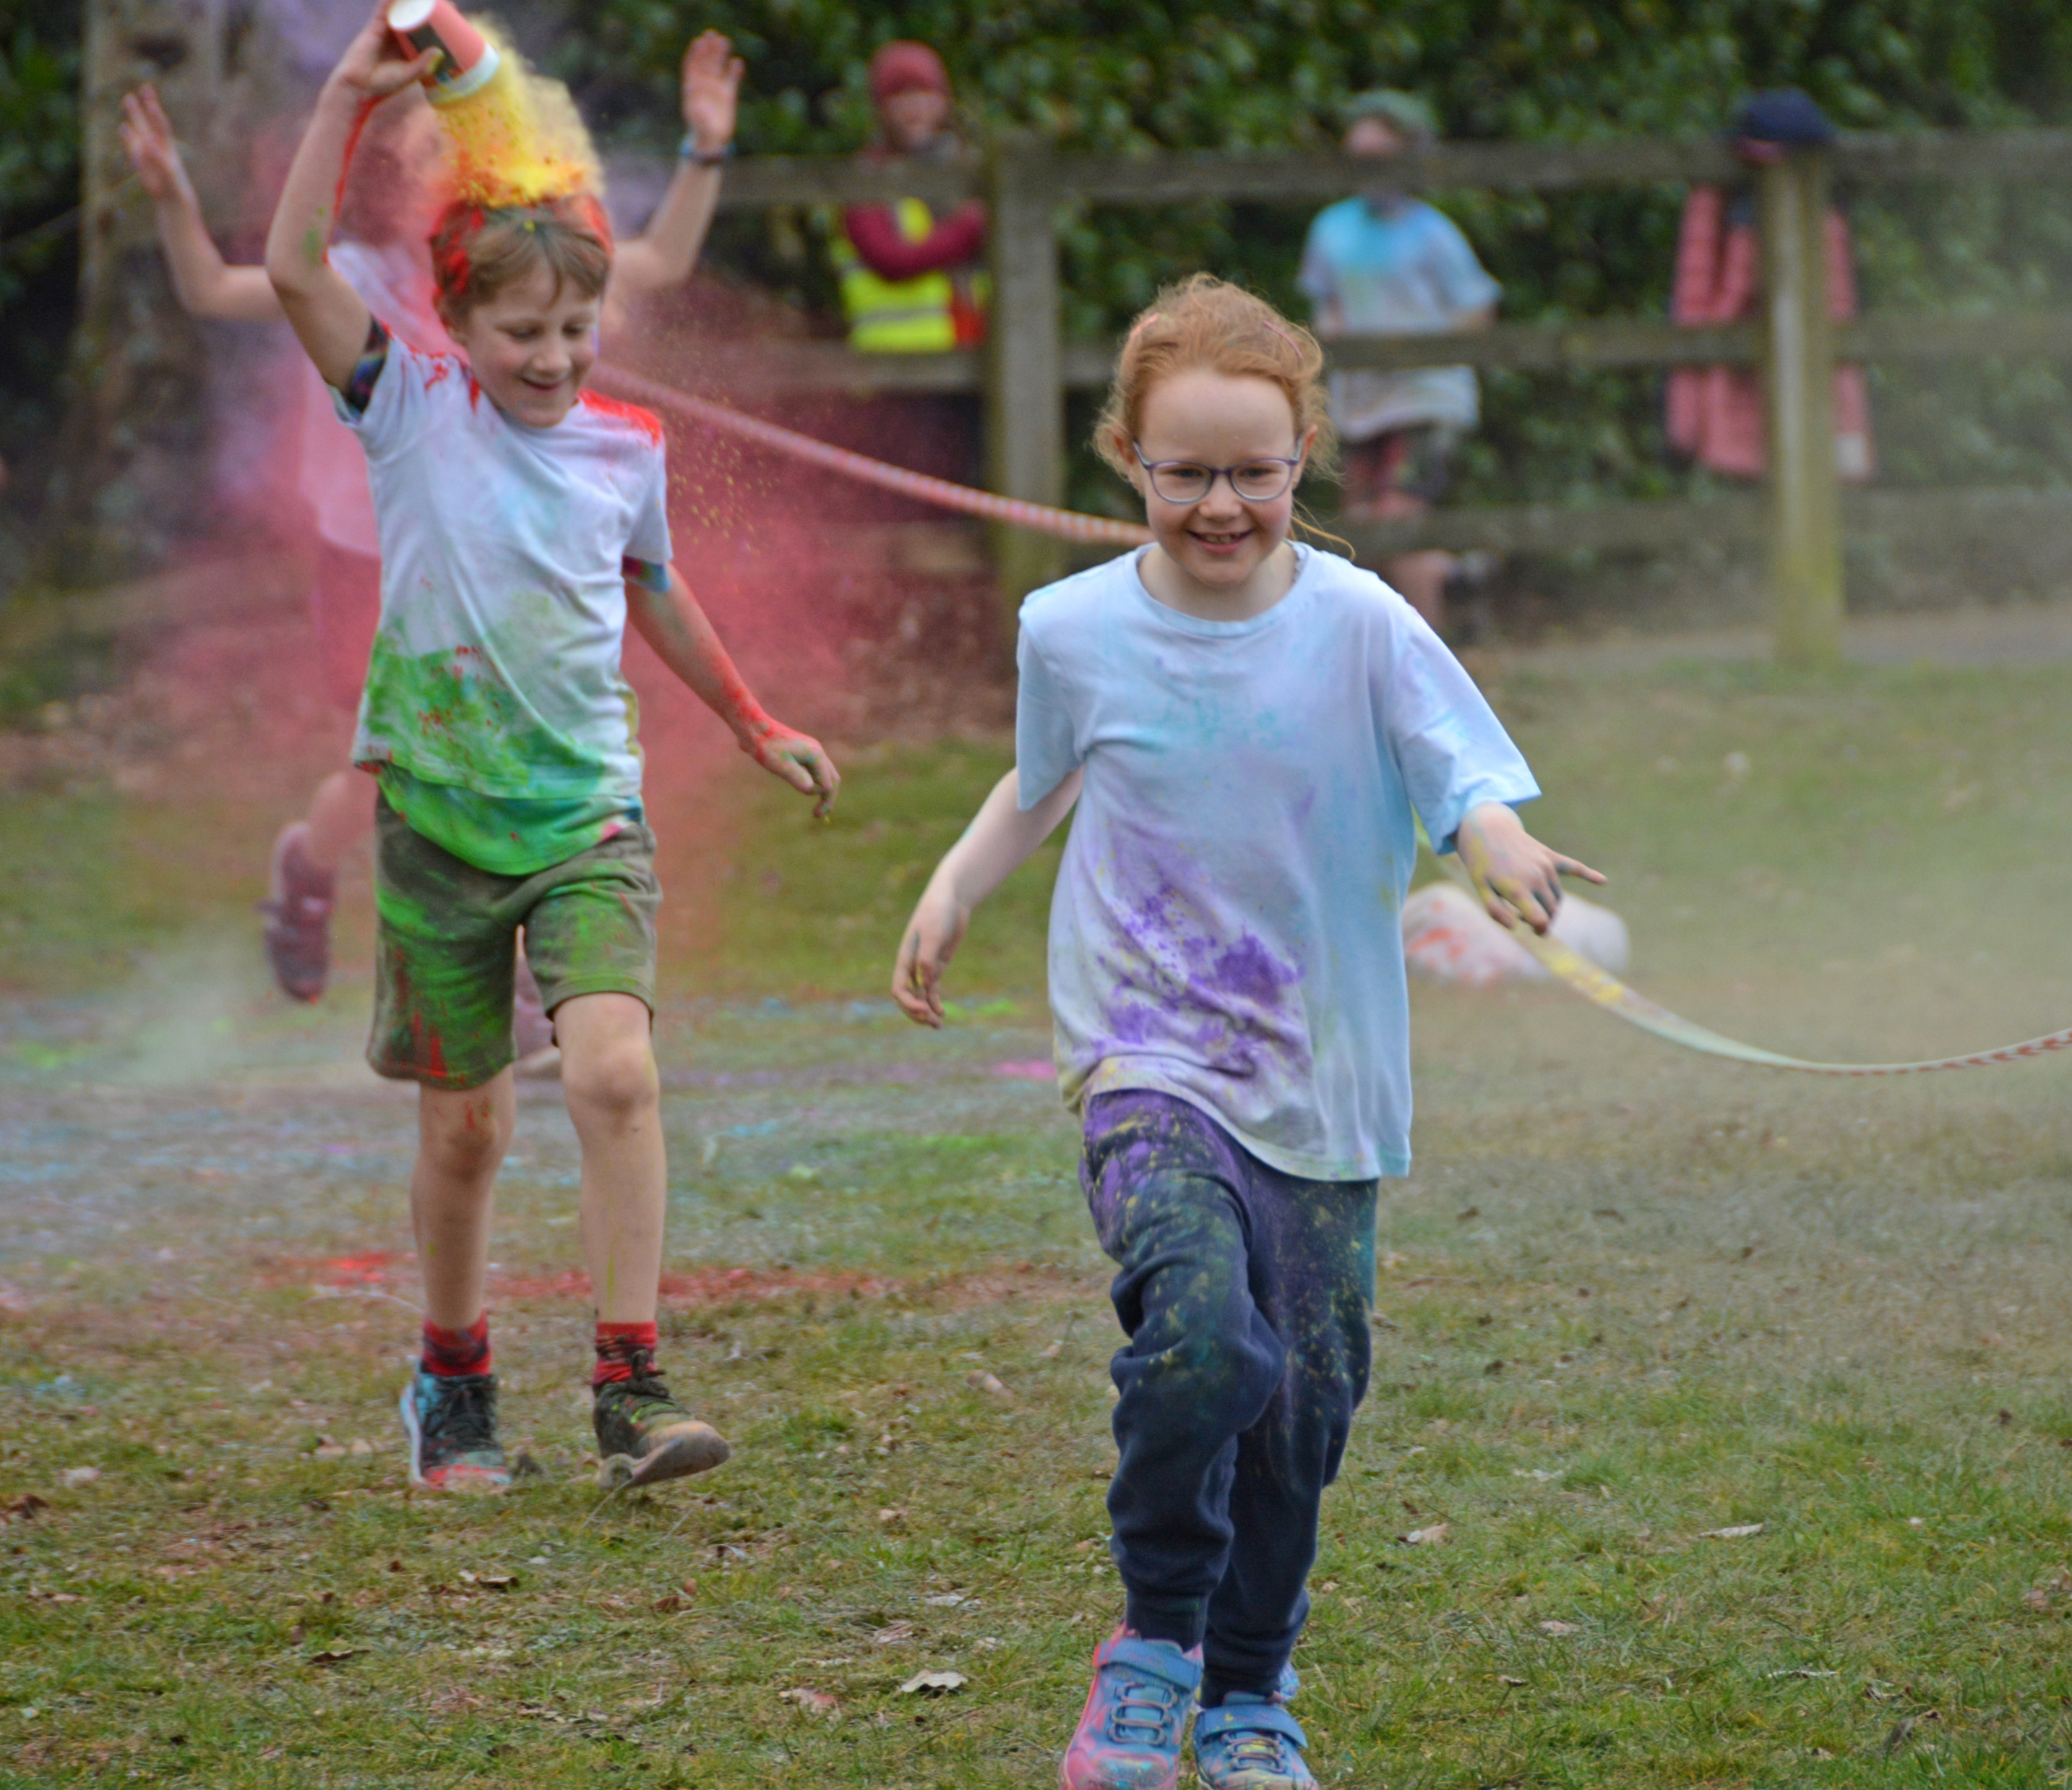
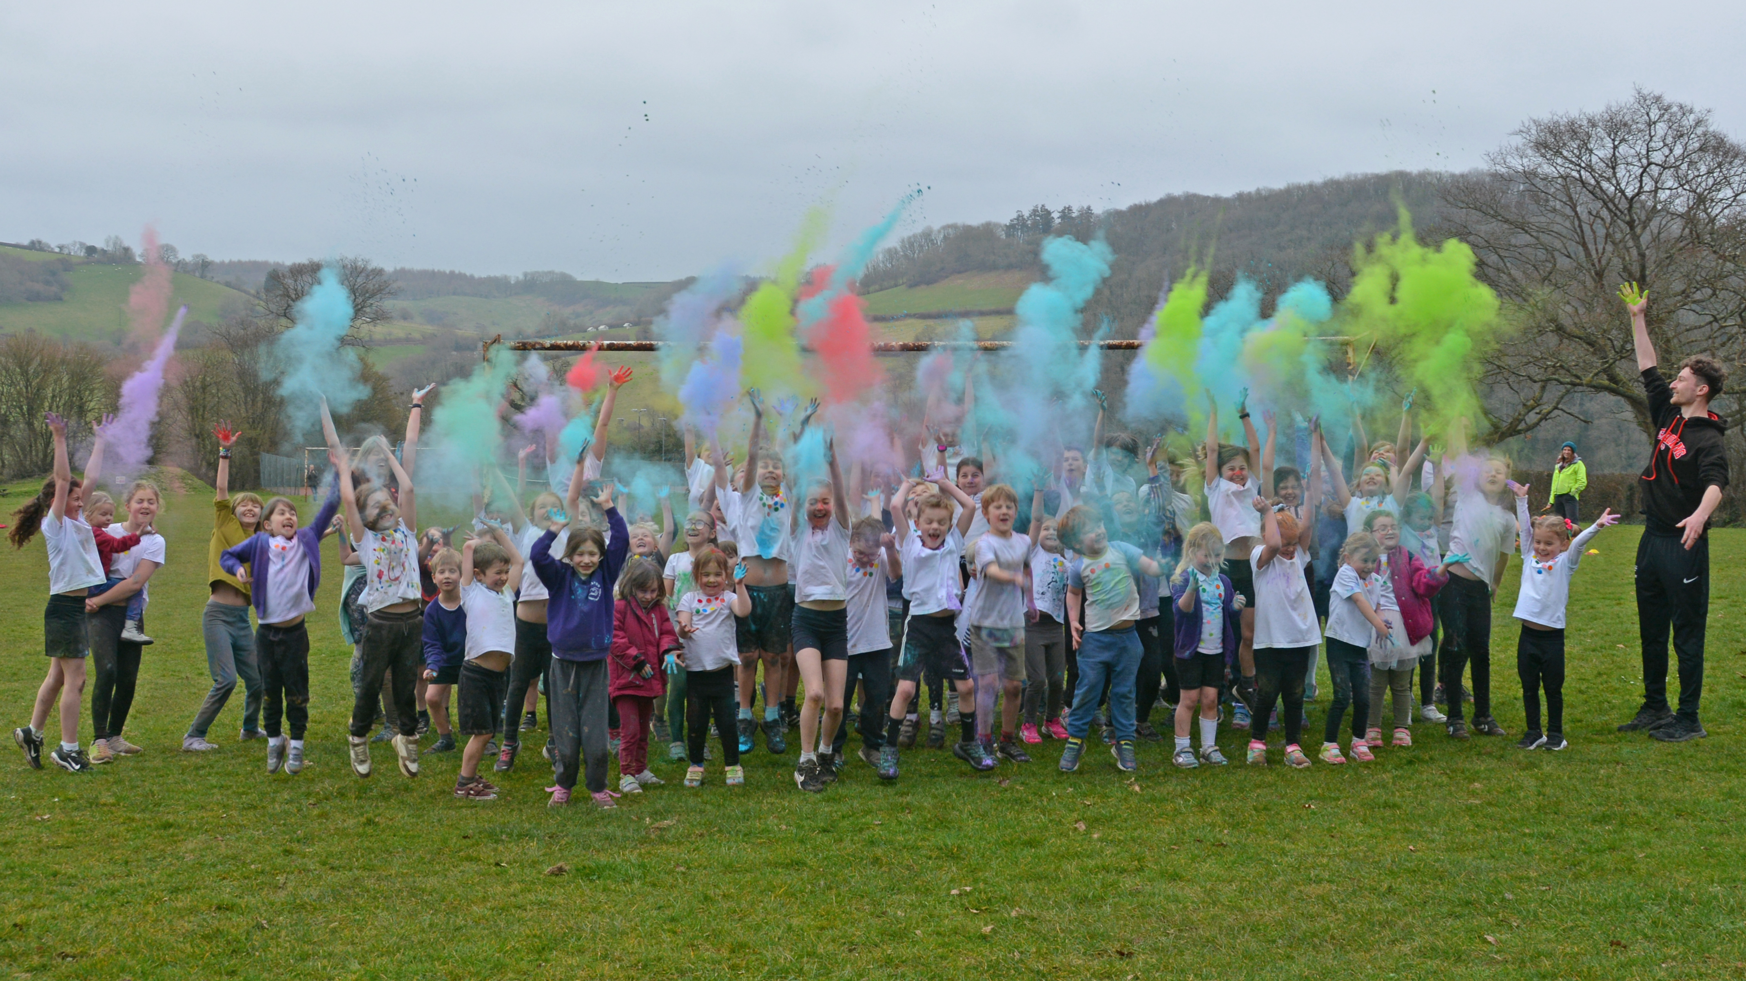
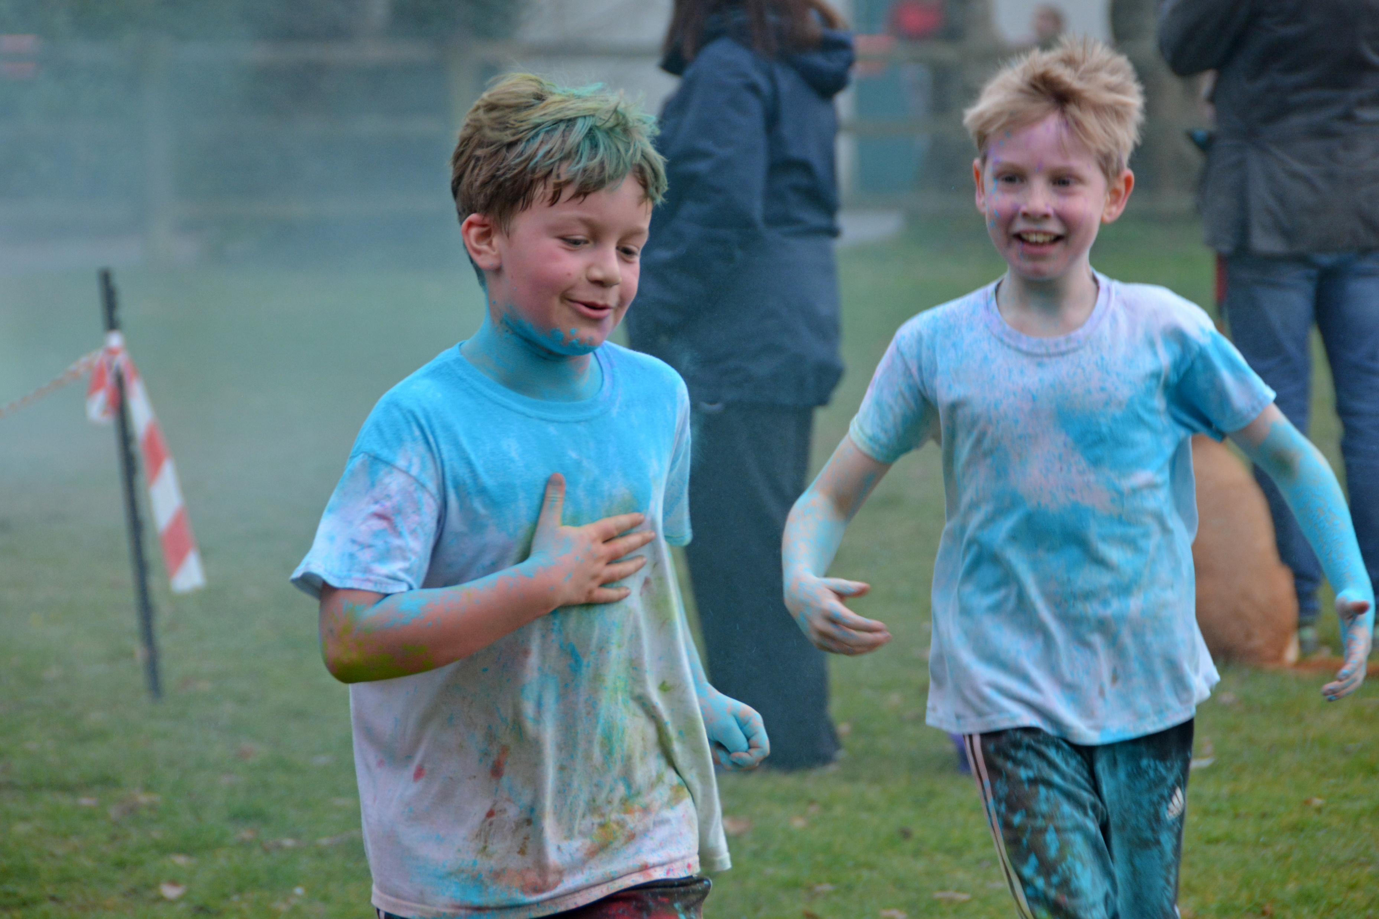
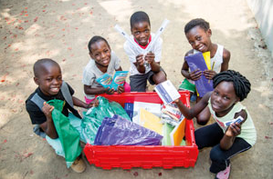
We raised £3196
“Christow Primary School have excelled themselves, as the £799 that we received from them, will enable two Literacy Boxes to be sent to the schools we work with in Zambia”
Notes:
Rowan – Every child has the right to an education
I am School Councillor and one event which I helped organise this year was a Sponsored Colour Run. The whole school took part in to run as many laps as they could around a 400m track. This event raised £3196. We decided to donate half of this to Literacy Shed, which meant two Literacy Boxes could be bought for a school in Zambia. The other half of the money will be spent on enhancing learning areas in our school, including a covered play space for Key Stage 1.

Slide 7
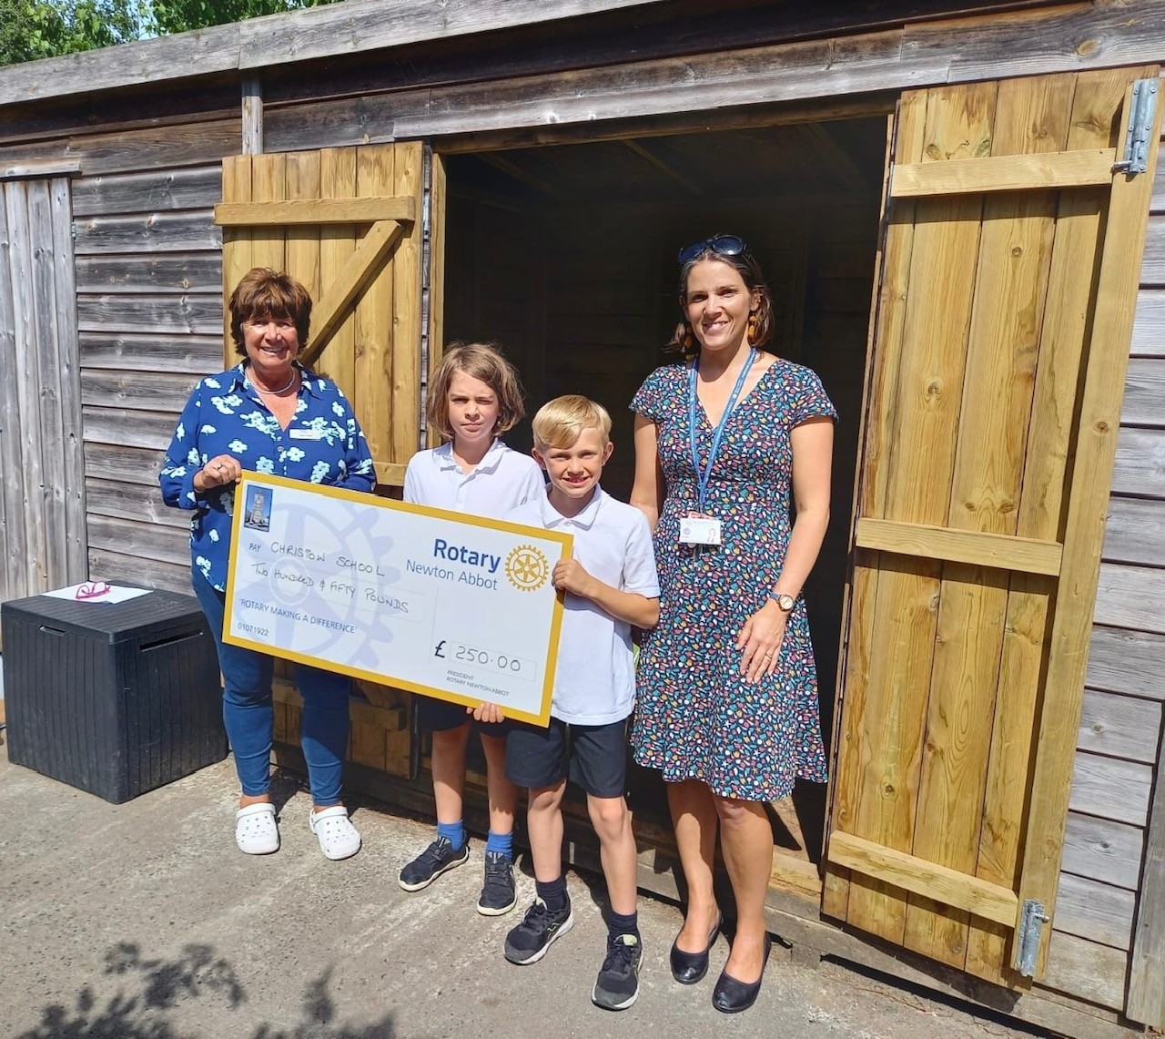
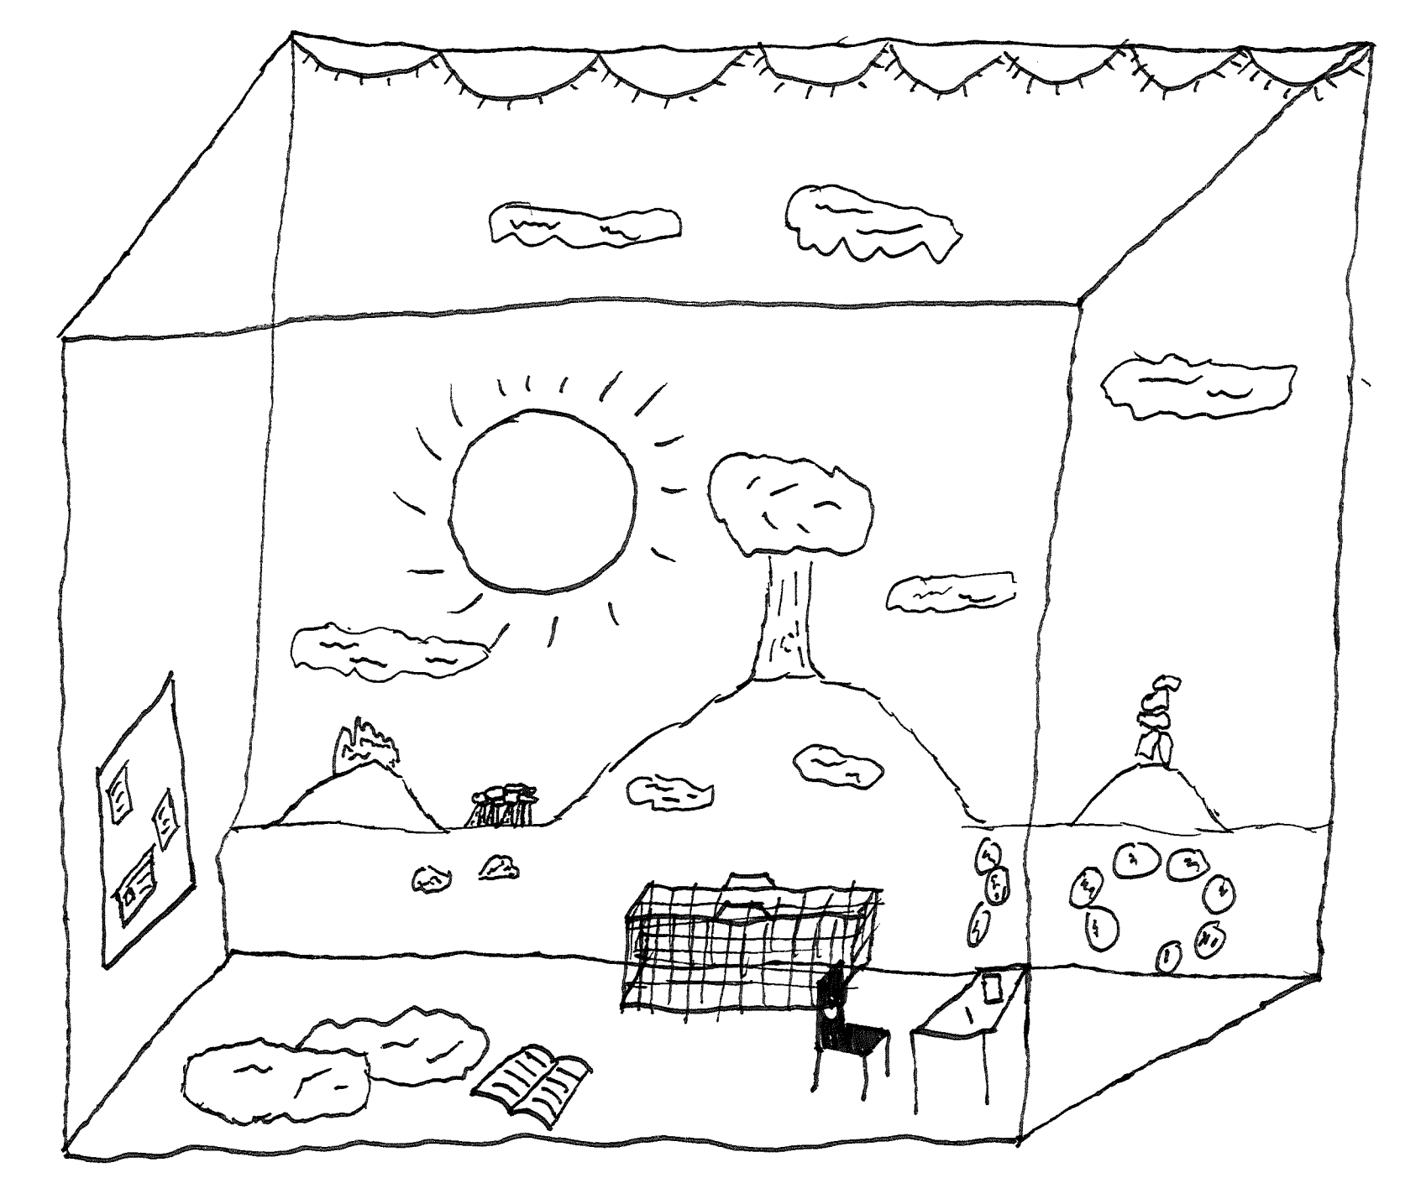
Our vision
INSERT PICTURE DRAWN BY BEN AND FRASER
Our design
Notes:
Fraser– Every child has the right to rest and relax
As a School Councillor, I have been helping to design a quiet, reading space on the playground. We have secured £250 from the Rotary Club to add furniture and decorations. This will help children who can find the noisy and busy playground more difficult. It will also promote a love of reading.
Another job the school council do, which has a big impact on the school and all the children in it, is that we help with the recruitment of new staff. We interview all the candidates and share our thoughts with the Headteacher.

