Slide 1

RSE PARENT/CARER INFORMATION

Slide 2
Key information
New guidance comes into effect in April 2021
WHY? 20 years since the last review of the curriculum – the world has changed
WHAT DOES THE GUIDANCE COVER? Relationships Education in primary schools and Relationships and Sex Education in high schools, Health Education in primary and high schools.
WHO DOES THE GUIDANCE APPLY TO? This guidance is for all primary schools including academies and faith based schools.
IS ALL CONTENT STATUTORY RSE? NO, some of the Y5 and Y6 statutory science curriculum form part of what is viewed as sex education - puberty and scientific parts of reproduction.

Slide 3
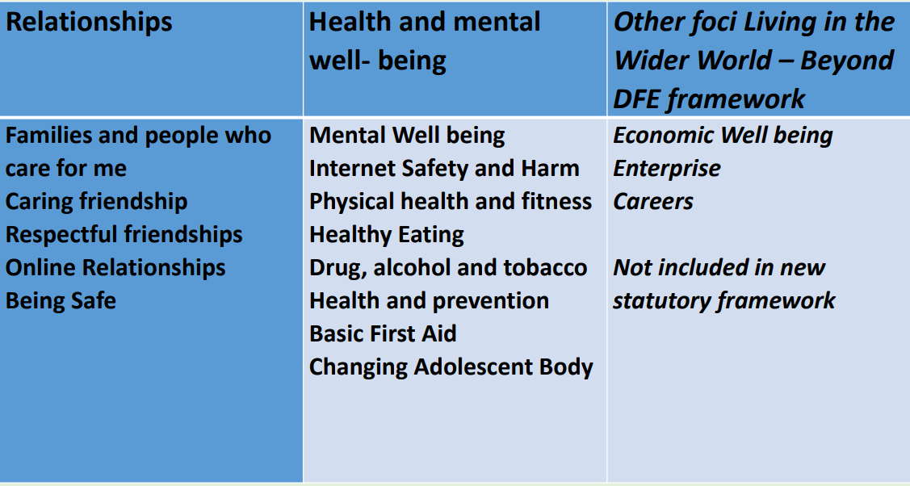
Proposed content of our curriculum...

Slide 4
We are teaching about equality....
This means that if someone is black, we include them, we show respect and tolerance; •
if someone uses a wheelchair, we include them, we show respect and tolerance;
if someone is gay, we include them, we show respect and tolerance;
Ethos of everyone is welcome in our school.
Our children will all have to interact with people from different backgrounds we want them to treat all members of the community with the same respect.
Just like racism school has a duty of care to challenge any language that may cause offence to others, whether used intentionally or not. Phrases such as “that’s so gay” or “that’s a girls/boys toy” when used in a negative manner may unintentionally cause offence to a child or adult. School will challenge this language

Slide 5
The Equality Act (2010)
The Equality Act 2010 states that it is against the law to discriminate against anyone because of: • Age • Disability • Gender reassignment • Marriage or civil partnership • Pregnancy or maternity • Race • Religion or belief • Sex/gender • Sexual orientation (Government, 2010, p1)
The public sector Equality Duty came into force on 5th April 2011 and requires that public bodies (including schools): • Have due regard to the need to eliminate discrimination • Advance equality of opportunity • Foster good relations between different people when carrying out their activities. (Government Equalities Office 2013, p1)
This makes it clear that promoting some of the protected characteristics of the Equality Act while ignoring others is against UK law.

Slide 6
Right to Withdraw...
Relationships, Health Education, including Mental Health are statutory and parents cannot withdraw their child from these lessons. Parents also cannot withdraw their child from aspects of RSHE/Relationships Education which are covered as part of the statutory science curriculum.
• Sex Education is not statutory in primary schools. Many primary schools already choose to teach some aspects of sex education and will continue to do so, although it is not a requirement.
• In Year 6 we choose to teach aspects of sex education (which go beyond the national curriculum for science), we will consult with parents on what is to be covered.
• Year 6 parents have the right to withdraw their children from these lessons. The guidance refers to this as granting an automatic right for parents to withdraw their child from sex education lessons

Slide 7
LGBT inclusion in the RSE curriculum
•The draft guidance states that schools should ensure that all of their teaching is sensitive and age appropriate in approach and content.
At the point at which schools consider it appropriate to teach their pupils about LGBT, they should ensure that this content is fully integrated into their programmes of study for this area of the curriculum rather than delivered as a stand‐alone unit or lesson. Schools must consult parents when deciding what content will be covered
Schools are free to determine how they do this, and we expect all pupils to have been taught LGBT content at a timely point as part of this area of the curriculum.
LGBT inclusive lessons are covered as part of Relationships Education, therefore parents cannot withdraw their children from these lessons. Parents cannot veto these lessons

Slide 8
Rationale
The intended outcomes of our programme are that pupils will:
• know and understand the characteristics of positive relationships, with particular reference to friendships, family relationships, and relationships with other children and with adults.
• understand they have a right to personal space and boundaries, showing respect and understanding the differences between appropriate and inappropriate or unsafe physical touch. Recognise and know how to report abuse, including emotional, physical and sexual abuse
• understand they have a responsibility to treat each other with kindness, consideration and respect including when on line, permission seek and give and understand the concept of privacy
• develop the skills of being able to express their emotions and seek help where needed, to build friendship and recognise how this can support mental well being
• develop the personal attributes of honesty, integrity, courage, humility, kindness, generosity, trustworthiness and sense of justice, and character traits such as perseverance, working towards long term goals, dealing with setbacks, resilience permission seeking and giving, and the concept of personal privacy
• understand how the Equality Act 2010 relates to them as a child and through adult life, to recognise and challenge any form of discrimination

Slide 9
Our Scheme
St John the Baptist Primary school has chosen to follow the Cambridgeshire PHSE scheme of work. The overview of this scheme is on our website.

