Slide 1
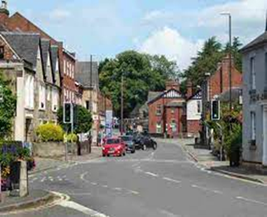

Curriculum Overview
William Gilbert Endowed Church of England Aided Primary School
Curriculum Overview For Parents
Term: Summer 1 2026 |  | Mrs Reed
Theme: ‘Who Lives Here?’ (Local Study)
Curriculum Overview
Mathematics | English | Geography
Unit 11 Multiplication and Division Counting in 2s, 5s and 10s Finding equal groups. Adding equal groups Arrays Making doubles Grouping and sharing Unit 12 Fractions Recognise and find half of a shape Recognise and find half of a number Recognise and find a quarter of a shape. Recognise and find a quarter of a shape. Unit 13 Position and Direction Describe turns Describe position – left/right, forwards/backwards, above/below Ordinal numbers Unit 14 Numbers to 100. Counting from 50 to 100 Counting in 10s to 100 Partition numbers into 10s and 1s Using a number line to 100. One more/less Comparing numbers to 100 | Fiction (Traditional Tales) Features of traditional tales Good characters Bad characters Story language (Once upon… and they all lived….) Problem Good overcomes bad and the problem is resolved. Hansel and Gretel Little Red Riding Hood The Three Little Pigs The Three Billy Goats Gruff Goldilocks and the Three Bears | Duffield is a village, Belper is a town and Derby is a city. Human features of Duffield include a school, church and park. Physical features of Duffield include a river, hill and trees. England is one of four countries in the United Kingdom. London is the capital city of England. England, Scotland, Wales and Northern Ireland are the four countries of the United Kingdom. The United Kingdom is an island surrounded by seas and oceans. The North Sea, Irish Sea, English Channel and the Atlantic Ocean surround the United Kingdom.

Slide 2
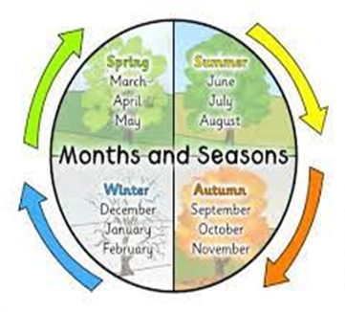
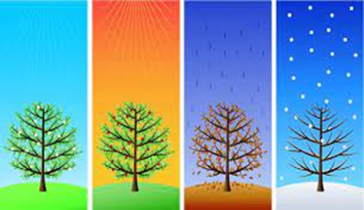
Curriculum Overview
William Gilbert Endowed Church of England Aided Primary School
Curriculum Overview For Parents
Term - Summer 1 2026 |  | Mrs Reed
Theme: ‘Who Lives Here?’ (Local Study)
Curriculum Overview
RHE | Design Technology | R.E
Recognise some of the needs of babies and younger children. Begin to recognise ways in which we are the same as and different from other people. Identify the range of groups that people belong to. Begin to know how democracy works. To discover what money is and how it helps us. To consider ways to keep coins safe. | Explore stability by balancing. To explore wide or narrow bases by building towers. To test a structures stability with weight added to different places. To design a stable structure that meets the needs of the user. To use a variety of cutting and joining techniques to make a stable product. | Everyone is valuable and unique. The Golden Rule for everyone is to ‘treat others how we would like to be treated’. At the Jewish festival of Sukkot, people spend time living outside to remember the Israelites escape from Egypt. The Good Samaritan tells us how to be a good neighbour to everyone. Tzedakah is the Jewish idea of charitable giving to those in need. This is to help make the world a better place.
Science | Computing – Digital Painting | P.E - Orienteering
Identify and name a variety of common wild and garden plants, including deciduous and evergreen trees. Identify and describe the basic structure of a variety of common flowering plants, including trees. Discuss and observe changes across the four seasons. Observe and describe weather associated with the seasons and how day length varies. | Create pictures by drawing, painting, photographing and using computers. Different tools on the computer can create different lines, shapes and colours. Artwork can be created using computers. | Understand what it means to work in a team. Work within a team to achieve an objective. Understand how to solve a problem. Recognise key landmarks on a map. Follow instructions from a map. Following directions and working as a team.
Things to look for and do at home/Any other information
We have been counting in 2s, 5s and 10s using a resource on the BBC website, please could your child have an extra practice counting in 5s https://www.bbc.co.uk/teach/supermovers/articles/zhbm47h Please make sure library books are signed off ready to change each Friday. Remember to log your child’s reading progress in the front of their reading record books, comments/feedback is checked each Tuesday when a new reading response is added. Creative Homework Ideas https://www.bbc.co.uk/bitesize/topics/zkvv4wx/articles/zyfhxbk https://www.bbc.co.uk/bitesize/topics/zkvv4wx/articles/z3kbydm Create a seasons/calendar wheel to show the relationship between the seasons and months. Produce a piece of artwork to show seasonal change. Go on a walk, look out for common and wild plants, can you identify them? Take some photographs to make a poster Use the computer to create a piece of digital art linked to our topic. Make a leaflet/poster to advertise Duffield, you could add headings ‘Places to visit’ ‘Places to eat’ ‘Things to do’ to list physical and human features. Please can work be brought into school by Monday 11th May (or before!) to receive a FREE STAR!!!

