Slide 1
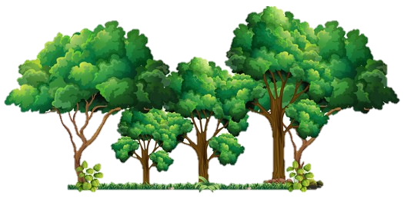
Curriculum Overview
Term: Summer 2
Class: Year 2
William Gilbert Endowed Church of England Aided Primary School
Curriculum Overview For Parents
Term – Summer 2 2026 |  | Year: 2
Theme: The Enchanted Wood
Class: Blue | Miss Hill
Curriculum Overview
Term: Summer 2
Class: Year 2
English | Mathematics | Science
Writing Newspaper report Letter writing Non-chronological report about woodland animals Reading Identifying features of non-fiction texts and exploring how they help the reader Scanning the text to retrieve information Discussing what they have read and meanings of new words Grammar Adding suffixes to root words such as –ful, -less, -ness, -ment, -er and –est Using co-ordination and subordination to link ideas together | Time Reading and recording times: o’clock, half past, quarter part and quarter to Finding the time to 5 minute intervals Exploring minutes in an hour and hours in a day Weight, Volume and Temperature Comparing mass and volume Measuring using grams, kilograms, millilitres and litres Reading thermometers for temperature Problem Solving Applying number skills to solve problems involving the four operations using efficient methods | Plants Exploring what plants need to grow well Recognising that plants comes from seeds and bulbs Observing how plants change as they grow Describing the life cycle of a plant Recognising that flowers have fruits that contain seeds
RE | Computing |  | Art & Design |  | Geography
Who is a Muslim and what do they believe? Recognising key vocabulary linked to the Muslim faith of Islam Exploring stories told by the prophet Muhammad and how they show Muslims to live their lives Describing parts of a mosque Exploring the Muslim holy book called the Qur’an | Information Technology: Data Handling - Pictograms Using tally charts to collect and record information that has been counted Using pictograms to represent information using symbols Creating pictograms using technology to show information that has been collected |  | Sculpture Recognising different types of sculpture and how they are made Exploring transient art Recording ideas and making observational drawings Using wire to create sculptures |  | The Enchanted Wood Describing a woodland and what lives there Using ariel photographs to locate places Exploring maps and their features Recognising the four main compass points Using grids on maps to locate features and places
RHE |  | Music |  | PE
Economic Wellbeing Understanding how people receive money Identify basic needs for healthy growth Explore how bank accounts and cards help to manage money |  | Musical Me - pitch Recognising and use notation Sing and use tuned instruments for pitch patterns |  | Striking and Fielding Controlling, stopping, blocking, trapping and catching a ball Bowling underarm and striking the ball Understanding the rules of rounders
Things to look for and do at home:
Reading with an adult multiple times at home – asking questions and discussing what has been read Recalling multiplication and division facts in the following order: 10x, 2x, 5x, 3x – TTRockStars/ Hit the Button Weekly home learning tasks – Spellings, 4 gems on Maths Whizz and a weekly reading response challenge Creative home learning ideas: Draw a map of your house, garden, local area or even your own fantasy world! Create your own ‘transient art’ using nature, grow your own plant and record any changes/take photos, or research your favourite woodland animal.

