Slide 1



Culcheth
Community
Primary School
Where learning is fun!
Dear Parents/Carers,
On behalf of all of our children, staff and Governors, I would like to offer you a very warm welcome to Culcheth Primary School.
We are extremely proud of our school and were delighted to win the Warrington School of the Year award in 2019 and Head teacher of the Year in 2018.
Our most recent Ofsted report stated that ‘The school has a very engaging curriculum. As a result, pupils have highly positive attitudes towards learning. They are extremely motivated, focused and attentive in class’.
Although keeping children happy and safe is our primary focus, this does not diminish our drive for every pupil to achieve the highest attainment possible. Our curriculum has been developed to offer ambitious learning opportunities for all children, while supporting those children who may need extra help.
Our school motto is, ‘Where learning is fun’ and every lesson is planned with this in mind. We ensure that we inspire and motivate our children and instil a passion for learning and the self-confidence needed to carry them through life’s challenges.
Mrs Dodd
Warrington Road
Culcheth
Warrington
WA3 5HH
Headteacher: Mrs Dodd
2

Slide 2
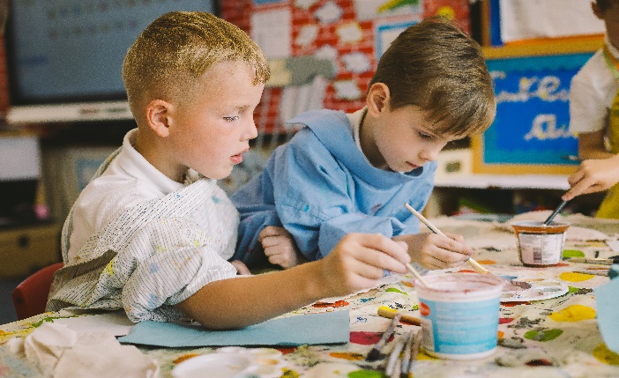

Our Staff Team
Headteacher:
Governors
Governors are similar to a Board of Directors who make decisions about future strategic direction and hold the school leaders to account re school performance.
They decide how the school budget is spent; interview and select senior staff, decide on the school curriculum and work on the School Improvement Plan with the Headteacher and the Leadership team to help to move the school forward.
Governors serve for a term of 4 years.
Full Governor meetings are held once a term. Committee meetings are held once or twice a term as required.
Deputy Headteacher:
SENCO:
Mrs Dodd
Mrs Rodgers
Mrs Gorman
Teaching Staff:
Mrs Smith
Mrs Edwards
Miss Wardle
Miss Challis
Mrs Kenny
Miss Lloyd
Miss Knowles
Miss Yarnold
Mr Chesworth
Mrs Bithell
Office Manager
Mrs Lea
Mrs Wright
Educational aims for our school
To develop excellent attitudes and behaviour.
To feel safe and valued as part of a caring school community that celebrates success.
To enjoy learning and develop a passion to be life long learners.
To develop learners with ‘enquiring minds’ who feel confident to ask questions.
To encourage all learners to develop their full potential.
To foster respect for others and an appreciation of the world in which we live.
Kitchen:
Mrs OReilly( Cook)
Midday Supervisors:
Mrs Smith , Mrs Leeming
Mrs Isles, Mrs Hollington Mrs Atkinson
Admission
Culcheth Primary is a community school for girls and boys from 4-11 years of age. Warrington Borough Council co-ordinates admissions to school. Our published admission number is 30 per year group.
Should this number be exceeded the Local Authority applies the following criteria when offering places:
Children in care
Siblings in school
Proximity to school
Secondary School Transfer
The current admission criteria for Culcheth High School are:
Child in care
Siblings
Proximity to school
Site Manager:
Mr Dodd
Teaching Assistants:
Mrs Isles
Miss Heywood Mrs Deakin Mrs Atkinson Mrs White
Mrs Kenny
Ms Fletcher
Governing Body:
Mrs Michaelas (Chair)
Mrs J Smith
Dr Hall (Vice)
Mrs O’Donnell
Mrs Pearson
Mrs Raftry
Mr Mills
Ms Singh
‘Pupils flourish at Culcheth Primary School and are cared for exceptionally well and encouraged to be their very best….. Pupils behave exceptionally well in lessons and around the school’ – Ofsted, May 2023

Slide 3


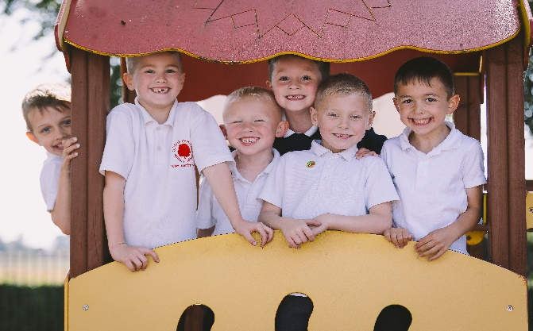
Organisation
Our school has seven classes, starting with Reception class followed by Y1 – Y6. Reception, Y1 and Y2 are known as Key Stage 1. Y3-6 are Key Stage 2.
We do not have any mixed age classes. We teach Maths/English in half classes – each with a qualified teacher from Year 1 to Year 6. We split the class alphabetically
School Meals
Lunch is prepared on the premises and served in the school hall. All meals meet the Government’s strict standards and are nutritionally analysed. All Infants are given a free school lunch.
School operates a daily pay system, which allows total flexibility to choose between bringing a packed lunch and having a meal provided by school.
Meals are paid for online via ParentPay.
We are a healthy school and try to encourage healthy eating. We will encourage your child to try a taste of new foods and encourage them to eat fruit and vegetables. We ask for your support if your child brings a packed lunch and request that their lunch is as healthy as possible. If you need any inspiration for ideas, please speak to the school office. Sweets are not allowed in packed lunches.
We are able to cater for any special diets or food intolerances and will arrange a meeting with the catering staff if this is required.
Before/ After School Care
– All Stars
This is run by our school staff in the school hall.
All Stars opens at 7.30am and runs until 6pm daily. Sessions are available on a flexible/ ad hoc basis.
Payment for sessions is made via Parent Pay. A range of childcare vouchers are accepted.. The cost is £3.50 per day for breakfast club and £10 for after school.
Our aim is to provide a service that meets the needs of all our families in school.
‘Leaders inspire pupils to be inspirational’ – Ofsted, May 2023
Water
We have fresh filtered water machines in school. Every child is encouraged to have a labelled water bottle and to drink regularly throughout the school day.
Times of School
Doors open at 8.35am
Morning School 8.45am – 12.15/12.45pm
Afternoon School 12.45/1.30pm – 3.15pm
Curriculum
We offer a rich, engaging curriculum.
We plan an exciting start to each topic, which may be a trip or visitor and finish each topic with a special activity, such as an assembly, making a film or book about the topic or making a mini museum for other children to learn about the topic.
Our School Website will give you more information about the curriculum.
Uniform
Grey skirt/pinafore/ trousers
White polo shirt with logo
Navy sweatshirt/ cardigan with logo
Plain socks
Black sensible shoes
(boots/ trainers may be worn outside)
In Summer a navy blue and white checked summer dress may be worn.
Hair must be a natural colour with no extreme hairstyles or tracks. Long hair must be tied back.
Your child will also need a book bag and a PE bag.
PE kit
Black/navy shorts
Blue PE shirt with logo
Black pumps
Tracksuit/ trainers for outdoor activities as advised by class teacher (any plain design)

Slide 4

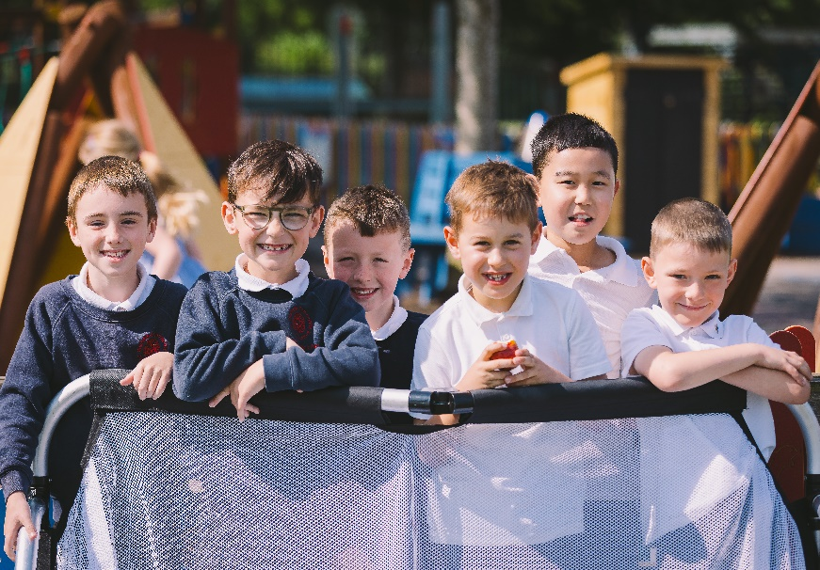
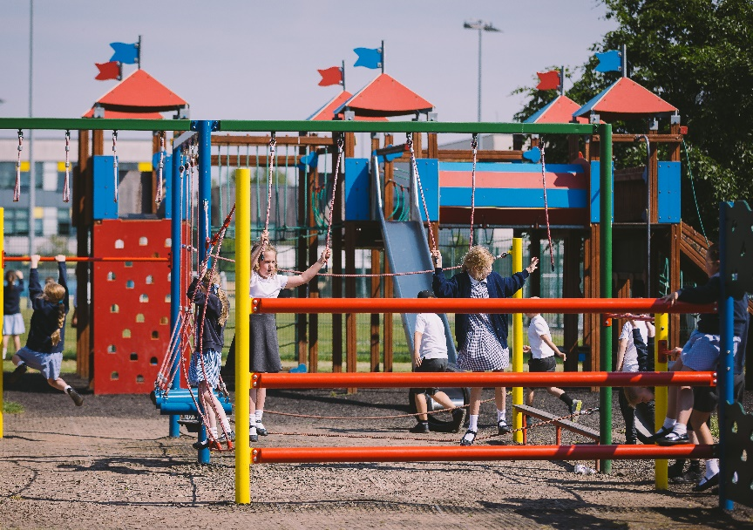
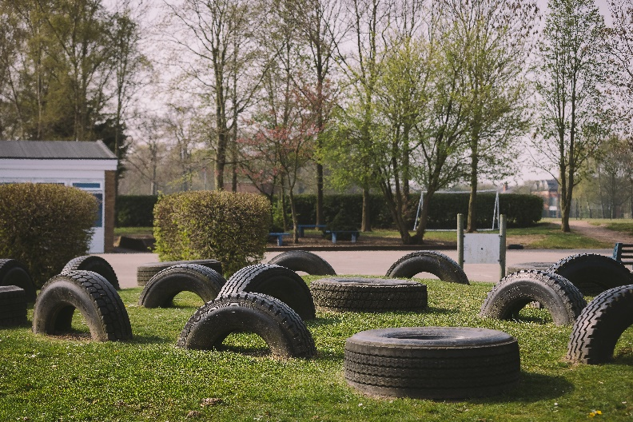
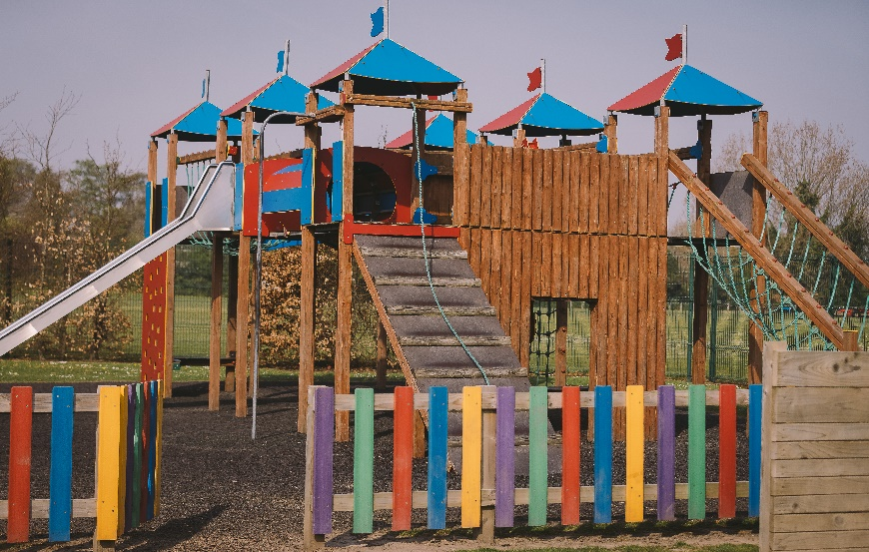
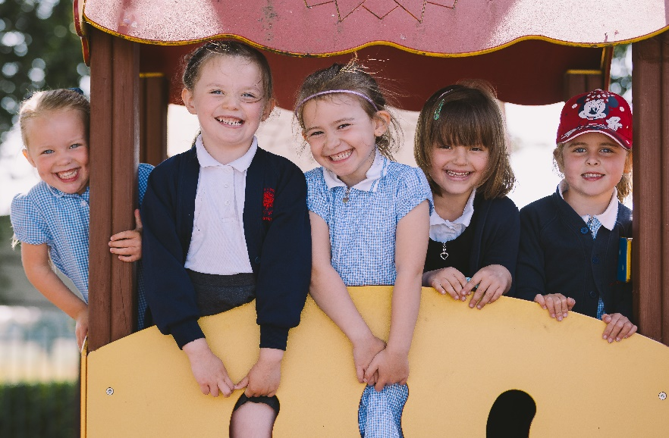

Extra curricular activities
After school activities
We offer a wide range of clubs and activities after school. Many of these are run by our own staff and are provided at a very low charge. A letter detailing which clubs are available is sent out each term.
Examples of clubs are running, reading, netball, tennis, rugby.
Residential Trips
Y4, 5 and 6 children are offered the chance to attend residential trips that build on the geography/history curriculum that they study in school.
Themed Days
We hold regular themed days through the year. Our regular days include:
Green Day – a whole day devoted to Eco-projects. We became the first ‘Eco-school’ in Warrington in 1997 and have ‘Green Flag’ accreditation.
Decoration Day – a day off timetable where we split into mixed age groups to make and design Christmas decorations to decorate our school for the Christmas period. This is the start of Christmas for us!
Arts week – usually 3 days devoted to the Arts- art, design, drama, dance and music. A range of activities and specialist teachers come in to work with classes.
We regularly invite visitors into school to enhance learning on our theme days.
Pupils have highly positive attitudes to learning. They are extremely motivated, focused and attentive in class’ -– Ofsted, May 2023

Slide 5

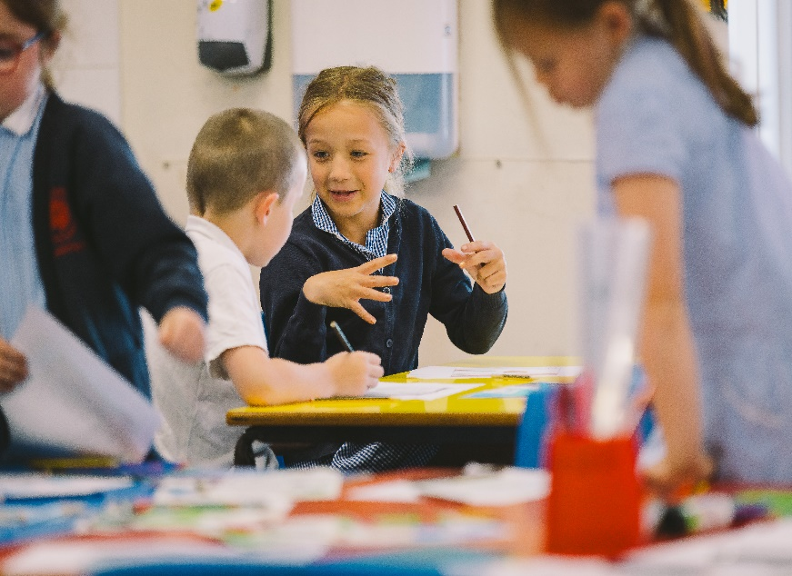
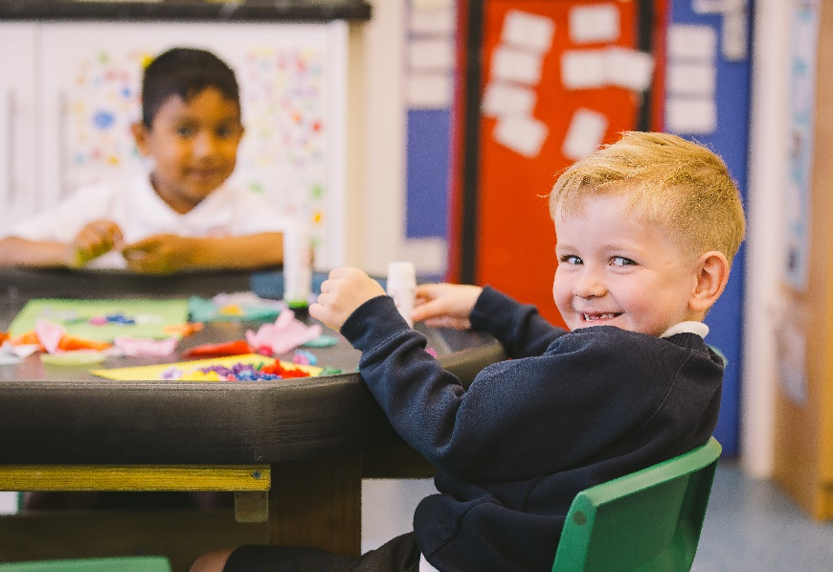
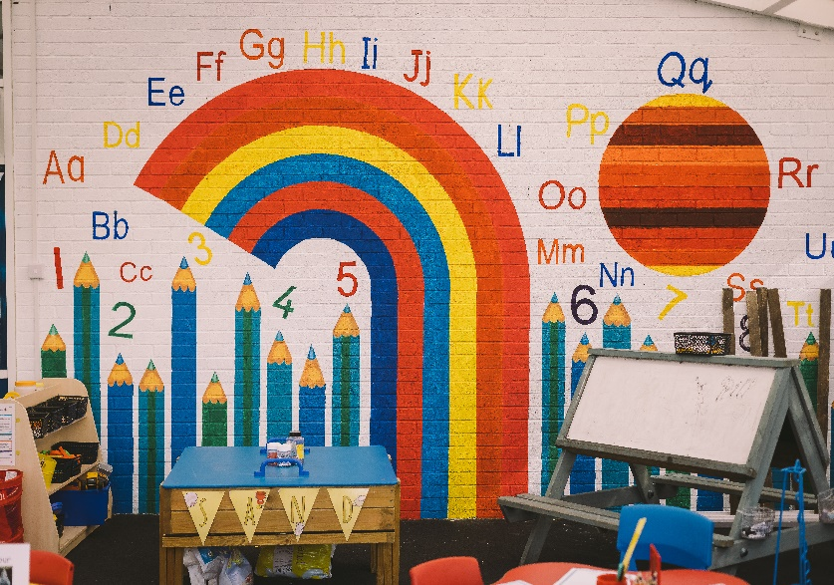
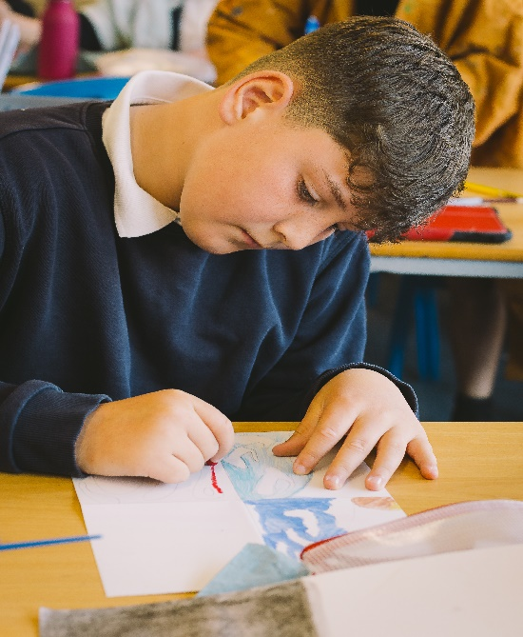
Parents in School
We have an Open Door policy – you will always be made very welcome in school. Please do contact school or speak to anyone if you have any worries or concerns as they are often very easy to solve if we are aware of them.
If you require an appointment to meet a teacher or the Headteacher, it is helpful if you phone in advance to check availability.
We ask that all children and their parents sign our ‘Home/school agreement’ so that we are all working in
partnership.
You will be invited to attend themed days, special assemblies, performances and sports days. We try to give as much notice as possible on our weekly newsletter.
Volunteers
We always welcome volunteers in school. Even if it’s only for an hour – if you have a particular talent or would like to help listen to children read, please let us know.
All volunteers will require a DBS check, please contact the office for a form and more details.
PTA
We have an active PTA who arrange events across the year. They meet each month – details will be in the newsletter. If you are unable to attend the meetings but would like to volunteer to help at an event, please
let one of the committee members or the office know.
Parents’ Evenings
We hold a parents’ evening each term to provide information on your child’s progress and development. A written report is sent home in the Summer term to summarise achievement and attainment and parents are given the opportunity to discuss this report, should they wish.
Culcheth Community Primary School
Warrington Road • Culcheth • Cheshire • WA3 5HH
T: 01925 764312 F: 01925 764690
E: culcheth_primary@sch.warrington.gov.uk
www.culchethprimary.co.uk

Slide 6
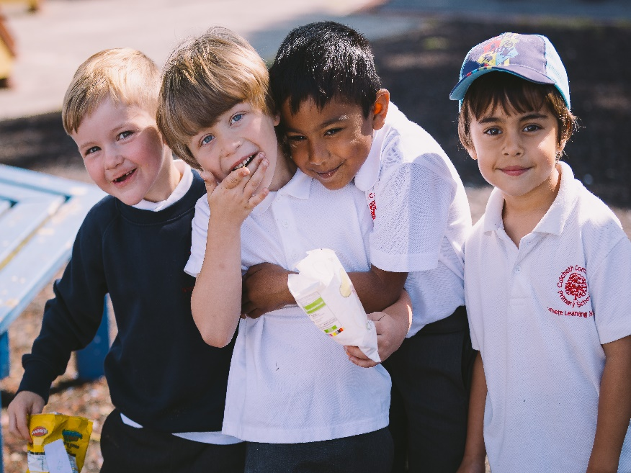
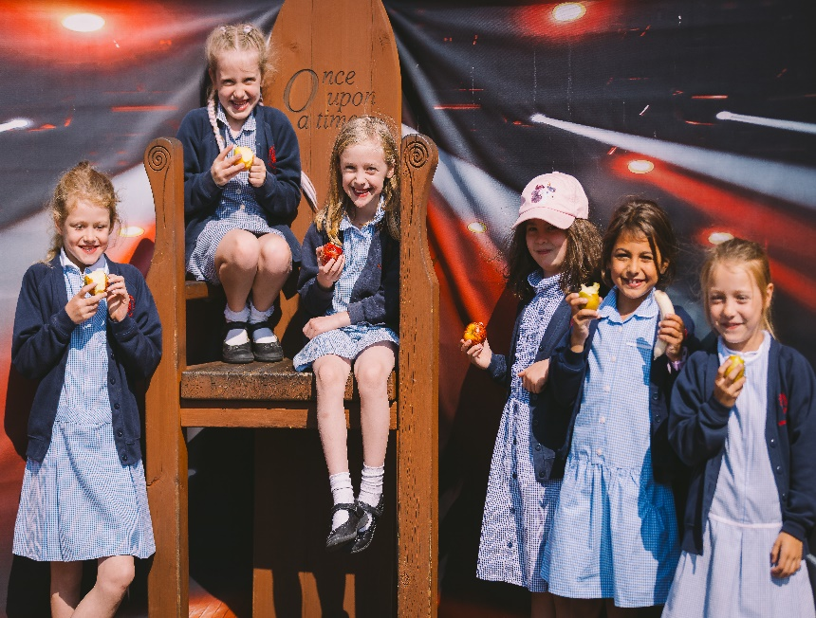
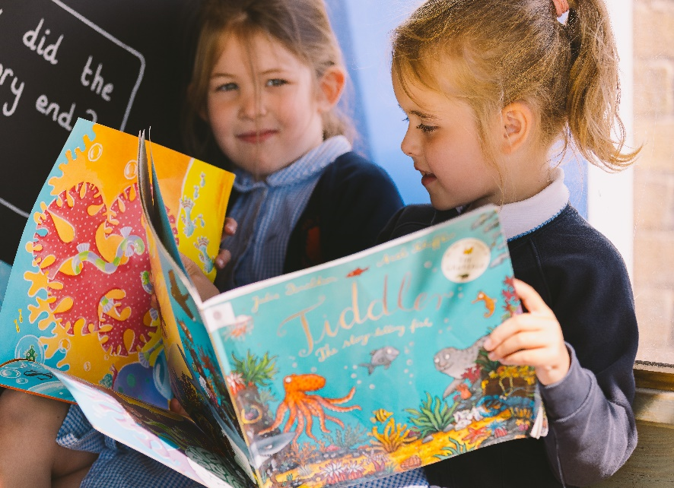
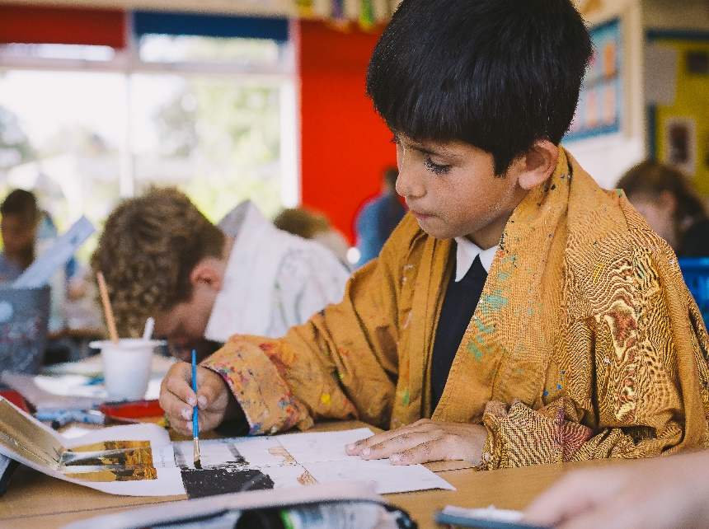
Culcheth
Community
Primary School
Where learning is fun!
Warrington Road
Culcheth
Warrington
WA3 5BG
Headteacher: Mrs Dodd
2

