Slide 1

Welcome to Year 2
Mr Lyons, Mrs Brindle and Mrs Laljee
“Living and learning, inspired by our faith”
September 2025

Slide 2
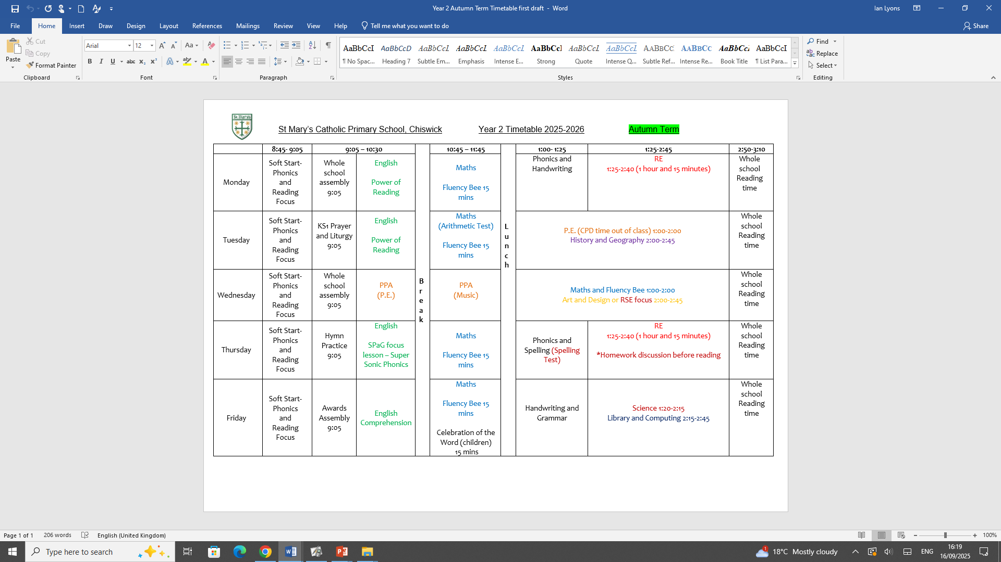
Timetable

Slide 3
PE Days / Uniform
P.E. will be on a Tuesday and Wednesday
The children are required to wear their P.E. kits for the whole day when taking part in P.E.
All clothing and bags should be labelled with your child's name.
Please remember to dress your child in the correct uniform on the days they do not have P.E. They should be wearing school shoes throughout the day. If your child cannot wear their school shoes, please inform me by writing in their diary.

Slide 4
Snacks / Drinks
Your child will be provided with fruit at break time.
If your child would like milk, please contact the office.
Only water is allowed during class time.

Slide 5
Dates for the Diary
Please always refer to the newsletter and community calendar on the website.
Coming up this Autumn:
Parents Evening: Thursday 27th November (online)
KS1 Nativity performance: Wednesday 10th and Thursday 11th December – This will be confirmed nearer the time because of the build.

Slide 6
Home / School Diaries
Books will be changed on your child’s reading day. One book will be chosen at a time. The current book must be returned before handing out a new book.
Please ensure your child reads for at least fifteen minutes every evening. Their reading diary must be signed to show they have read.
Please check that your child is able to comprehend and answer questions about the book they have chosen.
Any issues / messages can be placed into the diary for us to communicate.

Slide 7
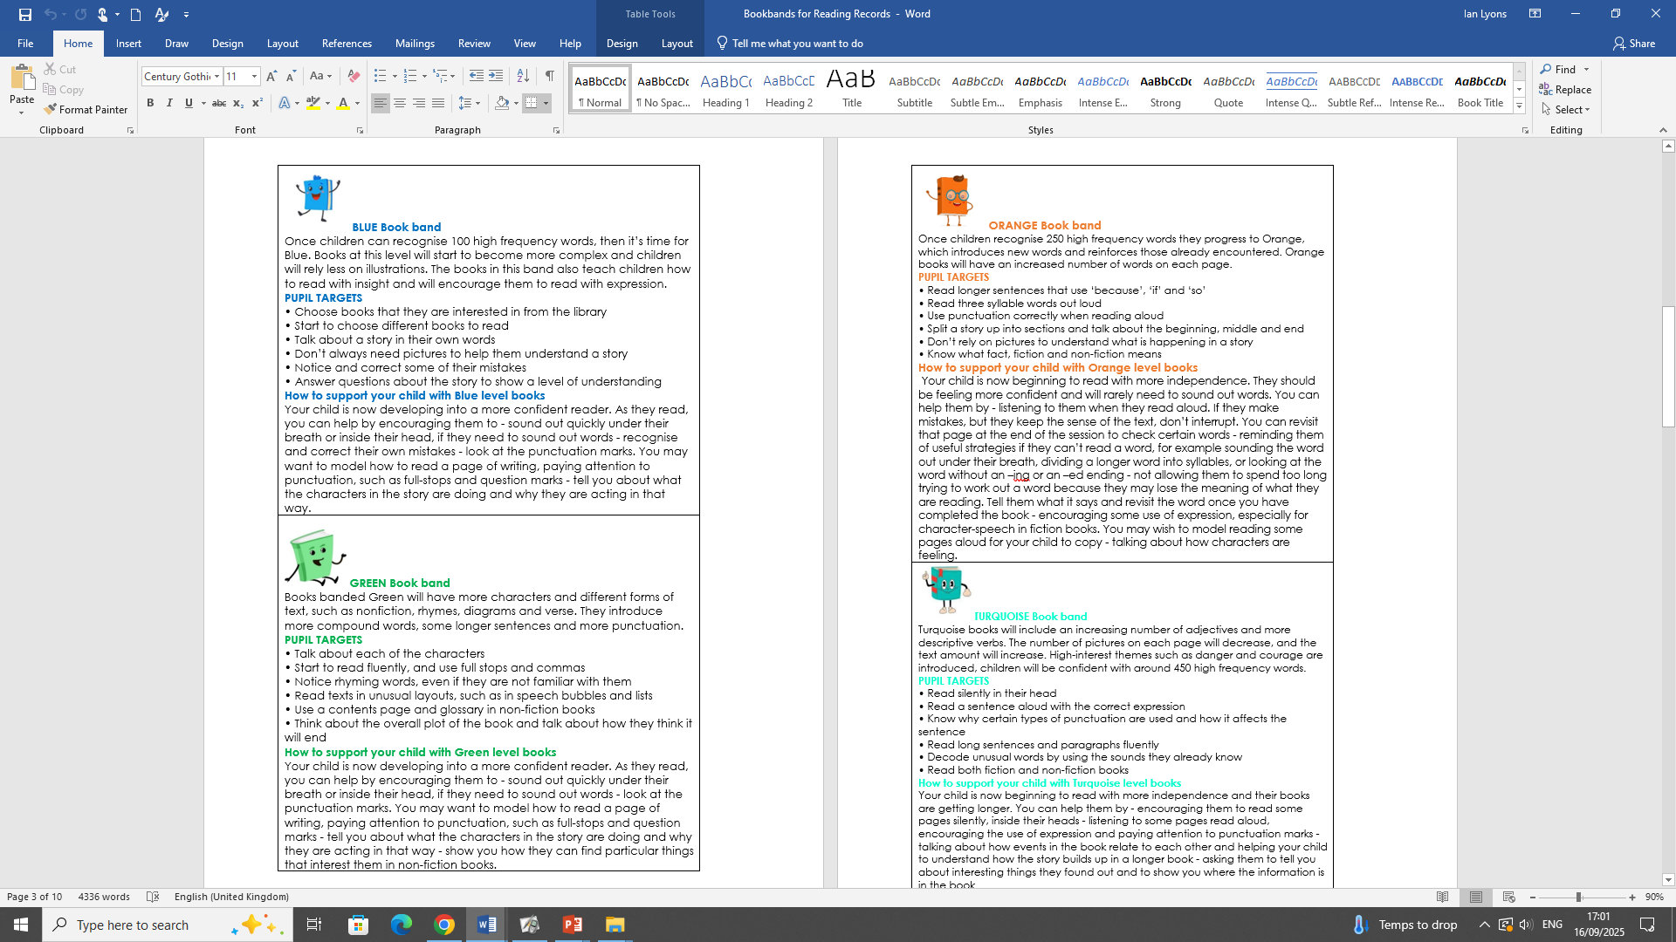
Target Sheets in Reading Diaries
These will be stapled into your child’s diary once they have been assessed and moved up a reading level. These provide you with targets linked to this book band and ways to support your child at home.

Slide 8
Kinetic Letters Handwriting
Please encourage your child to use Kinetic Letters in their homework. The children worked extremely hard to learn the different letter families in Year One and will be looking at consolidating this writing in Year Two.
I will begin to upload handwriting posters to the new school website shortly. These will help the children with writing these letter families at home.
The children are taught handwriting throughout the week and use the Kinetic Letters display in the classroom to guide them.

Slide 9
Phonics
Here at St Mary’s, we deliver our Phonic lessons through Super Sonic Phonic Friends. The website provides the class with child friendly characters and illustrations which underpin the whole scheme. They are easy to remember with accompanying rhyming phrases that are consistently repeated in every lesson.
E.g. What can we see in the Phonics TV?
Any children who did not pass the Phonics Screening check in Year One will have the opportunity to take the test again this year.
In Year Two, we focus on different spelling rules. We teach the children the concept that there an be more than one spelling for a sound that they can hear in a word.

Slide 10
White Rose Maths
Here at St Mary’s, we are committed to ensuring that children are able to recognise the importance of maths in the wider world and that they are also able to use their mathematical skills and knowledge confidently in their lives in a range of different contexts. We want all children to enjoy mathematics and to experience success in the subject, with the ability to reason mathematically.
We do this through the White Rose Mathematics Scheme. For each year group, the scheme of learning includes an overview of the maths that your child should be learning at any point in the year. Each year is split into three terms (autumn, spring and summer), and each term comprises individual blocks of learning about a particular topic.

Slide 11
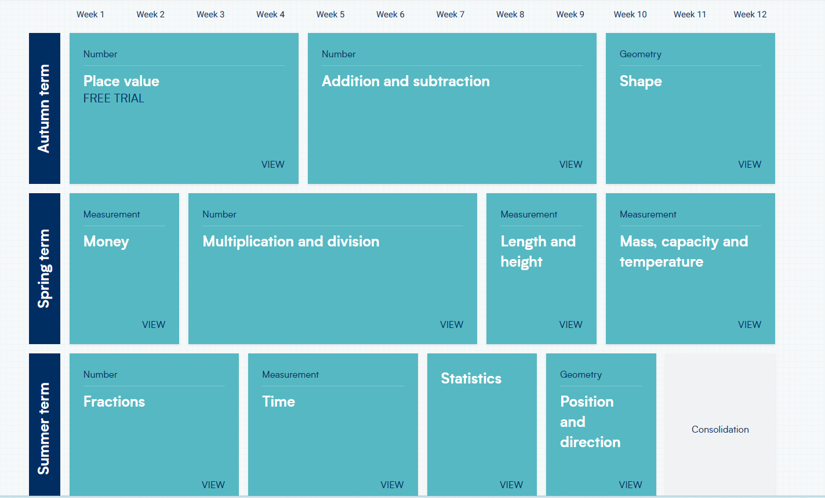
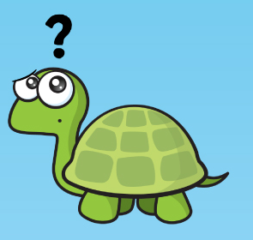
White Rose Maths continued…

Slide 12
White Rose Science
Here at St Mary’s, we recognise how science impacts every aspect of daily life, and without science humankind would not have made progress throughout history. As one of the core subjects taught at primary level, we give the teaching and learning of science the prominence it deserves.
As we have done in Maths, we are now teaching from White Rose Science planning. This scheme is very similar to how White Rose Maths is taught, where subjects are taught in blocks throughout the year.

Slide 13
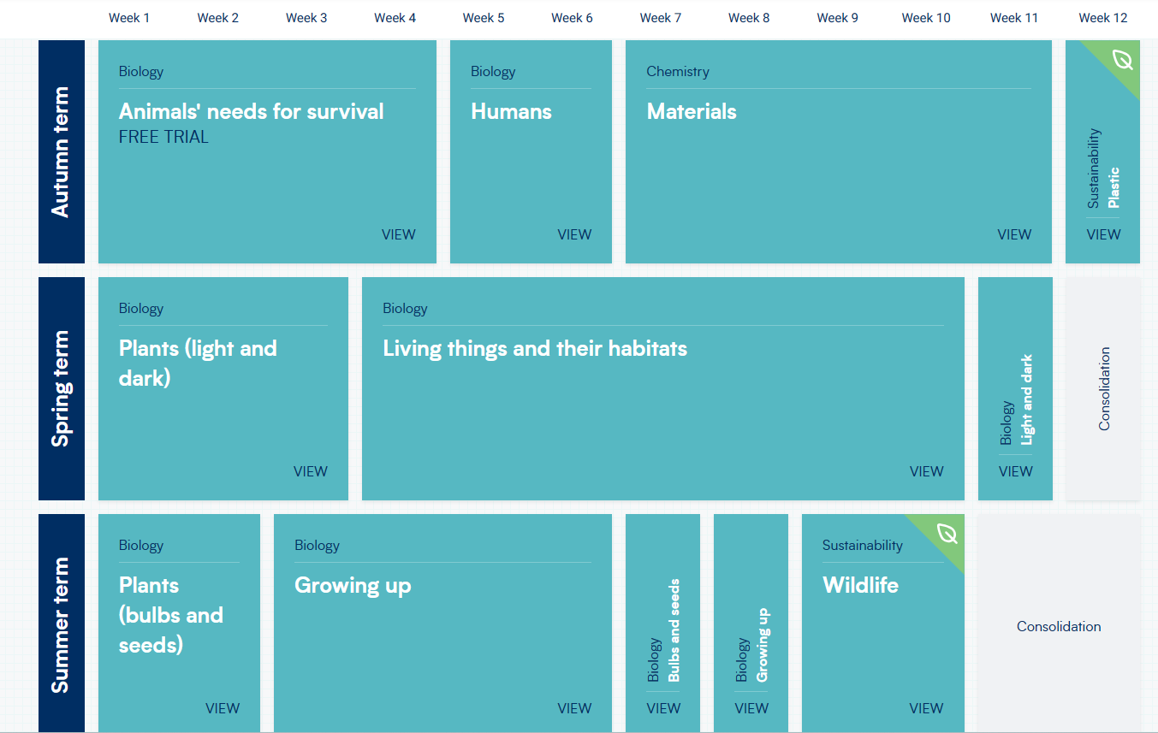
White Rose Science continued…

Slide 14
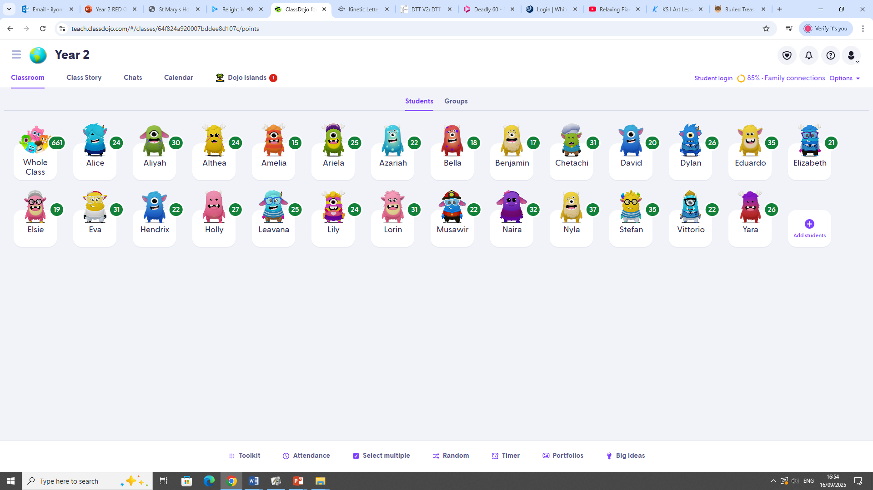
ClassDojo
The children are awarded Dojo points throughout the school day. These will be added and collated at the end of the week. Dojo points can be awarded for a number of different reasons including reading, helping others and hard work.

Slide 15
Music and P.E.
Music – Mr Keysell
P.E. – Coach Kyle

Slide 16
KIRFs
KIRFs or Key Instant Recall Facts support the mental skills and key knowledge that children need to secure for Maths. They include number bonds and times tables, and are particularly useful in developing confidence and understanding in addition, subtraction, multiplication and division.
These will be sent home every half term so that you can support your child with building fluency with these concepts. This will enable them to apply this knowledge to other areas of Mathematics and to develop higher order thinking, problem solving and reasoning.
We recommend that you spend 5-10 minutes a day working on these at home.

Slide 17
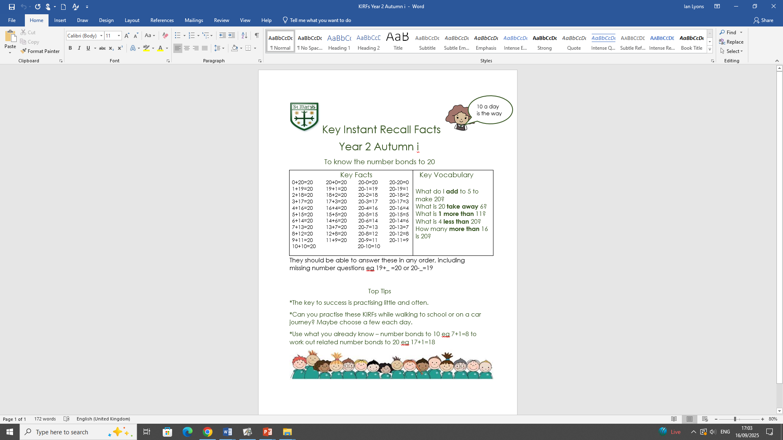
KIRFs continued…
This is the Year 2 KIRF for autumn term 1. These are displayed in the classroom and sent home for your child to practice.

Slide 18
Homework
Homework will all be handed out on Thursday. I will print off a copy of both the English and Maths homework for all children.
The homework due dates are as follows:
English – Monday
Mental Arithmetic test – Tuesday
Maths – Wednesday
Spelling test – Thursday
I will be writing test scores in diaries every Friday. Please ensure your child has their diary in their bag ready for this on a Friday. Thank you.

Slide 19
Topics
Autumn: How was school different in the past?
Would you prefer to live in a hot or cold country?
Spring: How did we learn to fly?
Why is our world wonderful?
Summer: What is a monarch?
What is it like to live by the coast?

Slide 20
Nativity Performance
Year Two will be leading the EYFS and KS1 Nativity performance this year which we are very much looking forward to.
We will start to organise this in October and will let you know your child’s role and what costume they will need.
The date for KS1 parents to watch is Wednesday 10th December.
As mentioned previously, because of the build, we are unsure about whether we will have access to the hall. Once we have confirmation, we will inform you of the plans.

Slide 21
Contact
If you need to contact me during the year, please feel free to email me at:
classenquiries@stmarys.hounslow.sch.uk

Slide 22
Questions
If you have any further questions, please refer to the contact slide in the presentation.
Thank you all for listening and I look forward to a positive academic year with the class.

