Slide 1
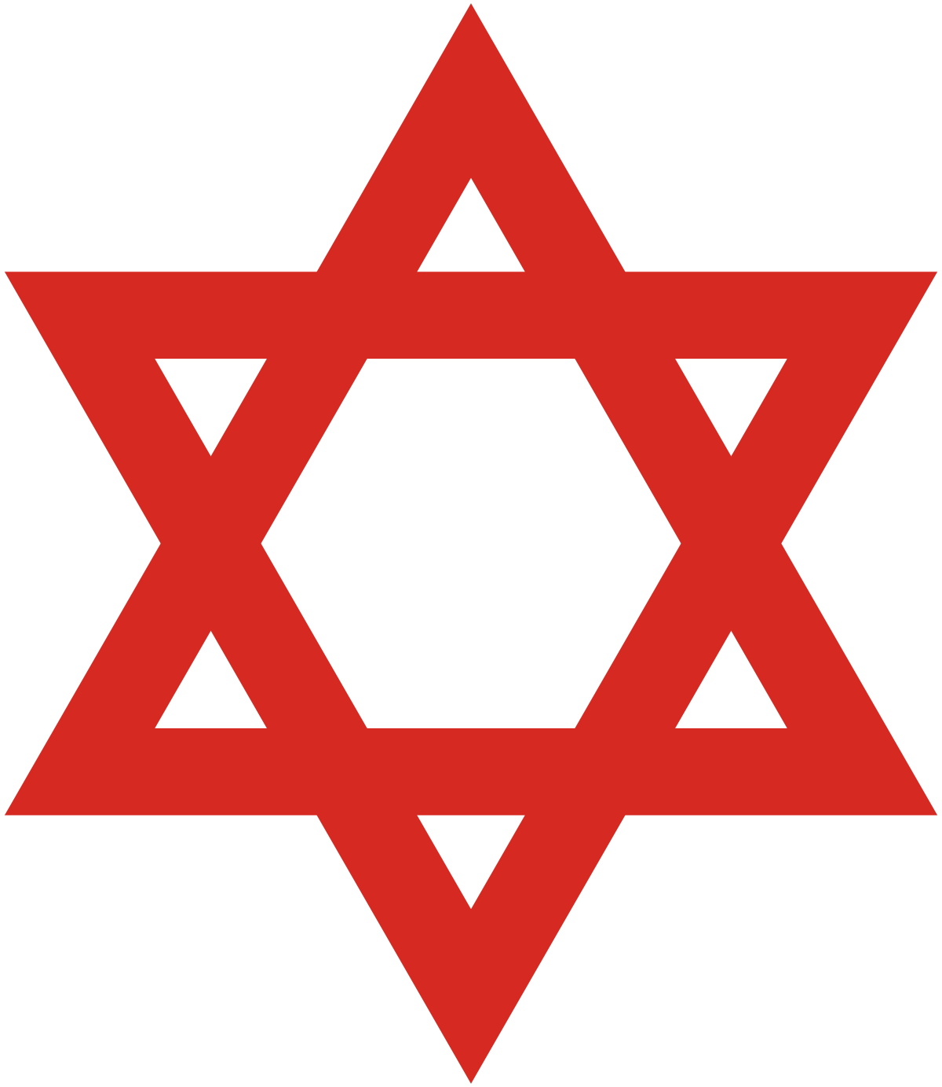
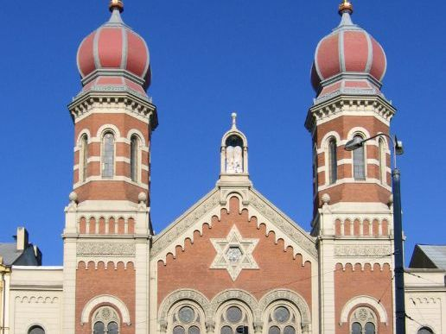
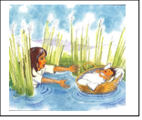
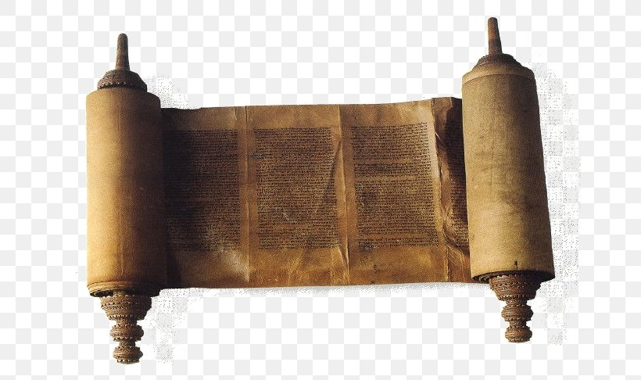
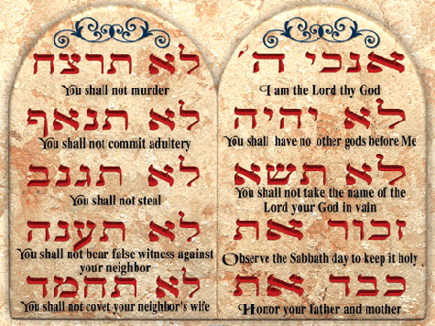
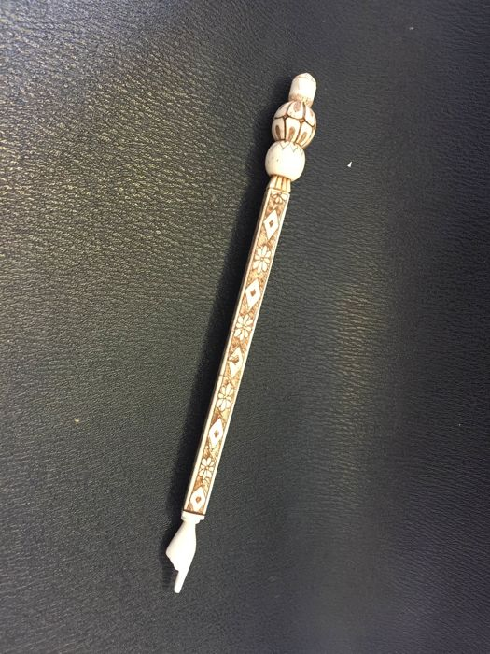
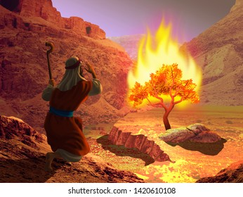
Vocabulary
Ark – the special cupboard in the synagogue where the Torah is kept.
Covenant – The agreement between Abraham and God
Jews – the people who follow this religion (also known as Hebrews)
Rabbi – leader of synagogue
Synagogue – Holy building of worship
Ten Statements – Set of rules also known as commandments
Torah – Holy text
Yad – pointer used with the Torah scroll
Judaism KS2
Where Judaism began: Isreal, Middle East
When Judaism Began
Jewish history begins with the covenant (agreement) established between God and Abraham around 1812 BC (over 3,800 years ago), during the Bronze Age, in the Middle East.
Moses, is also an important figure as he gave the Jews the Torah around 1250 B.C. The Torah contains the laws of God.
Star of David is a common Jewish symbol. The six-pointed star, has been used as a Jewish symbol since the Middle Ages.
Judaism is one of the six main world religions.
Main Festivals
Hanukkah, Passover, Yom Kippur, Sukkot, Rosh Hashanah
Jewish synagogue
Timeline of Judaism compared to other religions
Places of Worship:
The Synagogue.
At home.
Hinduism Buddhism Islam
2000 BCE 590 BCE 0 610 CE
1800 BCE 33 CE 1500 CE
Judaism Christianity Sikhism
Moses being placed in a basket on the river Nile.
Rules and Laws
Jews must follow the tradition of the Shabbat ceremony every week.
They have special dietary laws about eating Kosher food.
They follow the Ten Statements given to Moses by God.
Sacred Text: The Torah Scroll
The Torah is the first part of the Jewish bible.
Torah refers to the five books of Moses. Jews believe that God dictated the Torah to Moses on Mount Sinai 50 days after their exodus from Egyptian slavery. They believe that the Torah shows how God wants Jews to live. It contains 613 commandments and Jews refer to the ten best known of these as the ten 10 statements.
A yad (a pointer) is used to touch the text on the scroll to keep it clean.
Moses’ mother sent baby Moses floating down the Nile River in a basket to save him from the Pharaoh who had ordered all baby boys to be killed. The pharaoh’s daughter found the baby, and he grew up in the royal court.
When Moses was an adult he discovered a bush near the mount Sinai that was burning but was not burned up. From out of the bush he heard the voice of God telling him to ask the pharaoh to free the Hebrews.
Moses pleaded with the pharaoh, but the pharaoh refused to free the Hebrews. God then punished the Egyptians with 10 plagues. The final plague took the life of the pharaoh’s son, and the Hebrews were set free. This is known as the Exodus.
The Hebrews travelled across the desert for many years and Moses was given the 10 statements on Mount Sinai by God so that the Hebrews would have some rules to follow.
Main Beliefs
Jews believe in one God who is a spirit and has never been human.
Jews believe that God not only created the universe, but every Jew can have an individual and personal relationship with God.
They believe that God continues to work in the world, affecting everything that people do.
The Jewish relationship with God is a covenant relationship.
They believe that the Torah is the word of God written down by Moses and has rules and laws that should be followed.
Torah scroll
The Ten Statements
A yad is a pointer used with the Torah to keep the scroll clean.
Worship and prayer
Jews are supposed to pray three times a day; morning, afternoon, and evening. The Jewish prayer book (it's called a siddur) has special services set down for this. The Torah scroll is also used during prayers.
Praying regularly enables a person to get better at building their relationship with God.
Teachers of the Jewish faith are called rabbis. They lead worship in the synagogue, conduct marriage and funeral ceremonies and give people advice on religious matters.
God spoke to Moses through a burning bush.
Passover Festival
At Passover (in March or April) Jewish people remember how God brought the Jewish slaves out of Egypt led by Moses (known as the Exodus).
Temples are called synagogues
The central features are: the Holy Ark – a large cupboard at the front containing the Torah scroll.
The bimah (in Orthodox synagogues) – a raised platform from which the scroll is read. The ner tamid 'eternal light’, (symbol of the eternal presence of God) – hangs from the ceiling.

