Slide 1
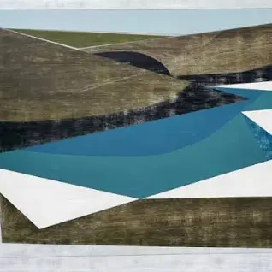
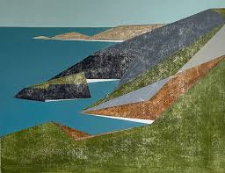
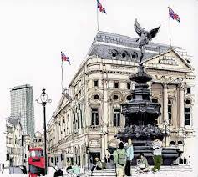
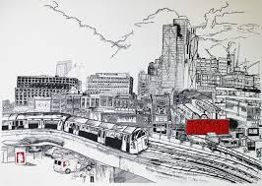
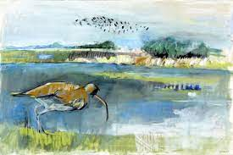
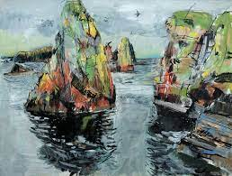
Key Vocabulary
Key Word | Definition
Landscape | All the visible features of an area of land.
Seascape | A view of an expanse of sea.
Cityscape | Visual appearance of a city – city landscape.
Architecture | The art or practice of designing or constructing buildings.
Working from life | Reflects society and is a form of communication.
Linear | Arranged or extending along a straight line.
Representative | Describes, implies or depicts something.
Sense | A feeling of something.
Spirit | The attitude of something.
Energy | Use of colour, form and composition to express life and power.
Composition | The way art is put together to create an effect.
Mixed media | Use of more than one medium to create art.
Art: Summer Term​
​Mixed Media Land & Cityscapes (Mixed Media/Architecture)
Learning Sequence
Understand how Vanessa Gardiner captures the spirit of a place in their artwork. Use linear approach to represent a landscape.
1
Understand how The Shoreditch Sketcher captures the spirit of a place in their artwork. Use watercolour and pen to create a landscape.
2
Explore how Kittie Jones combines paint, pastel and pen to create seascapes.to create and effect
3
Drawing upon the techniques of artists, create mixed media waterscapes or cityscapes.
hen start to paint the scene
4
Complete waterscape or cityscape.
5
Frame or back final piece. Share, review and reflect on artwork.
6

