Slide 1
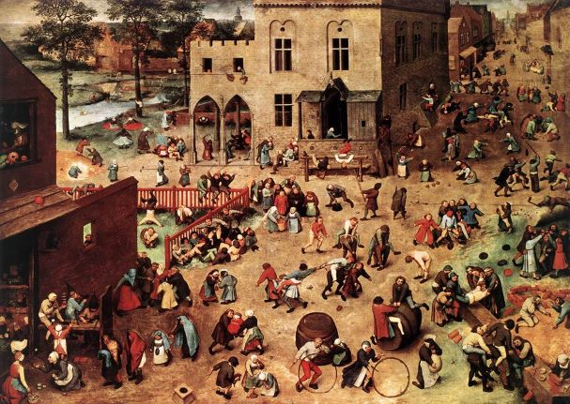
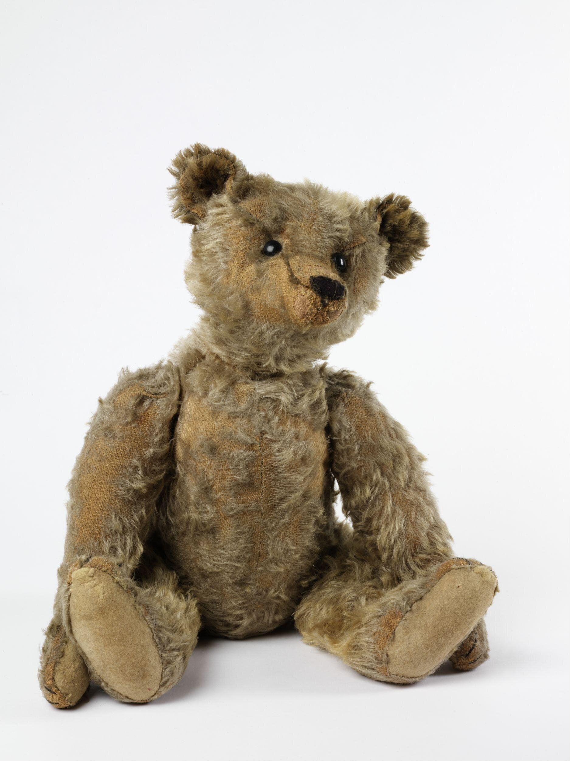
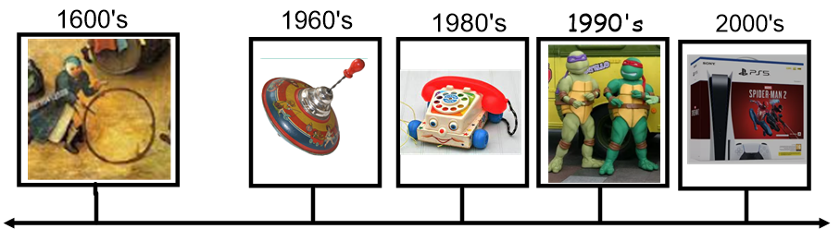
Key Vocabulary
Key Word | Definition
past | A time that has already happened
old | Someone or something that has been around for a long period of time
new | Something that has been around for a short period of time
change | Not the same
game | An organised activity with rules
source | Something that gives us information on an event or topic. a diary, book or a photograph
Museum | a building that holds a collection of objects that are found in nature or objects that people created.
artefact | An object made by a human being
Knowledge Organiser History: Toys and Games
Learning Sequence
How is my favourite teddy different from the very first teddy bears?
1
What toys and games did my parents and grandparents used to play with?
2
How have toys and games changed?
3
Painting by Pieter Bruegel
What can we learn from an old painting of children playing?
Stiff teddy bear
4
How have games changed?
5
Create a class museum
6

