Slide 1
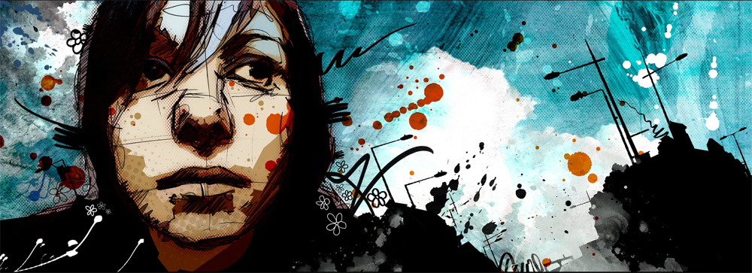
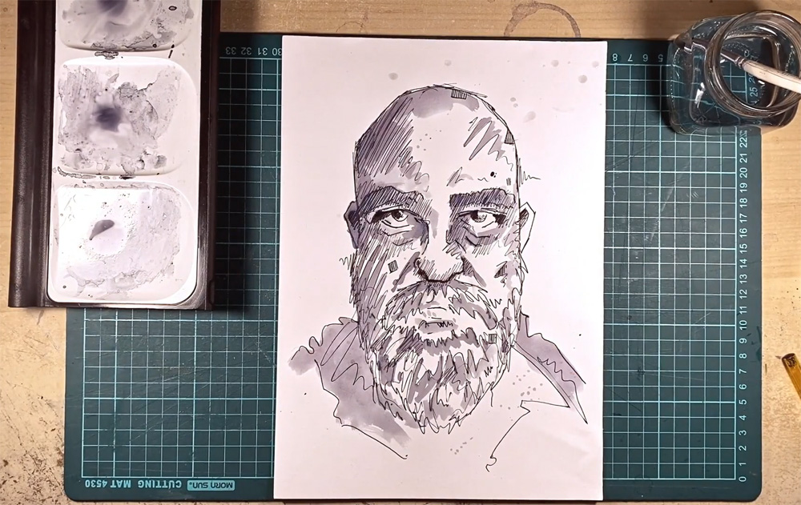
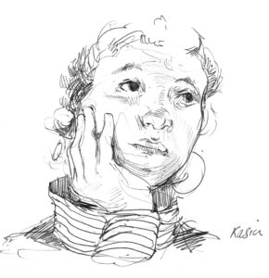
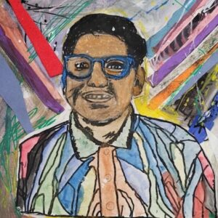
Key Vocabulary
Key Word | Definition
Identity | Who somebody is as a person.
Constructed | Putting together or building an artwork.
Portraiture | The art of painting a picture or taking a picture of a person.
Layering | Overlapping materials such as paint, to give depth.
Digital Art | Art that is made or presented using digital technology.
Physical | Artwork as a physical object e.g painting, sculpture, photograph.
Mixed Media | Use of more than one medium to create art.
Art: Autumn Term​
​Exploring Identity – Portraits (Drawing)
Learning Sequence
Explore how different artists represent identity through their artwork.
1
Use a range of media to create portraits (groups drawing each other).
2
Use pen and ink to create a portrait.
3
Use mixed media to create a background.
hen start to paint the scene
4
Use ink, paint and a range of media to add finishing touches to a self portrait.
5
Share, review and reflect on artwork.
6

