Slide 1
Year 2
Assessment Afternoon
March 2023

Slide 2
Aims of the meeting….
To provide up to date information about the assessment arrangements in Year 2.
To share pupil expectations by the end of KS1 in reading, writing and maths.

Slide 3
The Curriculum
Sets high expectations for pupils and encourages a deeper understanding of concepts.
Ensures children have the correct knowledge and skills to flourish and be prepared for secondary school.
Standard Assessment Tasks applies to pupils at the end of key stages 1 and 2 i.e. Years 2 and 6.

Slide 4
Year 2 assessment
Teachers will continue to use their own Teacher assessment judgements as the main focus for end of KS assessment and reporting. It is carried out as part of teaching and learning.
It is a statutory requirement that children sit tests in Maths and Reading
These will provide additional evidence to support the final teacher assessment judgement.

Slide 5
Tests
Tests consist of…
English reading paper 1
English reading paper 2
Mathematics paper 1 – arithmetic.
Mathematics paper 2 –reasoning.
There is no test for writing – teachers assess this throughout the year based on children's performance in class.
2 Spelling and Grammar tests (optional)
Tests are used to support teacher assessment judgements.

Slide 6
Tests will be administered in May.
Teachers do not see the tests before administering.
All tests marked by Year 2 teachers.
Guidance is provided about timings but not strictly timed.

Slide 7
Reporting to parents
Teacher assessments will be reported as either…
  Growing development of the expected standard (PKF)
  Working towards the expected standard (WTS)
  Working at the expected standard (EXS)
  Working at greater depth within the expected standard (GDS)
  Science will be reported as working at the expected standard or NOT.

Slide 8
What do the children need to know?
Reading
Greater emphasis on comprehension (understanding and inference)
Range of texts including: fiction, non-fiction and poetry.

Slide 9
Reading
To achieve the expected standard the children should be able to…
Read most words of 2 or more syllables, words containing common suffixes and words given in weekly spellings.
In age appropriate books, read words fluently (over 90 words per minute)
Sound out unfamiliar words accurately.
Check for sense, self correcting when necessary, answer questions and make inferences.
https://www.youtube.com/watch?v=z9KRimNLkJQ
https://www.youtube.com/watch?v=w4c_DMS-3IE

Slide 10
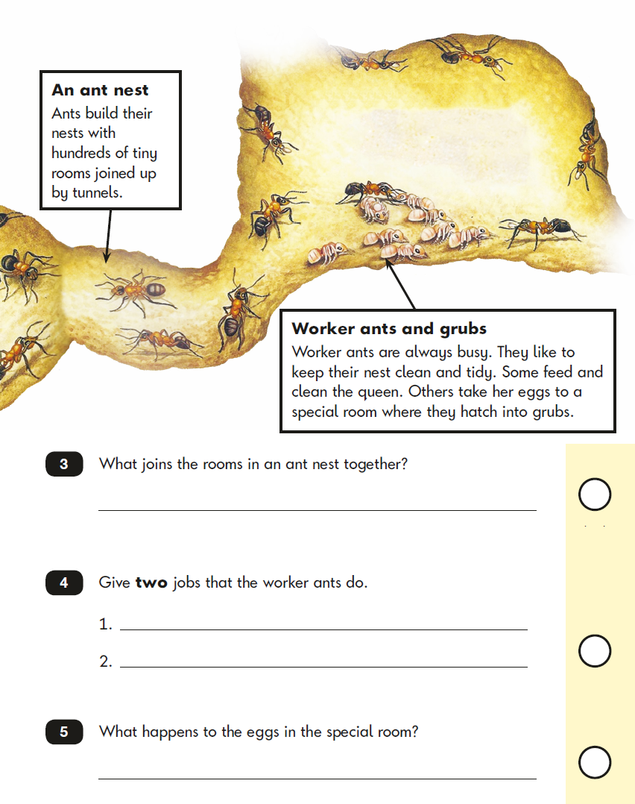
Reading paper 1

Slide 11
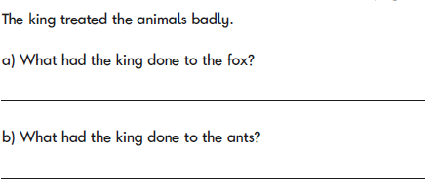
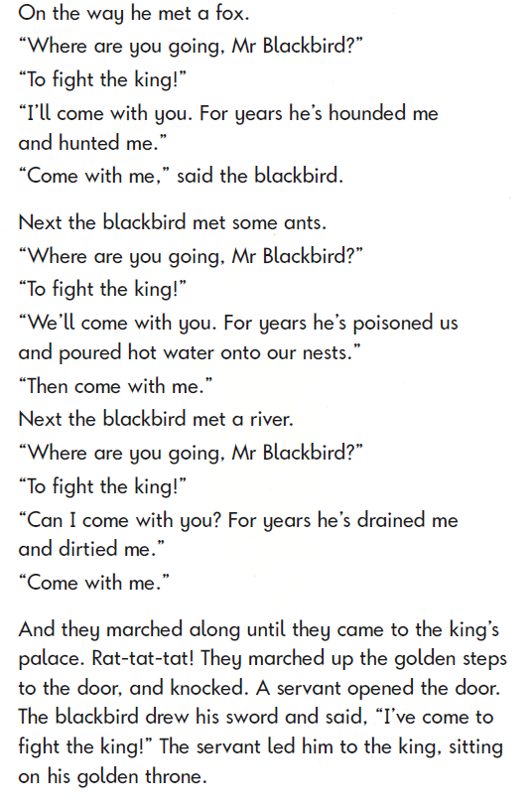
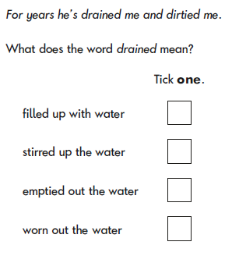
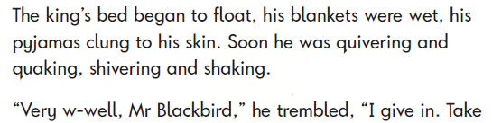
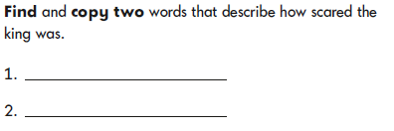
Reading paper 2

Slide 12
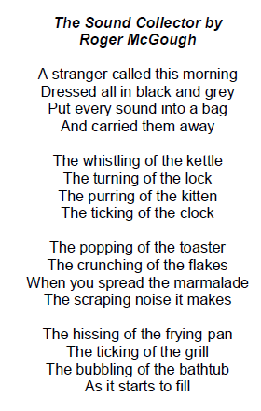
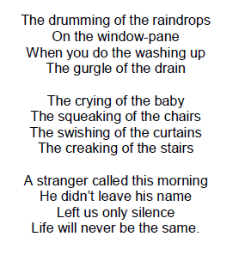
Reading at greater depth

Slide 13
Writing
Teacher assessed as part of teaching and learning in the classroom.
Based on a range of pieces of writing in different contexts.
Assessed against framework.
Evidence needed a number of times to achieve standard.
Children must be able to demonstrate all statements to achieve standard.

Slide 14
To achieve the expected standard, children will need to…
Punctuate most sentences correctly with capital letters, full stops and question marks when required.
Use present and past tense.
Use coordination (or, and, but) and subordination (when, if, that, because)
Spell words learnt for homework consistently and correctly in their writing.
Form capital letters and digits of the correct size, orientation and relationship to one another and to lower case letters.
Use spacing between words.

Slide 15
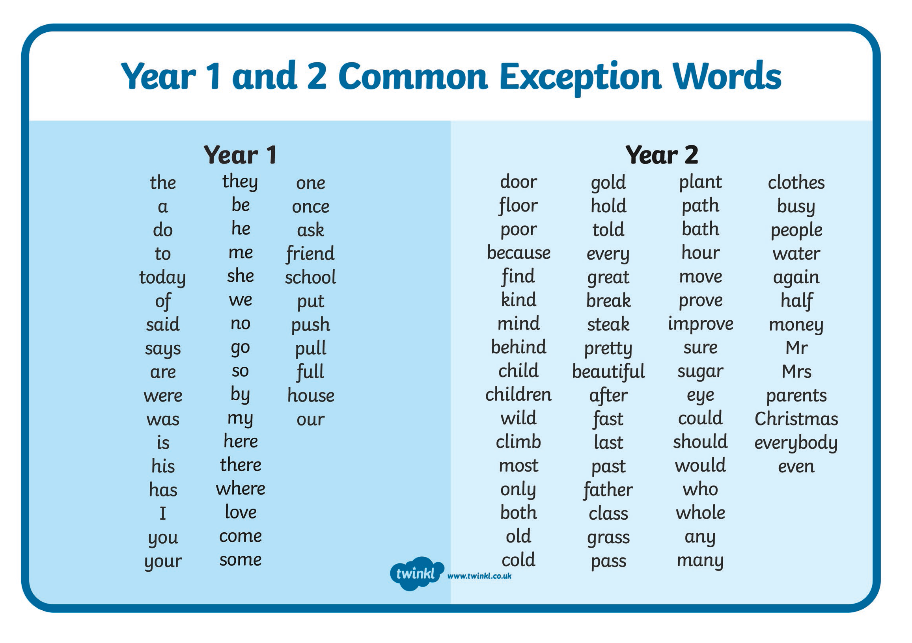

Slide 16
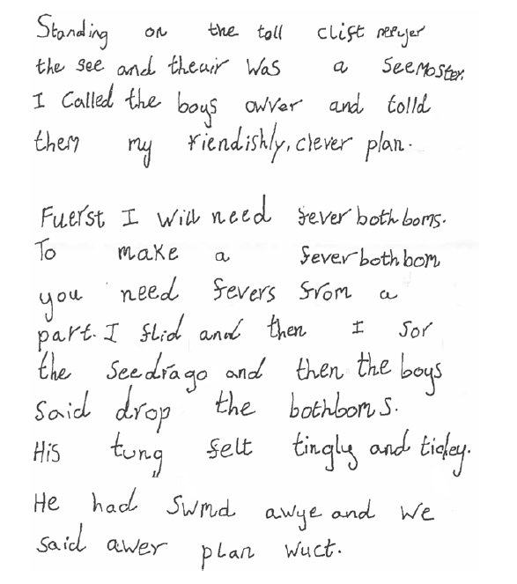
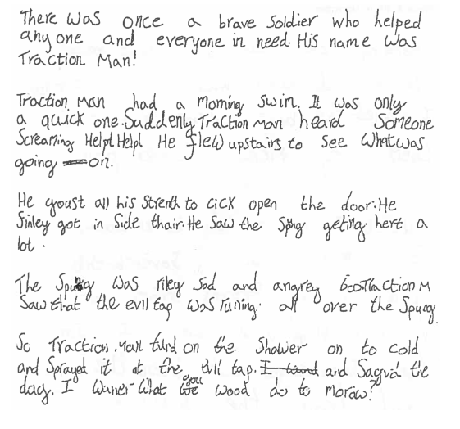
Working Towards the expected standard

Slide 17
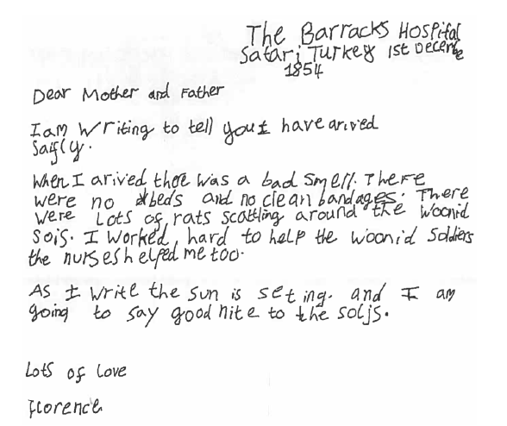
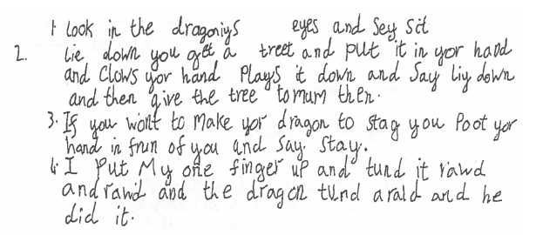

Slide 18
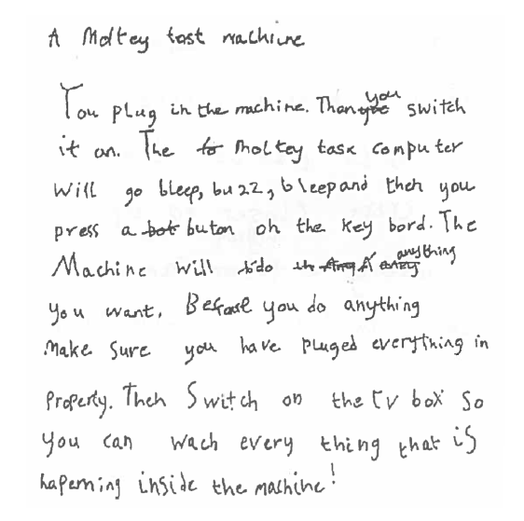
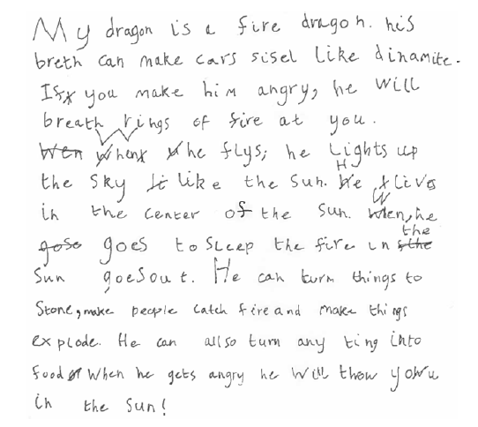
Working at the expected standard.

Slide 19
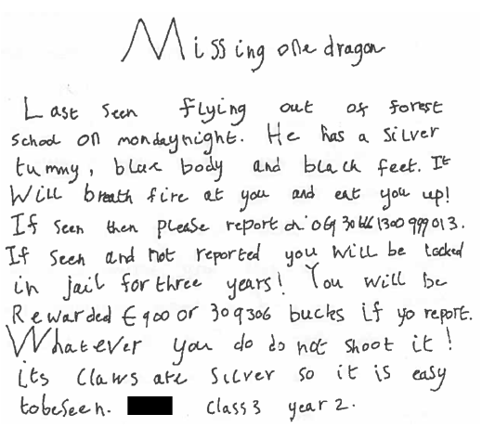
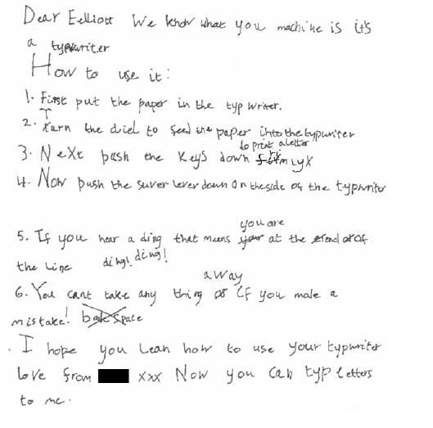

Slide 20
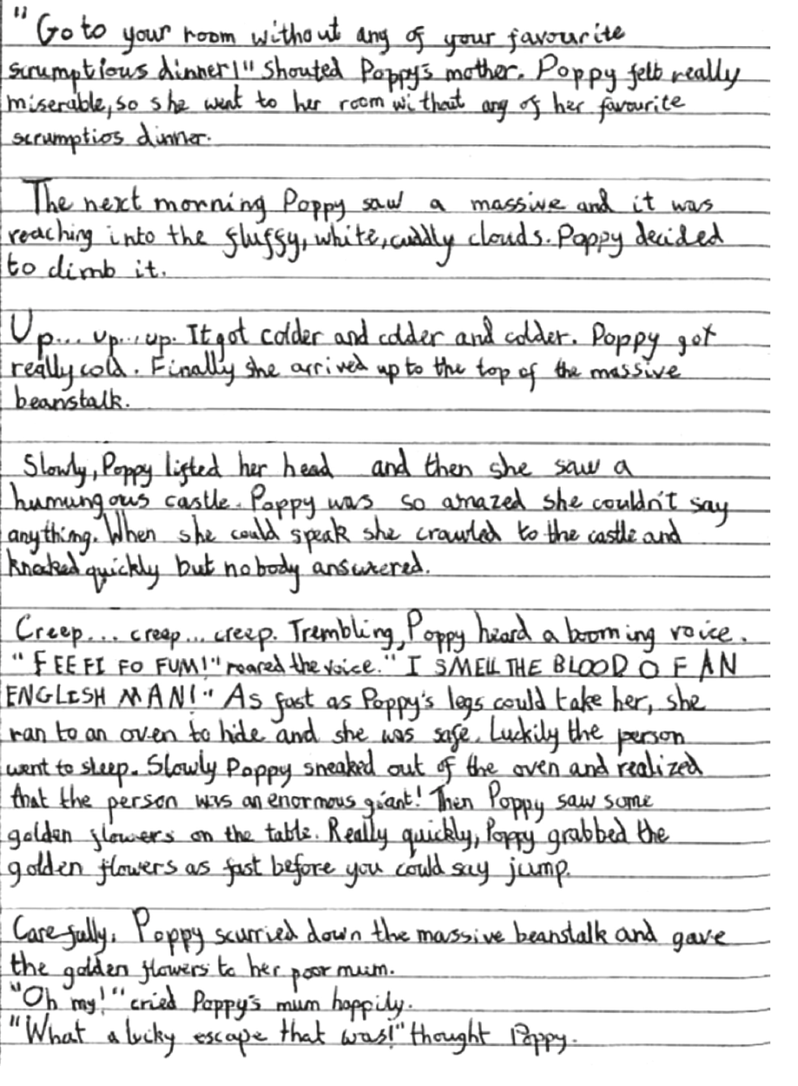
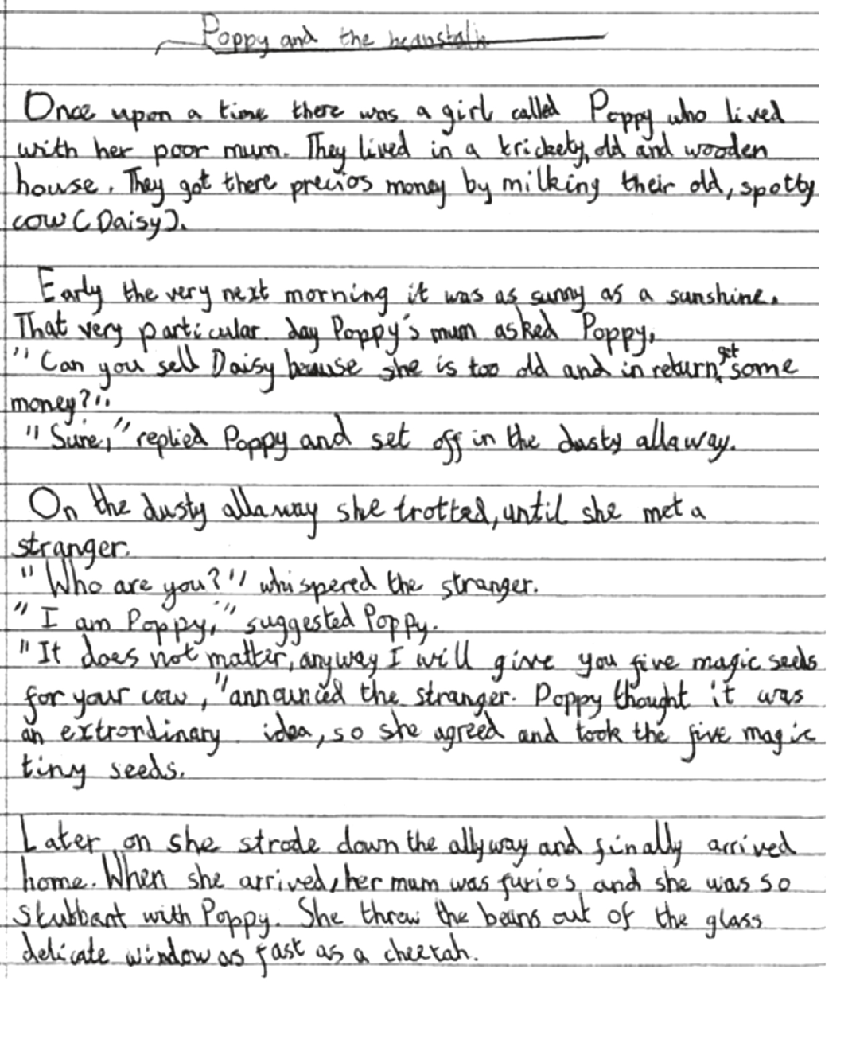
Working at greater depth

Slide 21
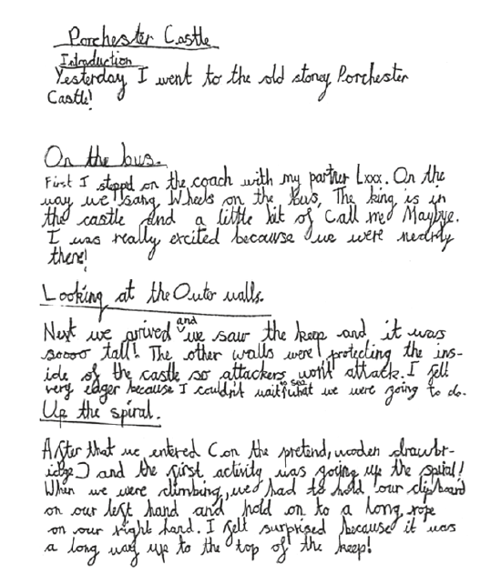
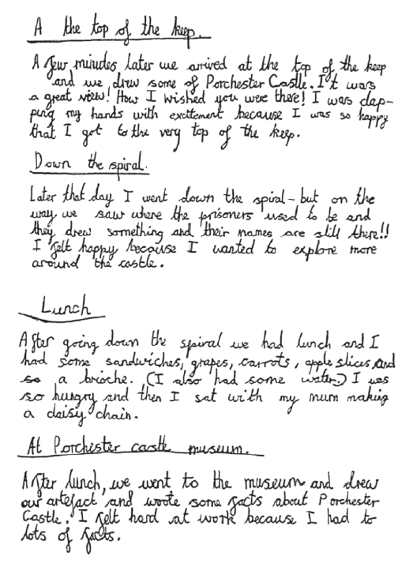

Slide 22
Maths
Paper 1
Arithmetic test focussing on number and calculation skills practised throughout the year.
Paper 2
Reasoning test.
No apparatus is allowed in either test

Slide 23
Reaching the expected standard in maths.
Children will need to demonstrate they can …
Partition 2 digit numbers in different ways.
Add two 2 digit numbers.
Estimate an answer as a way of checking.
Subtract mentally a 2 digit number from another 2 digit number e.g. 74-33.
Understand inverse relationships.
Know multiplication and division facts for 2, 5 and 10 times tables.
Understand fractions – 1/3, ¼, ½, 2/4, ¾.
Solve problems in all areas.

Slide 24






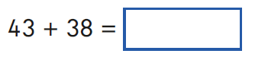
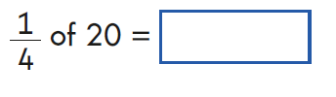
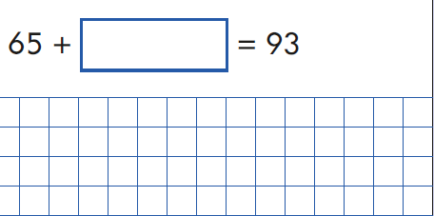

Arithmetic Paper – examples of questions.

Slide 25
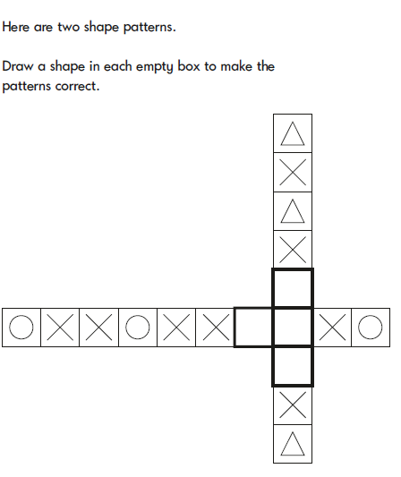
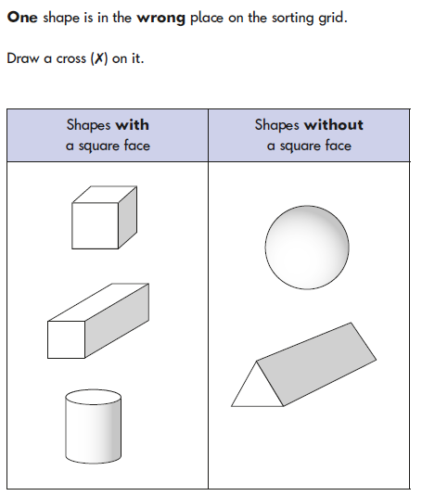
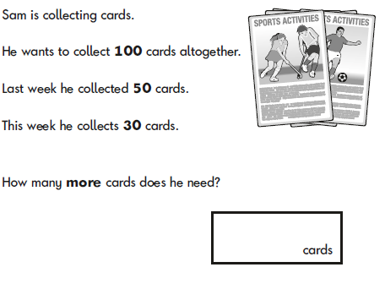
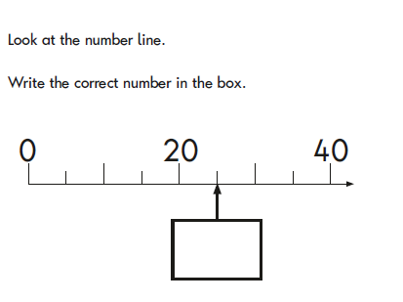
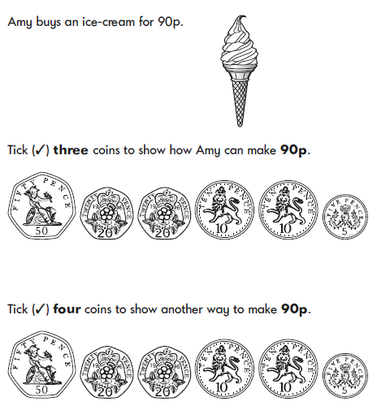
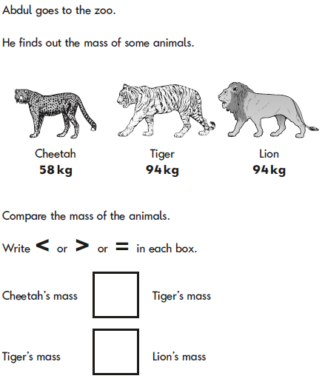
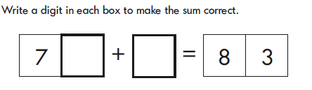
Reasoning paper – examples of questions.

Slide 26
How can you help?
Homework
Read regularly with your child, asking lots of questions to confirm understanding of the text.
Learn number bonds to 20 for RAPID RECALL.
Learn 2, 5 and 10 times tables for mental recall.
Learn weekly spellings and meanings of these words.
Practise correct letter formation.

Slide 27
Any questions?

