Slide 1
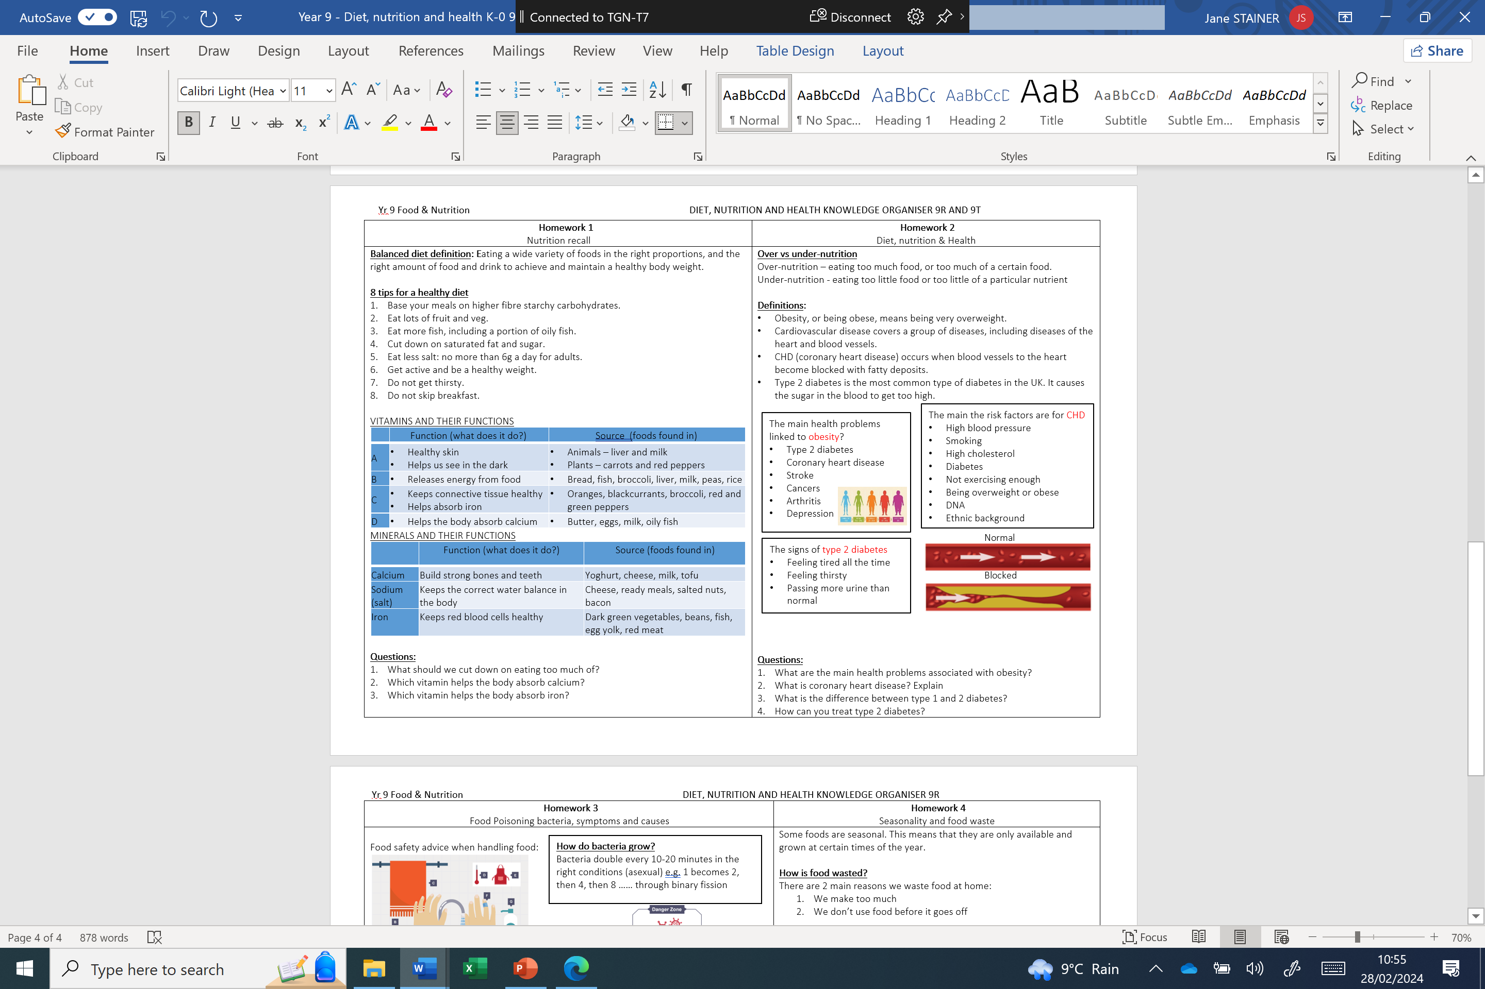
Year 9 Catering Food Assessment Revision Checklist
The end of cycle assessment will cover mainy the following topic areas: Use the RAG1 before and RAG2 after you revise to identify areas of strength and weakness.
Knowledge Organiser |  | Notes | RAG1 | RAG2
Use your knowledge organiser to revisit key terms and a summary of each lesson. Please focus revision on areas you are least confident in. The knowledge organiser is available here: Food Technology
Key Terms to help with Assessment
Term | Definition / Function | Definition | RAG1 | RAG2
Calcium
Iron
Sodium
Vitamin A
Vitamin B
Vitamin C
Vitamin D
Over-nutrition
Under-nutrition
Obesity
CHD
Salmonella
Listeria
Bacteria
Seasonal
Food waste
Reduce Food Waste
This is only a Guide to help with Revision – you should use your previous knowledge as well during Assessment.

