Slide 1
School Training on Adrenaline Auto-Injectors
Trafford School Nurse Team
September 2020
Helen McNulty, Team Leader
Maureen Tait, Practice Teacher Assessor

Slide 2
Aims of this Session
    To provide a brief overview of allergy/anaphylaxis.
    Video demonstrations on the administration of all 3 types of Adrenaline Auto-Injector pens that may be in your school.

Slide 3
Allergy
  “Can be recognised as mild, moderate and severe allergic reactions; depending on the symptoms present, the professional will decide the appropriate treatment and course of action following the allergic reaction pathway”.

Slide 4
Anaphylaxis
“A severe and sometimes life-threatening
allergic reaction”
    May be triggered by allergens, or allergy-provoking proteins, e.g. eggs, cow’s milk, shellfish, nuts (particularly peanuts), bee/wasp stings.
    Anyone may react in such a way for the first time at any age.

Slide 5
Anaphylaxis
    Anaphylactic shock occurs because the body’s immune system goes overboard in it’s response to an allergen.
    Cell comes into contact with allergen.
    Cells release histamine in large amounts.
    Causes blood vessels to become leaky causing swelling in the surrounding tissues.

Slide 6
Signs and Symptoms of Anaphylaxis
    Include:
    A feeling of being unwell (impending doom).
    Flushing of the face and neck.
    Sweating, nausea, vomiting and diarrhoea.
    A feeling of itchiness and swelling particularly around the mouth and tongue – “funny’ metallic taste in mouth.”
    Difficulty in swallowing, speaking and breathing.

Slide 7
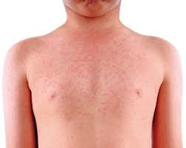
Urticarial Rash (nettle rash/hives)
Urticarial rash may occur

Slide 8
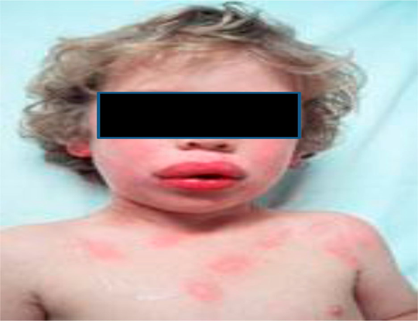
Swelling of the face, eyelids and lips

Slide 9
Signs and Symptoms
  St. John’s Ambulance video:
  https://www.youtube.com/watch?v=QrueP382UjY

Slide 10
Prevention
    Children should be educated on the risks of eating foods/coming into contact with the allergen.
    Encourage child not to accept treats from friends. Alternative suitable treats provided by parents could be kept for the child.
    A packed lunch is a sensible option.
    Should there be a strong wish for the child to eat school meals, consider exclusion of the food from the menu.
    Staff in contact with the child should be alerted to the fact that the child has a serious/life threatening allergy to a particular allergen.

Slide 11
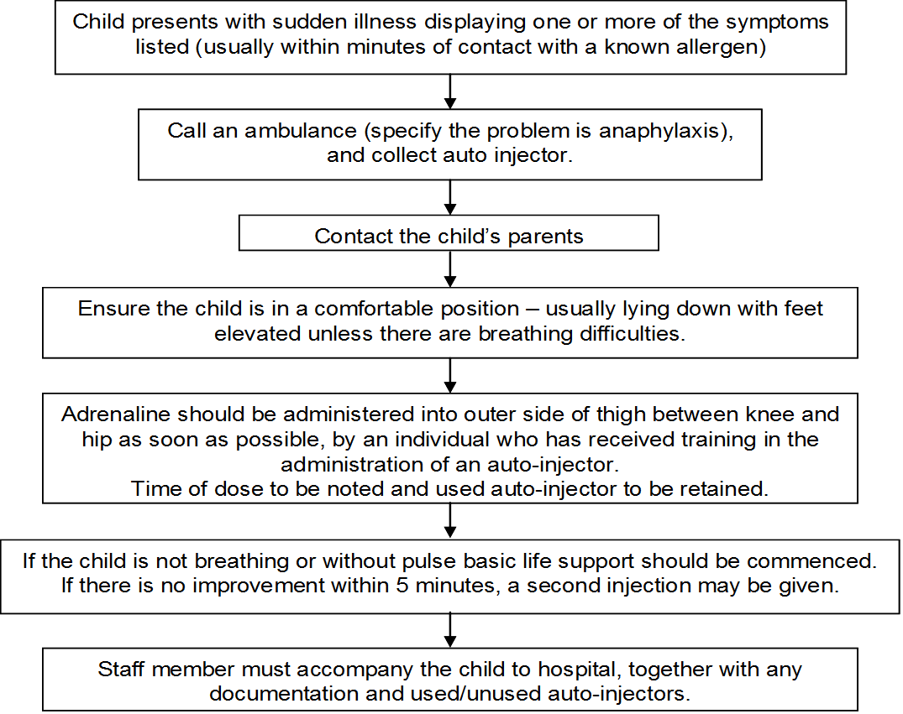
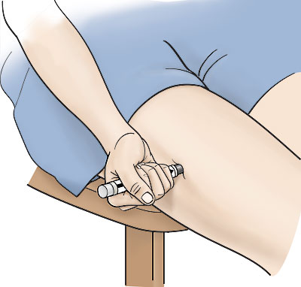
Management of anaphylaxis using a prescribed auto-injector

Slide 12
Site for Injection

Slide 13
Using an Adrenaline Auto Injector
    There are 3 different Adrenaline pens available on the market. Your school may have all 3.
    Please choose the relevant demonstration video from the links below:
http://www.epipen.co.uk/demonstrationvideo/
https://hcp.jext.co.uk/about-jext/video-demonstrations/
(please follow health care professional link)
https://www.emerade.com/instruction-video

Slide 14
Following Administration
    Child to go to hospital in ambulance accompanied by a member of staff/parent.
    Used auto-injector and any unused auto-injectors to go in the child’s box with all documentation with the staff member.
    Parent to replace auto-injector as soon as possible.
    Inform School Nurse so that care plan can be reviewed/renewed.

Slide 15
Will it harm the child if an auto-injector is administered unnecessary?
    There are no contraindications to the use of adrenaline and it is a safe medication.
    Side-effects of giving and auto-injector include palpations, tremor, headache. However these are usually mild and pass without any long-term effects for the young person and potentially it may save their life.

Slide 16
Information for School
    Good practice dictates 2 pens are kept in school.
    Stored together in a labelled box in an accessible location recognised by all trained staff.
    (Secondary age children might carry one pen in their bag/blazer).
    Pens and care plan should be taken on school trips and child accompanied by a trained member of staff

Slide 17
Information for School
Supporting pupils at school with medical conditions:
https://www.gov.uk/government/publications/supporting-pupils-at-school-with-medical-conditions--3
Parental responsibility to ensure that pens are in date and in school for use and replaced if used.

Slide 18

Any Questions?

