Slide 1
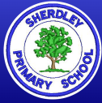
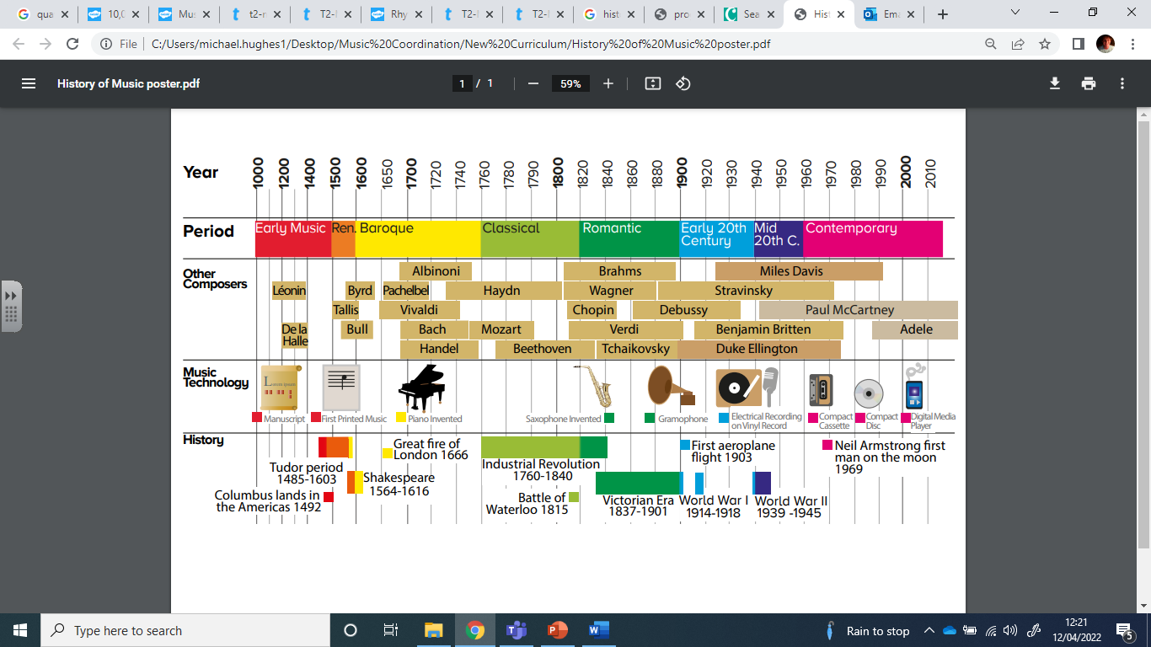
Music Knowledge Organiser – Year 6
Other useful vocabulary
Pentatonic | A scale (ordered series of notes) with five notes. A major pentatonic uses notes 1,2,3,5 and 6 of the scale (in C major this would be C,D,E,F and G).
Melody | A sequence of notes – a tune.
Harmony | Two or more pitches played or sung together.
Accompani-ment | An instrumental or vocal part designed to support a melody.
Ternary | A piece of music with a structure of three parts – the last part is often a repeat or variation of the first part.
Triad | A chord of three notes – one, three and five of the scale.
Chord | Three or more notes played together at the same time (A dyad is a two-note chord).
Key Vocabulary – can you compare and contrast across different genres and pieces of music?
Pulse | A steady beat. Does the beat change?
Rhythm | What types of notes do you hear? Crotchets/quavers? Are there any rests?
Pitch | How high or low a note is. How does this change in a piece of music?
Tempo | Speed the music is played at – fast or slow? Does this change?
Dynamics | Levels of sound – how loud/soft?
Timbre | The character of the sound – is it wooden, metallic, breathy?
Texture | How the different sounds and instruments work together. Thick or thin? How many layers?
Structure | The order the different parts of a piece of music are played.

Slide 2
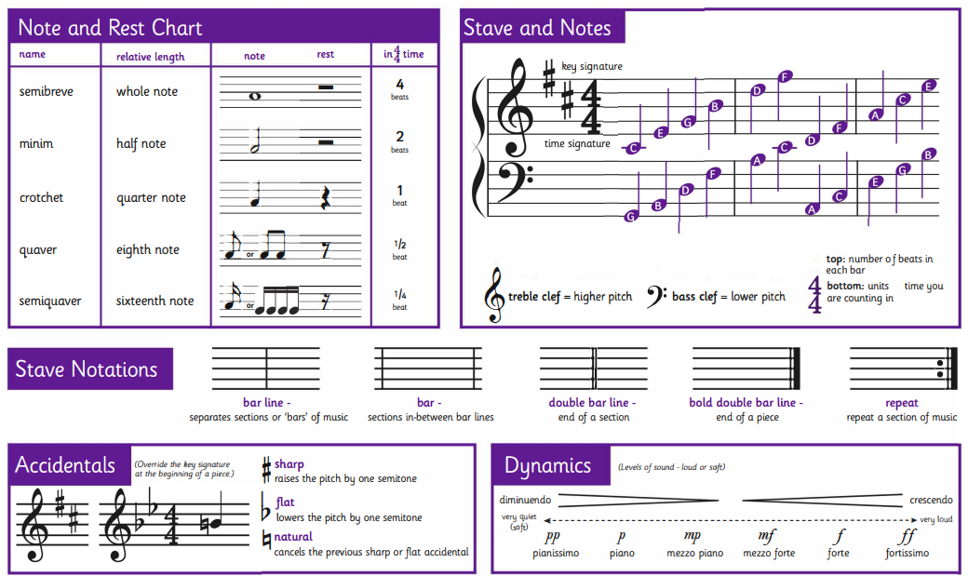
Music Knowledge Organiser – Year 6

