Slide 1



Maths Calculations Year 6
Methods for teaching the four calculations at St. David’s.

Slide 2
Year 6 National Curriculum objectives.
Addition, Subtraction, Multiplication and Division
multiply multi-digit numbers up to 4 digits by a two-digit whole number using the formal written method of long multiplication
divide numbers up to 4 digits by a two-digit whole number using the formal written method of long division, and interpret remainders as whole number remainders, fractions, or by rounding, as appropriate for the context
divide numbers up to 4 digits by a two-digit number using the formal written method of short division where appropriate, interpreting remainders according to the context
perform mental calculations, including with mixed operations and large numbers
identify common factors, common multiples and prime numbers
use their knowledge of the order of operations to carry out calculations involving the 4 operations
solve addition and subtraction multi-step problems in contexts, deciding which operations and methods to use and why
solve problems involving addition, subtraction, multiplication and division
use estimation to check answers to calculations and determine, in the context of a problem, an appropriate degree of accuracy

Slide 3
Vocabulary related to the four calculations for Year EYFS – Year 6.
In each year group it shows the new vocabulary taught.
EYFS/Year 1
more (than) less (than) total
fewer (than) equal (to) most
least
sum difference between total
first
plus add(ition) subtract(ion)
minus ones tens column(s) multiples
Year 2
multiple commutative
>as ‘greater than’
< as ‘less than’ partition
place holder
place value estimate
estimation
inverse
array
calculate
multiplication division
times tables
Year 3
multiple(s) inverse operations integer(s) decimal(s) remainder
Year 4
round rounding
negative
operation
Factor
factor pairs distributive associative derive remainder
odd even double halve pair
how much how many larger smaller estimate compare together
Year 5
power(s) prime complement
composite prime factor square(d)2 cube(d)3 equivalence
Year 6
long division Multi-step common factors common multiple

Slide 4
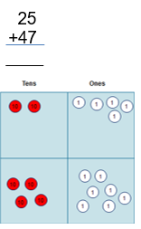
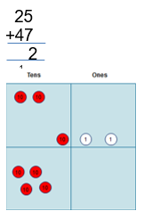
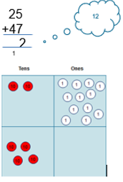
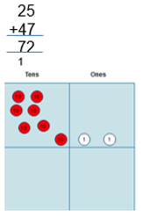
Addition
The concept of exchange is reinforced through continued use of manipulatives.
Teachers model:
1.
“I have two
tens and five ones,
which need adding to four tens and seven ones.”
2.
“\I add five ones to seven ones,
which gives me twelve ones.”
3.
“I exchange ten of my twelve ones for a ten counter.”
4.
“I add my three tens and four tens to make seven tens.”
“Altogether, I have seven tens and two ones.”

Slide 5

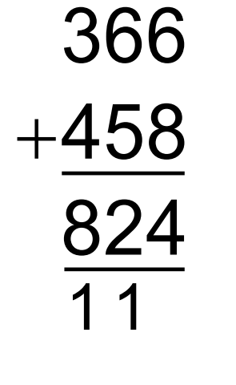
Children then advance to model the addition of two 3-digit numbers through a compact method and then go beyond to more digits.
Need to be able to:
•Add in columns.
•Have place value awareness.
•Organisation (layout)
•Ability to estimate.
•Can check answers for reasonableness

Slide 6
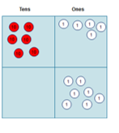
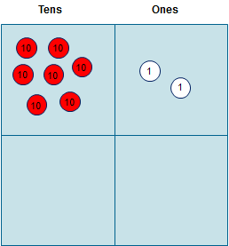


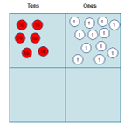
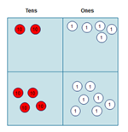


Subtraction
I have seven tens and two ones. I need to subtract four tens and seven ones.”
3. “Now I can take away seven ones from twelve ones, so that I have fives ones left.“
1.
I have seven tens and two ones. I need to subtract four tens and seven ones.”
3.
“Now I can take away seven ones from twelve ones, so that I have fives ones left.“
2.
“At the moment, I cannot subtract seven ones from two ones, so I need to echange one ten to become ten ones.”
“At t2. “At the moment, I cannot subtract seven ones from two ones, so I need to transfer one ten to b I cannot subtract seven ones from two ones, so I need to transfer one ten to become ten ones.”
“I can now subtract four tens from six tens, which leaves me with two tens.”
4.
“I can now subtract four tens from six tens, which leaves me with two tens.”
5.
“Finally, I recombine two tens and fives ones to understand that I am left with twenty-five.”

Slide 7
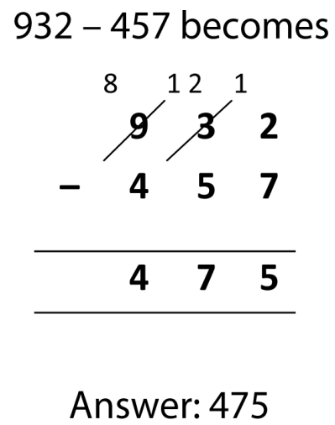
Children then advance to model the subtraction of two 3-digit numbers through a compact method and then go beyond to more digits.
Need to be able to:
•Subtract in columns
•Have place value awareness.
•Organisation (layout).
•Knows to work from right to left.
•Understands conservation of number.
•Knows larger number goes “on top”.
•Knows you can only exchange one ten , hundred, thousand etc.
•Ability to estimate.
•Can check answer for reasonableness

Slide 8
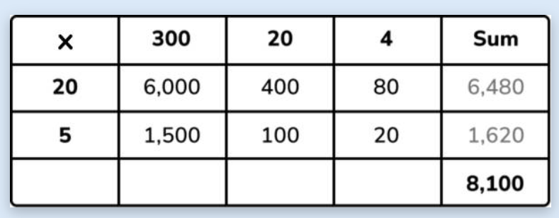
Multiplication
324 x 25 = 8,100
Partition your numbers out 324 = 300, 20, 4 25 becomes 20 and 5
Multiply each set of numbers – along and up
20 x 300
20 x 20
20 x 4
5 x 300
5 x 20
5 x 4
Add together the answers to the multiplication to find your answer.
Grid method or area model

Slide 9
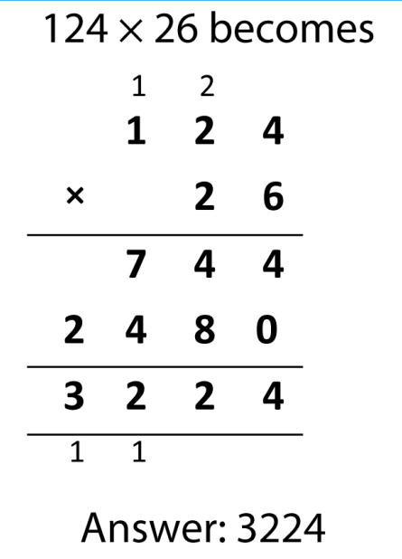
Long Multiplication
Children then advance to the model of long multiplication up to 4 digit by 2-digit numbers.
•Knows times tables
•Have place value aware
•Organisation (layout)
•Ability to estimate
•Can check by applying the inverse
Need to be able to:
Steps:
Times by ones
Times by tens (making sure you place the 0 at the end of the row)
Add all column together to get your answer.

Slide 10

Short Division
Short division – sometimes referred to as the bus stop method
Steps
How many 6s are in 1? It can’t be done so carry over the 1.
How many 6s in 13? 2 so 2 goes above the 13 on top of the box. 2 x 6 = 12 so 13-12 leaves 1. Carry over the 1 onto the next digit.
How many 6s in 18? 3 so put the 3 on top of the box above the 18.
138 ÷ 6 = 23.

Slide 11
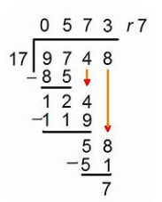
Long Division
Number stack
1x = 17
2x = 34
3x = 51
4x = 68
5x = 85
6x = 102
7x = 119
8x = 136
9x = 153
10 x 170.
Step one – create a number stack of the divisor which in this example is 17.
This cuts back on lots of working out when trying to work through the method.
Mistakes can be made so use the 5 x and 10 x to check that the number stack is correct.
Steps ÷ x - divide, multiply, subtract, bring down and repeat
17 into 9 doesn’t go so carry over the 9 to make 97
17 into 97 goes 5 times. Put 5 on top of the box.
17 x 5 = 85. Put this under the 97 and subtract.
7-5 = 2. 9-8 = 1. Place under the 85. Then bring down the next digit (4).
17 into 119 goes 7 times. Place 7 on top of the box .
124 – 119 = 5. write it under the 119 in the ones column. Bring down the next number (8).
17 into 58 goes 3 times. Place the 3 on top of the box.
17 times 3 = 51. Subtract 51 from 58 = 7.
17 will not go into 7 so you have a remainder of 7.
9748 ÷ 17 = 573 remainder (r) 7.

