Slide 1


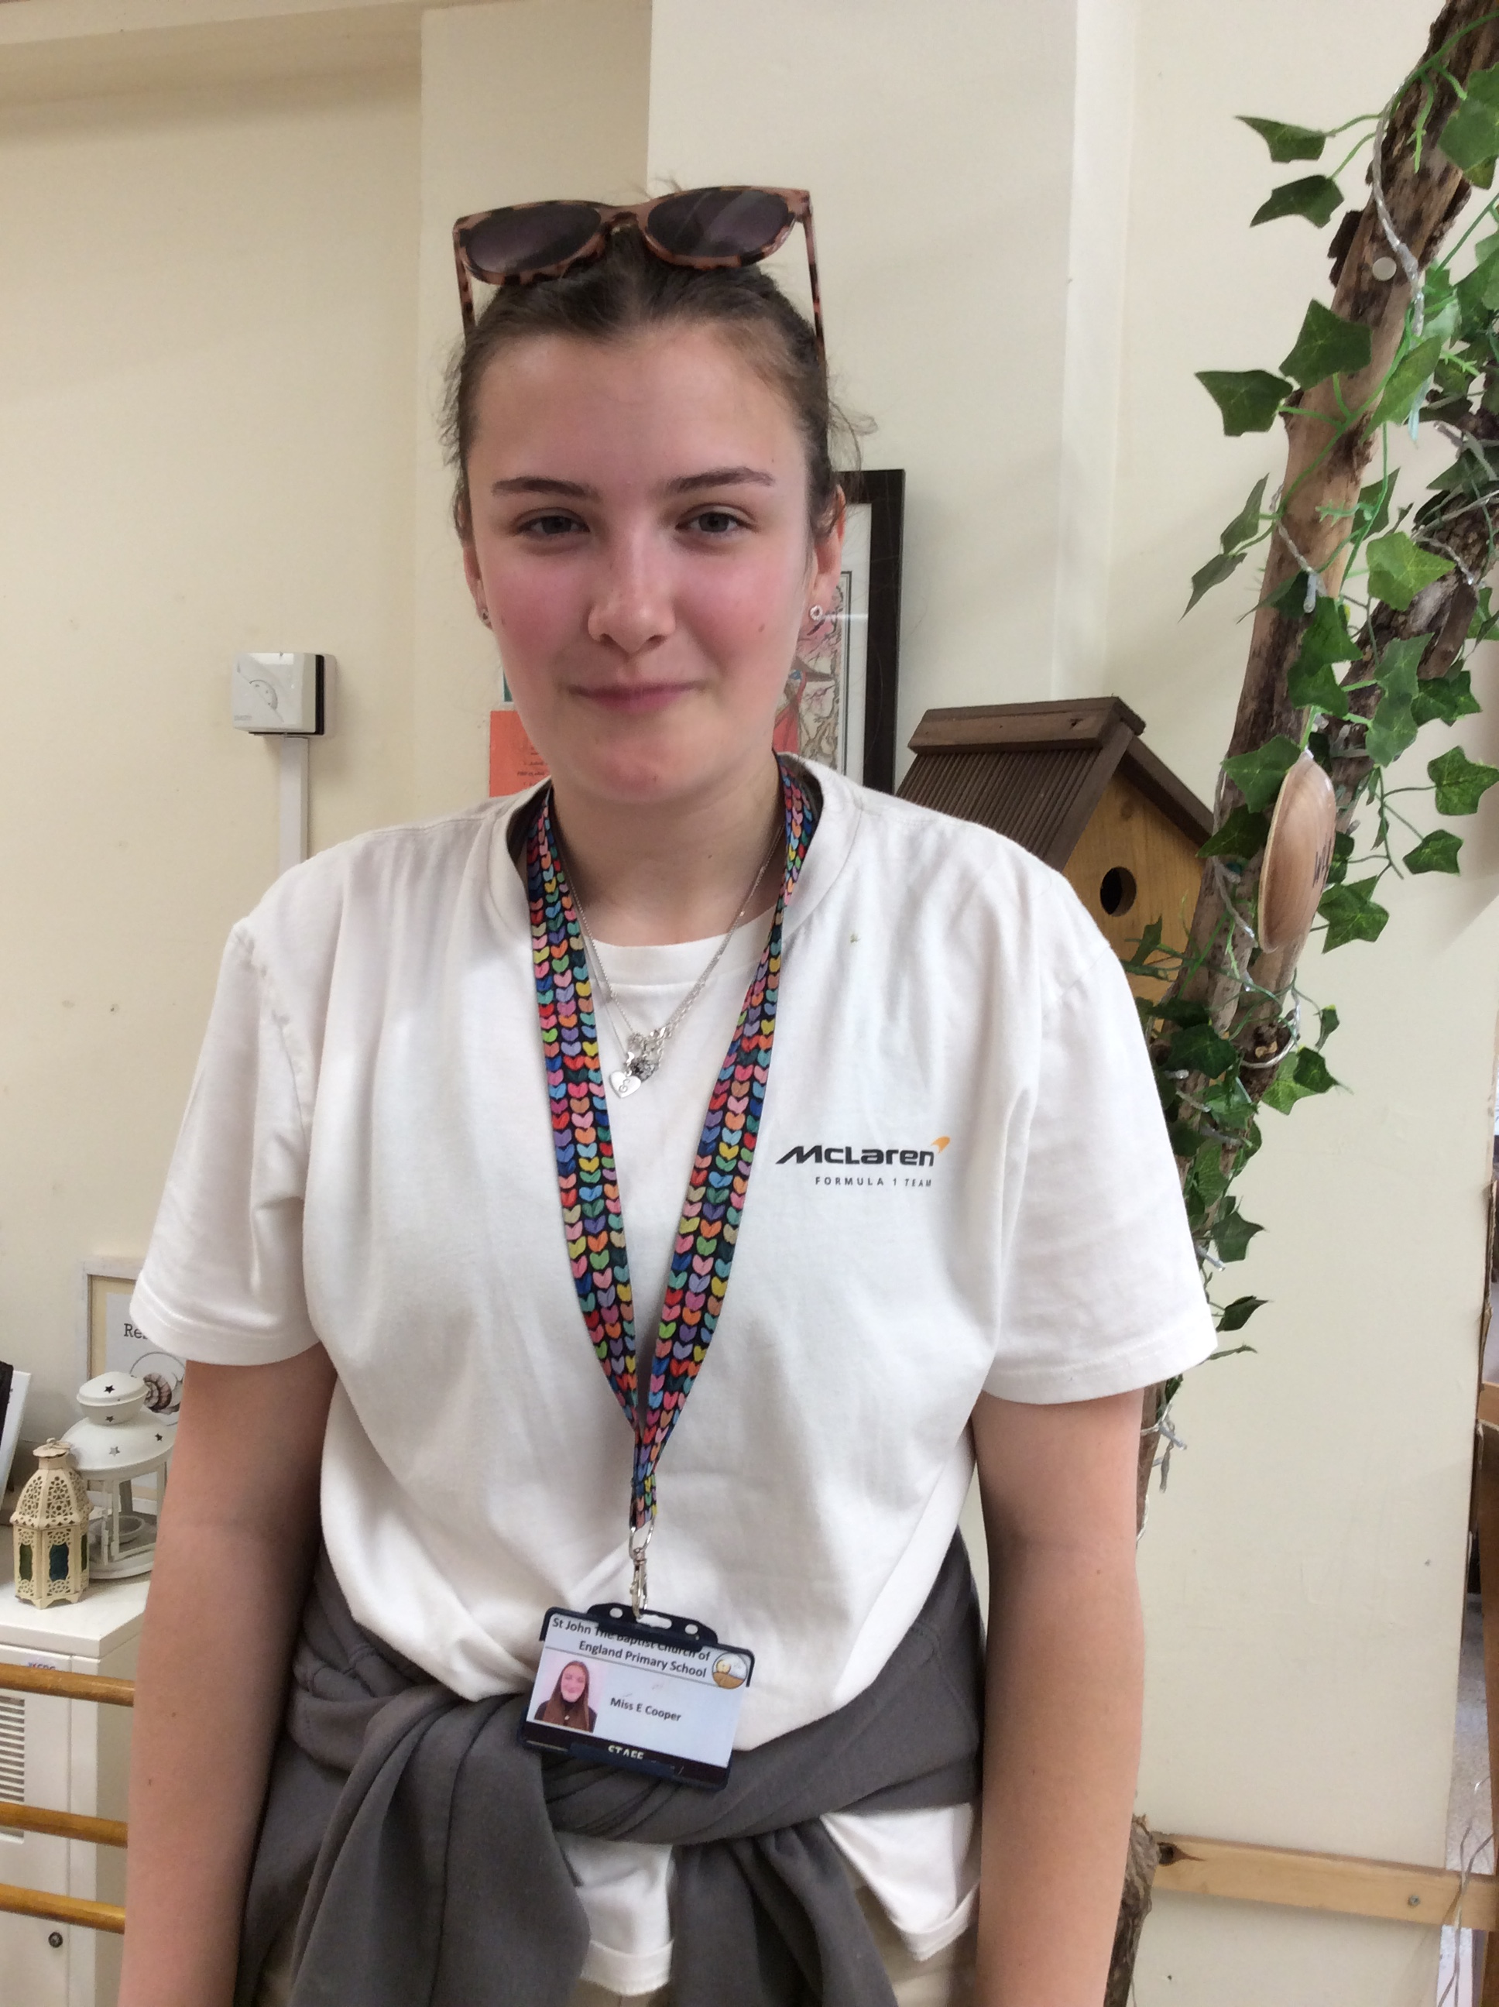
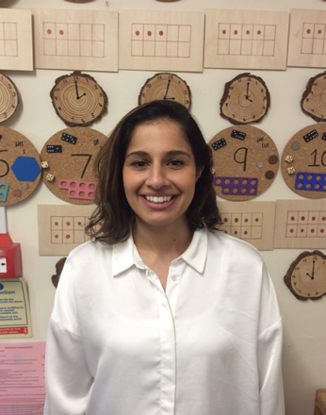


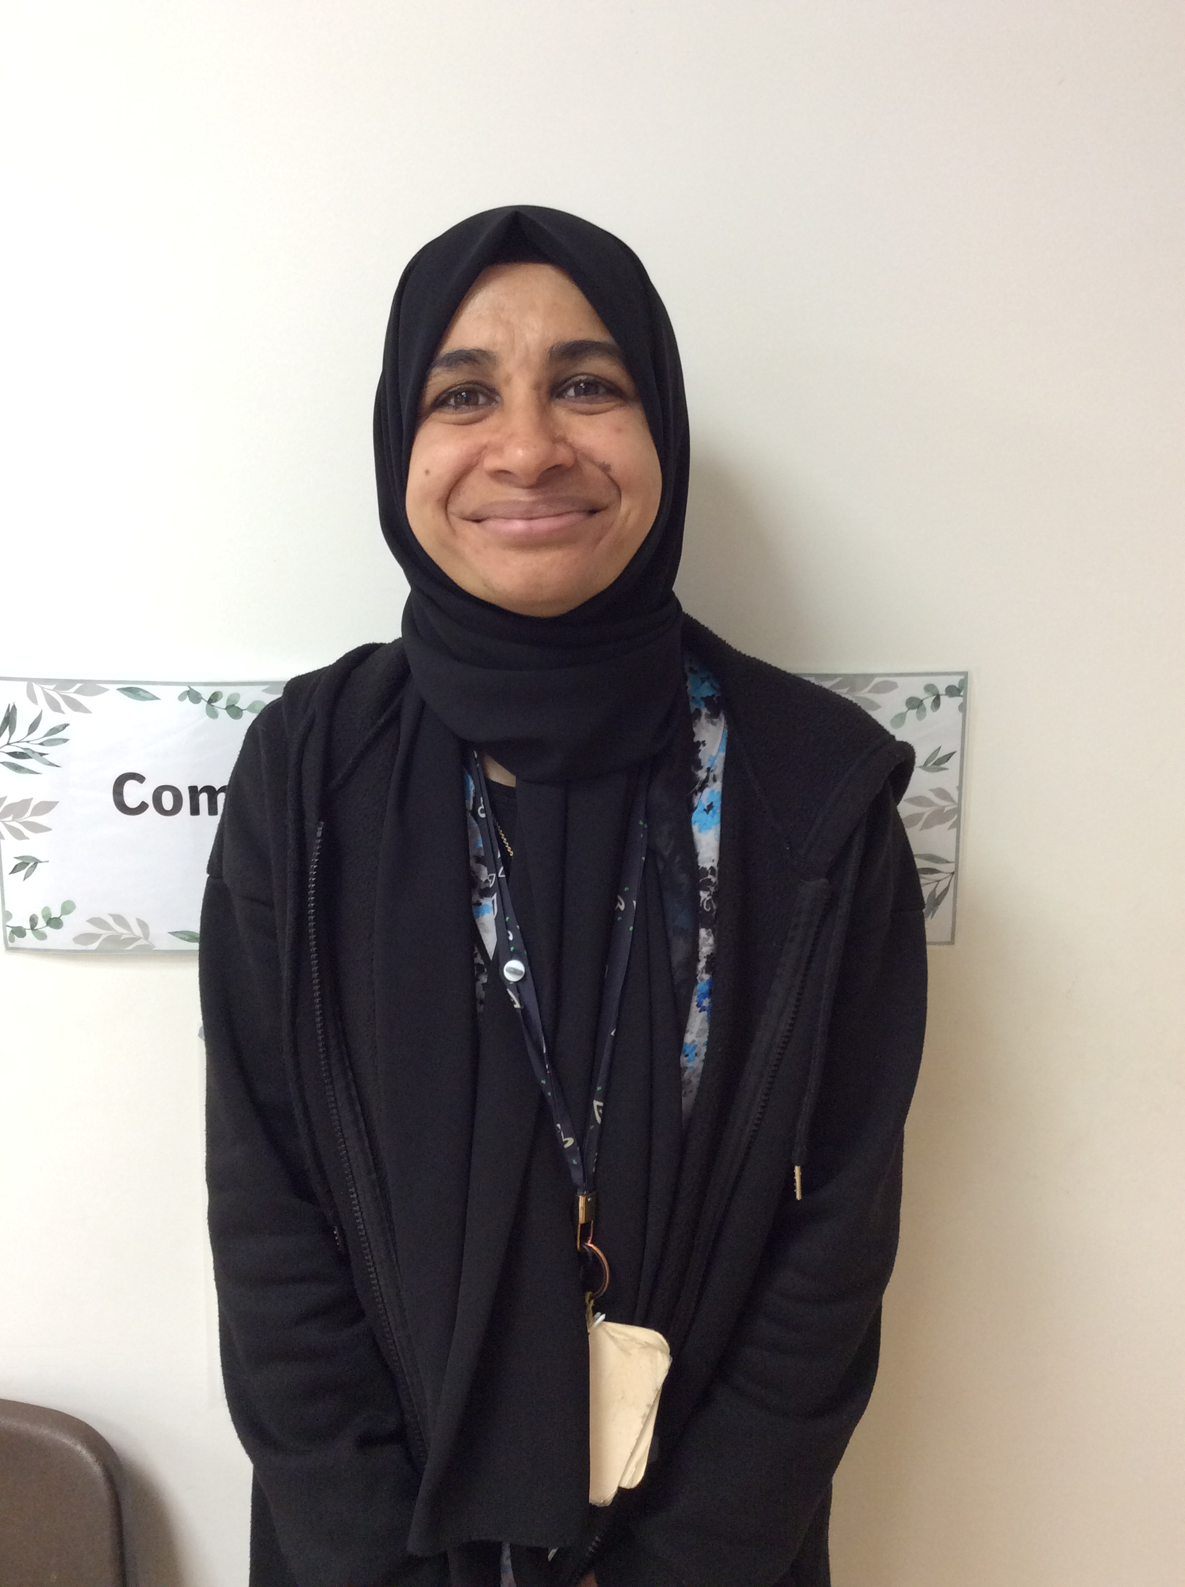
Mrs Issa
My name is Mrs. Issa and I am going to be your class teacher. I love going on walks and days out with my children. One of my favourite places in the classroom is the art area—it’s the perfect spot to get creative and let your imagination shine! I also really enjoy the role play area, where you can dress up, have fun, and explore new ideas through play. Reading stories is something I truly enjoy, and I’m looking forward to sharing lots of wonderful books with you. I am sure we are going to have lots of fun!
Miss Cooper
My name is Miss Cooper and I will be your teaching assistant this year! When I’m not at school, you’ll often find me out on the water—I absolutely love water sports. At school, one of my favourite places to be is the outdoor area. I especially enjoy getting creative in the mud kitchen—it’s the best spot for messy fun and imaginative play!
Miss Dakri
Hello! My name is Miss Dakri and I am excited to join the Hungry Caterpillars. I am really looking forward to meeting you all and be a part of your learning journey. I enjoy building in the construction area and I can't wait to make some great models with you.

