Slide 1

Issue 20 September 2025
William Gilbert Endowed C of E Primary School and Nursery
www.williamgilbertend.derbyshire.sch.uk Safeguarding and Child Protection
at William Gilbert School
Welcome to our Safeguarding Newsletter
Coming up in this issue – our safeguarding team, what is child abuse, sexual harassment/harmful sexual behaviour, mental health, online safety, keeping safe in the community – road and fire safety.
Safeguarding & Child Protection is the most important issue for our children and young people. At William Gilbert School, we feel it is crucial to work with our parents and the high-quality agencies that support schools and young people, so that we can offer a safe environment allowing children to be aware of the risks they may face and how to respond to them safely.
Safeguarding and promoting the welfare of children is everyone's responsibility
The Safeguarding Team at William Gilbert Primary The William Gilbert safeguarding team has five Designated Safeguarding Leads or DSLs. These members of staff have enhanced safeguarding training and have a vital role in taking lead responsibility for child protection issues in school. The senior DSL is Mrs Britten. A DSL is always available during school hours for pupils, parents and staff to discuss any safeguarding concerns. Mrs Aston continues to support pupils and their families in her role as Pastoral and Wellbeing Mentor. Part of her role is to provide advice and access help as soon as a need emerges. Mrs Aston can support families with a wide range of issues, including but not limited to, mental health and wellbeing, attendance, persistent lateness, the impact of community safeguarding issues including bullying and online safety. Mrs Aston can be accessed at the school gate most mornings, via the school office or via pastorallead@williamgilbertend.derbyshire.sch.uk There is always a member of the DSL team at one of the school gates each morning for support, advice or a listening ear.
Our Safeguarding Curriculum
‘Keeping Children Safe in Education 2025’(KCSIE) reminds us that safeguarding and promoting the welfare of children is everyone’s responsibility. Everyone who comes into contact with children and their families has a role to play. This means that they should always consider what is in the best interests of the child. At WGES we believe that it is vital for our children to have opportunities to learn how to stay safe both in and outside of school—learning which comes from parents and staff at WGES. Safeguarding awareness and understanding of issues including, but not limited to, children absent from education, harmful sexual behaviour, bullying, domestic abuse, discrimination, inequality, drugs & alcohol abuse, faith abuse, forced marriage, gender violence, radicalisation and mental health - all start with the knowledge and skills we introduce at school.
Useful Acronyms & Vocabulary
DSL: Designated Safeguarding Lead
PREVENT: Part of the Governments Counter Terrorism Strategy to stop people being drawn into extremism
LADO: Local Authority Designated Officer - who deals with position of trust safeguarding issues
CEOP: Child Exploitation and Online Protection Centre
National Online Safety -Online training and support for families about all things online
KCSIE: Keeping Children Safe in Education (available on the school web pages)
Who’s Who at WGES
Mrs E H Britten - Senior DSL
Mrs Z Kibble - Deputy DSL
Mrs A Aston - DSL and pastoral wellbeing lead.
Mrs S Owen – DSL and mental health first aider
Mrs R Manners – DSL and SBM
Dr N Ruggins – Safeguarding Governor
Miss K Whiting –Mental Health First Aider
Mrs E Davies – SENCO
Designated Safeguarding Leads can be accessed via our safeguarding email
safeguarding@williamgilbertend.derbyshire.sch.uk
If you believe that a child or an adult is at immediate risk of harm and in need of protection then you should call the Police - 999, straight away.
Alternatively if you want advice from the Police and the child or adult is not in immediate need of protection, you can call the Police on the telephone number 101.
Here are some examples coming this term that you can discuss with your child
Weekly Safeguarding Awareness Assemblies covering the following topics this term –Who is a trusted adult at school and home; How to stay safe on the playground; NSPCC speak out to stay safe; online safety; World mental health day, road safety, safety in the community and how to report concerns/worries.
Religious Education lessons reinforce messages of tolerance and respect for others. Opportunities to learn about other faiths and visit places of worship.
RSHE lessons – see knowledge mats on the school website for year group information
Links with the NSPCC initiatives through workshops, assemblies and lessons
Balanceability and Bikeability training
Engagement with charities that broaden pupils' awareness, understanding and worldview
Behaviour policy and practice in school under the ‘Golden Rules’
Visit from our local PCSO to promote safety in the community during the autumn nights and festivities.

Slide 2


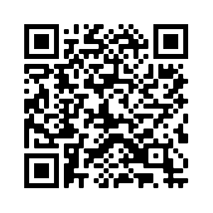
What are the signs of child abuse?
NSPCC
The signs of child abuse aren't always obvious, and a child might not feel able to tell anyone what's happening to them. Sometimes, children don't even realise that what is happening to them, is abuse.
There are different types of child abuse and the signs that a child is being abused may depend on the type. For example, the signs that a child is being neglected may be different from the signs that a child is being abused sexually.
Common Signs
Some common signs that there may be something concerning happening in a child’s life include:
unexplained changes in behaviour or personality
becoming withdrawn
seeming anxious
becoming uncharacteristically aggressive
lacks social skills and has few friends if any
poor bond or relationship with a parent
knowledge of adult issues inappropriate for their age
running away or going missing
always choosing to wear clothes which cover their body
These signs don’t necessarily mean that a child is being abused, there could be other things happening in their life which are affecting their behaviour – but we can help you to assess the situation.
You may also notice some concerning behaviour from adults who you know have children in their care, which makes you concerned for the child/ children’s safety and wellbeing.
https://www.nspcc.org.uk/what-is-child-abuse/
https://www.nspcc.org.uk/what-is-child-abuse/types-of-abuse/
Sexual Harassment in Schools
What is Sexual Harassment?
Sexual harassment in general is any unwanted sexual attention online and offline that can cause physical, emotional/mental, psychological or economic harm to the victim.
Can this happen in Primary School?
Research suggests that more than a third of sexual abuse reported by any age children is perpetrated by their peers (Child on Child Sexual Abuse) - with girls being the victim in the majority of cases. Sexual violence and sexual harassment can occur between two children of any sex. It can also occur through a group of children sexually assaulting or sexually harassing a single child or group of children. It is important that we teach all children (boys and girls), of all ages, what is acceptable interaction and what is not, and then what they must do if any unwanted sexual attention happens to them.
What can we do to teach children appropriate interaction?
Boys and girls mix together in every social environment, at every age and many children will never experience sexism, harassment or abuse based on gender. To ensure that our youngest children know how to keep themselves safe we must encourage an open honesty about their experiences so that they know it is always safe to disclose to a trusted adult. Parents and staff should make sure they model the best ways of showing respect between the genders and challenge any attempt by family members, friends, other parents and organisations to undermine that work.
Useful Acronyms & Vocabulary
Sexual Violence: Incidents such as rape, assault by penetration and sexual assault.
Sexual Harassment: sexual comments, remarks, jokes and online sexual harassment, which may be stand-alone or part of a broader pattern of abuse.
Sexting: also known as ‘youth-produced sexual imagery’
Sexual abuse: being persuaded or forced into undesired sexual activity
Misogyny: Feelings of hating women or the belief that men are better than woman.
Safeguarding Information at WGES
We have a wealth of information on our school website for parents to access, including important documents and contact details.
Please visit www.williamgilbertend.derbyshire.sch.uk
Scan the QR code below to take you to our safeguarding page

Slide 3
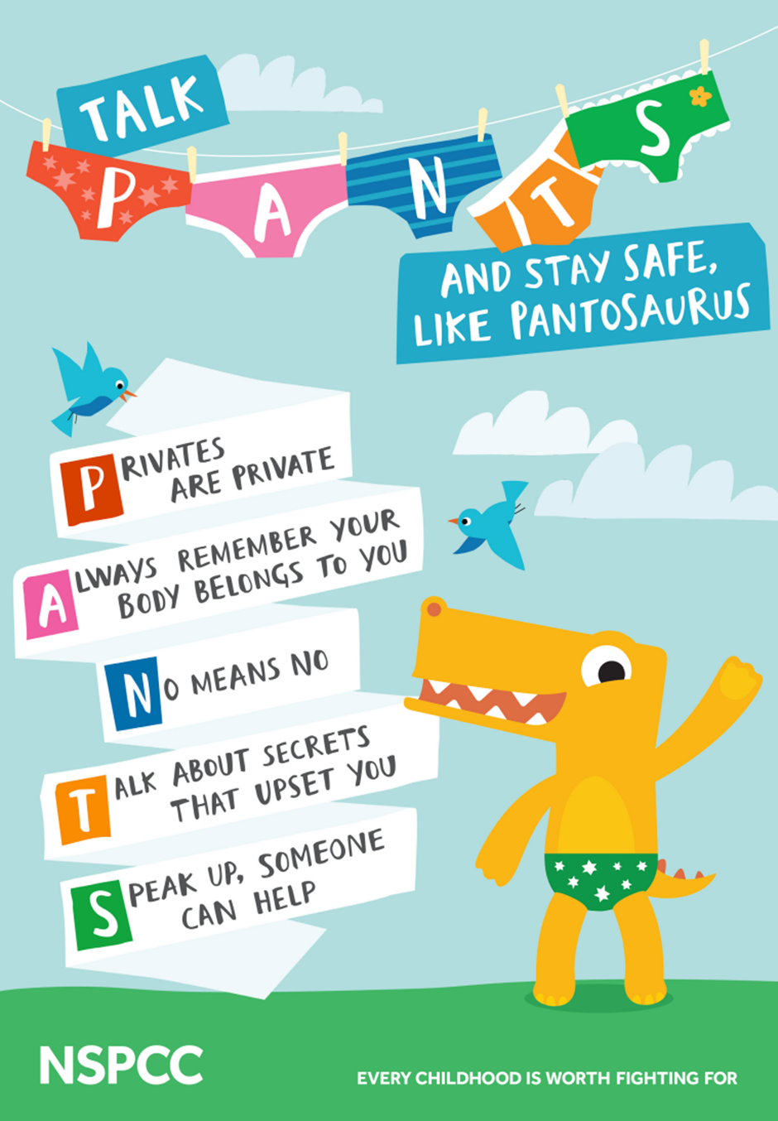
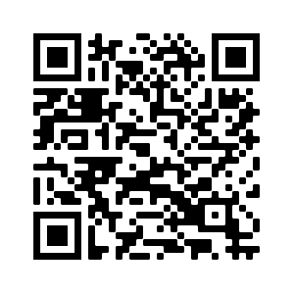
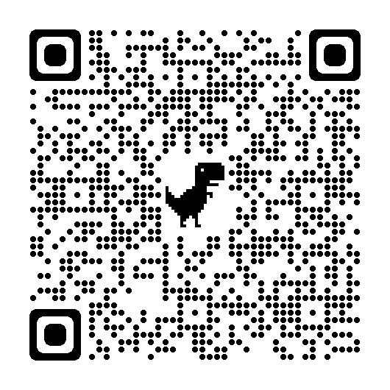
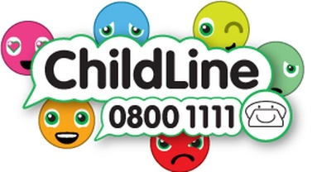
How to prevent Sexual Harassment in School and protect your child from sexual abuse
Useful Acronyms & Vocabulary
CAMHS: Child and Adolescent Mental Health Services
My Concern – Safeguarding record system (safeguarding and child protection software for schools used at WGES).
EHA: Early Help Assessment
SEND: Special Educational Needs & Disabilities
Safeguarding Information at WGES
We have a wealth of information on our school website for parents to access, including important documents and contact details.
Please visit www.williamgilbertend.derbyshire.sch.uk
If you believe that any child is in danger ring Call Derbyshire Tel: 01629 533190 choosing the option for urgent child protection calls at any time
At Primary School, we have to be very proactive in creating an environment that teaches boys and girls how to behave respectfully towards each other, and how to respect personal/physical boundaries set. We must make sure all of our young people (boys and girls) are prepared for the wider world of secondary school and employment.
Developing Awareness
We should not frighten children but should develop age-appropriate awareness and understanding of the dignity of the person and how to respect self, thereby giving skills to respect others. If children understand their own bodies, the terminology to use, why other words are not appropriate, they will speak more knowledgably and respectfully to each other.
Pupils who are the victim of any level of inappropriate sexual behaviour must tell (and adults must make it safe for them to do so)
Challenge your child if they are using stereotypical or sexist language and educate why it is wrong—the sooner we remove the normalisation of this language, the better.
Talk openly (in an age-appropriate way) about anatomy and the similarities and differences between people. We are all made in the image and likeness of God and so our form, no matter what form that takes, is always perfect to God (there is no superior gender)
Teach your child (and model) what healthy relationships look like—this is lifelong learning that will shape how your child views their future interactions with people and what they see as acceptable
Teach your child about consent
Make sure that your child knows they can say “No” if the behaviour of another person crosses a boundary making it unacceptable.
Teach your child to tell someone they trust about what has happened to them—we take all reports seriously and take action to support alleged victims and alleged perpetrators.
We use the NSPCC resources to teach pupils, in an age-appropriate manner about how to keep safe from sexual abuse.
Every family is different, and when and where you have these conversations may depend on your child's age, or how grown up they are - it's all about whatever feels natural for you and them.
Scan the QR code or follow the link below to take you to the NSPCC website to find lots of information for parents and fun songs to teach them these crucial messages.
https://www.nspcc.org.uk/keeping-children-safe/support-for-parents/pants-underwear-rule/

Slide 4
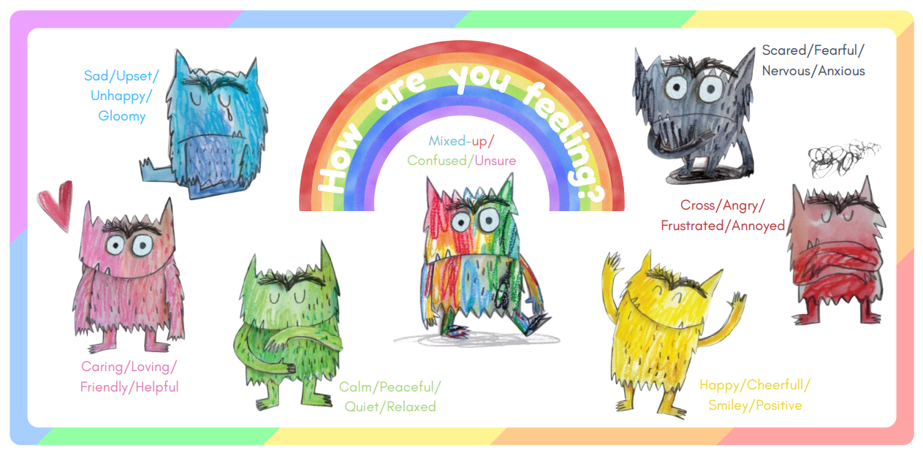
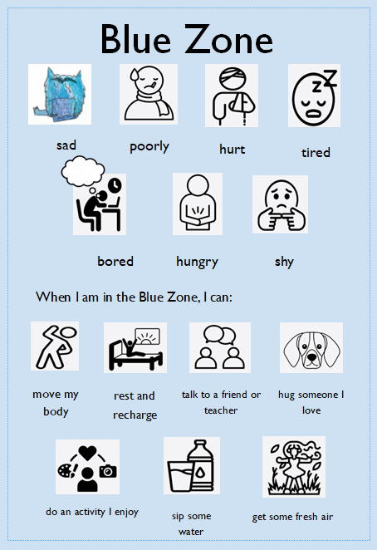
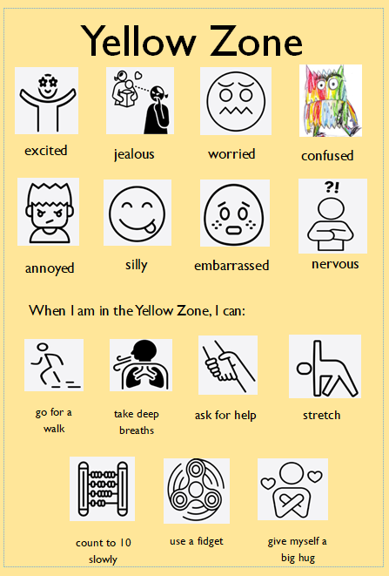
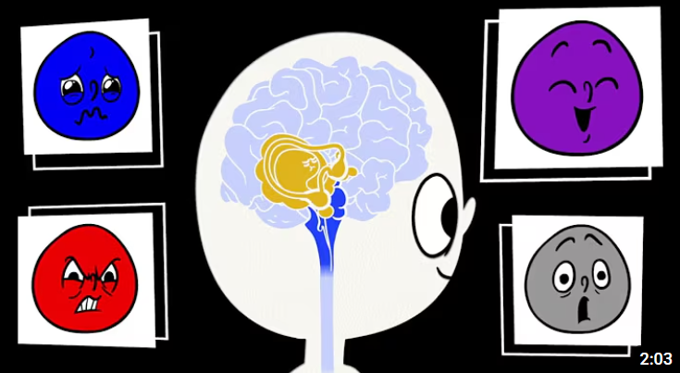
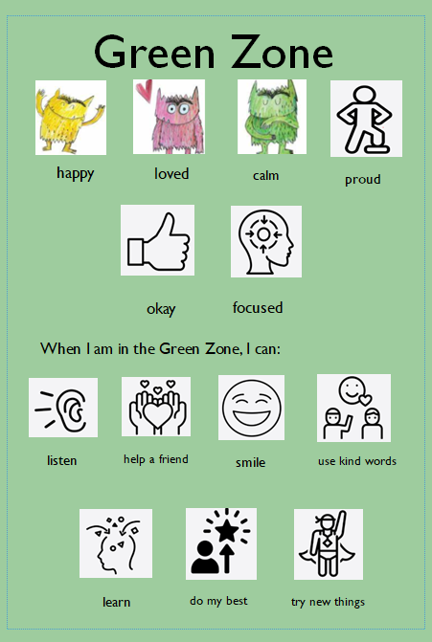

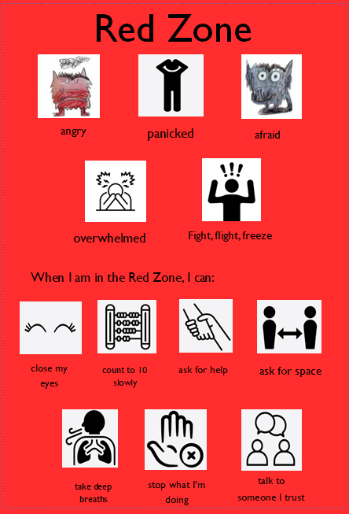


Supporting Pupils Mental Health
At William Gilbert C of E Primary School and Nursery, we are committed to supporting the emotional health and wellbeing of our pupils and staff. We know that everyone experiences life challenges that can make us vulnerable, and, at times, anyone may need additional emotional support. We take the view that positive mental health is a universal right and that we all have a role to play. Our Relationships and Health Education lessons support pupils in developing strategies to take care of their mental health and well-being. This month we raised awareness further through assemblies to mark World Mental Health Day.
At William Gilbert Primary School and Nursery, we:
At our school, we place a strong emphasis on helping children understand and manage their emotions. In Years 1 to 6, we use the Zones of Regulation to support pupils in recognising how they’re feeling, identifying the physical signs of different emotions, and learning strategies to help them regulate their responses. In Early Years, we use The Colour Monster resources to introduce these ideas in a gentle, age-appropriate way, helping our youngest children begin to name and understand their feelings.
Across all year groups, we also explore the science of the brain—how different parts help us think, feel, and respond—and how we can use tools like breathing, movement, and mindfulness to calm ourselves when emotions feel overwhelming. This whole-school approach helps children build emotional literacy, resilience, and confidence in managing their mental health.
Useful Acronyms & Vocabulary
CAMHS: Child and Adolescent Mental Health Services
My Concern – Safeguarding record system (safeguarding and child protection software for schools used at WGES).
EHA: Early Help Assessment
SEND: Special Educational Needs & Disabilities
Safeguarding Information at WGES
We have a wealth of information on our school website for parents to access, including important documents and contact details.
Please visit www.williamgilbertend.derbyshire.sch.uk
Scan the QR code below to take you to our parenting support page for further advice on mental health
The children’s mental health charity, Place2Be, has launched a new website aimed at helping parents with typical situations they may experience with children.
The Parenting Smart website can be found here: https://parentingsmart.place2be.org.uk/
The Colour Monster and Zones of Regulation are used in school to teach children about their emotions and strategies to support them manage them.
Watch this video that explains the science of the brain linked to emotions and feelings.
Parental Support
We know parenting isn’t always easy. Young Minds have lots of practical advice and tips on supporting your child - from how to encourage your child to open up about their feelings to dealing with mental health services. No matter what you and your child are going through, things can get better. They also have a Parents Helpline which can provide advice and support if you're worried about a child or young person.
Visit https://www.youngminds.org.uk/parent/
As a parent or carer, you may sometimes experience your own mental health issues or anxieties and find it difficult to cope with parenting your child. But with the right support and resources it is perfectly possible to be a good parent while managing these problems and to care for and support your children in a positive way. For those affected, the websites below may be helpful, or accessing early help through our well-being and pastoral mentor – Mrs Aston (01332) 840 395 or pastrorallead@williamgilbertend.derbyshire.sch.uk

Slide 5


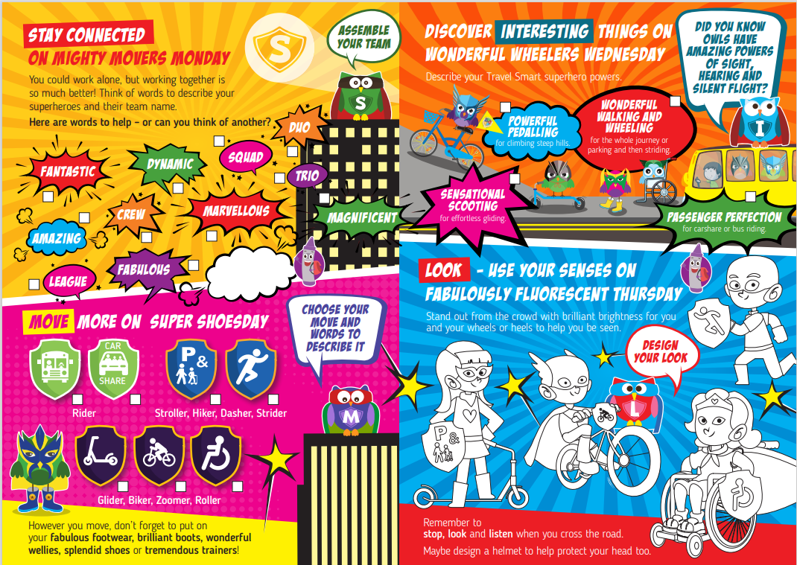
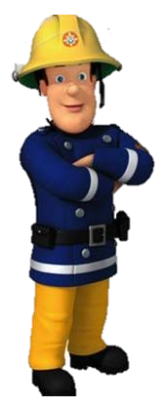

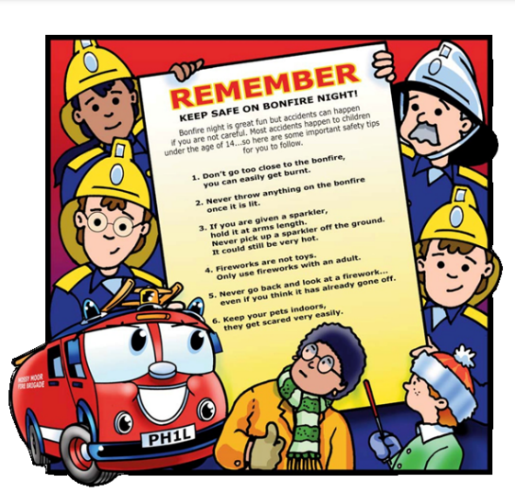
Keeping Safe in the
Useful Acronyms & Vocabulary
RoSPA: Royal Society for the Prevention of Accidents
My Concern – Safeguarding record system (safeguarding and child protection software for schools used at WGES).
EHA: Early Help Assessment
SEND: Special Educational Needs & Disabilities
Safeguarding Information at WGES
We have a wealth of information on our school website for parents to access, including important documents and contact details.
Please visit www.williamgilbertend.derbyshire.sch.uk
If you believe that any child is in danger ring Call Derbyshire Tel: 01629 533190 choosing the option for urgent child protection calls at any time
Road Safety
All class teachers encouraged pupils to take part in the Derbyshire County Council Travel Smart Week 20th -24th October 2025. These regular events encourage children to make more active and environmentally friendly journeys to school.
Scooter Safety training – 18th September 2025
Rob Bounds Senior Transport Officer for Derbyshire County Council will lead scooter safety training workshops in school on 18th September 2025. These fun sessions aim to help keep children road aware when using local pavements. He will be inviting parents into school at 9am for KS1 and 3:15pm for KS2 to share top tips (whilst your children listen) to scooter safely along roads near school.
Please remember, Vicarage Lane is a School Street, meaning it is closed to parent cars between 8:20 and 9:05am and 3:00 and 3:45pm. Remember you can park at the Viceroy or Golf Club car parks and then walk to school.
We teach children about Road Safety in our weekly safeguarding assemblies. This will be a focus during Road Safety week 16th – 22nd November 2025.
Further support
To reinforce these skills on the journey to school visit these useful sites to watch a Road Safety video.
Think Road Safety video age 3-6
https://www.think.gov.uk/resource/safer-journeys-anthem/
Think Road Safety videos age 7-12
https://www.think.gov.uk/education-resources/explore-education-resources/?age%5B0%5D=7-to-12&resource_type%5B%5D=film
Fire Safety
Staying safe with fireworks.
Fireworks can create a spectacularly colourful evening, but if safety advice is not followed, fun celebrations can soon turn to disaster.
Whilst Derbyshire Fire & Rescue Service recommends that people should consider attending an organised bonfire event, many people still choose to hold their own private bonfire party at home. A few simple precautionary safety measures can help ensure that everyone stays safe and can enjoy the celebrations without injury or harm.
If you are having a firework party at home, you can make the occasion fun and safe for everyone by following the Firework Code.
Come and watch some short videos helping you learn about how to keep safe on Bonfire Night
https://www.bbc.co.uk/newsround/50288114
https://www.youtube.com/watch?v=JTqb8JLgiew

Slide 6

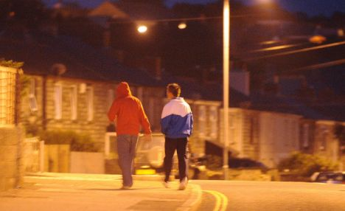
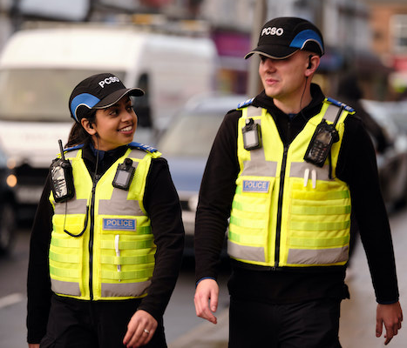

Lengthen night and shorten day…
Useful Acronyms & Vocabulary
CAMHS: Child and Adolescent Mental Health Services
My Concern – Safeguarding record system (safeguarding and child protection software for schools used at WGES).
PCSO: Police Community Support Officer
EHA: Early Help Assessment
Safeguarding Information at WGES
We have a wealth of information on our school website for parents to access, including important documents and contact details.
Please visit www.williamgilbertend.derbyshire.sch.uk
If you believe that any child is in danger ring Call Derbyshire Tel: 01629 533190 choosing the option for urgent child protection calls at any time
Fall, leaves, fall
By Emily Bronte
Fall, leaves, fall; die, flowers, away;
Lengthen night and shorten day;
Every leaf speaks bliss to me
Fluttering from the autumn tree.
I shall smile when wreaths of snow
Blossom where the rose should grow;
I shall sing when night’s decay
Ushers in a drearier day.
Clocks going back – 26th October 2025
Every autumn when the clocks go back and sunset suddenly occurs earlier in the day, there are a host of negative impacts on the way we live our lives.
The number of road casualties rises, with the effects being worse for the most vulnerable road users like children.
It means that we have less usable daylight in the evenings to do the things we enjoy in the outdoors or in social environments. For our oldest pupils who may be playing out close to home or at the park and we remind parents to be extra vigilant in the supervision of your children. It is not appropriate for primary aged pupils to be playing out in the dark. Use the event of the clocks going back to discuss road safety with your child and reduce your child’s curfew so they arrive home in the light.
Community PCSO Updates – Halloween
Sometimes we get asked why we don’t, as a school, celebrate Halloween. The name ‘Halloween’, after all, comes from ‘All Hallows’ Eve’ – the day before All Saints’ (All Hallows’) Day in the church calendar.
Today there is a wide diversity of opinion regarding Halloween. Some would argue that Halloween is dangerous, citing three main reasons:
1. Halloween can lead to fear and distress;
2. ‘Trick or Treating’ can lead beyond harmless pranks to vandalism, violence, and anti-social behaviour.
3. Knocking on the doors of strangers is dangerous for children. Other Christians (and other faiths too) feel there is something inherently wrong about the celebration, even if they are unsure as to why it is not healthy, wholesome, or positive.
Others, however, see it as just a harmless, commercialised American import, arguing: ‘There’s nothing wrong with children dressing up and enjoying themselves’ or ‘It’s only a bit of fun and brightens up the autumn’.
As a school we do not promote Halloween – it is not part of our curriculum, we don’t hold any Halloween events, we don’t plan Halloween activities, and it isn’t part of structured play. We reinforce guidance regarding dangerous situations, and we respond to individual children’s questions and concerns. We don’t make it our business to tell parents or their children to avoid Halloween; respecting instead parents’ own decisions as to whether activities their children are engaged in outside of school are safe.
On Tuesday 21st October our local PCSO Mark Worrell will visit school and deliver a workshop to our pupils around dark nights and Bonfire Night. Some of the key safety messages that they will share with the children or messages you can reinforce at home.
• Young children should always be accompanied on their neighbourhood rounds.
• Talk with children about the risk of distracted walking.
• Stay on well-lit streets and always use the pavement.
• Older children should travel in groups and create a "buddy system" to get each other home safely.
• Remind children to never enter a home or car for a treat.
• Plan costumes that are bright and reflective.
•Look for "flame resistant" on the costume labels.
Safeguarding children is everyone’s responsibility
Keep the lines of communication open with your child. Conversations with your child that are appropriate to their age are key to safeguarding them. Be aware that the age of criminal responsibility in England and Wales is 10 years old. If you are concerned that your child may be involved in anti-social behaviour, please get in touch with us at school so we can support you and your child.

Slide 7


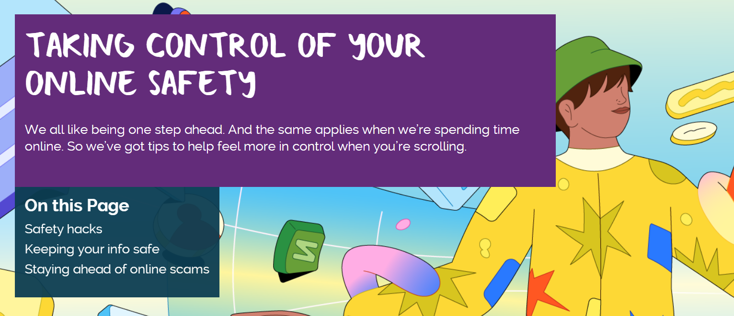

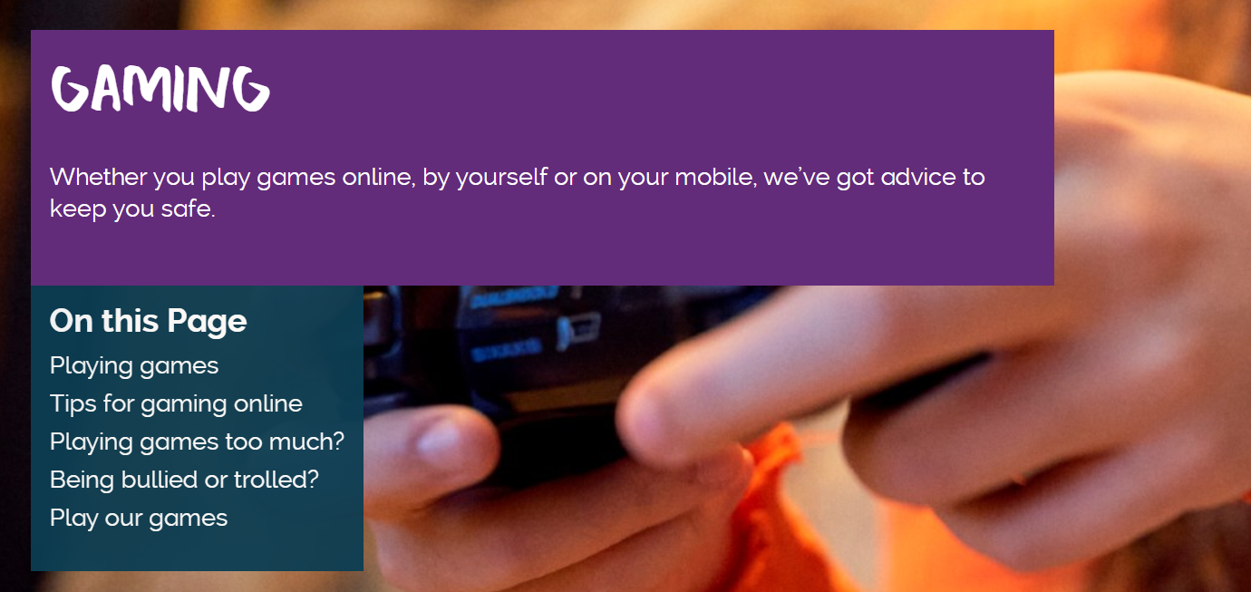
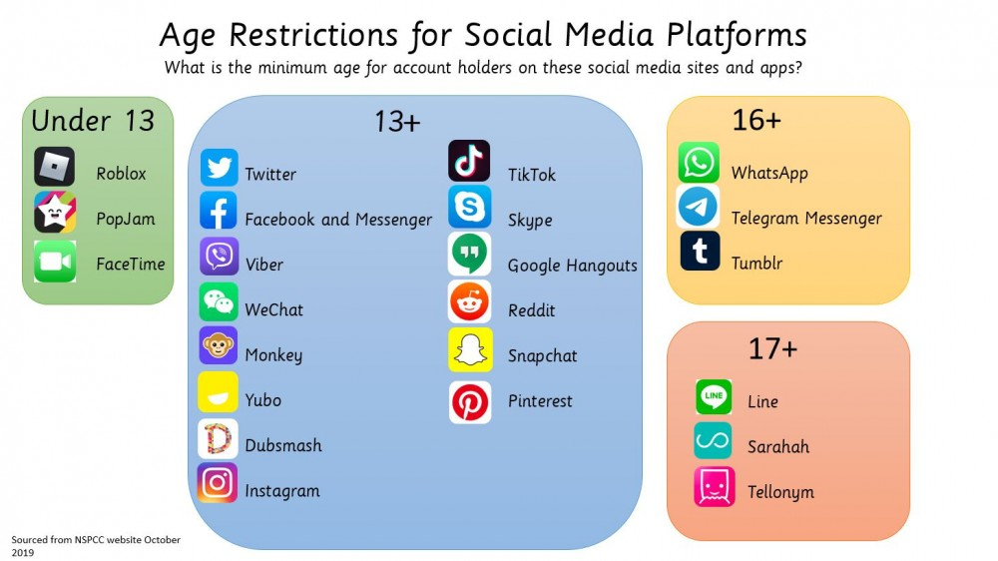

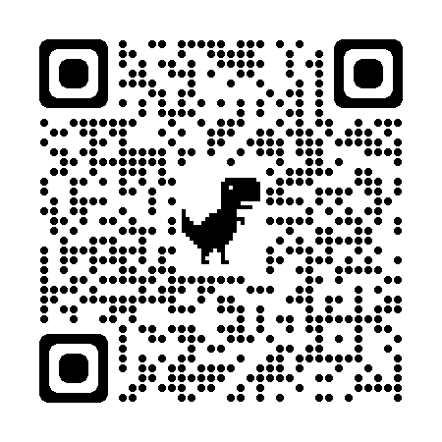
Keeping safe online
Fake news, deep fakes and misinformation
Helping Children Navigate Misinformation Online
In today’s digital world, children are constantly exposed to information—through social media, video platforms, messaging apps, and websites. While this can be a powerful tool for learning and connection, it also brings risks. One growing concern is the spread of fake news, deepfakes, and misinformation, often created using artificial intelligence (AI).
These types of content can be highly convincing and difficult to spot, even for adults. Deepfakes, for example, use AI to manipulate videos or images to make them appear real. Misinformation: false or misleading information shared without harmful intent Disinformation: information shared deliberately to deceive
This content can shape how children view the world, influence their beliefs, and even affect their mental health and wellbeing. What a young person sees online can impact their understanding of current events, relationships, and themselves. That’s why it’s so important to help children develop the skills to question what they see and think critically about the content they consume.
How You Can Support Your Child
Here are a few simple ways you can help your child stay safe and informed online:
Talk regularly about what they’re watching, reading, or sharing. Ask open questions like, “Where did you hear that?” or “Do you think that’s true?”
Help them spot the signs of fake content—look out for sensational headlines, poor grammar, or sources that aren’t trustworthy.
Explain how deepfakes work and why they can be misleading. Reassure your child that it’s okay to ask questions and seek help if something feels off.
Use trusted sources and fact-checking websites together. This builds confidence and helps children learn how to verify information.
Model healthy habits by sharing how you check facts and make decisions about what to believe online.
Useful Acronyms & Vocabulary
My Concern – Safeguarding record system (safeguarding and child protection software for schools used at WGES).
Cyberbullying is any form of bullying which takes place online or through smartphones and tablets – adults and children can be victims.
CEOP: Child Exploitation and On-line Protection Centre
https://www.thinkuknow.co.uk/parents/
Online Safety
Information at WGES
We have a wealth of information on our school website for parents to access.
Please visit https://www.williamgilbertend.derbyshire.sch.uk/staying-safe-on-the-internet/
Or scan the QR code below
-
Find further around online safety and gaming click on the images to take you to the articles on ChildLine or visit.
https://www.childline.org.uk/get-involved/articles/how-to-spot-fake-news/
Visit internet matters to access a useful misinformation guide for parents.
Visit BBC bitesize Fact or Fiction pupil guide.

