Slide 1
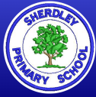
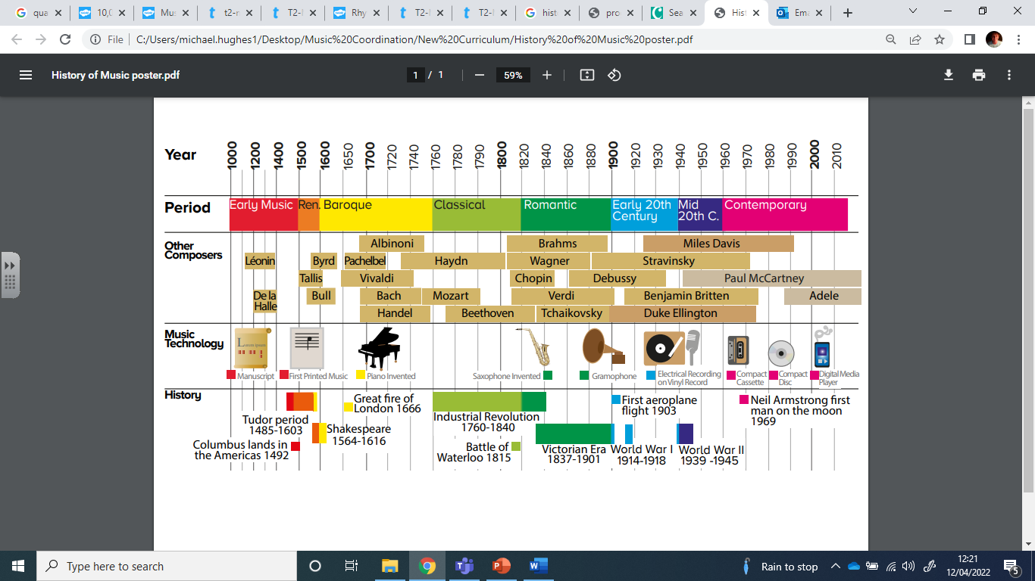
Music Knowledge Organiser – Year 5
Other useful vocabulary
Ostinato | A repeating pattern.
Melody | A sequence of notes – a tune.
Harmony | Two or more pitches played or sung together.
Structure | The order the different parts of a piece of music are played.
Ternary | A piece of music with a structure of three parts – the last part is often a repeat or variation of the first part.
Triad | A chord of three notes – one, three and five of the scale.
Chord | Three or more notes played together at the same time (A dyad is a two-note chord).
Key Vocabulary – can you compare and contrast across different genres and pieces of music?
Pulse | A steady beat. Does the beat change?
Rhythm | What types of notes do you hear? Crotchets/quavers? Are there any rests?
Pitch | How high or low a note is. How does this change in a piece of music?
Tempo | Speed the music is played at – fast or slow? Does this change?
Dynamics | Levels of sound. Use some of the vocabulary on the back to describe.
Timbre | The character of the sound – is it wooden, metallic, breathy?
Texture | How the different sounds and instruments work together. Thick or thin? How many layers can you hear?

Slide 2
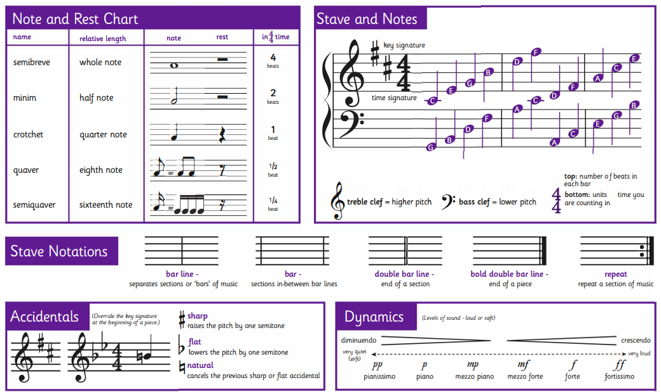
Music Knowledge Organiser – Year 5

