Slide 1
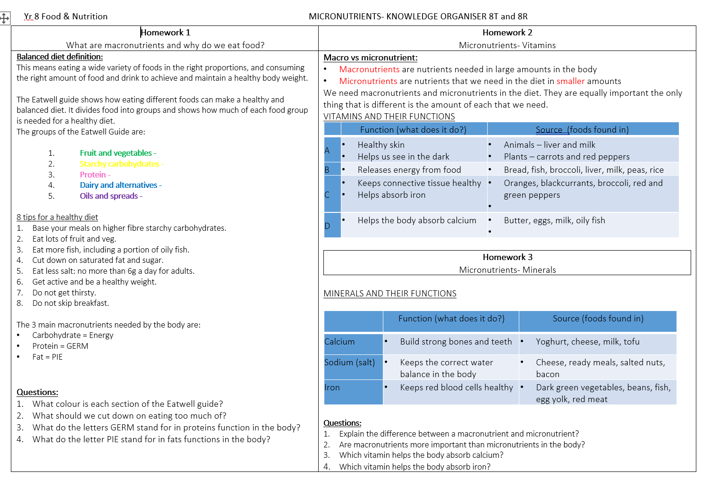
Year 8 Catering Food Assessment Revision Checklist
The end of cycle assessment will cover mainly the following topic areas: Use the RAG1 before and RAG2 after you revise to identify areas of strength and weakness.
Knowledge Organiser |  | Notes | RAG1 | RAG2
Use your knowledge organiser to revisit key terms and a summary of each lesson. Please focus revision on areas you are least confident in. The knowledge organiser is available here: Food Technology
Key Terms to help with Assessment
Term | Definition / Function | Definition | RAG1 | RAG2
Balanced Diet
Macro-nutrients
Micro-nutrients
Calcium
Sodium
Iron
Nutritional needs
Allergies
Allergic reaction
Lactose
Coeliac
Protein
Fat
Carbohydrates
This is only a Guide to help with Revision – you should use your previous knowledge as well during Assessment.

