Slide 1
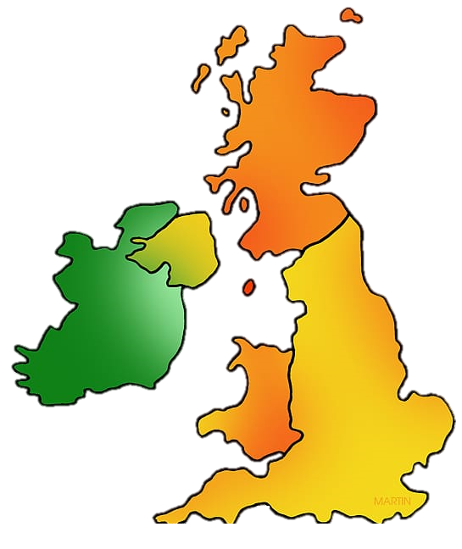
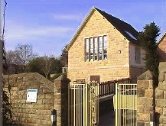
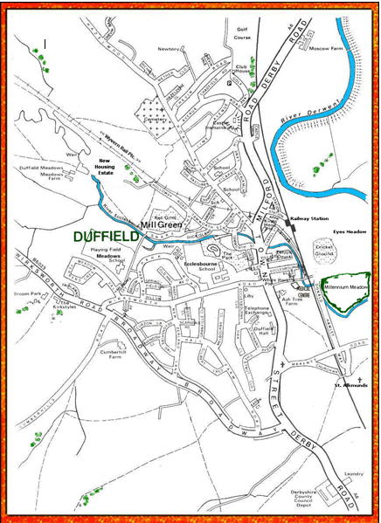
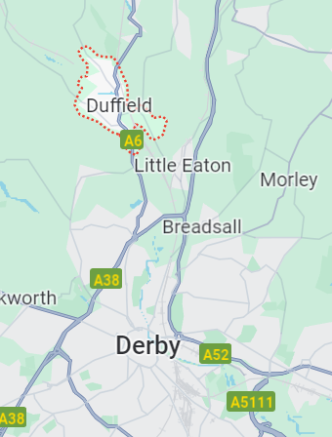
Curriculum Overview
Term: Summer 1
Class: Year 2
William Gilbert Endowed Church of England Aided Primary School
Curriculum Overview For Parents
Term – Summer 1 2026 |  | Year: 2
Theme: Who lives here?
Class: Blue | Miss Hill
Curriculum Overview
Term: Summer 1
Class: Year 2
English | Mathematics | Science
Writing Poetry and instructions based on ‘What a Ladybird Heard’ by Julia Donaldson Character description based on the film ‘Up’ Reading Discussing the meaning of vocabulary Scanning the text to retrieve answers to questions about what they have read Grammar Apostrophes for possession Adding suffixes to root words such as –ful, -less, -ness, -ment, -er and -est | Column Method Using the column method for adding and subtracting 2-digit numbers Statistics Making tally charts Understanding tables and block diagrams Drawing and interpreting pictograms Position and Direction Explaining positions Describing movements Describing turns Making patterns by turning shapes Fractions quarters, halves and thirds Time | Animals including Humans (Life Cycles) Exploring what animals need to survive Recognising offspring of different animals Understanding that a life cycle of a living things is the changes it goes through from the beginning of its life until it dies Describing the life cycle of a human, frog and butterfly
RE | Computing |  | Art & Design |  | Geography
Who made the world? Exploring the creation story within the book of Genesis in the Bible Recalling the creation story Showing thankfulness to others Giving ways to look after God’s world | Information Technology: Word Processing Using the ‘caps lock’ key to type upper and lower case letters Separating sentences using full stops Using the ‘enter’ key to start a new line Saving work using ‘Save As’ |  | Printing Exploring block printing Overlapping prints and colours to create patterns Using raised objects and inks to create images Exploring mono-printing and collagraphs |  | Who lives here? Locating the UK in the world Naming and locating the countries within the UK Naming villages, towns and cities Identifying human and physical features of the local area Comparing desirable and undesirable features of the village
RHE |  | Music |  | PE
Living in the Wider World - Money Understanding why it is important to look after money Knowing how to make responsible choices with money and the difference between ‘need’ and ‘want’ |  | Structure - rhythm Clap a rhythm based on a phrase of a story Use a rhythm in different ways to demonstrate structure To perform a group composition |  | Orienteering Working as a team Solving problems Recognising key landmarks on a map Following directions
Things to look for and do at home:
Reading with an adult multiple times at home – asking questions and discussing what has been read Recalling multiplication and division facts in the following order: 10x, 2x, 5x, 3x – TTRockStars/ Hit the Button Weekly home learning tasks – Spellings and tasks within their named SATS Practice folder Creative home learning ideas: Exploring the local area and taking photographs of human and physical features, making a tally chart of the number of different things you see out and about, comparing a chosen village, town or city, drawing a map of the UK

