Slide 1

Y6 Transition
Physical Education

Slide 2
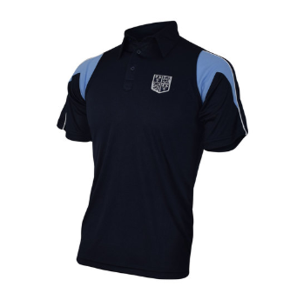
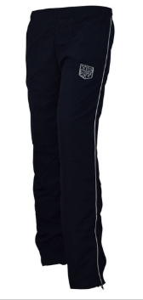
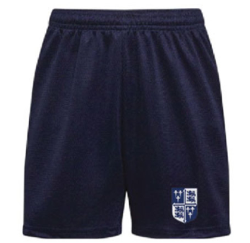
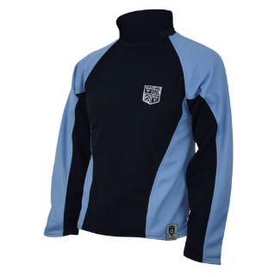
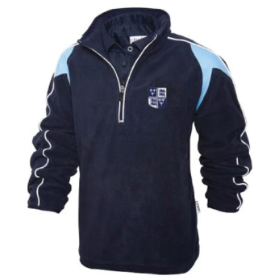
What to wear for your PE lessons?
For your PE lessons at Holte school you have to wear the Holte PE kit. Which includes;
Holte polo shirt
Holte tracksuit bottoms
Holte shorts
Holte long sleeve rugby top
Holte fleece
You must wear a Holte School polo shirt, with either Holte tracksuit bottoms or Holte shorts. Long sleeve tops are additional items that can be brought. If wearing Holte shorts you must also wear navy blue football socks.

Slide 3
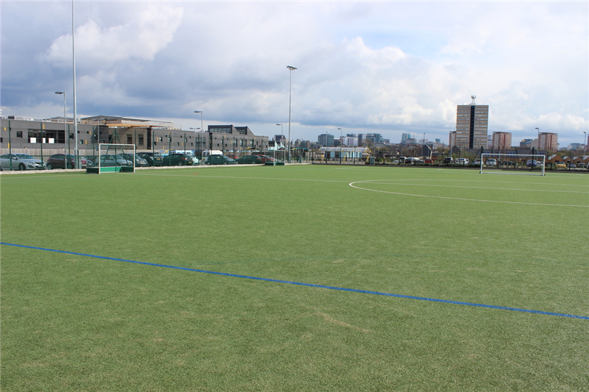
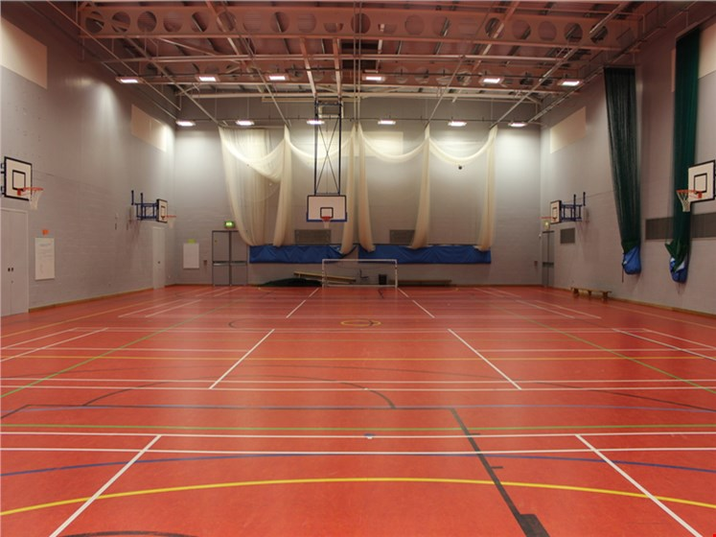
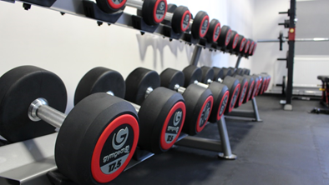
Facilities at Holte School

Slide 4
Who will be my teacher for PE?
For PE at Holte school, boys and girls are taught separately in small groups.
Any one of the following might be your PE teacher at Holte;
Miss N Hamilton – Head of PE
Mr L James – Second in PE
Miss A Hunt
Miss W Hamilton
Ms H Aktar
Mr M Reid
Mr P Higby
Mr R Griffith
Mr C Walters

Slide 5
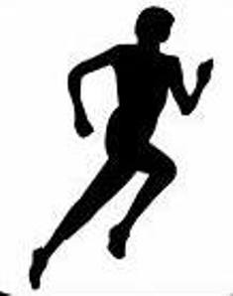


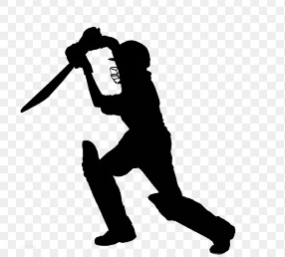
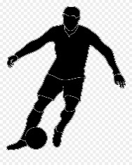



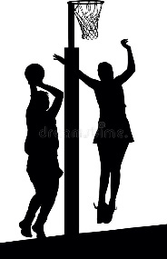
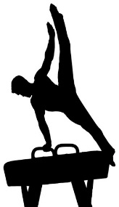
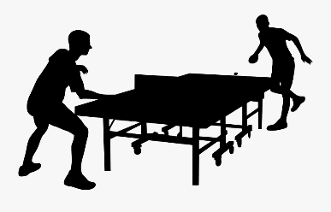
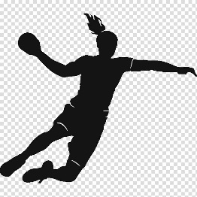
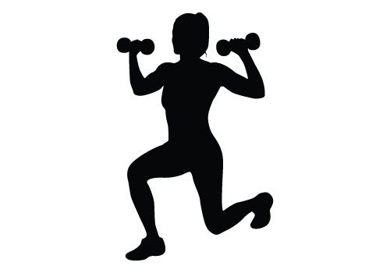
What will you be learning in PE?
In your PE lessons you will be studying a variety of different sports, where you will learn the skills needed to be successful in that sport. As well as how to become a good leader, team work skills and how to live a healthy active lifestyle.
Some of the sports include;
Athletics
Rounders
Swimming
Football
Hockey
Dance
Cricket
Badminton
Netball
Table tennis
Handball
Fitness
Gymnastics

Slide 6
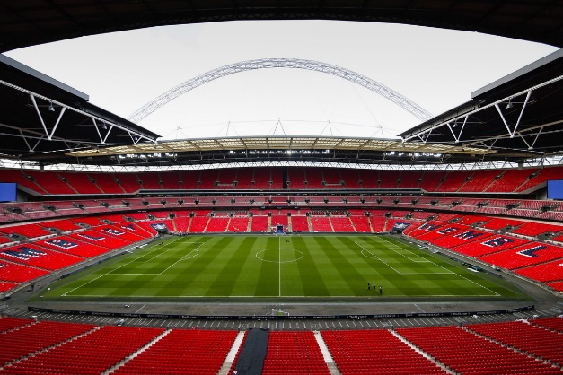
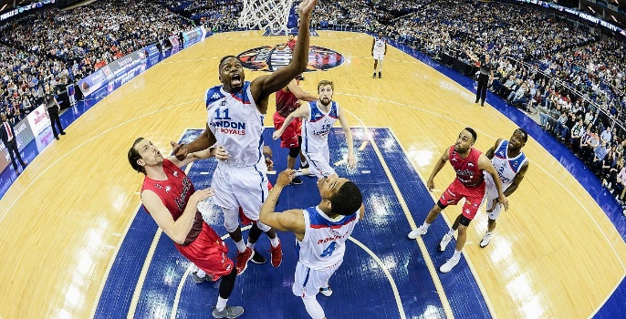

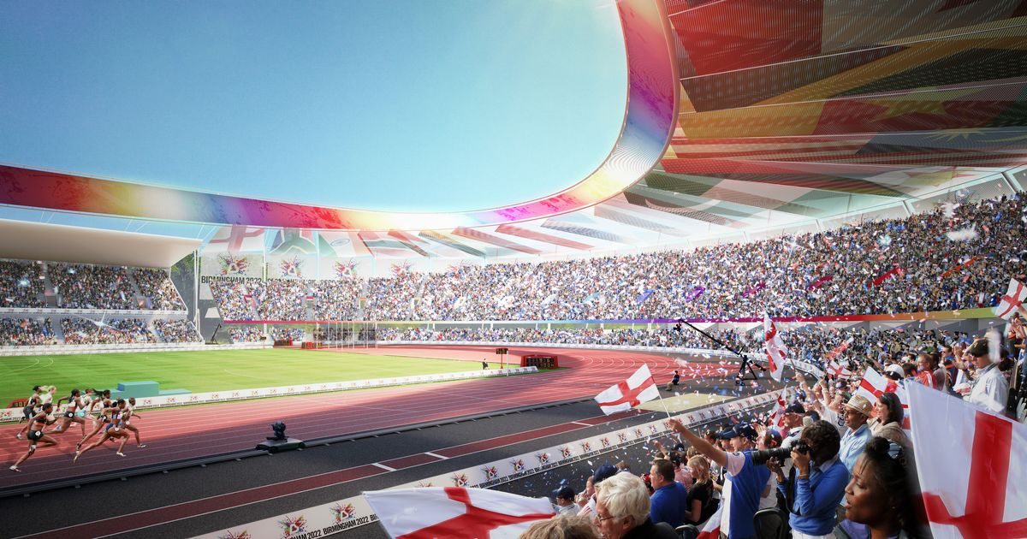
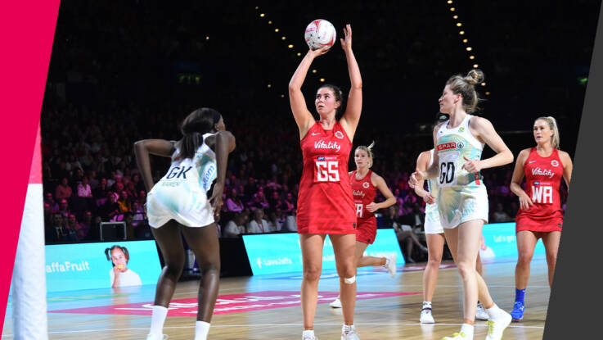

Trips and activities

Slide 7
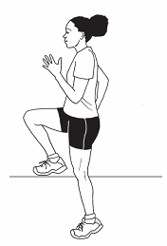
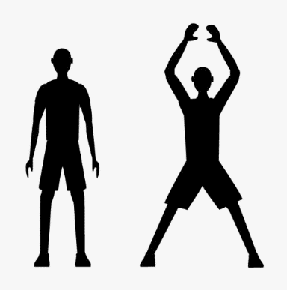
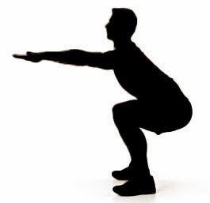

Transition Task 1
Attempt to complete the following practical task at home. How many of each exercise can you complete in 30 seconds?
Jumping Jack’s
High knees
Sit ups
Squats

Slide 8

Transition Task 2
Create a poster on your favourite sport/activity that you did in your PE lessons in primary school.
What was your favourite thing about that sport?
What were the rules of that sport?

