Slide 1
Ancient Influences - ARISTOTLE
WHO
384-322 BCE
Father of empiricism
Born in Macedonia (in Greece)
Pupil of Plato
Investigated science in particular biology – his works were not surpassed for almost 2000 years
Tutor to Alexander the Great
Set up the Lyceum School
Also wrote about drama, rhetoric, ethics amongst other things.
Great admirer of Plato – but did not totally agree with his approach.
WHAT
Physical world around us is the key to knowledge (not an imaginary world of forms)
Experience through the senses and observation is how we learn – empirical evidence is the basis for knowledge.
Interested in explaining why things exist as they do.
Rejected Plato’s dualist view of the world and of the body and soul.
Acknowledged that everything in the physical world is in a constant state of motion/change
Studying this change and the cause of it could lead to knowledge.
Believed that the Universe was everlasting, had no beginning or end and was not created – it had always existed.
Thought that the earth was the centre of the universe and that forty concentric rings of stars revolved around it.
The first ring of stars was moved by the second, the second by the third and so on.
The question was, what moved the fortieth ring and set the whole universe in motion?
CAUSE AND PURPOSE
Fascinated by the question of cause – what causes things to be as they are.
Wanted to know why things exist at all.
Recognised that something can have many different explanations for its existence on different levels.
Also recognised that everything in the physical world is in a state of motion – e.gs planets - always moving; trees grow, blossom, leaves, drop, starts again; humans …
Unlike Plato, Aristotle thought that we can learn from finding the cause of change/motion.
Saw that change is always caused by something acting upon a thing.
Saw that everything is in a state of actuality or potentiality – e.g. acorn into a tree into a table etc.
Something must therefore ‘actualise the potential’ of things – so cause the change
Aristotle also believed that everything had a purpose and a thing was ‘good’ if it fulfilled its purpose properly (see note on Final Cause below)
Aristotle page 1

Slide 2
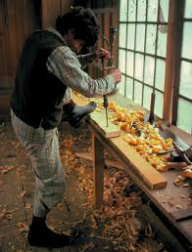
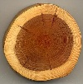
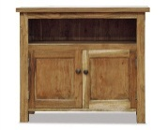
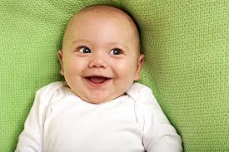
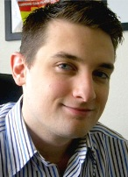



Ancient Influences - ARISTOTLE
THE FOUR CAUSES
Aristotle thought that ‘cause’ could be understood in four different ways:
Material Cause – what something is made from, the substance from which an object is
created. So a human is made of flesh, bones, muscle, fat, blood, organs etc. But this does not give us the full picture and does not explain everything about us. The material cause, whilst helping us to learn about something does not alone provide an explanation for why it exists or how it changes.
Efficient Cause – the way in which an object is created. The efficient cause of a human is the activity of mummy and daddy human. The efficient cause of a desk would be the carpenter who created it. Aristotle described this as ‘actualising of potential’. E.g. wood has the potential to be made into furniture, it needs a carpenter (efficient cause) to realise this potential. The efficient cause is what brings about the change in something.
Formal Cause – what gives an object its form or shape. The formal cause is what allows a thing to be identified as whatever it is e.g. can identify a human as a human because of our form and shape; carpenters can make all kinds of furniture out of wood, we can identify a desk from a chair because of their form and shape.
Final Cause – an objects purpose, the reason it exists. Often called the Teleological cause because of the Greek ‘telos’ meaning end. The final cause of a desk is to is to be used for writing or working at, the final cause of a mug is to hold drinks, the final cause of the fur on a polar bear is to keep the bear warm. Etc.
Aristotle used his concept of final cause when he discussed the nature of goodness and the right way for people to behave. Links into his ethics.
He also thought that something was good when it fulfilled it’s telos. So an axe is a good axe if it cuts well; boots are good boots if they keep your feet warm and dry etc.
Actualising of potential
Actual
Potential
Actual
Potential
A good axe?
Good boots?
Good people?
Aristotle page 2

Slide 3
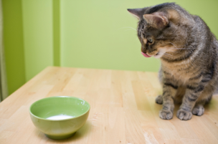
Ancient Influences - ARISTOTLE
Aristotle observed that everything that exists is in a permanent state of motion – motus = change
Physical world in a constant state of motion and change.
Planets seemed to be moving eternally.
Change or motion is always caused by something.
Objects in the physical world are in a state of actuality and potentiality.
From his four points, Aristotle concludes that something must exists that causes the motion and change without being moved itself. There must be something that actualises the potential of the universe.
For Aristotle, this something is the Prime Mover – also known as the First Cause or the Uncaused Cause.
THE PRIME MOVER (PM)
PM has necessary existence. It doesn’t depend on anything else for its existence. If it did then it would have to be capable of change – e.g. if it relied on sunlight to exist, PM would change and die if the sun fizzled out.
PM has no potential, so therefore has no capacity for change and must exist independently, or ‘necessarily’.
PM must be eternal because of its lack of potential. If PM cannot change, then it cannot cease to be; and if it exists, then it must have always existed.
PM must be perfectly good, because badness is related to some kind of lack, an absence of something that ought to be there. What is more, if the PM is pure actuality, then it must contain everything that ought to be there, so it must be perfect.
PM must be immaterial and transcendent (beyond time and space). All matter is capable of being acted upon and so PM cannot be made of matter.
If PM is immaterial, then PM cannot perform any kind of physical activity – it cannot actually do anything
PM must be purely spiritual, pure thought, and not thinking about anything that could cause it to change; which leads to the conclusion that PM must think only of itself and its own perfect nature.
PM is ‘pure actuality’ and has no potential. It is therefore perfect and so must be perfectly good as it lacks nothing.
According to Vardy the Prime Mover is the ‘great attractor’ it attracts the outer ring of stars causing movement without moving itself. From this motion, the whole universe is put into motion.
The Prime Mover is therefore the Final Cause – it is the ultimate explanation for why things exist.
The PM can be likened to a magnet – it causes every in the universe to pull towards it.
Fr Gerry Hughes SJ uses the example of a cat and a bowl of milk to explain the PM:
Imagine there is a room with a pink carpet and a cat at one side. A bowl of milk is
placed at the other end. The cat will cross the room to get to the milk. The milk
therefore causes the cat to move, even though it doesn’t act (move) itself.
Aristotle page 3

Slide 4
Ancient Influences - ARISTOTLE
CRITCISM/CHALLENGES
Aristotle’s work often lacks clarity – unlike Plato who wrote in elegant prose with plenty of examples to illustrate his views, Aristotle’s work is difficult to follow. Many scholars believe that his writings were notes not meant for publication or that they could be the notes of his students.
Some challenge him for his over emphasis on empirical evidence and his rejection of Plato’s ideas, arguing that there is some sense to talk of ‘intuitive knowledge’
More recent thinkers including Bertrand Russell, Jean-Paul Satre and Richard Dawkins have questioned whether the universe and everything in it must have a ‘telos’ or purpose. The universe exists by and chance and is not ‘supposed’ to do anything.
Theists often reject Aristotle’s God for being almost irrelevant to the universe. The Prime Mover does not interact with the universe in any way, it is not active in creation and is unaffected by it. This is very unlike the God of Judaeo-Christian tradition and unlike the God of their personal experience.
KEY TERMS:
Cause/causality purpose telos actual potential Uncaused cause/First Cause/Prime Mover
Material Cause / Formal Cause / Efficient Cause / Final (Teleological) Cause
Aristotle page 4

