Slide 1


Welcome to
Holte school
Year 6 transition 2021

Slide 2
FORM TUTORS
7R Mrs F Jamila & Mr A Khan N104
7S Mr A Ajmal & Mrs A Cohen P106
7T Mrs J James & Mr J Wilkinson Q106
7U Ms S Sodhi & Miss K Fatima Q103
7V Mr M Spiers & Mrs S Asghar N106
7W Mr A Ali & Mrs T Ghani M110

Slide 3
Times of the day
Registration/Assembly: 8:40 - 9:05am
Period 1: 9:05 - 10:05am
Period 2: 10:05 - 11:05am
Break: 11:05 - 11:20am
Period 3: 11:20 - 12:20pm
Period 4:12:20 - 13:20pm
Lunch: 13:20 - 14:00pm
Period 5/Registration: 14:05 - 15:10pm

Slide 4
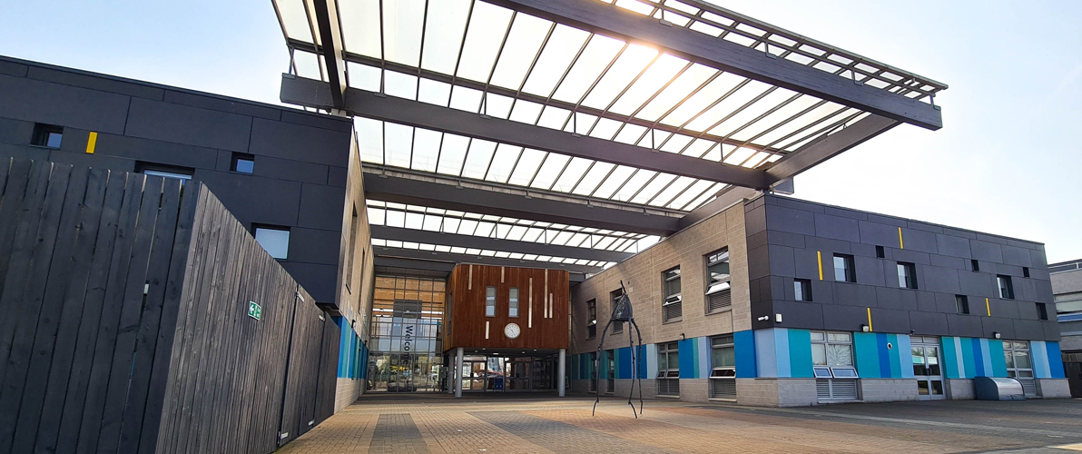
School starts at 8:40

Slide 5
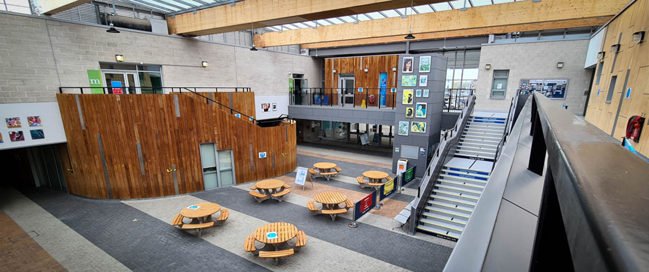
Once inside you will go straight to your form room

Slide 6
During form time…
You will be expected to have all your equipment for the day on your desk, ready to work.
One day a week you will have an assembly in the main hall.
You will have activities to do in form, including work set by Mr Higby and Miss Evans.

Slide 7
Academic mentoring
This will also take place during form time.
You will sit with your form teacher and set targets for all of your subjects.

Slide 8
Lessons
Lessons begin at 9:05am everyday.
All lessons last 1 hour.
You MUST be on time for all lessons.
It can be strange having different teachers, in different rooms, but you will soon get used to it.

Slide 9
Finding your way around
All departments are found in ‘clusters’
English (Literacy) - K cluster
Maths (Numeracy) - N cluster and P cluster
Science - M Cluster
Humanities – Q cluster
Music and Drama - E cluster
Technology and Food - G cluster/Market Place
Art - D cluster
PE - S cluster
Sometimes these lessons may be in another cluster.

Slide 10
Attendance
If you have 100% attendance, you will be rewarded with prizes and trips!
The more regularly you attend school, the higher your grades and levels will be.
Our top attenders have won Kindles, vouchers and had a reward trips at the end of each term.

Slide 11
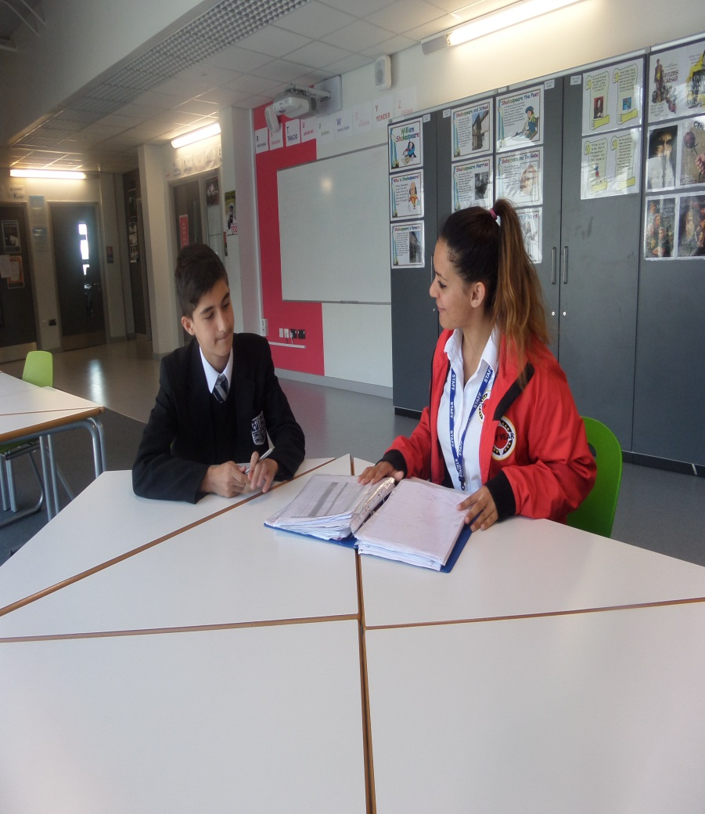
City Year mentors
Mentors work with pupils across the school. They are called City Year Volunteer Mentors and wear a black and white uniform with a red jacket.
The City Year VM’s will organise clubs during break, lunch and after school, which you may be interested in joining.

Slide 12
uniform
Your uniform MUST always be to the highest of standards.
Boys need to wear a white shirt, Holte School tie and blazer, with black trousers and smart shoes.
Girls can either wear a white shirt, Holte School tie, blazer and trousers or skirt with smart shoes (No ballet pumps) or a salwar kameez with a blazer.

Slide 13
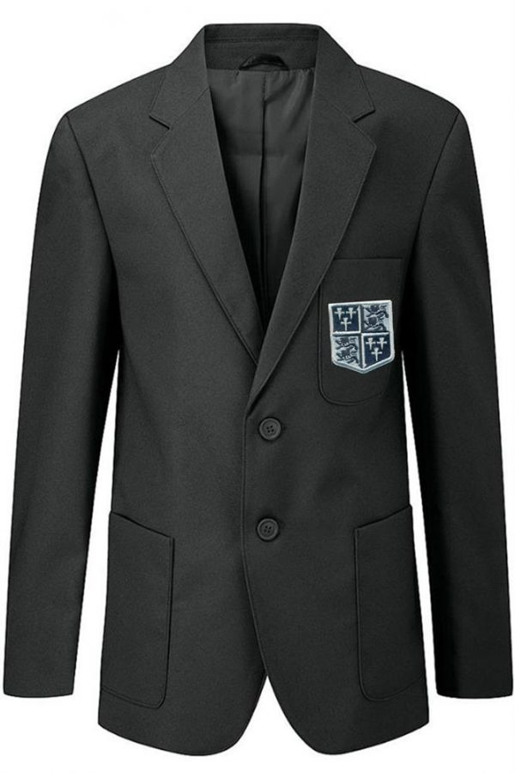
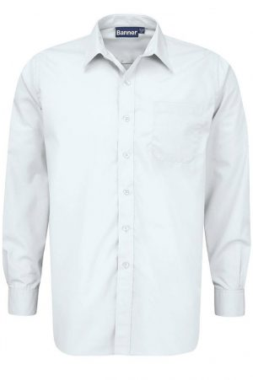
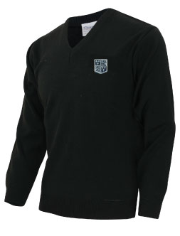

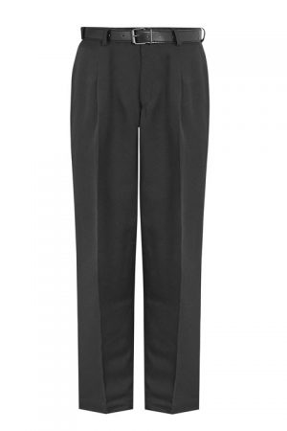
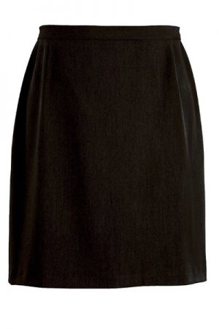
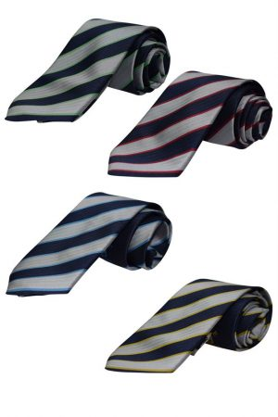

Slide 14
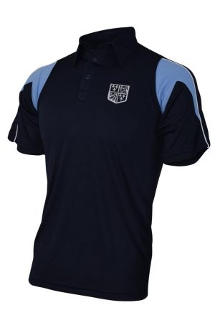
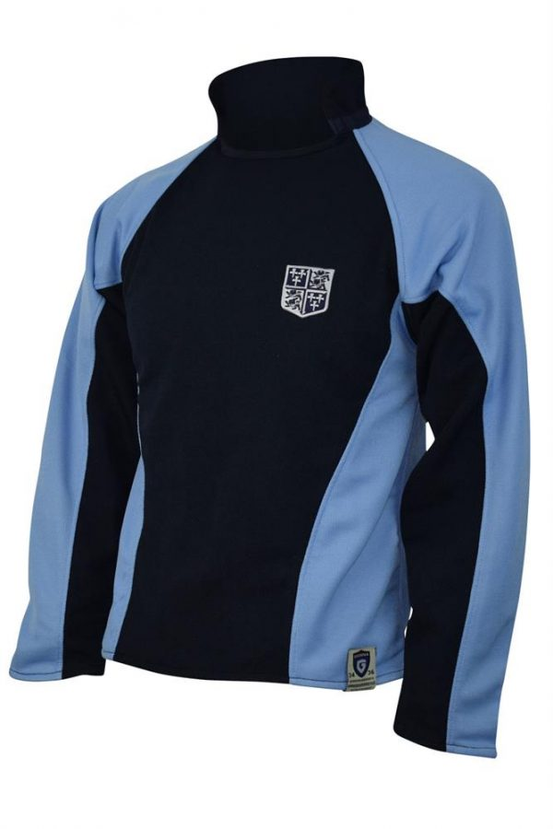
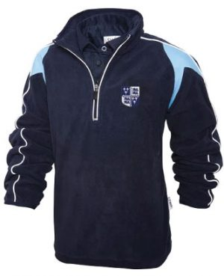
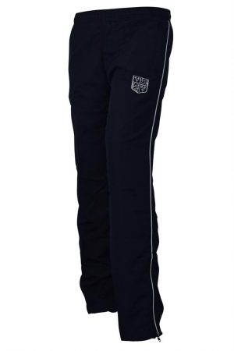
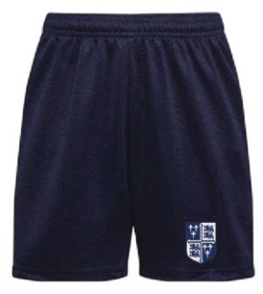

Slide 15
Do you have any questions for us?

