Slide 1
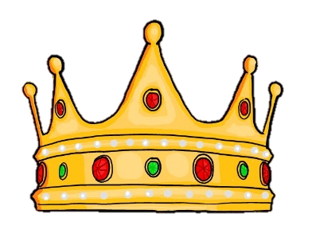


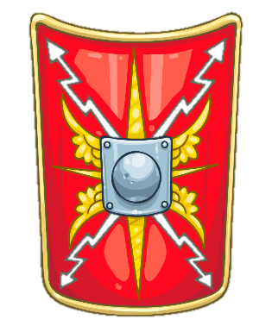
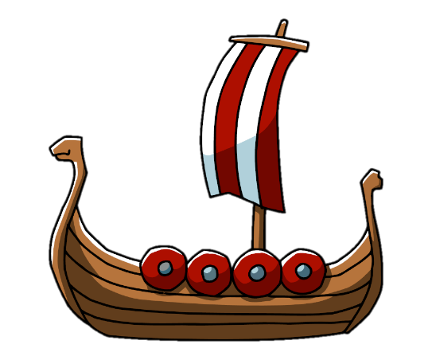
William Gilbert Endowed Church of England Aided Primary School
Curriculum Overview For Parents
Term – Summer 2024 |  | Year: 4
Theme: Building Britain
Class: Year 4 | Mrs Owen
English | Mathematics | Science
Reading Class text : Tom’s Midnight Garden Philippa Pearce Various extracts from classic/modern literature and poetry/ non fiction texts Retrieving evidence from texts Inference from texts Graphic Novels Writing Descriptive/Narrative writing Non chronological report writing Persuasive writing Poetry Spelling rules: possessive apostrophes, suffixes, prefixes, homophones Fronted adverbials for when and where, | Decimals :Tenths and hundredths ,Comparing, ordering decimals Money: Converting, comparing, ordering, problem solving Time: converting analogue/digital, 12hr/24hr times, problem solving Statistics: interpreting charts, line graphs, draw line graphs, problem solving Geometry- position and direction: describe position, plot coordination, translate shapes on a grid | Materials can be sorted and grouped according to whether they are solids, liquids or gases and have different properties and a different arrangement of particles. Materials can change state when they are heated or cooled (E.g. chocolate, butter and water). Degrees Celsius (°C) are used to measure temperature. The water cycle consists of four main stages: evaporation, condensation, precipitation and accumulation. Parts of the ear include the outer ear, middle ear and inner ear, ear canal, cochlea and ear drum. Vibrations from sounds travel through a medium to the ear. Sound travels in waves measured in decibels. The size of the vibration is called the amplitude. Sounds can be compared based on their pitch and volume.
RE |  | History |  | Art& Design
When Jesus left, what was the impact of Pentecost? The day of Pentecost is told in the New Testament in the book of Acts and led led to the spread of Christianity around the world. Pentecost is the birthday of the church The Holy Spirit can be seen as symbols like dove, fire and wind. The ‘fruit’ of the spirit are :kindness, generosity, love, faithfulness, gentleness, peace, self-control, joy, patience. Why do some people think life is a journey and what significant experiences mark this? There are different types of baptism in Christianity The use of water symbolises cleansing from sin Jewish people celebrate becoming an adult at a bar/bat Mitzvah Hindus believe tat life is a journey from one body to another – called reincarnation Marriage is an important stage in life for many religions We are on many different actual and metaphorical journeys during our lives |  | There were several attempts of the Romans invading Britain, before Emperor Claudius successfully invaded. Julius Caesar was probably the best known Roman leader. Boudicca led a Celtic tribe in England who fought back against the Romans, but she was defeated. Hadrian’s Wall across the north of England was built by the Romans to stop Scottish rebels from attacking. Romans introduced roads, aqueducts, sewers, a written language and coins to Britain. The Anglo-Saxons sailed across the North Sea into ‘Anglo-Land’ (England) and built settlements across the country. They were a mix of tribes from Germany, Denmark and the Netherlands known as the Angles, Saxons and Jutes. Anglo-Saxons brought Christian beliefs, craft skills and a new life style to Britain. |  | Mosaics- Collages can be made from a variety of materials that are stuck down and over lapped. A photomontage is a type of collage made by overlapping two or more photographs into make a new image. Anthony Gaudi was an artist who created mosaics inspired by nature
 |  |  |  | Design & Technology
 |  |  |  | Structures- Design a Pavilion Make different shaped frame structures Select appropriate materials to build a strong structure Reinforce corners to strengthen my structure Refer to my design sheet to create my pavilion Design ‘cladding’ for exterior of structure
Computing | RHE |  | Music |  | German | PE
Programming – Scratch Repetition is used when an instruction needs Programs can be debugged through trial and error. Online – not all content is trustworthy or reliable- we need to cross check our information online | Understanding my own strengths and weaknesses Setting realistic goals- making steps to achieve goals Financial management and planning is important from a young age The make-up of family units can diff¬er Stereotypes can be unfair, negative or destructive. |  | Djembe Drumming – concluding with performance to parents |  |  | Orienteering Striking and fielding
Things to look for and do at home:
Reading with an adult multiple times at home – asking questions and discussing what has been read Weekly Spellings Recalling multiplication and division facts for all timestables – TTRockStars/ Hit the Button Maths homework is 3 gems and 3 rubies on Maths Whizz every week

