Slide 1



Maths Calculations Year 2
Methods for teaching the four calculations at St. David’s.

Slide 2
Year 2 National Curriculum objectives.
Addition and Subtraction
solve problems with addition and subtraction:
using concrete objects and pictorial representations, including those involving numbers, quantities and measures applying their increasing knowledge of mental and written methods
recall and use addition and subtraction facts to 20 fluently, and derive and use related facts up to 100
add and subtract numbers using concrete objects, pictorial representations, and mentally, including: a two-digit number and ones and a two-digit number and tens - two two-digit numbers -adding three one-digit numbers
show that addition of two numbers can be done in any order (commutative) and subtraction of one number from another cannot
recognise and use the inverse relationship between addition and subtraction and use this to check calculations and solve missing number problems.

Slide 3
Multiplication and Division
recall and use multiplication and division facts for the 2, 5 and 10 multiplication tables, including recognising odd and even numbers
calculate mathematical statements for multiplication and division within the multiplication tables and write them using the multiplication (×), division (÷) and equals (=) signs
show that multiplication of two numbers can be done in any order (commutative) and division of one number by another cannot
solve problems involving multiplication and division, using materials, arrays, repeated addition, mental methods, and multiplication and division facts, including problems in contexts.

Slide 4
Vocabulary related to the four calculations for Year EYFS – Year 6
EYFS/Year 1
more (than) less (than) total
fewer (than) equal (to) most
least
sum difference between total
first
plus add(ition) subtract(ion)
minus ones tens column(s) multiples
Year 2
multiple commutative
>as ‘greater than’
< as ‘less than’ partition
place holder
place value estimate
estimation
inverse
array
calculate
multiplication division
times tables
Year 3
multiple(s) inverse operations integer(s) decimal(s) remainder
Year 4
round rounding
negative
operation
Factor
factor pairs distributive associative derive remainder
odd even double halve pair
how much how many larger smaller estimate compare together
Year 5
power(s) prime complement
composite prime factor square(d)2 cube(d)3 equivalence
Year 6
long division Multi-step common factors common multiple

Slide 5
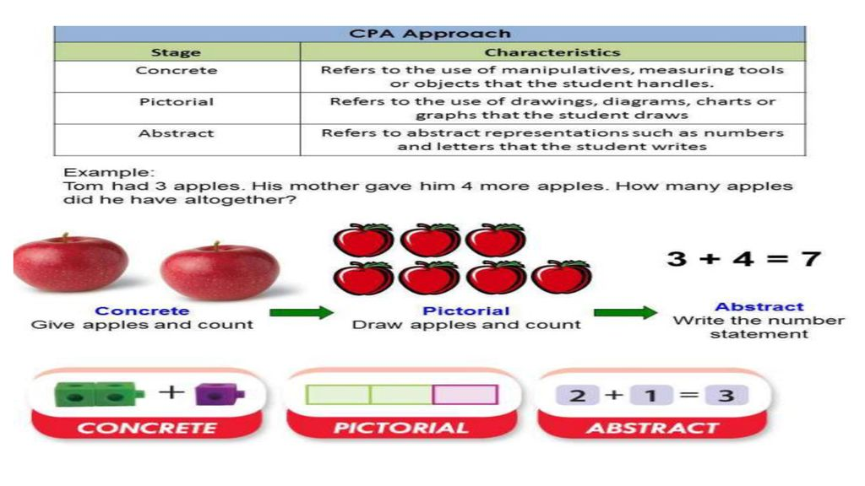
We approach all 4 calculations in a 3 step approach; concrete, pictorial leading on to abstract

Slide 6
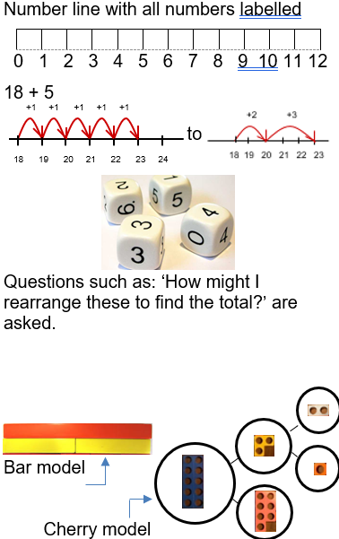
Addition
Counting on from the largest number:
Children begin to use number lines to support their own calculations, initially counting on from the largest number in ones before beginning to work more efficiently.
Reordering calculations to apply use of mental maths strategies:
Children reorder ‘strings’ of numbers to apply their understanding of mental maths strategies, including doubles and number bonds,
e.g. 6 + 7 + 4 reordered to 6 + 4 = 10 and then 10 + 7 = 17. Jottings are used to help keep track of thinking.
Whole / part-whole model:
The concept of a whole / part-whole model is reinforced and extended.

Slide 7
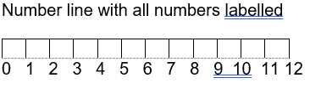
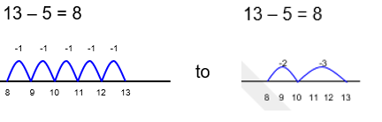
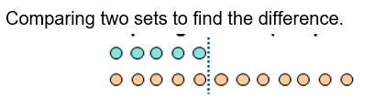
Subtraction
Taking away:
Children begin to use number lines to support their own calculations, initially counting back in ones before beginning to work more efficiently.
Finding the difference:
Teachers model how to find the difference when two numbers are relatively ‘close together.’

Slide 8
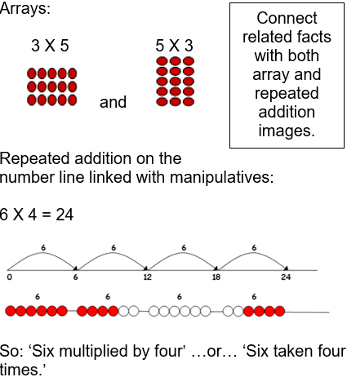
Multiplication
Understanding multiplication as repeated addition:
Investigate multiplication as repeated addition, so that the law of cummutativity is understood.
Whilst arrays are also modelled explicitly at this stage, it is important to note that they will continue to be a key model at later stages, alongside more formal methods of calculation.

Slide 9
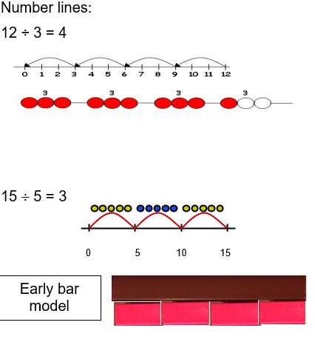
Division
Understanding division as repeated subtraction:
Investigate division as repeated subtraction.
Through teacher modelling, children need to know that division is not commutative.

