Slide 1
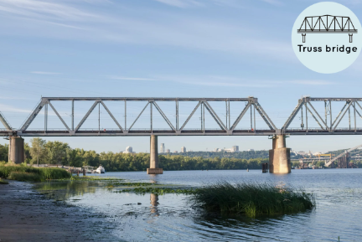
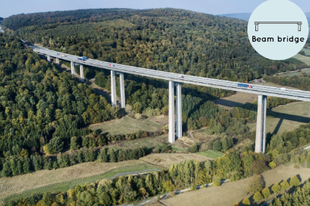
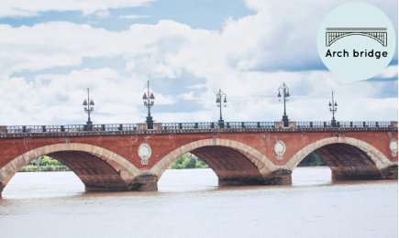
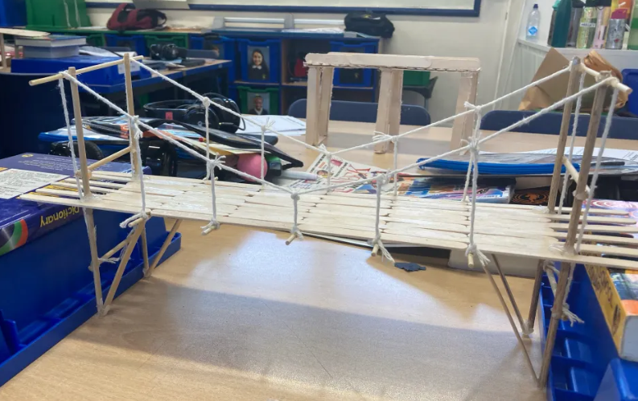
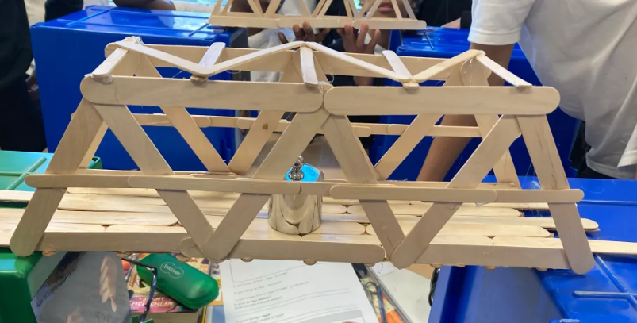
Key Vocabulary
Key Word | Definition
Beam bridge | A bridge which is built with horizontal beams and vertical pillars.
Truss bridge | A bridge which is built from a series of triangular beams.
Arch bridge | A bridge which is built with a curved arch.
Lamination | Layers of material bonded together.
Corrugation | A material with parallel folds on the surface.
Rigid | Something that is stiff or fixed which cannot be bent easily.
Stiffness | How firm or hard something is.
Stability | Something that is firmly fixed or unlikely to move.
Aesthetics | How artistic or beautiful something is.
Year 5 Structures Summer Term
Bridges (Evaluate)
Learning Sequence
Use existing knowledge to build a structure.
1
Evaluate existing structures and materials.
2
Design a structure based on the design brief.
3
Assemble, join and combine materials to make a structure (bridge).
4
Assemble, join and combine materials to make a structure (bridge).
5
Evaluate the stability, strength, appearance and complexity of a structure.
6

