Slide 1
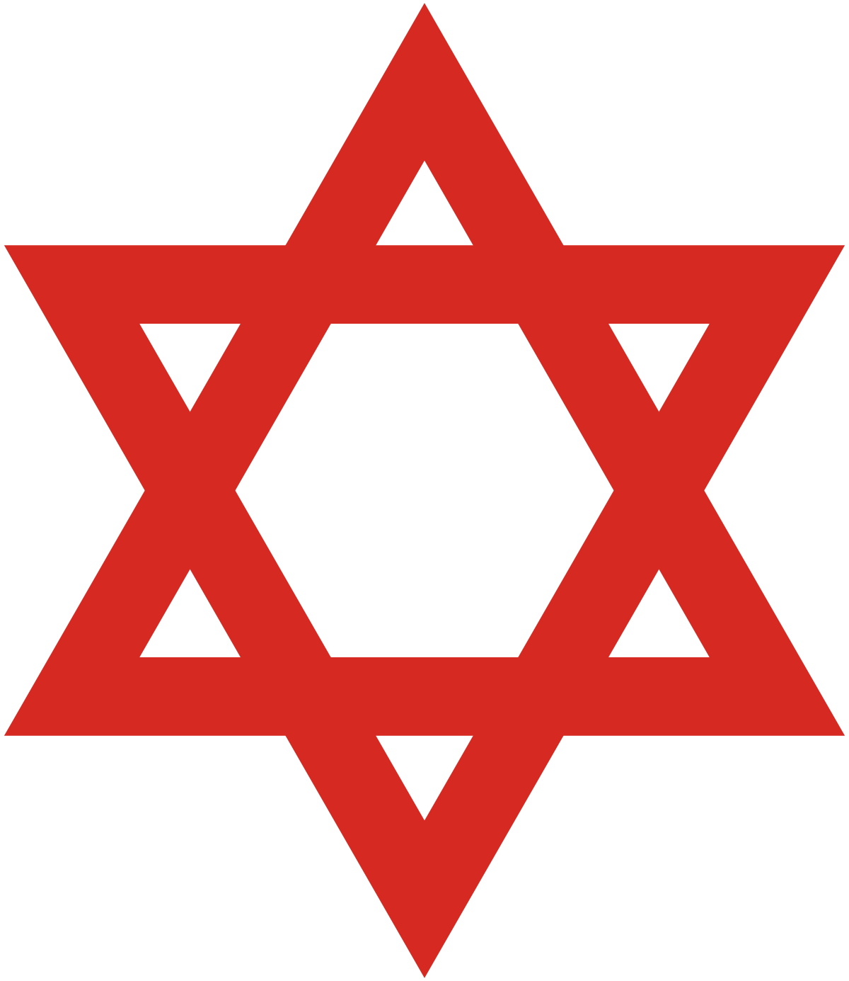
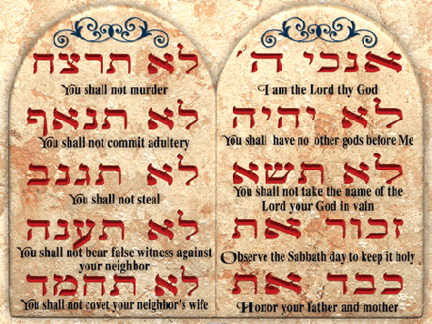
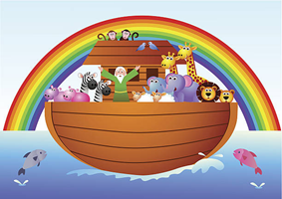
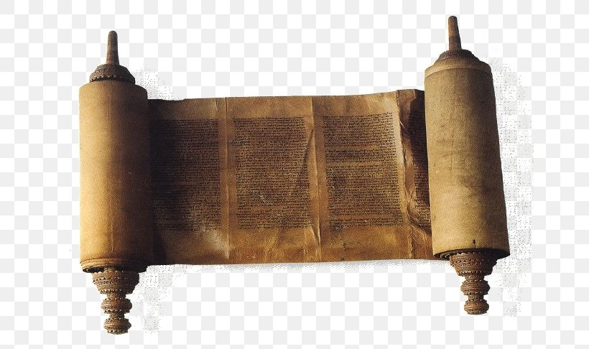
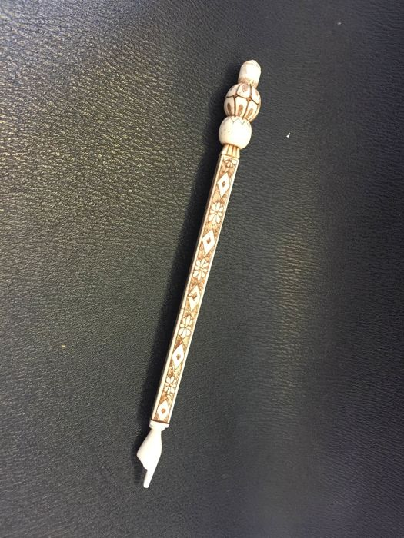
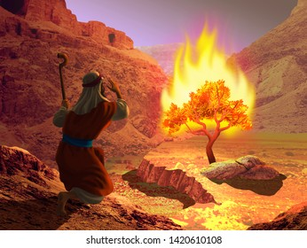
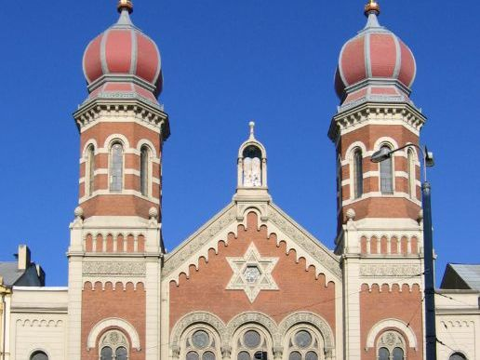
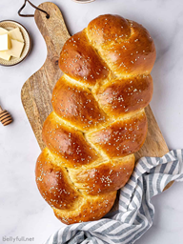
Vocabulary
Ark – A boat that Noah built, it can also be a cupboard in the synagogue.
Commandments – Rules that God gave Moses for the people to follow.
Jews – the people who follow Judaism.
Passover – Passover is a Jewish Festival.
Shabbat – a special day of rest where a family meal takes place every week beginning on a Friday evening until Saturday evening.
Sukkot – A festival where Jews celebrate and remember that God looked after them for 40 years in the desert.
Synagogue – Holy building where Jews pray.
Torah – Holy text or a scroll
Judaism - KS1
Judaism began in Isreal
Main Festivals
Sukkot
Hanukkah
Passover
Sukkot Festival
Jews celebrate with huts called sukkah and have lots of fun in them.
Star of David is a common Jewish symbol. It is a six pointed star.
Promises
Promises are really important to Jews.
In the Noah’s Ark story God promises the people that he will never send the floods again. So Jews trust God.
The Ten Commandments were written on stone by God and given to Moses.
Noah’s Ark
A yad is a pointer used with the Torah to keep the scroll clean.
Torah scroll
Important people in Judaism
- Noah
- Abraham
- Moses
Moses and the burning bush – God spoke to Moses through a burning bush and told him to free the slaves.
Holy Book/Text: The Torah scroll is written in Hebrew and was given to the Jews by Moses.
A yad (a pointer) is used to point to the words on the scrolls to keep the paper clean.
Shabbat/Sabbath
Shabbat is the Jewish day of rest. It begins just before sunset on a Friday night and lasts until after dark on Saturday.
Shabbat is very important to Jewish people: they dress in their best clothes, set the table beautifully and light candles.
They serve the best food and always have Challah bread.
Main Beliefs
Jews believe in one God.
They believe that the Torah (Holy text) is the word of God written down by Moses and has rules and laws that should be followed.
God and family are very important to Jewish people so they have a special family meal every Friday called Shabbat.
Challah bread – Jews always have these on Shabbat
Places of Worship:
The synagogue (temple).
At home.
Jewish synagogue
Temples are called synagogues
The central features are: the Holy Ark – a large cupboard at the front containing the Torah scrolls.

