Slide 1


Issue 22 February 2026
William Gilbert Endowed C of E Primary School and Nursery
www.williamgilbertend.derbyshire.sch.uk Safeguarding and Child Protection
at William Gilbert School
Welcome to our Safeguarding Newsletter
Coming up in this issue – Online Safety –Safer Internet Day, Supporting Children’s Wellbeing, Managing Big Emotions, Staying Safe in the Home.
Safeguarding & Child Protection is the most important issue for our children and young people. At William Gilbert School, we feel it is crucial to work with our parents and the high-quality agencies that support schools and young people, so that we can offer a safe environment allowing children to be aware of the risks they may face and how to respond to them safely.
Safeguarding and promoting the welfare of children is everyone's responsibility
The Safeguarding Team at William Gilbert Primary
The William Gilbert safeguarding team has expanded and now has five Designated Safeguarding Leads or DSLs. These members of staff have enhanced safeguarding training and have a vital role in taking lead responsibility for child protection issues in school. The senior DSL is Mrs Britten. A DSL is always available during school hours for pupils, parents and staff to discuss any safeguarding concerns. Outside of school hours a DSL can always be reached via the dedicated safeguarding email safeguarding@williamgilbertend.derbyshire.sch.uk information sent to this email is highly confidential. Mrs Aston continues to support pupils and their families in her role as Pastoral and Wellbeing Mentor. Part of her role is to provide advice and access help as soon as a need emerges. Mrs Aston can support families with a wide range of issues, including but not limited to, mental health and wellbeing, attendance, persistent lateness, the impact of community safeguarding issues including bullying and online safety. Mrs Aston can be accessed at the school gate most mornings, via the school office or via pastorallead@williamgilbertend.derbyshire.sch.uk
Our Safeguarding Curriculum
‘Keeping Children Safe in Education 2025’(KCSIE) reminds us that safeguarding and promoting the welfare of children is everyone’s responsibility. Everyone who comes into contact with children and their families has a role to play. This means that they should always consider what is in the best interests of the child. At WGES we believe that it is vital for our children to have opportunities to learn how to stay safe both in and outside of school, learning which comes from parents and staff at WGES. Safeguarding awareness and understanding of issues including, but not limited to, children absent from education, harmful sexual behaviour, bullying, domestic abuse, discrimination, inequality, drugs & alcohol abuse, faith abuse, forced marriage, gender violence, radicalisation and mental health - all start with the knowledge and skills we introduce at school.
Useful Acronyms & Vocabulary
DSL: Designated Safeguarding Lead
PREVENT: Part of the Governments Counter Terrorism Strategy to stop people being drawn into extremism
LADO: Local Authority Designated Officer - who deals with position of trust safeguarding issues
KCSIE: Keeping Children Safe in Education (available on the school web pages)
Who’s Who at WGES
Mrs E H Britten - Senior DSL
Mrs Z Kibble - Deputy DSL
Mrs A Aston - DSL and pastoral wellbeing lead.
Mrs S Owen – DSL and mental health first aider
Mrs R Manners – DSL and SBM
Dr N Ruggins – Safeguarding Governor
Miss K Whiting –Mental Health First Aider
Mrs E Davies – SENDCO
Designated Safeguarding Leads can be accessed via our safeguarding email
safeguarding@williamgilbertend.derbyshire.sch.uk
If you believe that a child or an adult is at immediate risk of harm and in need of protection then you should call the Police - 999, straight away.
Alternatively, if you want advice from the Police and the child or adult is not in immediate need of protection, you can call the Police on the telephone number 101.
Here are some examples coming this term that you can discuss with your child
Weekly Safeguarding Awareness Assemblies covering the following topics this term –Online Safety- Safer internet day 10th February 2026, Anxiety – Children’s Mental Health Week 9th – 15th February 2026, Safety in the Home – including the garden, water safety – frozen ponds/canals.
Religious Education lessons reinforce messages of tolerance and respect for others. Opportunities to learn about other faiths and visit places of worship.
RSHE lessons – see knowledge mats on the school website for year group information
Engagement with charities that broaden pupils awareness, understanding and worldview – our school charity this year is The British Heart Foundation
Visit from Saltmine Theatre company – can they share the 4 Space Code online safety rules they were taught during the performance?

Slide 2

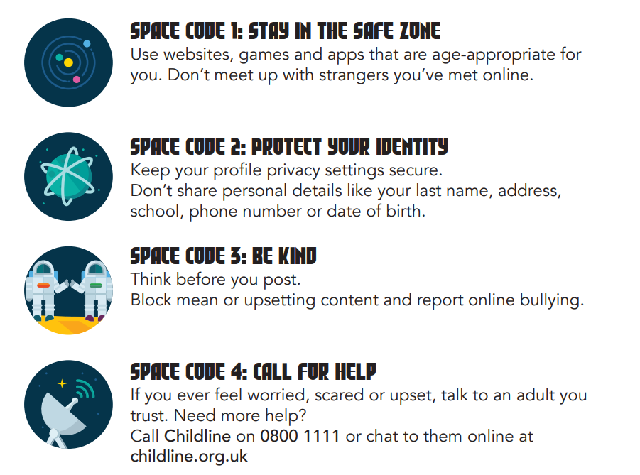
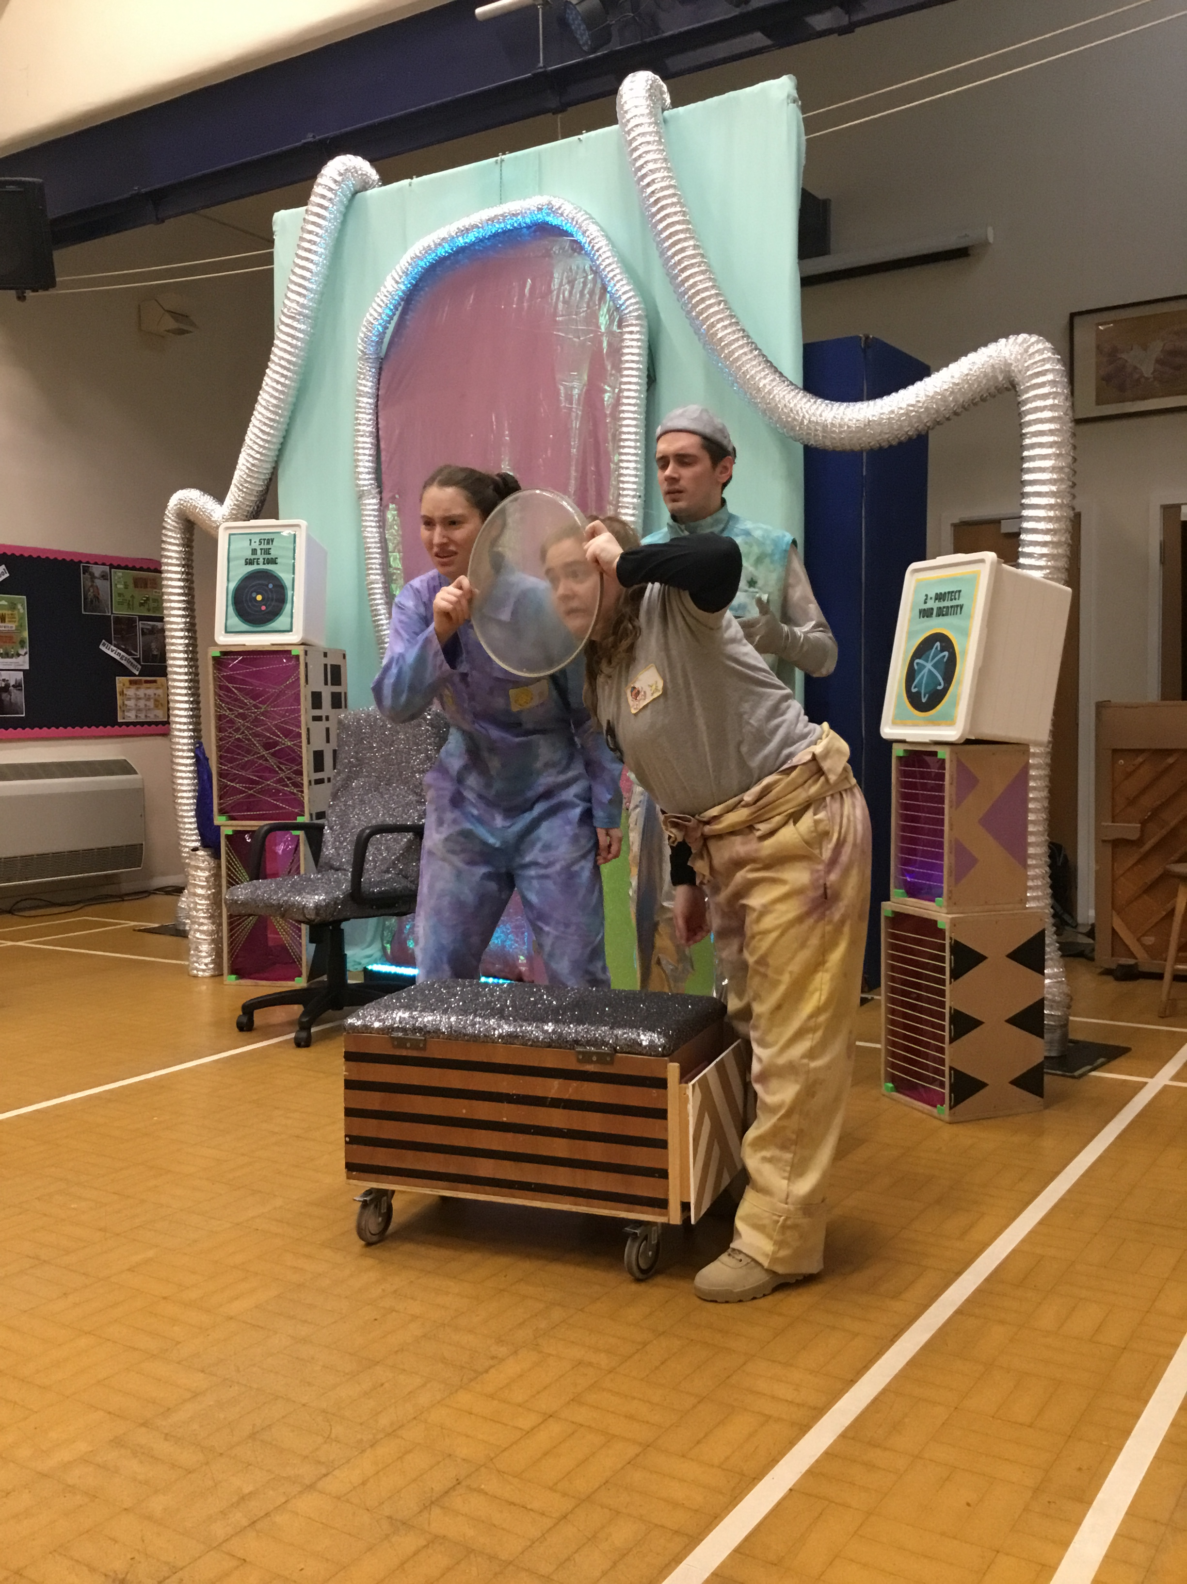
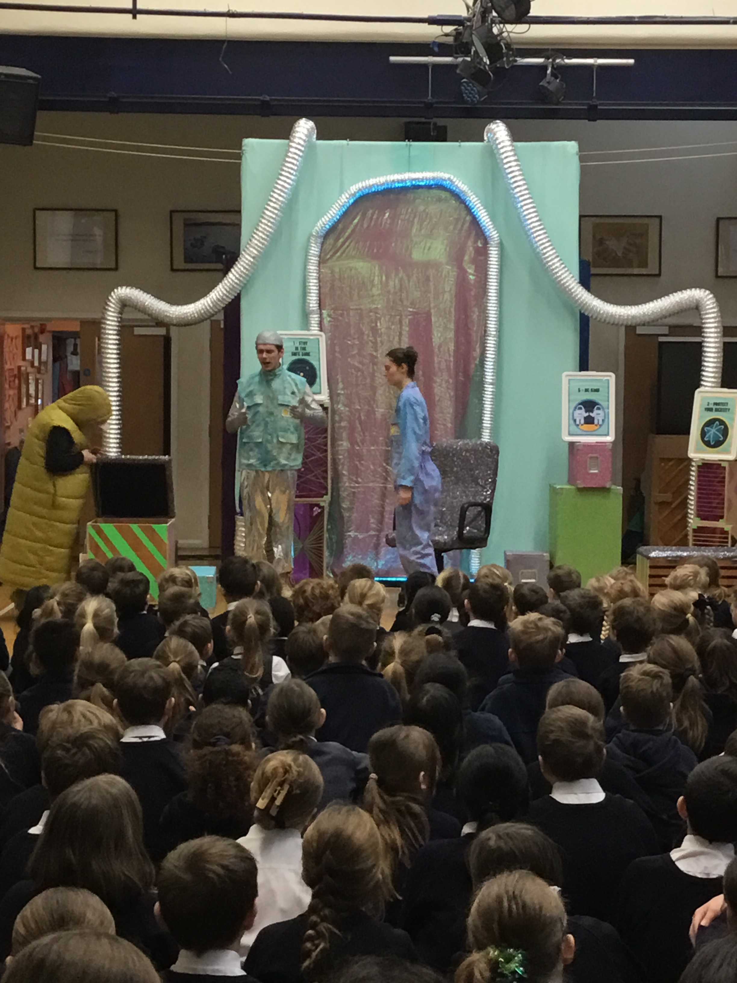
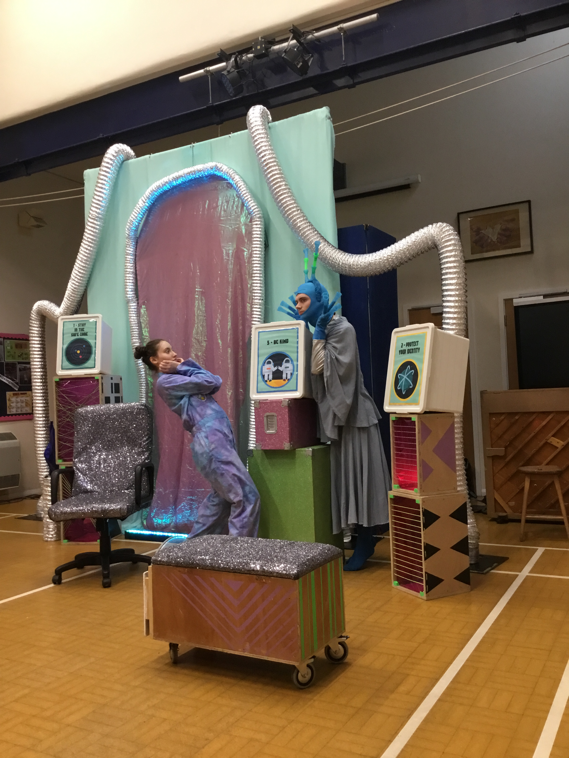
Building Digitally Resilient Citizens
Saltmine Theatre Company Visit William Gilbert
Children thoroughly enjoyed watching the Saltmine Theatre Company’s performance called Blast Off and took part in an interactive workshop which explored how we can safely use the internet. Blast Off uses the analogy of space to represent the internet and follows the story of Imogen, a young girl who is old enough to journey into “space” on her own. To help protect them, pupils learn the importance of following the Space Code. Below is the Space Code that was taught to the children to support them when they are online.

Slide 3
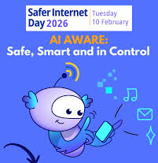
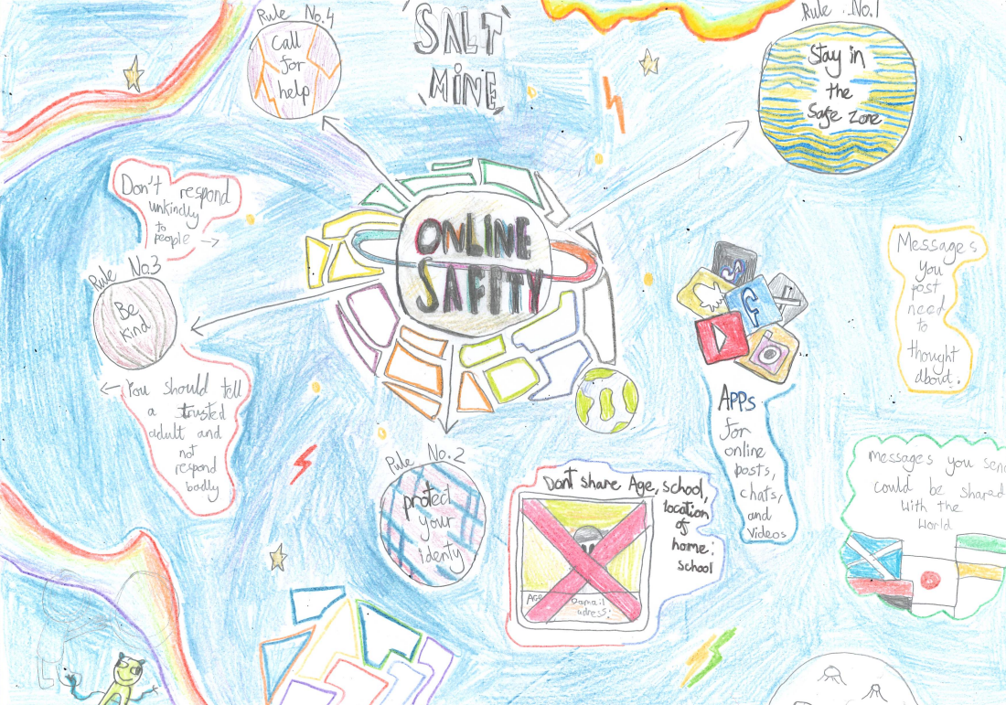
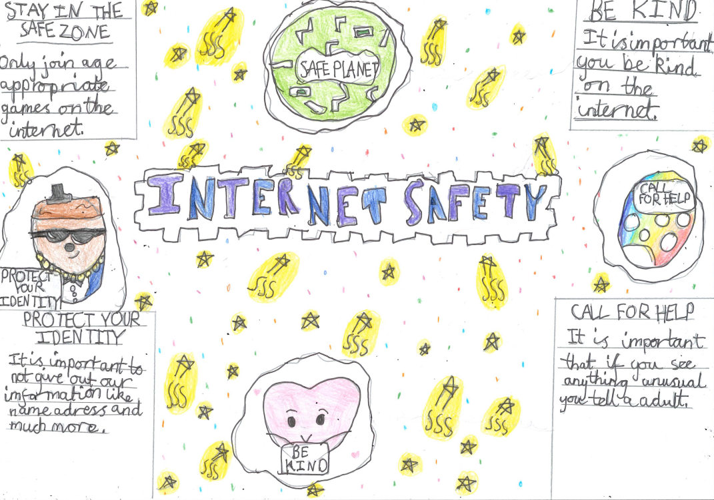
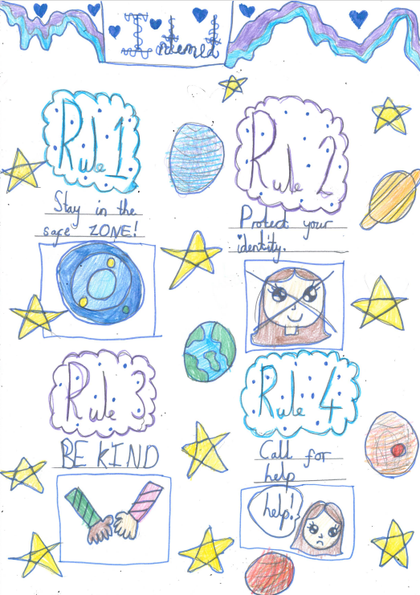
Keeping Safe Online
Safer Internet Day 2026 – Smart Tech, Safe Choices
Safer Internet Day 2026 will take place on 10th February 2026, with celebrations and learning based around the theme “Smart tech, safe choices – exploring the safe and responsible use of AI.” This year’s theme recognises how deeply AI tools - such as chatbots, voice assistants, filters, gaming features and personalised recommendation systems - are woven into children’s everyday digital lives.
Using the internet safely and positively continues to be a key message we promote at William Gilbert School, and Safer Internet Day provides a valuable opportunity to revisit those important conversations with pupils and families.
Pupils across the school have celebrated and promoted all they have learnt about keeping safe online.
George – Year 4
Juno – Year 4
Sarah Dufton Digital PCSO visited school on 11th February 2026 and delivered an Online Safety workshop. She was very impressed with the pupil’s knowledge, enthusiasm and online safety work.
Melody – Year 4
Online Safety: Helping Your Family Navigate AI and Smart Technology
Smart technology and AI bring exciting opportunities for learning and creativity, but they also introduce new risks—such as misinformation, deepfakes, privacy concerns and AI‑powered scams. Children need support in understanding how to question, evaluate and respond safely to what they see online.
Here are Top Tips for Parents to help your family make smart choices with smart tech:
✔ Talk About AI Together
Help your child understand how AI works in the apps, games and devices they use. Explain that AI can create images, videos or messages that look real but may not be. Encourage them to question unusual content and check with a trusted adult if something feels “off.”
✔ Encourage Critical Thinking
Teach your child to spot red flags such as unrealistic claims, emotionally charged messages, or content that tries to influence their decisions. Help them learn the difference between verified information and AI‑generated misinformation or deepfakes.
✔ Protect Personal Information
AI systems often learn from user data. Remind children never to share personal details, photos, passwords or location online—even if a message sounds helpful or trustworthy. Make privacy settings a regular part of your family’s online discussions.
✔ Model Safe Use of Smart Tech
Show your child how you make safe choices online—checking sources, questioning unexpected messages, using secure passwords and thinking carefully before sharing content. Children learn safe habits when adults model them.
✔ Stay Informed About New Technologies
AI tools and digital platforms evolve quickly. Keep yourself updated on new features, tools and potential risks, including AI‑generated scams, manipulated media and targeted advertisements. Understanding how these systems operate helps you guide your child with confidence.
✔ Teach How to Report & Respond
Make sure your child knows how to block, report or flag harmful or suspicious content. Remind them that they can always talk to you or another trusted adult if something online makes them feel unsure, upset or uncomfortable.

Slide 4



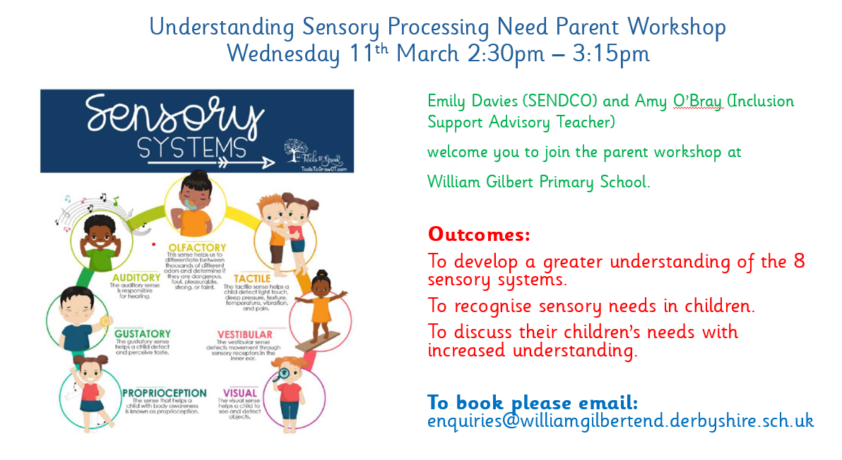
Supporting Children’s Wellbeing
The theme for Children’s Mental Health Week this year is ‘This is my place’, which focuses on helping children and young people understand where they feel safe, valued and supported. It encourages them to recognise the people, spaces and activities that help them feel grounded and confident, and to use these as tools for expressing how they feel. As parents and carers, you play a vital role in supporting your child’s emotional wellbeing, and there is a wealth of guidance and resources available on their website. Follow the link below to find out more. https://www.childrensmentalhealthweek.org.uk/families/
At William Gilbert C of E Primary School and Nursery, we are committed to supporting the emotional health and wellbeing of our pupils and staff. We know that everyone experiences life challenges that can make us vulnerable, and, at times, anyone may need additional emotional support. We take the view that positive mental health is a universal right and that we all have a role to play. This month we will be raising their awareness further through assemblies and class-based learning around the theme of Children’s Mental Health week.
Parental Support
We know parenting isn’t always easy. Young Minds have lots of practical advice and tips on supporting your child. They also have a Parents Helpline which can provide advice and support if you're worried about a child or young person.
Visit https://www.youngminds.org.uk/parent/
If you are concerned about your child’s mental health and wellbeing, please get in touch. We can offer advice and support. Mrs Aston is our Pastoral and Wellbeing lead and can be approached at the school gate or via the school email address pastorallead@williamgilbertend.derbyshire.sch.uk Below you can find links to other areas of further reading and support.
Compass Changing Lives offers early emotional wellbeing and mental health support for children, young people and families across Derby and Derbyshire. Their Mental Health Support Teams and Early Intervention service work together to provide help in schools and local communities, offering free and confidential support for children aged 5–18 (and up to 25 for care leavers or those with SEND). The team supports children experiencing mild to moderate worries - such as feeling sad, anxious, angry or overwhelmed - and also provides guidance for parents and carers to help them better understand and support their child’s mental health. Whilst school support pupils mental health and wellbeing through our extensive school level Early Help offer and pastoral provision, there may be times when more specialist support is required. School and families can refer to this service. For more information follow the link or click the image above. https://compass-uk.org/services/compass-changing-lives/
Come to our second parent workshop of the year. Understanding Sensory Processing Needs. It’s an informal and welcoming opportunity to discuss any challenges you are facing. See below for further details.

Slide 5
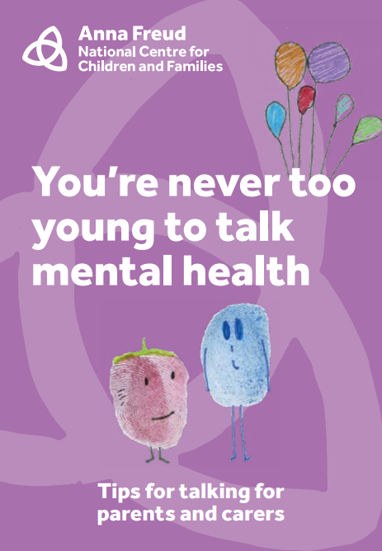
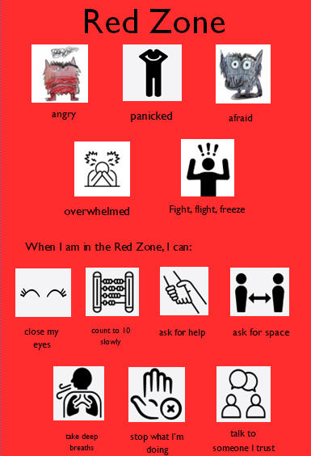


Managing Big Emotions
Teach Your Children How To Be Angry
Anger is an emotion that we all feel at times and for our children it is a natural way to express themselves. Supporting children to manage these big emotions is an important part of our work in school. I hope you find some of the ideas helpful for home too. Finding the words to express feelings when you are a child is hard and so we need adults to support them to show their emotions. To know that adults understand big feelings and teach children to recognise the emotion and why they may feel that way.
Allow them to express themselves through art, music or sport.
Talk to them about how you handle your emotions Talk to your children about how you handle your own emotions (walking, talking with friends, positive affirmations, reading, whatever it is that helps you remain regulated – you may have to think about this one). Make sure they know that you have ways to work to cope with the things you’re feeling.
Spend time outdoors together. Being outside is something that helps to relax people immensely. While it may not seem like much at first, as time passes it will work wonders. Moments of awe and wonder feed the soul, make connections and develop children's spirituality and sense of wellbeing.
Set a good example emotionally, don’t overreact or lash out. Set a good example for your children. They react to the way you act and will change themselves to mimic you. If you are handling your emotions with care and thought, they will also be able to work towards the same. When children see and hear overwhelming emotions spill over e.g. swearing at other drivers when in the car. Children replicate this pattern of behaviour.
Set and maintain boundaries with your children without dismissing them. Make sure they know that when it comes to their emotions they need to think and take a minute before they act. Feeling bad doesn’t mean they should lash out, we need to help them understand that there are consequences for everything we do.
Try to ensure they are comfortable coming to you to talk about feelings and emotions. Let your children know that you are there for them and you want to listen and have the time to listen. They need to feel safe and secure with you and be sure that you will not judge them.
Use TV shows, favourite films , books and other things your children like to talk about emotions. Help your children to relate better by using things they like. If they see someone angry on a show or in a film, ask them how that makes them feel. Try to talk about a wide range of emotions. Having emotions is one of the things that makes us human. However, when we or our children experience strong overwhelming emotions, we must learn how to recognise them, name them and tame them.
Use the Zones of Regulation Posters . Children are familiar with the red zone which names some of these strong emotions and have ideas and strategies to help them calm and regulate.
A useful guide for parents with lots of useful tips and advice. Click the image or follow the link below Guide for talking parents and carers
Talk about uncomfortable emotions. Be willing to talk about the things your children or you might consider to be uncomfortable. Sadness, grief or loss doesn’t feel good, but it is unavoidable throughout life. They need to know that they are not alone with this feeling.
‘All feelings are welcome; all behaviours are not’

Slide 6



Safety in the Home
Raising Awareness About Allergic Reactions
Following a report from a parent in our school community about their child suddenly developing a serious allergic reaction to a food they had previously eaten without any issues, we would like to share important information to help raise awareness of this potentially life-threatening condition.
The parent shared that having a bottle of Children’s Allergy Relief Antihistamine was helpful and was used under the guidance of emergency services when they dialled 999.
Please note: Always seek medical advice before administering any medication if anaphylaxis is suspected, as this condition requires urgent medical attention.
We want to reassure parents that our school has an EpiPen on-site for emergency use, and staff are fully trained in how to administer it should it ever be required. An EpiPen is a life-saving device used to treat severe allergic reactions (anaphylaxis) while awaiting medical help. If you have any concerns or would like to discuss your child’s allergies, please contact the school office.
Further Advice for Parents can be found here:
Supporting people living with allergy
https://www.allergyuk.org/
Anaphylaxis UK is the only UK-wide charity operating solely for the growing numbers of people at risk of serious allergic reactions and anaphylaxis. https://www.anaphylaxis.org.uk/
NHS advice website
https://www.nhs.uk/conditions/anaphylaxis/
What to Do in an Anaphylactic Emergency
(Adapted from the NHS website)
If someone is experiencing an anaphylactic reaction:
Use an adrenaline auto-injector (e.g., EpiPen) immediately – instructions are on the device.
Call 999 and state it’s an anaphylactic reaction.
Lie down and raise legs. If breathing is difficult, sit up slowly or raise shoulders (pregnant individuals should lie on their left side).
Remove insect stings if visible in the skin.
Use a second auto-injector after 5 minutes if symptoms don’t improve.
Do not stand or walk, even if feeling better.
Quick action saves lives—always seek emergency help.
RoSPA: Royal Society for the Prevention of Accidents https://www.rospa.com/policy/home-safety/advice
If you have any symptoms of anaphylaxis, stay where you are. You should lie flat with your legs raised to help blood flow back to your heart and vital organs.
Top Tips for a Safe Home – Further advice found at: https://www.safeathomecip.org.uk/safety-advice/
Give young children your full and undivided attention when they are in the bath or around water.
Check smoke alarm batteries every six months to make sure they are working.
Keep cribs clear of objects, and make sure babies sleep alone, on their backs, and in a crib every time they sleep.
Install safety gates to keep children from falling down staircases and window guards or stops to prevent falls from windows.
Keep all medicine up and away, even medicine you take every day. Be alert to medicine stored in other locations, like pills in purses, vitamins on counters, and medicine on nightstands.
If you believe that any child is in danger ring Call Derbyshire Tel: 01629 533190 choosing the option for urgent child protection calls at any time

