Slide 1



Year 6 MFL Transition 2020
Español
Français

Slide 2


Year 6 MFL Transition 2021
Welcome year 6 students to Holte School. We look forward to you all joining the year 7 year group in September 2021.
All year 7 pupils will be allocated to study either French or Spanish.
We would like you to familiarise yourselves with Spanish and French so that you are ready for foreign language studies in September.
Try to see how well you do at the following tasks and challenges. Good luck!

Slide 3
Français

Slide 4
Que savez vous?-What do you know?
Write down your answers to the questions on a piece of paper
How many people in the world speak French? Can you name 5 countries where French is spoken?
Can you give 4 examples of famous french people, famous landmarks or food?
What do think merci means?
Hello
Thank you
Please
Challenge task:
Write down 3 other French words that you know and their meanings
Notes:
Ans: Approx 270 million. It is the official language of 29/30 countries.
Group activity. One piece of A3.

Slide 5
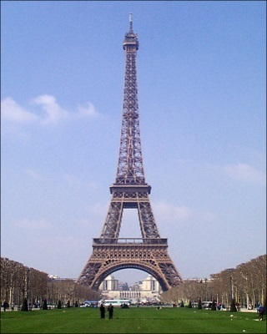
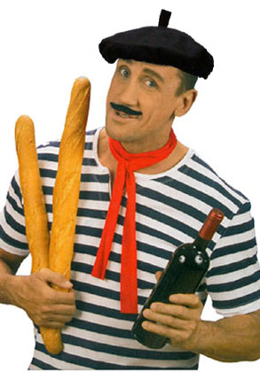
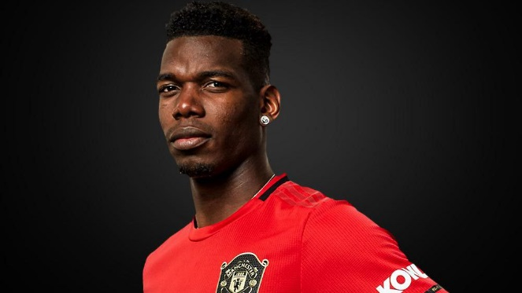


Que savez vous?-Answers
How many people in the world speak French? Can you name 5 countries where French is spoken?
Approximately 270 million. It is the official language of 29 countries. Examples of French speaking countries are Belgium, Morocco, Senegal, Switzerland and Algeria
2. Can you give 4 examples of famous french people, famous landmarks or food?
3.
3.What do think merci means?
Hello b)Thank you c)Please
Croissants
Paul Pogba
Eiffel Tower
La baguette
Mark your own work. How many did you get right?

Slide 6
Greetings
Bonjour-Hello
Read these different French greetings and see if your can memorise them
Salut-Hi
Literacy link
Salut and coucou are synonyms. This means that the different words have the same meaning
Coucou-Hi
Bonsoir-Good evening

Slide 7
Au revoir-bye
Read these different French greetings and see if your can memorise them
À demain-see you tomorrow
À plus tard-see you later
À bientôt-see you soon

Slide 8
Match the French and English phrases
Write your answers on a piece of paper.
Bonjour, Salut, Coucou
Bonsoir
Au revoir
À plus tard
À demain
À bientôt
See you tomorrow.
Goodbye
See you later.
Hello
See you soon.
Good evening

Slide 9
Match the French and English phrases
Mark your own work. How many did you get right?
Bonjour, Salut, Coucou
Bonsoir
Au revoir
À plus tard
À demain
À bientôt
See you tomorrow.
Goodbye
See you later.
Hello
See you soon.
Good evening

Slide 10

Español

Slide 11
Spanish Quiz
Multiple Choice
Write the numbers 1-10 on a piece of paper and write the letter for the correct answer to the question
For example 1. B
2.
3.
4.
5.
6.
7.
8.
9.
10.
Remember to mark your answers as you are going along
How many do you think you will get right?

Slide 12
1) What is the capital city of Spain?
a) Paris
b) Madrid
c) Barcelona

Slide 13
1) What is the capital city of Spain?
a) Paris
b) Madrid
c) Barcelona

Slide 14
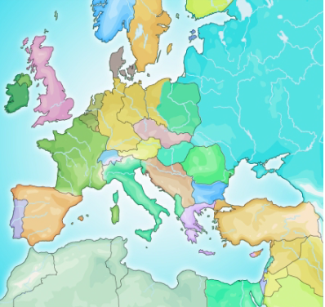
2)Which 2 countries border Spain?
a) France and Portugal
b) Italy and France
c) Italy and Portugal

Slide 15
2)Which 2 countries border Spain?
a) France and Portugal
b) Italy and France
c) Italy and Portugal

Slide 16
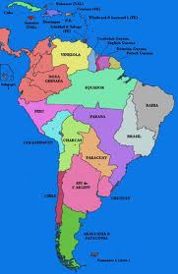
3) In which of these countries is Spanish not spoken?
a) Mexico
b) Argentina
c) Brazil

Slide 17
3) In which of these countries is Spanish not spoken?
a) Mexico
b) Argentina
c) Brazil

Slide 18
4. What is the name of the Spanish King?
King Felipe VI
King Alfonso
King George V

Slide 19
4. What is the name of the Spanish King?
King Felipe VI
King Alfonso
King George V

Slide 20
5. How many official languages are spoken in Spain?
1
3
4

Slide 21
5. How many official languages are spoken in Spain?
1
3
4
Notes:
Castellano, Catalan, Basque, Gallega

Slide 22

6. Which one of the following sweets does not come from Spain?
Chupa chups lollipops
Werther’s Originals
Smints

Slide 23
6. Which one of the following sweets does not come from Spain?
Chupa chups lollipops
Werther’s Originals
Smints

Slide 24
7. The Spanish introduced this Mexican drink to Europe.
hot chocolate
coffee
tea

Slide 25
7. The Spanish introduced this Mexican drink to Europe.
hot chocolate
coffee
tea

Slide 26
8. Which of these is in the Canary Islands?
Mallorca
Tenerife
Ibiza

Slide 27
8. Which of these is in the Canary Islands?
Mallorca
Tenerife
Ibiza
Notes:
Who has been to any of these places?

Slide 28
9. Which of these flags belongs to a Spanish speaking country?

Slide 29
9. Which of these flags belongs to a Spanish speaking country?

Slide 30
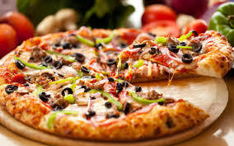
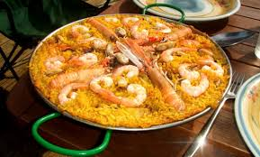
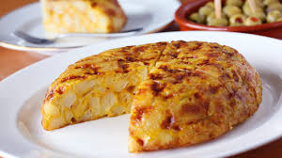
10. Which of these is not a Spanish dish?
Pizza
Paella
Tortilla (potato omelette)

Slide 31
10. Which of these is not a Spanish dish?
Pizza
Paella
Tortilla (potato omelette)

Slide 32
Spanish greetings
Read these different spanish greetings and see if your can memorise them and the spellings

Slide 33
¡ Hola !=Hello
¡ Buenos días !=Good morning
¡ Buenas tardes !=Good afternoon
¡ Buenas noches !=Good evening
Literacy link
In Spanish, exclamation marks are used for emphasis. You put the upside down exclamation point before the beginning of every new sentence and the regular exclamation point at the end.

Slide 34
¡ Adiós != goodbye
¡ chao !=bye
See you later=¡ Hasta luego !

Slide 35
Match the Spanish and English phrases
Write your answers on a piece of paper.
¡ Hola !
¡ Buenas noches !
¡ Adiós !
¡ Buenas tardes !
¡ Buenos días !
¡ Hasta luego !
See you tomorrow.
Goodbye
See you later.
Hello
See you soon.
Good evening

Slide 36
Match the Spanish and English phrases
Mark your own work. How many did you get right?
¡ Hola !
¡ Buenas noches !
¡ Adiós !
¡ Buenas tardes !
¡ Buenos días !
¡ Hasta luego !
Good afternoon
Goodbye
See you later
Hello
Good morning
Good evening

Slide 37
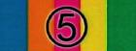

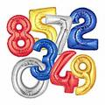
5 – 5 – 1
Summarise what you have learnt into 5 sentences.
Reduce to 5 words (This could be a mixture of French and Spanish words).
Now to 1 word.

Slide 38
Vocabulaire (Français)
Bonjour, Salut, Coucou
Bonsoir
Au revoir
À plus tard
À demain
À bientôt
Comment t’appelles-tu?
Je m’appelle (Marie).
Ça va?
Bien!
Très bien!
Génial!
Comme ci, comme ça!
Bof!/Ça ne va pas!
Hello
Good evening
Goodbye
See you later
See you tomorrow
See you soon
What are you called/What is your name?
I am called/My name is (Marie).
How are you?
Good!
Very well!
Great!
So-so (in the middle)!
Not so well!

Slide 39
Vocabulario (Español)
¡Hola!
¡Buenos días!
¡Buenas tardes!
¡Buenas noches!
¿Cómo te llamas?
Me llamo (Maria).
¿Qué tal?/¿Cómo estás?
¡Bien!
¡Muy Bien!
¡Mal!
¡Adiós!
¡Chao!
¡Hasta luego!
Hello!
Hello!/Good day!
Good afternoon!
Good evening!
What are you called/What is your name?
I am called/My name is (Maria).
How are you?
Good!
Very well!
Not so good!
Goodbye!
Bye!
See you later!

