Slide 1

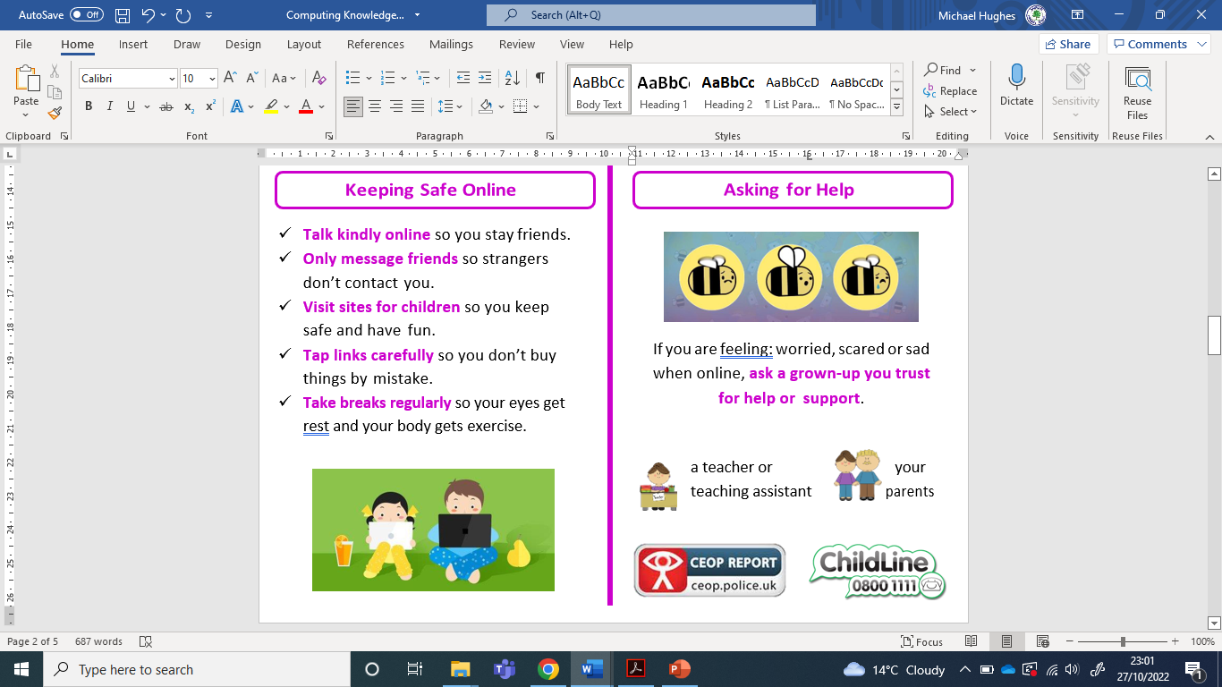
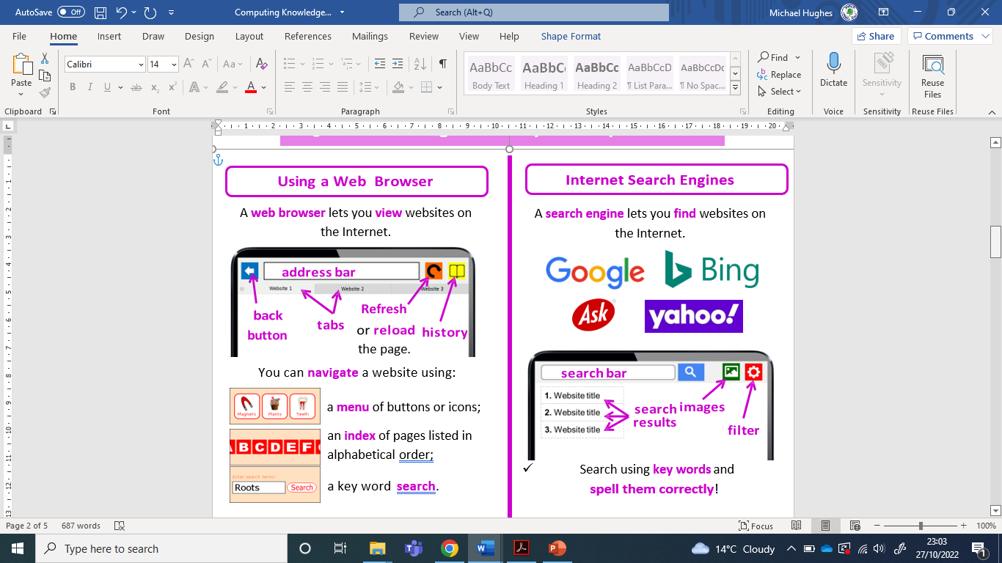
Sherdley Primary School Computing Knowledge Organiser
Year 1: Digital Literacy
Handy vocabulary
DL1.1 | Be able to access information on the internet and navigate a website using a QR code or links.
DL1.2 | With support, be able to access and view pictures or work via an online platform.
DL1.3 | Be able to use a search engine or in-app search to search for and save images, using keywords provided by the teacher.
DL1.4 | Be able to change options in simulations that represent real or fantasy situations and scenarios to create different outcomes and effects.
DL1.5 | Be aware of some of the dangers of online activity and know to tell an adult if they feel something they see online is inappropriate or hurtful.
Digital Literacy
Home Screen - The primary screen on a device from which apps and other functions can be accessed. QR Code - A machine-readable code, used for storing information such as URLs. Internet - A network of lots of computers that are linked all over the world. Website - A collection of web pages on the internet that we can view through a web browser. Username - An identification used to give access to a website or computer. Password - A secret word, picture or phrase that allows access to a website or computer. Log in / Log out - Using a username and password to access a website or computer.

Slide 2
Sherdley Primary School Computing Knowledge Organiser
Year 2: Digital Literacy
Handy vocabulary
DL2.1 | Be able to independently navigate to the right information on a website using links or buttons.
DL2.2 | With support, be able to share pictures or work to an online platform.
DL2.3 | Be able to use a search engine to search for given information, if necessary using keywords provided by the teacher.
DL2.4 | Be able to make changes in a model/simulation and use them to make and test predictions.
DL2.5 | Be able to explain online danger and begin to be responsible for their actions online, saying what personal information should be kept private.
Digital Literacy
Private Information - Information that should be kept private and not shared publicly with strangers. Inappropriate website – A website that contains materials that may be unsuitable for a child. Share - Allow other users access to a resource or information. Save / Open - Create a copy of work or information on a digital device that can be retrieved at a later date. Icon - A picture that is displayed to help to navigate a computer. Search Engine - A web-based tool that allows us to find information on the World Wide Web. Keyword - A search term entered on a search engine (e.g. Google), used to generate results or find information.
Worried about something online? Report it.

Slide 3
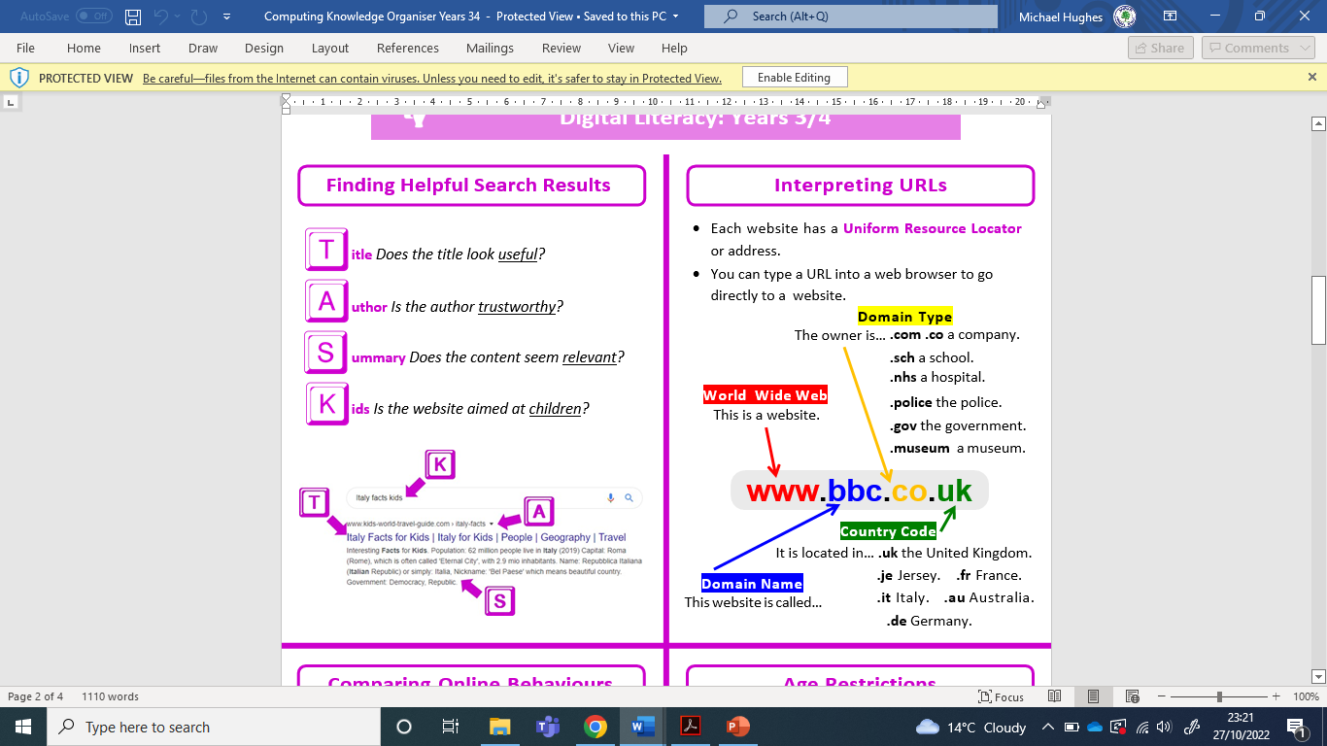
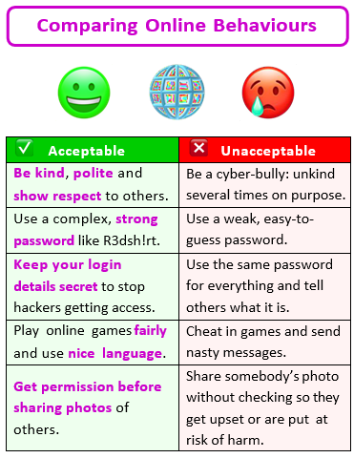
Sherdley Primary School Computing Knowledge Organiser
Year 3: Digital Literacy
Handy vocabulary
DL3.1 | Be able to identify and use links within a web page to answer questions.
DL3.2 | Use computer networks, including the world wide web to independently share suitable pictures and work on an online platform.
DL3.3 | Independently, be able to use a search engine to search for specific information.
DL3.4 | Be able to enter data into a computer simulation, change data and observe changes in results.
DL3.5 | Be aware of some of the consequences of their online actions and be able to explain the importance of balancing game and screen time with other parts of their lives.
Digital Literacy
eSafety - The safe and responsible use of technology. Software – Computer programs and applications or apps. Folder - A way to organise computer files. A folder can also contain other folders. Link (hyperlink) - Data that we can tap or click to jump to a new location, usually to a website. Email - Electronic mail that is sent by users between digital devices. Attachment - A file that can be sent with an email.
Worried about something online? Report it.

Slide 4
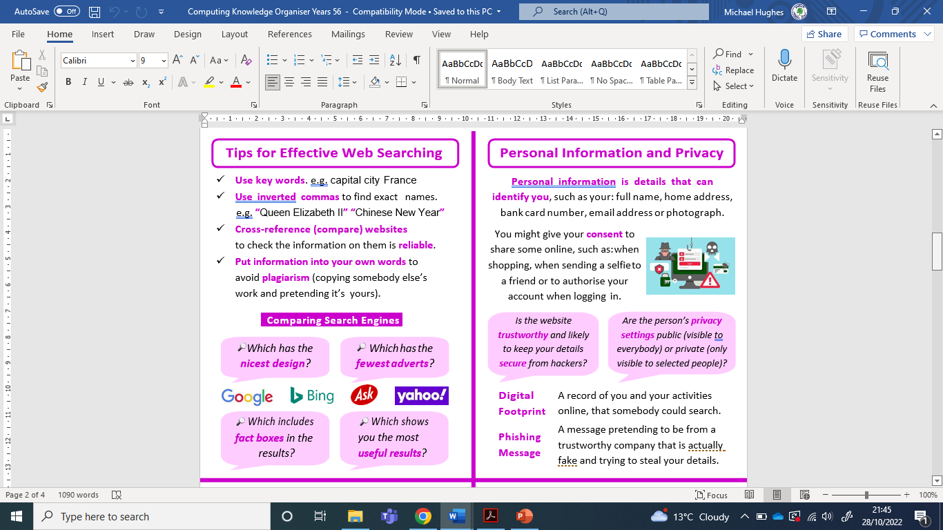
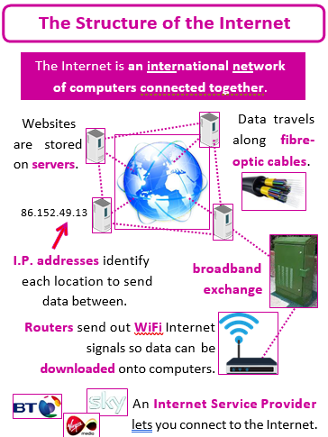
Sherdley Primary School Computing Knowledge Organiser
Year 4: Digital Literacy
Handy vocabulary
DL4.1 | When searching for information online, be able to evaluate how appropriate a website is.
DL4.2 | Use computer networks, including the world wide web, to work collaboratively with others.
DL4.3 | Be able to search for and select relevant information (pictures and text) to use in other software, sorting by text, pictures, sound and video.
DL4.4 | Be able to explore and predict the effect(s) of changing the variables in digital simulations and observe the results.
DL4.5 | Be able to identify appropriate behaviour when participating or contributing to collaborative online projects for learning and understand the reasons for using strong passwords.
DL4.6 | Be aware of ways in which we interact with online communities and be able to suggest and use strategies for dealing with cyberbullying.
Digital Literacy
World Wide Web (www) - All of the web pages on the internet. We can access these using a web browser. We use the web to help communicate with, and over, the internet. Internet Browser – A software program that lets you view web pages on a digital device. Shortcut - An icon that points to a website. Bookmark - Also called favouriting. Saves a digital location to allow quick access e.g. to a website. Spam - Unwanted email communication that gets sent out in bulk. Simulation - Using a computer to represent a real-world scenario.
Worried about something online? Report it.

Slide 5
Sherdley Primary School Computing Knowledge Organiser
Year 5: Digital Literacy
Handy vocabulary
DL5.1 | Be able to search the internet for specific information using tools such as Boolean search or Google Advanced Search.
DL5.2 | Use computer networks, including the world wide web, to work collaboratively with others with support. to engage in online communication with teachers and other pupils, making use of a growing range of features.
DL5.3 | Be able to search using more than one search term, adapting the search terms to refine search results.
DL5.4 | Use modelling and simulation software to explore or create realistic or fantasy representations of the real world.
DL5.5 | Be able to demonstrate an understanding of responsible social media use, including knowledge of their digital footprint, sharing information and images, and communication with others.
DL5.6 | Demonstrate an understanding of the risks of online gaming and know strategies for healthy online behaviours.
Digital Literacy
Cyberbullying – Using electronic means to bully or harass someone. Network - A group of computers that are connected (like the internet). Copyright - The rights of a creator to control how their media is used. This can cover music, books, software and videos. Virus - A malicious software program (malware) that can replicate and spread on a computer system without the user’s permission. Boolean Searching - Used to help find results faster and with more accuracy. Uses operators such as AND, OR and NOT. URL - Uniform Resource Locator (an address for a website).
Worried about something online? Report it.

Slide 6
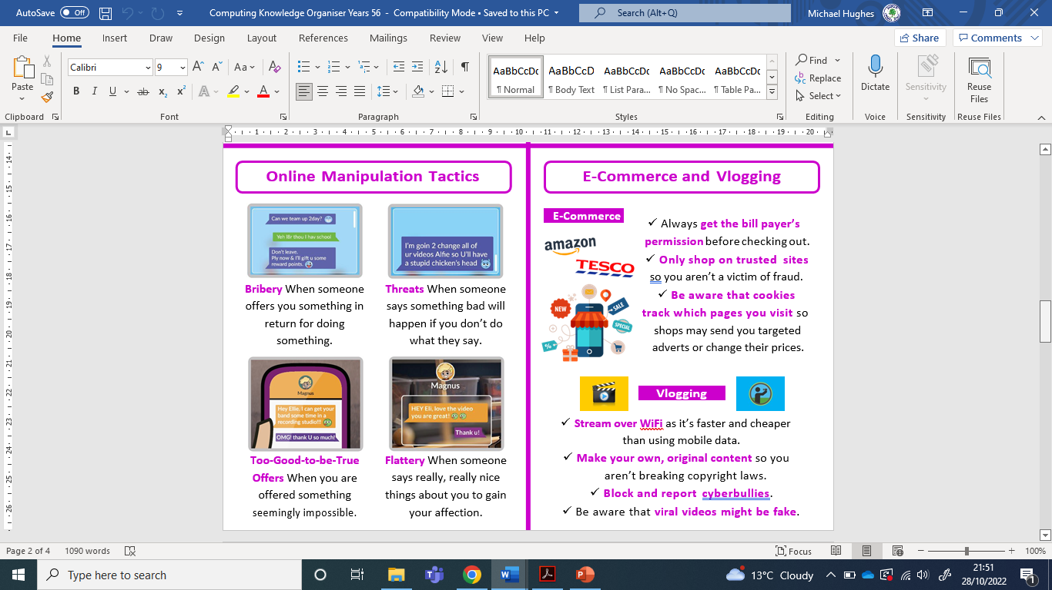
Sherdley Primary School Computing Knowledge Organiser
Year 6: Digital Literacy
Handy vocabulary
DL6.1 | Identify irrelevant, implausible and inappropriate information, when searching for information online.
DL6.2 | Use computer networks, including the world wide web, to work with others to create an online collaborative project for a specific purpose, sharing and appropriately setting permissions for other group members.
DL6.3 | Be able to show an awareness that some media is copyrighted and cannot be used without permission.
DL6.4 | Be able to use modelling software to explore and create detailed virtual environments or simulations.
DL6.5 | Be able to demonstrate an understanding of media bias and strategies for ensuring a balanced view, including gender stereotypes.
DL6.6 | Be able to explain how to develop positive online relationships and have strategies to prevent and stop negative situations and manage their private information.
Digital Literacy
Trolling – Leaving intentionally provocative or offensive messages on the internet in order to get attention or upset someone. Influencer - A person with the ability to influence potential buyers by promoting or recommending something on social media. Plausibility - Whether or not content on a website is believable and accurate. Local Area Network (LAN) – A collection of devices together in one location, such as a school. Wide area network (WAN) – A large network of computers that may span areas or even countries. The internet is an example of this. Router - A networking device that forwards data packets between computer networks. Access Point - A networking hardware device that allows other Wi-Fi devices to connect to a wired network.
Worried about something online? Report it.

