Slide 1
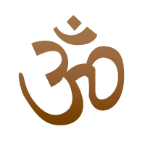
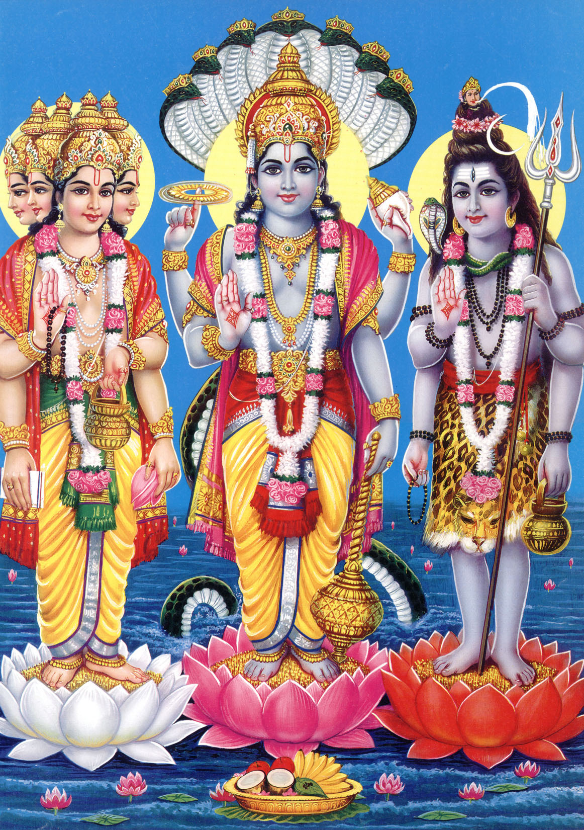
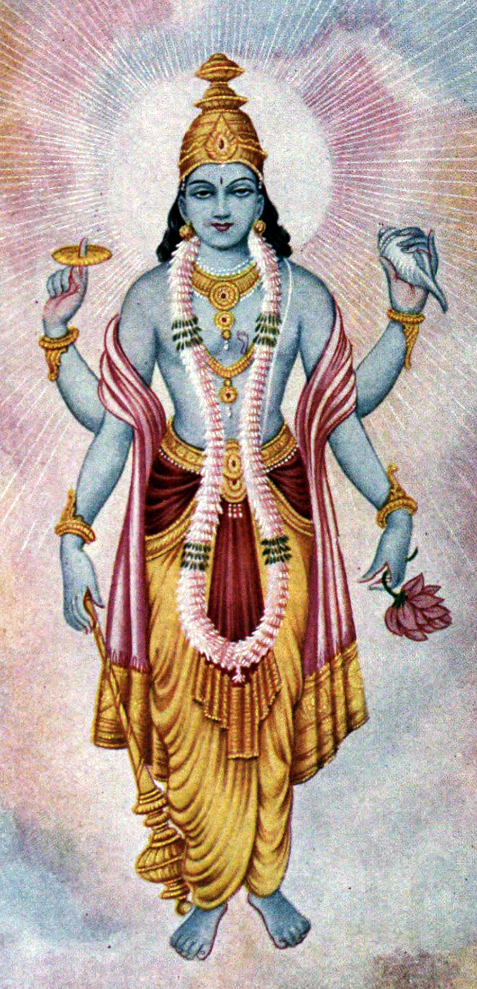
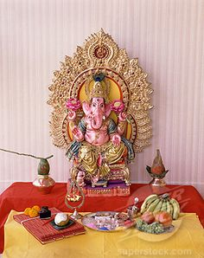
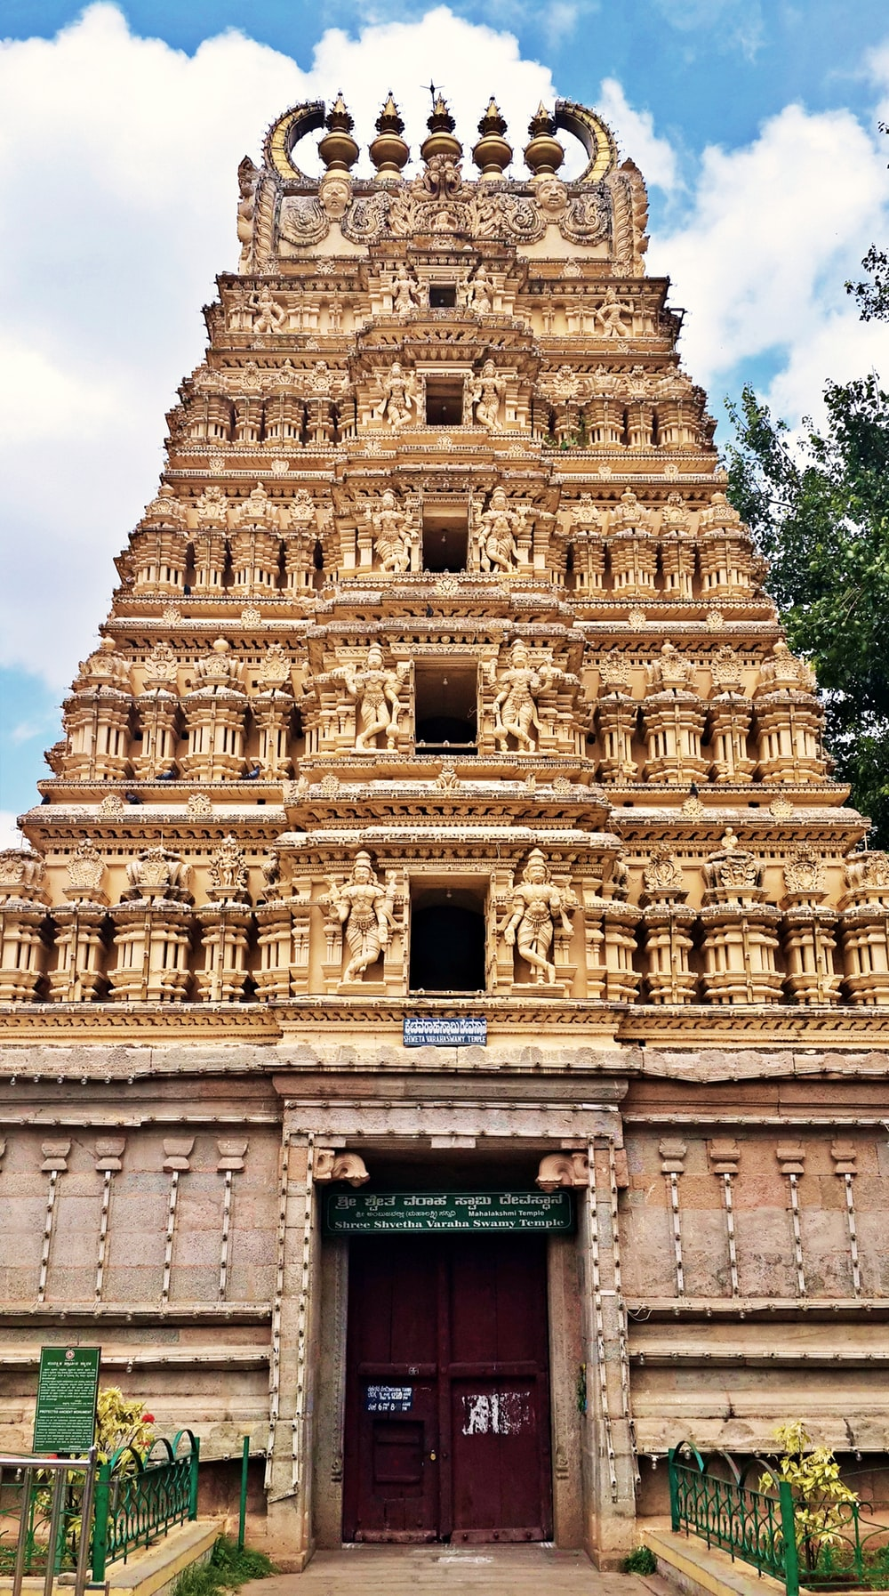
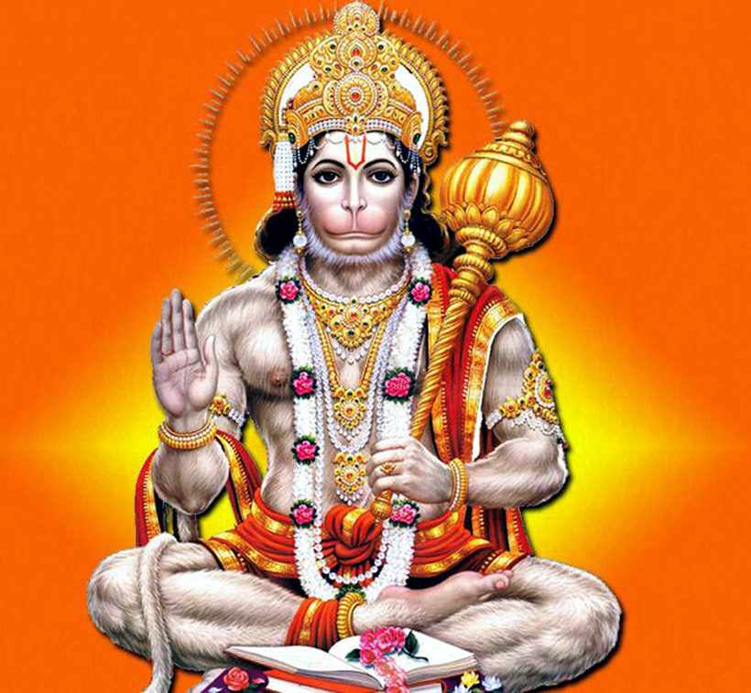
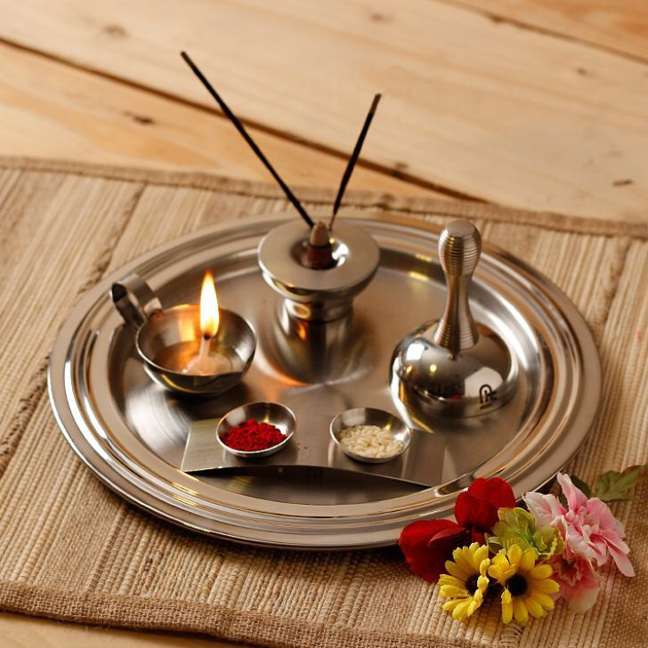
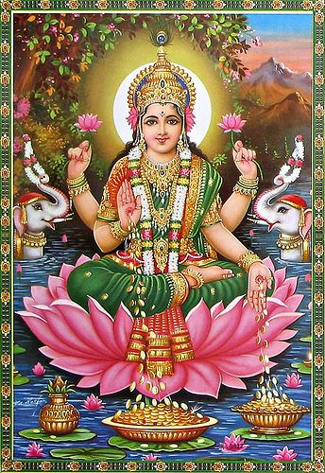
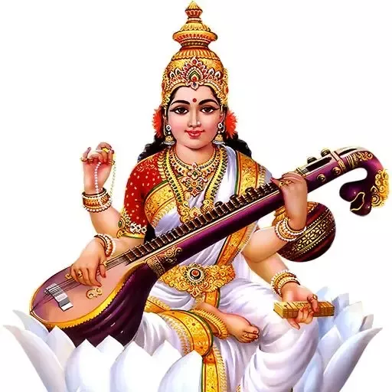
Vocabulary
Hinduism – the religion
Hindu – a person who follows Hinduism
Deity – A God or Goddess
Mandir – A Temple where Hindus go to pray.
Shrine – Can be a cupboard or a table containing all the things a Hindu needs to worship.
Dharma – the right way of living
Puja – The act of worship
Hinduism – KS1
Where Hinduism Began: India
The Hindu symbol is called the Om.
Trimurti in Hinduism, three main gods Brahma, Vishnu, and Shiva
A Hindu God called Vishnu – he sometimes comes to earth in many forms – the most famous is Rama in the Divali story.
Most popular Festivals are Divali and Holi.
Shrines
What you would find on a shrine
- Photos or statues of Gods
Flowers and food offerings eg fruit
Incense sticks
Puja items which include:
Container for water
Spoon.
Incense holder
Bell
Container for Kum Kum powder
Diva lamp
Worship
Arti is the ritual and
Puja is the act of worship
The worshipper must be clean
They remove their shoes
Ring bell
Light Diva Lamp and wave around
Light incense sticks and move around.
Place red powder as a dot on forehead of deity.
Place red dot on own forehead.
Say prayers
Share food.
Places of Worship:
- The Mandir
- A shrine at home
Main Beliefs
Dharma – the right way of living
Hindus believe that there is one God but he appears in many forms.
The many forms of Gods are known as deities.
Gods
One supreme being: Brahman
Popular Gods: Brahma, Vishnu, Shiva, Hanuman, Lakshmi, Ganesh.
A home shrine containing one of the Hindu Gods – Ganesh - he is an elephant God of wisdom.
A Hindu Temple is called a Mandir.
Lakshmi–Goddess of wealth and purity.
Puja Tray for Hindu worship
Saraswati – Goddess of knowledge and music.
Hanuman – The monkey god – is god of courage and strength.

