Slide 1
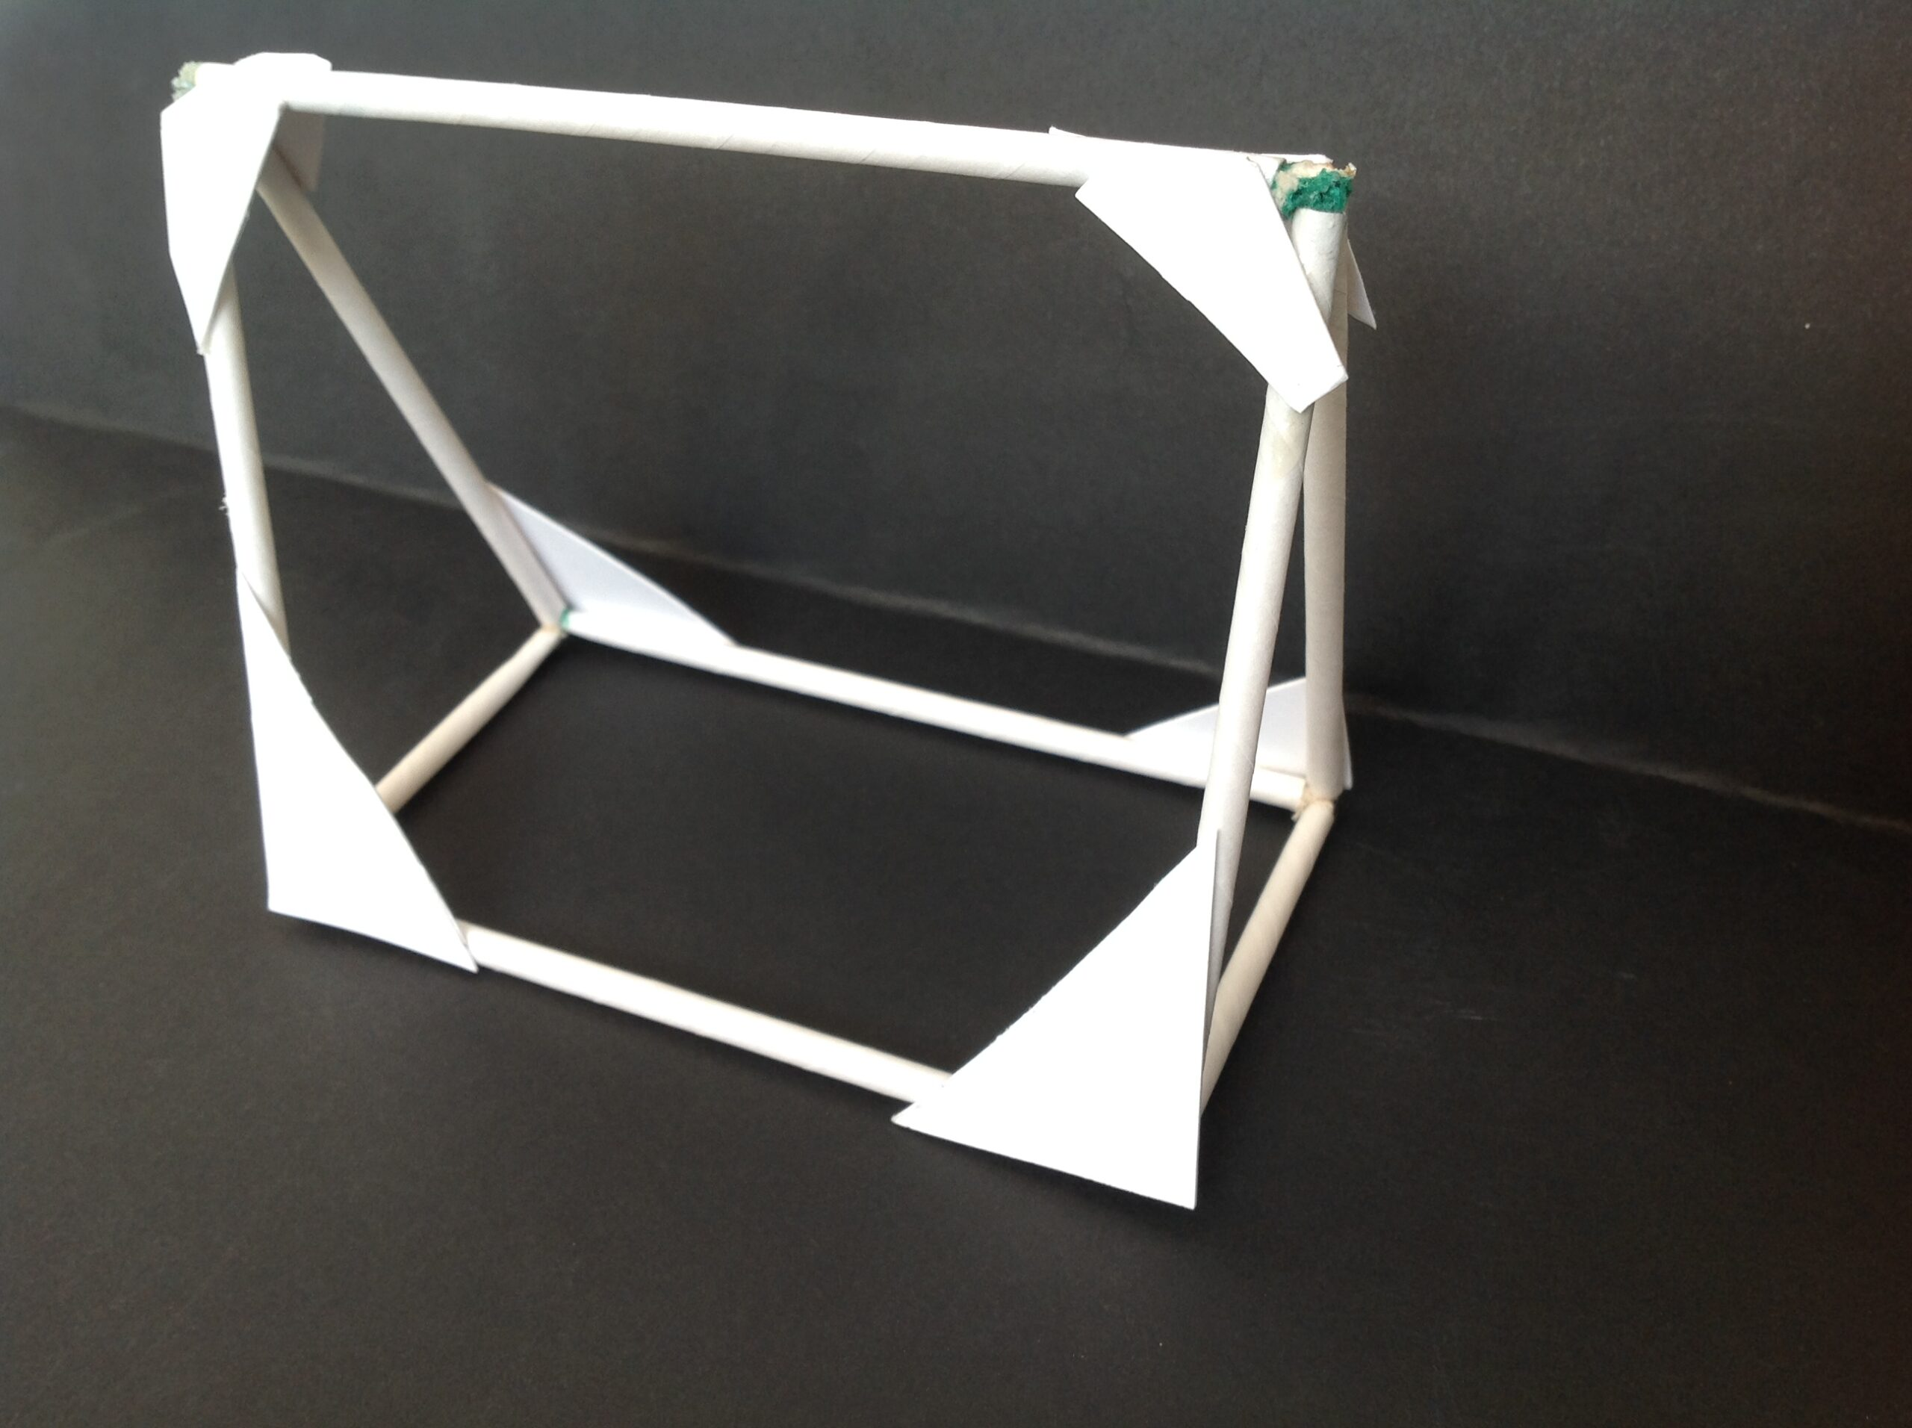
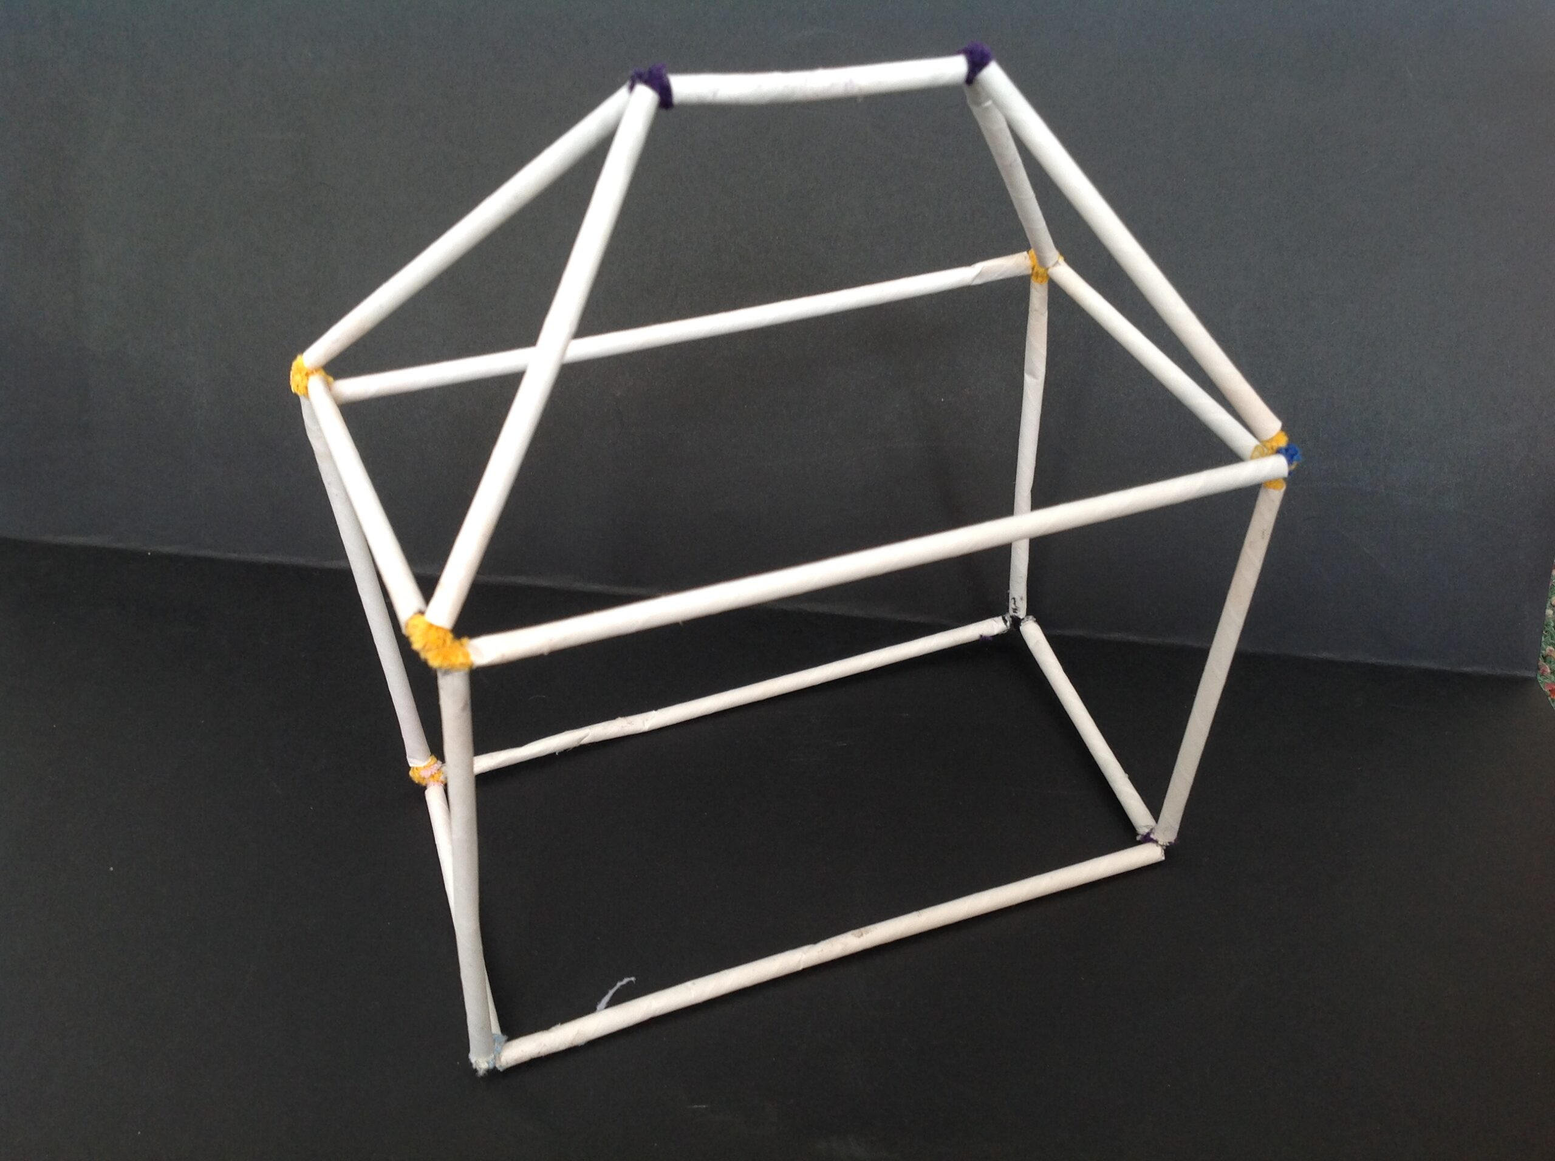
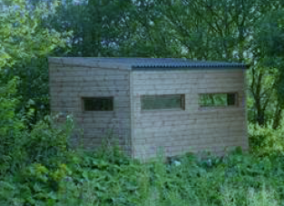
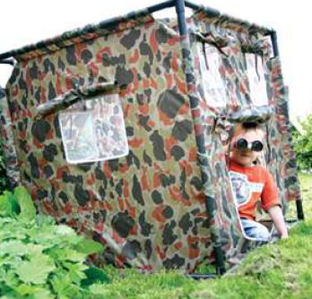
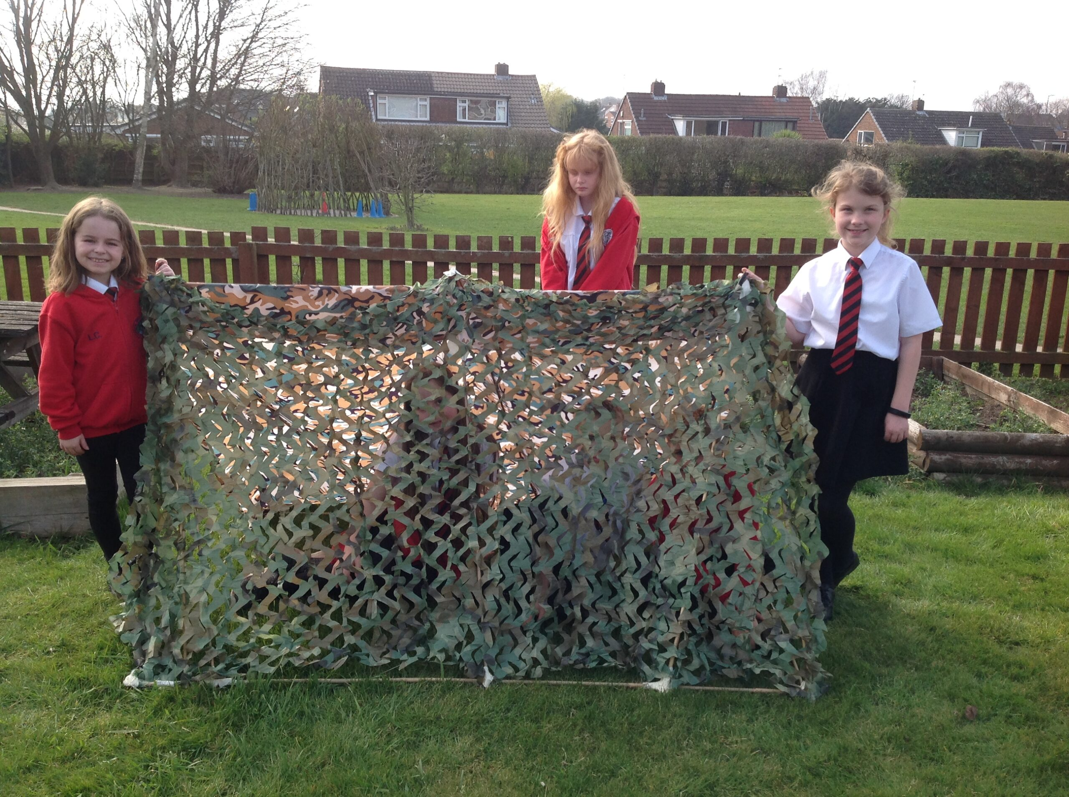
Key Vocabulary
Key Word | Definition
Frame structure | A structure that is made stable by a skeleton that is able to stand by itself as a rigid structure
Stiffen | To support or strengthen
Strengthen | To make or become stronger
Reinforce | To strengthen or support an object by the addition of extra material
Stability | The state of being stable
Triangulation | The use of triangles to strengthen and solidify structures
Temporary | Lasting for only a limited time. Not permanent
Permanent | Intended to last or remain unchanged
Camouflage | To hide or disguise the presence of something
Year 3/4 Structures (Autumn Term)
Bird Hide (Design)
Learning Sequence
Research and evaluate existing structures (bird hides)
1
Design prototype structures
2
Make prototype structures
3
Use design criteria to design a structure (bird hide)
4
Assemble, join and combine materials to make a structure
5
Evaluate a product against design criteria
6

