Slide 1


Asthma in Schools
Staff Update
Claire Booth, Children’s Community Asthma Nurse

Slide 2
AIM OF THE PRESENTATION
To help school staff support children who have asthma.
Raise awareness of the condition and how its managed.
Better understanding of what to do in an emergency

Slide 3

For the child asthma can be:
Disturbed sleep
Absence from school
Missed social and leisure activities
Perceived as different from their peers
Frightened/scared

Slide 4
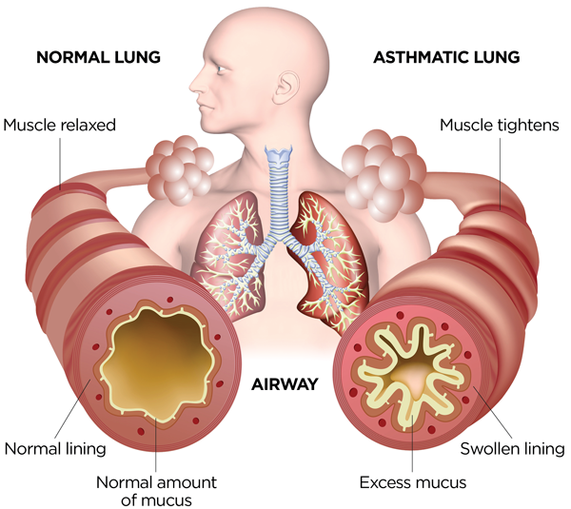
What is asthma?

Slide 5
Symptoms of asthma
Cough
Wheeze
Breathlessness
Chest tightness
Being unable to talk in full sentences
Younger children may complain of “tummy ache”

Slide 6
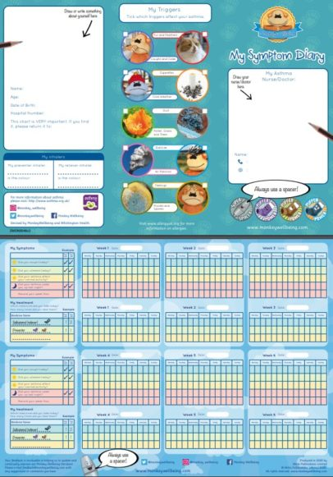
Triggers
Common Triggers are:
Viral illness
Animal dander
Cigarette smoke
Cold weather/changing weather
Exertion/emotion
Pollen
Mould
Pollution/chemicals

Slide 7
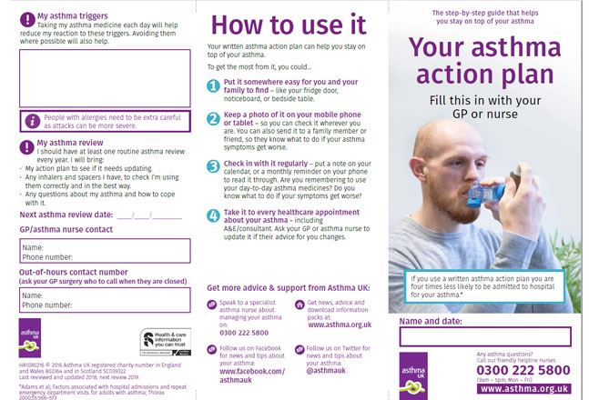
PE, school sports & break time activity
Important for all children to take part. If child is unwell with asthma try to get them involved in a less energetic role.
Always have blue inhaler with the child
Work within asthma action plan

Slide 8
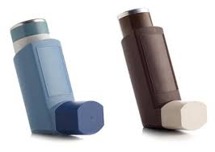
Asthma Medication
Preventer inhalers – Help to keep the child well by reducing the inflammation in the airways. Should be taken every morning and evening and should NOT be in school
Reliever inhalers – BLUE. Used to relieve symptoms of cough, wheeze, tight chest or breathlessness quickly, by opening the airways. Should be in school.

Slide 9
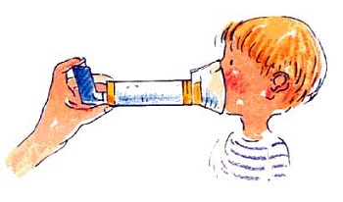
Asthma Medication in School
Where should the school keep reliever inhalers?
What happens if a child takes too much reliever inhaler?
Do inhalers expire after a given amount of
time?

Slide 10
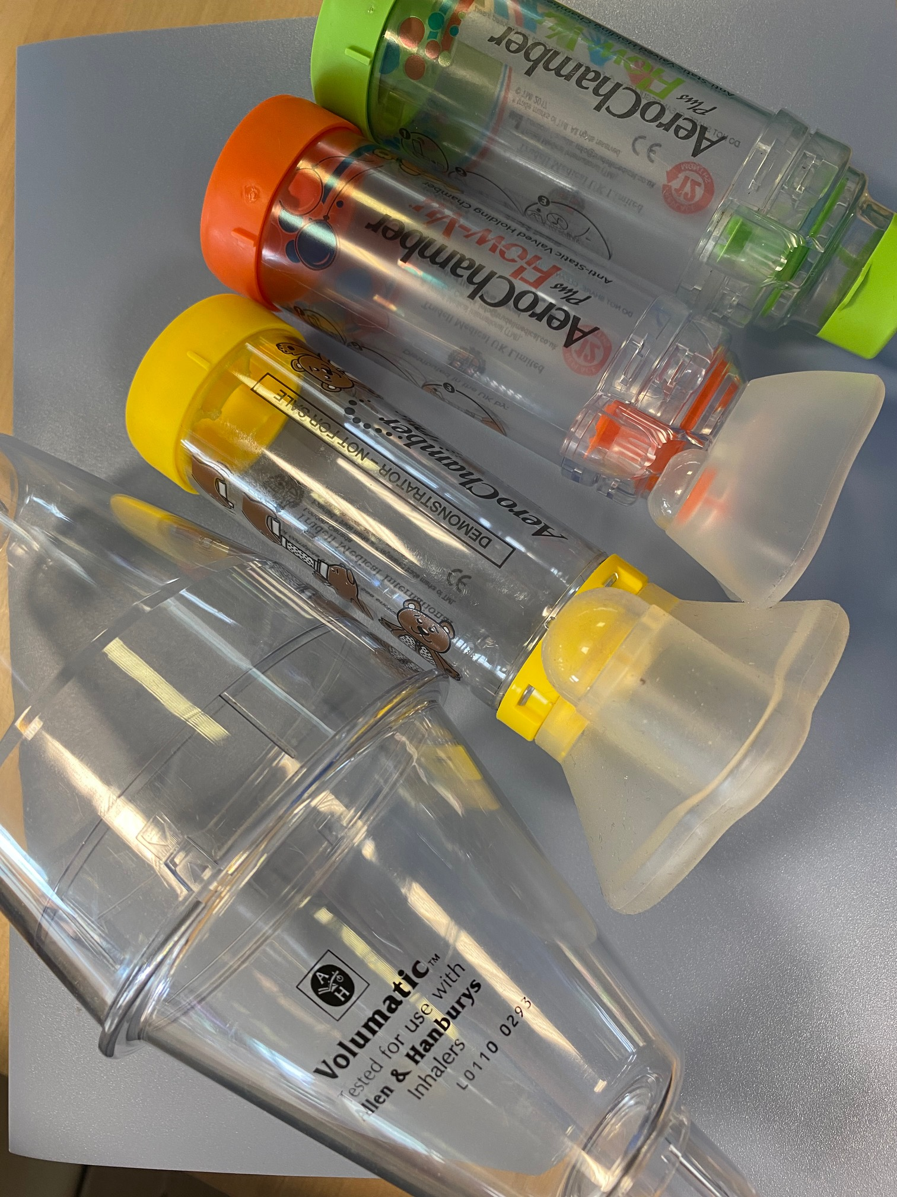
Spacers
  Spacers are the best way to take the inhalers. It is not recommended that children use aerosol inhalers (most commonly used) without a spacer.
  Older children may have a powder device that can be used without

Slide 11
Panic Attack vs Asthma Attack
Is it an Asthma Attack or a Panic Attack?
Knowing the difference can be difficult but here are some ways to tell:
Asthma Attack Cough Wheeze Low Peak Flow Your reliever (usually blue) isn’t helping or you need it every four hours or more If it’s an Asthma Attack: Folow your Asthma Action plan | Panic Attack Dizziness Tingling in fingers/lips Nausea Light headedness Cramps Hyperventilating If it’s a Panic Attack and you are hyperventilating, try some breathing exercises. Panic Attack usually subside quickly. | Both Shortness or Breath Tight Chest Felling tense or anxious Racing Heart Cannot talk in full sentences

Slide 12
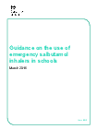
Emergency inhalers in school
Change in the law Oct 2014
Allows schools to purchase a spare salbutamol inhaler and spacer for emergency use
  Spacers are single person use
  Should only be used for children with a diagnosis of asthma and prescribed an inhaler or when a child has been prescribed an inhaler as a reliever medication and consent has been obtained from parents.
  Schools are responsible re: supply, storage, care & disposal
More information - Guidance on the use of emergency salbutamol inhalers in schools.
https://assets.publishing.service.gov.uk/government/uploads/system/uploads/attachment_data/file/416468/emergency_inhalers_in_schools.pdf

Slide 13
What to do if the child is having an asthma attack
BLUE INHALER – 2 puffs.
1 puff at a time, count to 10 seconds, shake the canister between puffs. Try to leave 30 seconds between puffs.
Encourage slow deep breaths, try to keep them relaxed.
Children may find it easier to breathe sitting upright and leaning slightly forward. Loosen tight clothing.
If no improvement after 5-10 mins: make sure the child takes one puff of their reliever inhaler every minute for five minutes (up to 4 puffs) or until their symptoms improve. Inform parent/carer.
This would be a total of 6 puffs

Slide 14

What to do in an emergency
If there is no improvement in symptoms after taking 6 puffs of their blue reliever:
The child can’t walk or talk easily
They are breathing hard and fast – using their ribs and tummy to breathe
Coughing and wheezing a lot
Lips and finger tips turning blue
Ring 999 and ensure the child takes 1 puff of their blue inhaler every minute for up to 10 puffs
School staff should NOT take children to hospital in their own car

Slide 15
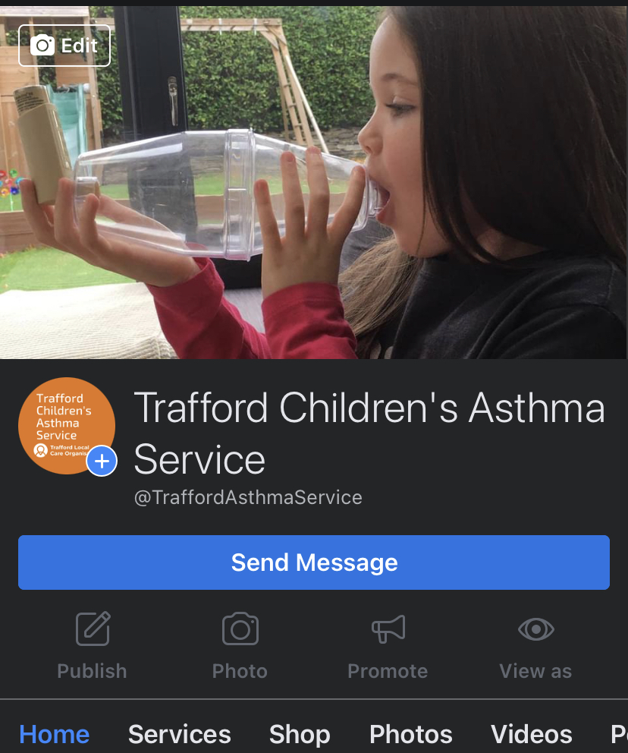

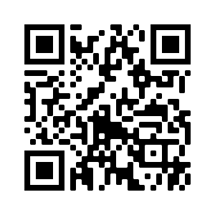
Resources & Information
Trafford Childrens Community Nurses: 0161 934 833
Trafford Children’s Asthma Nurse: 07572150937
www.twitter.com/TraffordAsthma
www.facebook.com/TraffordAsthmaService
School Nursing Team: https://www.facebook.com/traffordschoolnurses
Asthma + Lung UK: www.asthma.org.uk
www.georgecoller.co.uk - Free training module
Beat Asthma: www.beatasthma.co.uk

Slide 16

Any questions?

