Slide 1

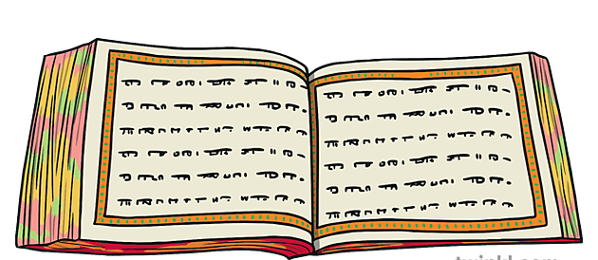
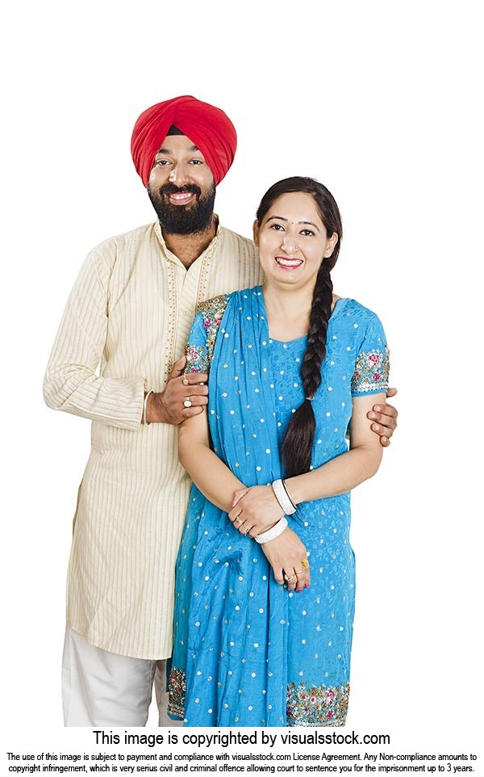
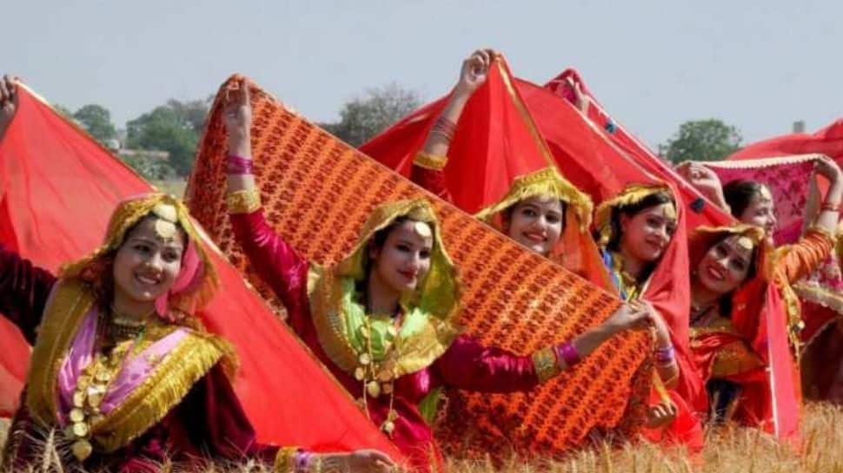
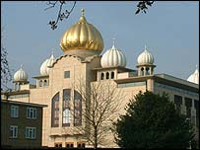
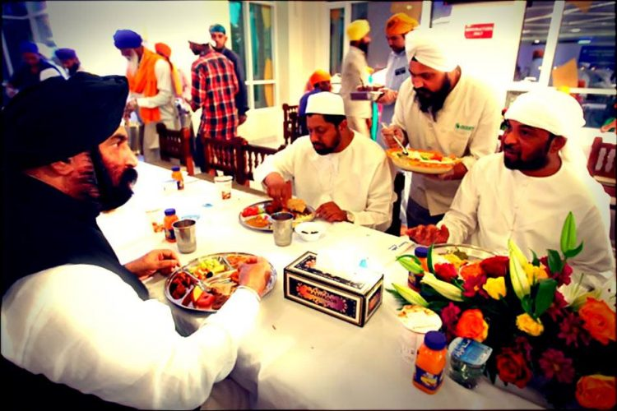

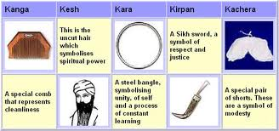
Vocabulary
Sikh – a person who follows the religion of Sikhism – it actually means learner.
Khalsa – Sikh community.
Khanda – the symbol of Sikhism
Guru – leader, guide or teacher of faith
Gurdwara – temple for Sikhs
Langar – community kitchen in the temple.
Guru Granth Sahib – Sacred Text
Sikhism Y3/4
Sikhism is the youngest of the six main world religions.
Where Sikhism Began: Punjab region of India
Sikhs believe in one God who has no form or gender. They believe everyone is equal before God.
Main Festivals
Hula Mohalla, Baisakhi, Divali, Guru Nanak’s birthday.
Baisakhi Festival (Vaisakhi) – March/April - is the festival which celebrates Sikh New Year and the founding of the Sikh community in 1699, known as the Khalsa.
Sikhs parade through the streets singing and chanting in their colourful clothes.
In the evening they have a special meal with their family.
The Khanda is the symbol of Sikhism. It is a double edged sword. It represents the belief in one God.
Sacred Text: Guru Granth Sahib.
Hinduism Buddhism Islam
2000 BCE 590 BCE 0 610 CE
1500 BCE 33 CE 1500 CE
Judaism Christianity Sikhism
Baisakhi parade
How Sikhism Began
The Sikh faith was founded by Guru Nanak (1469-1539) and shaped by his nine successors in the sixteenth and seventeenth centuries in South Asia. There were 10 Gurus (teachers) but the 9th one was the last human Guru.
The last Guru, Guru Gobind Singh (1666- 1708), did not appoint a human successor. Instead, he transferred his authority jointly to two institutions:
the Guru Granth Sahib (the Sikh scripture)
the Guru Khalsa Panth (the community of committed Sikh believers initiated through a special ceremony).
Traditional Sikh clothing.
Gurdwara in Southall, London
Nishan Sahib – Sikh flag.
The Gurdwara – Place of Worship
All Gurdwaras across the globe have:
The Sikh scripture - Guru Granth Sahib
Langar - Community Kitchen
Food is cooked by the members of the community and served by members of the community, to all people at the Gurdwara. (known as Sewa) The idea is to demonstrate equality of all people.
Four Doors - The gurdwara usually has four doors to show that it is open to all.
The "Nishan Sahib," a yellow (saffron) triangular flag bearing the Sikh symbol of "Khanda" flies from every Gurdwara. The term 'nisan' means 'flag' and 'sahib' is a term of respect.
Visitors irrespective of their religion can expect shelter, comfort and food at all Gurdwaras.
Everyone who enters a gurdwara must cover their head and take their shoes off. Hands are washed and in some Gurdwaras there are feet washers.
There are no chairs, everyone sits on the floor.
Men and women do not sit together. The women sit on one side of the Guru Granth Sahib and men on the other. (In some smaller Gurdwaras, men and women may be seen sitting mixed in the congregation.)
Eating at the Gurdwara
Main Beliefs
Sikhism teaches that all human beings are equal and can realise the divine within them through devotion to God, truthful living and service to humanity.
The core beliefs:
One God
All Are Equal
Men and Women have the same rights/responsibilities
Meditation
Remember God
Live Honestly (Kirat Karna)
Sikhs are supposed to work hard and live honestly
Share with Others (vand chakna)
Give to the needy.
Young Sikhs are 14 before they embrace all of the 5 K’s.

