Slide 1
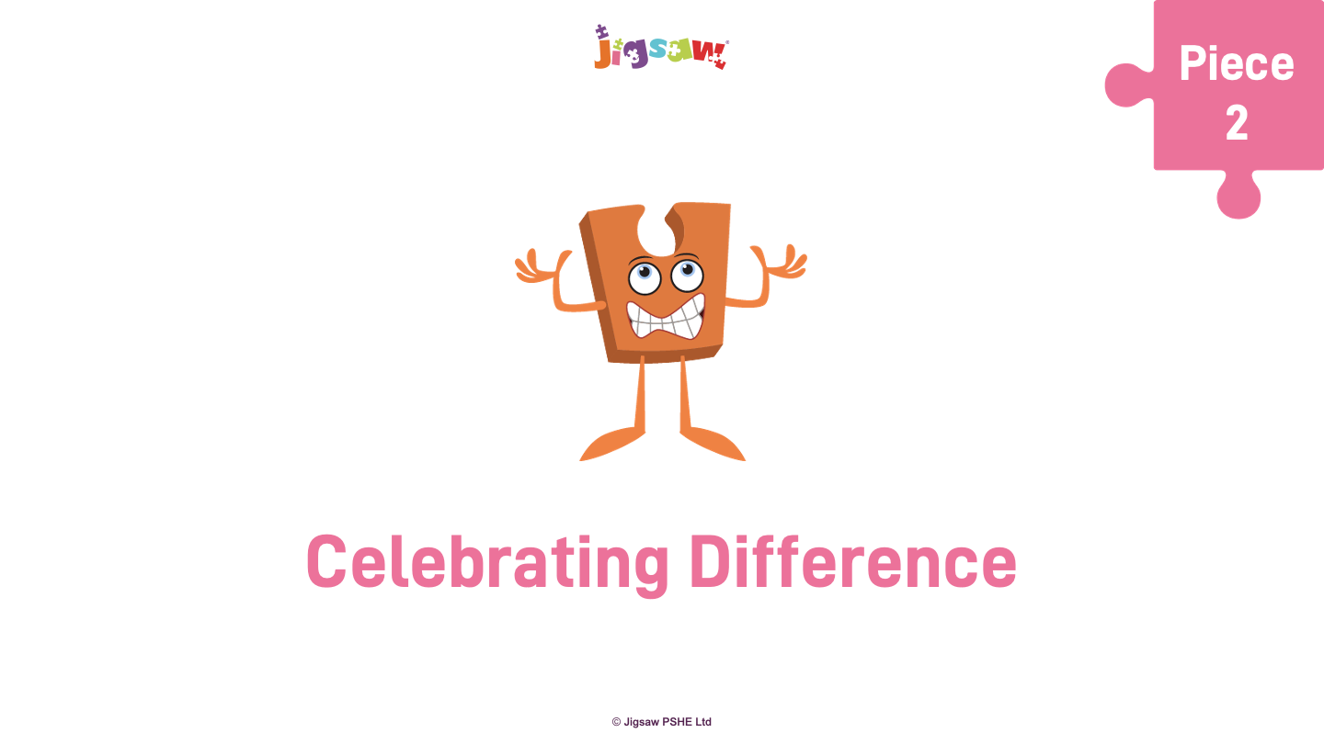
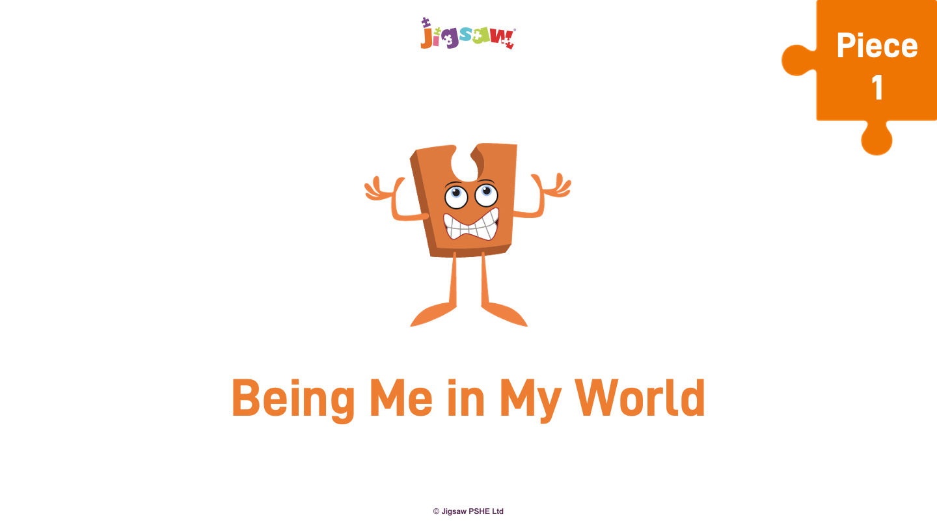
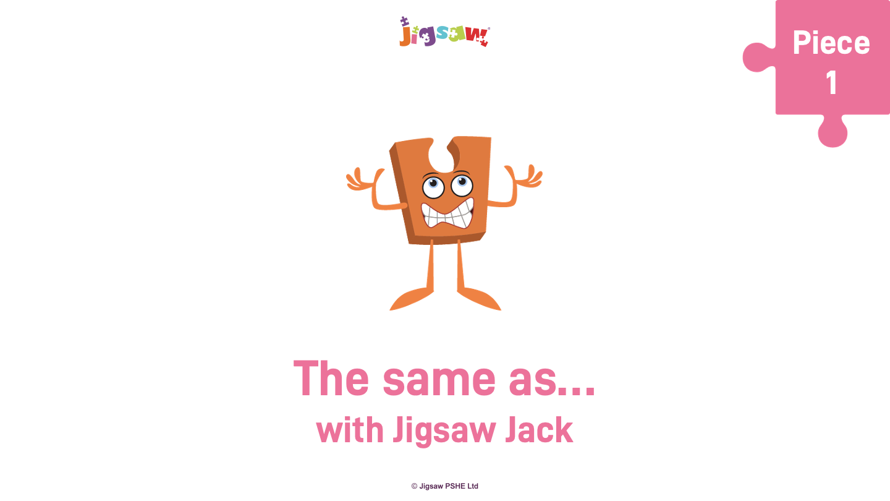
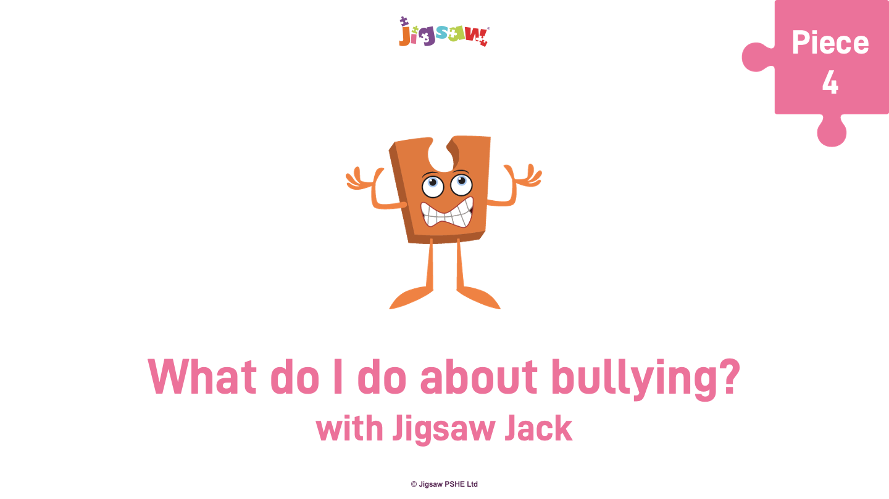
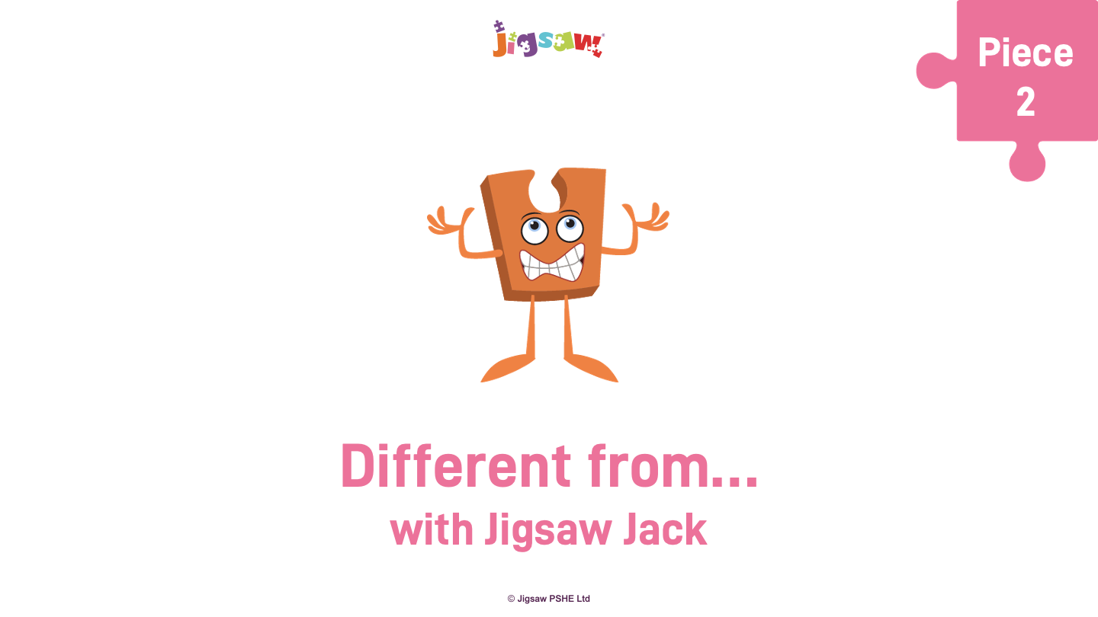

Slide 2
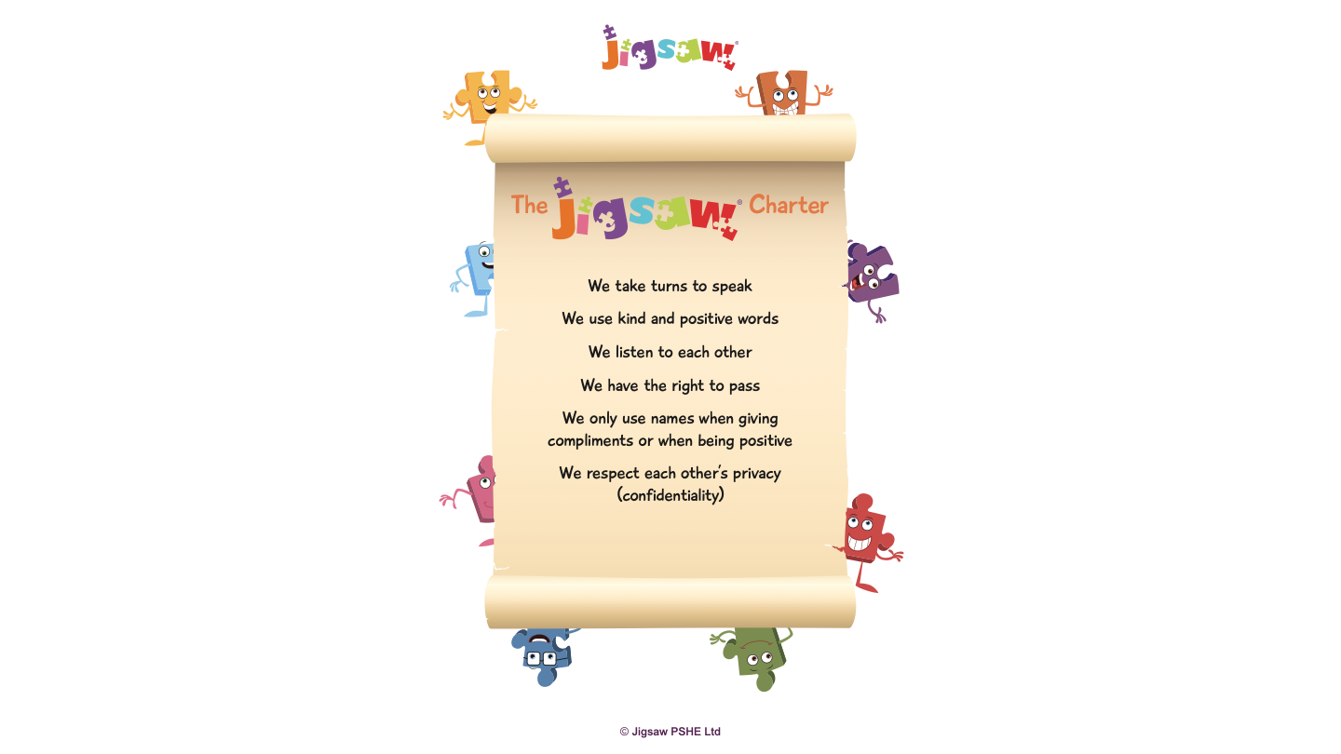
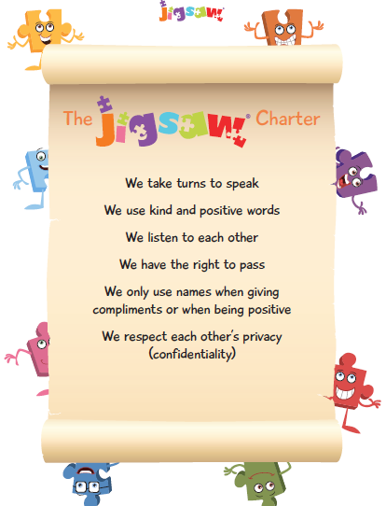
Jigsaw Charter

Slide 3
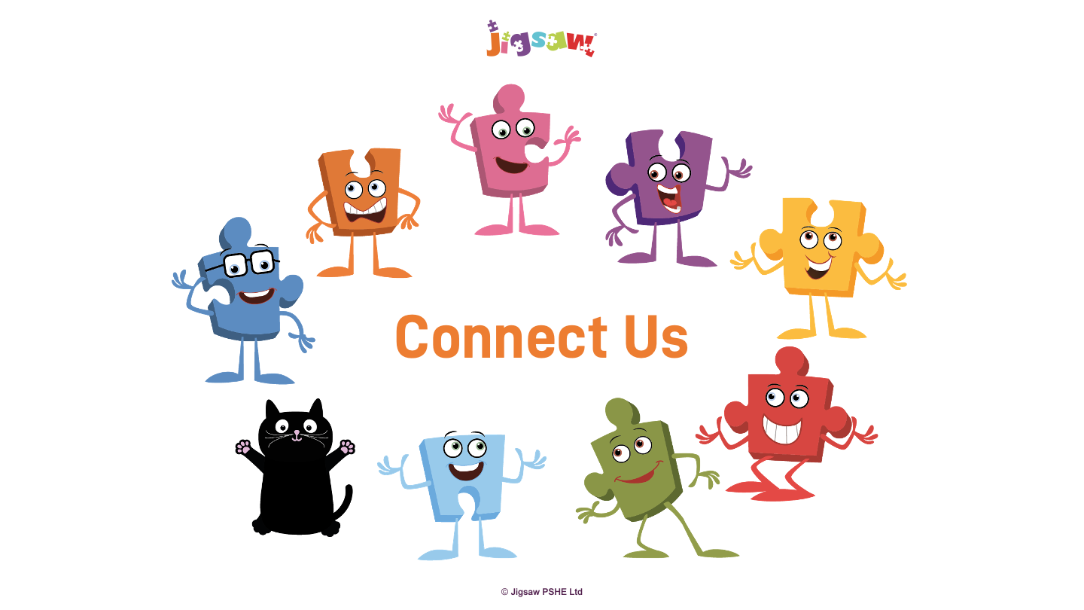
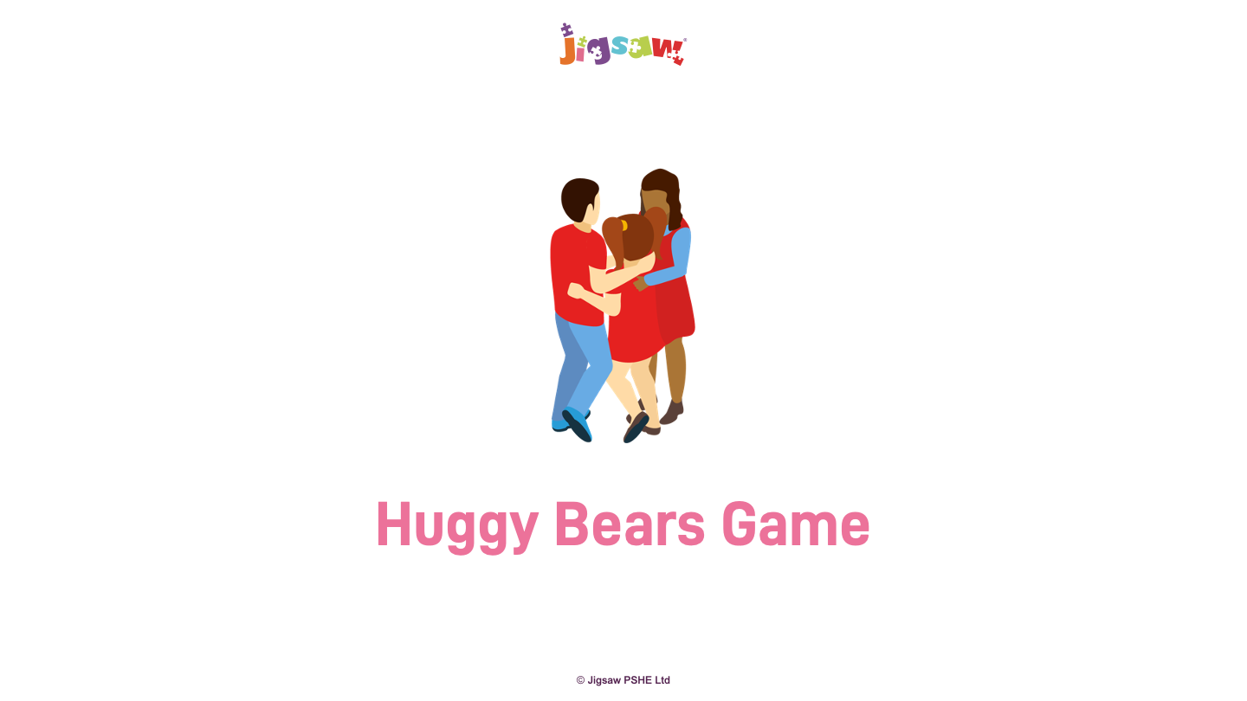
Huggy Bears Game: Children move around the space and when the teacher calls “Huggy bears - threes”, the children run and hug each other in a group of three. Repeat this with other numbers.
Notes:
Huggy Bears Game: Children move around the space and when the teacher calls “Huggy bears - threes”, the children run and hug each other in a group of three. Repeat this with other numbers.
Discuss how it feels to be part of a group and how it feels if you are left out. Reinforce the idea (with the Learning Charter) that we all have the right to be included.
Children have the right to pass (some children are tactilely defensive and may not want to hug. They can join the groups but not hug).

Slide 4
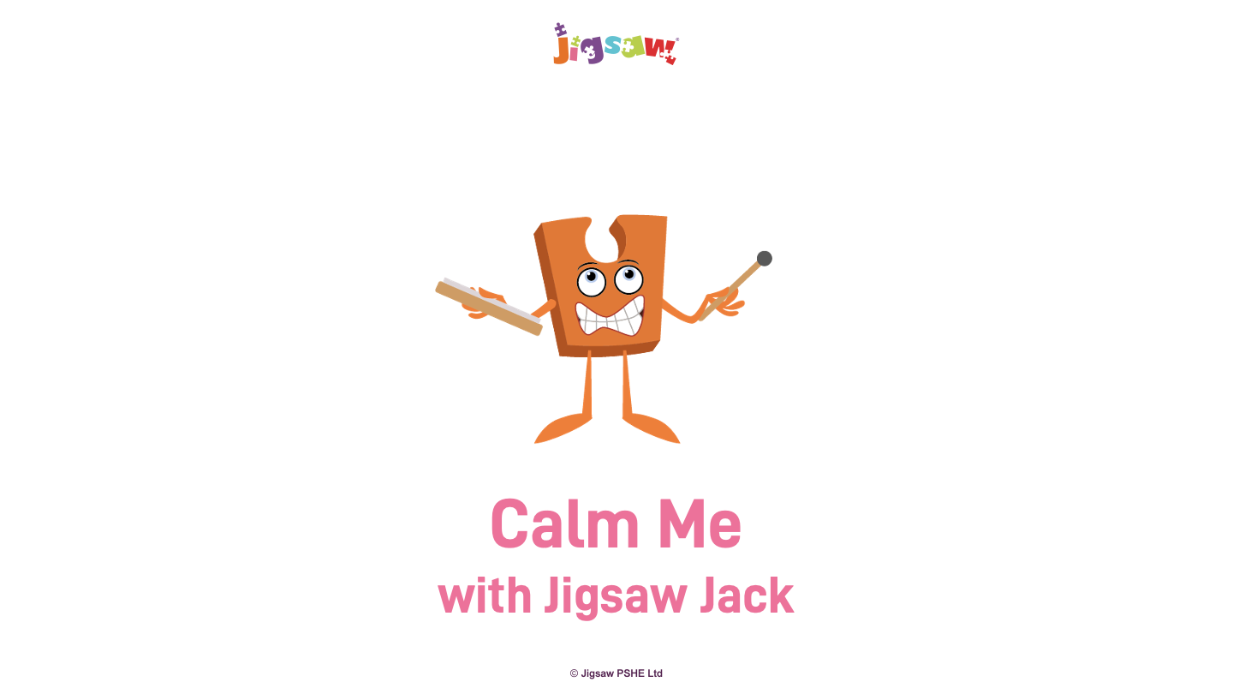

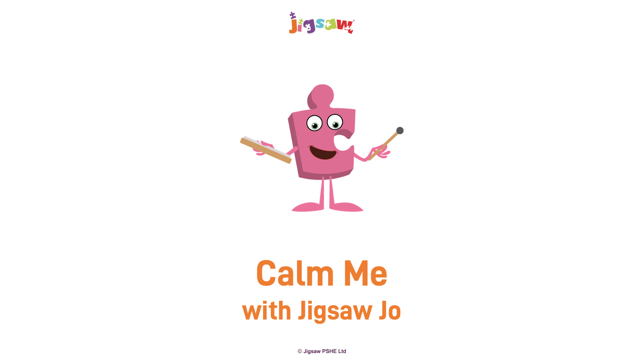
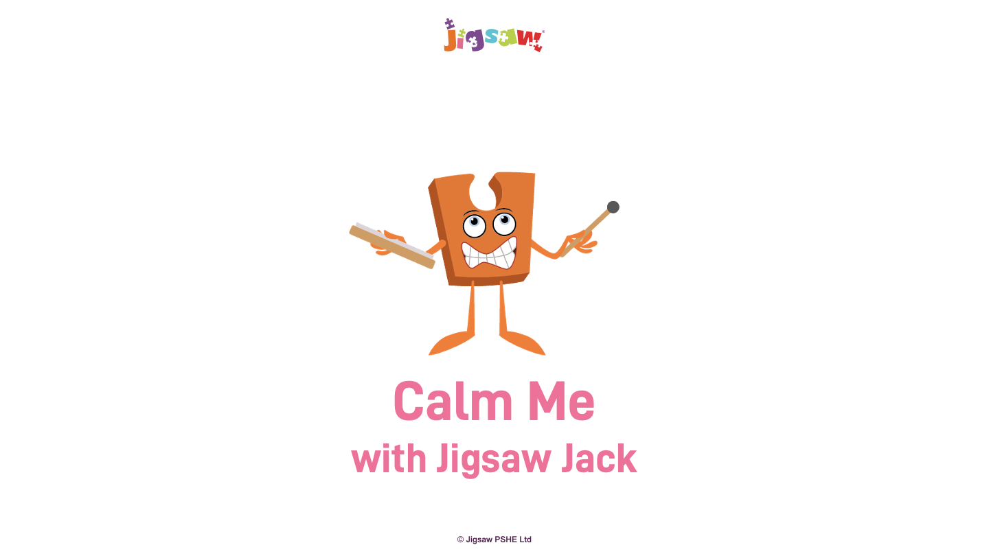
Vocabulary
Safe
Special
Calm
Freeze screen: Calm Me Script in notes
Notes:
Share these ‘calm’ pictures with the children.
(Invite one of the children to fetch the Jigsaw Chime to indicate that Calm Me Time is about to start. Jigsaw Jack and Jigsaw Jerrie Cat may like to join the class for Calm Me as well.)
I invite you to sit comfortably in your chair with your back nice and straight and your feet flat on the floor, if you can reach. Feel your spine stretching tall.
Put your hands gently in your laps and close your eyes.
When I sound the Jigsaw Chime I invite you to listen to the sound until it has gone. Help your mind to keep listening.
(Sound the Chime.)
Now place your hands on your tummy and take nice deep breaths, in......and out.....
Feel your tummy move out and in when you breathe.
Breathe in through your nose.......feel your tummy getting bigger.
Breathe out through your mouth as your tummy gets smaller again.
(Do this a few times, aware that children’s breathing will be quicker than adults’.)
Enjoy taking a few more deep breaths.
I breathe in and feel calm.
I breathe out and feel peaceful.
When I sound the Chime again this time I invite you to listen until the sound has all gone and then gently open your eyes and bring your attention back into the room.
Everyone give each other a big peaceful smile.

Slide 5
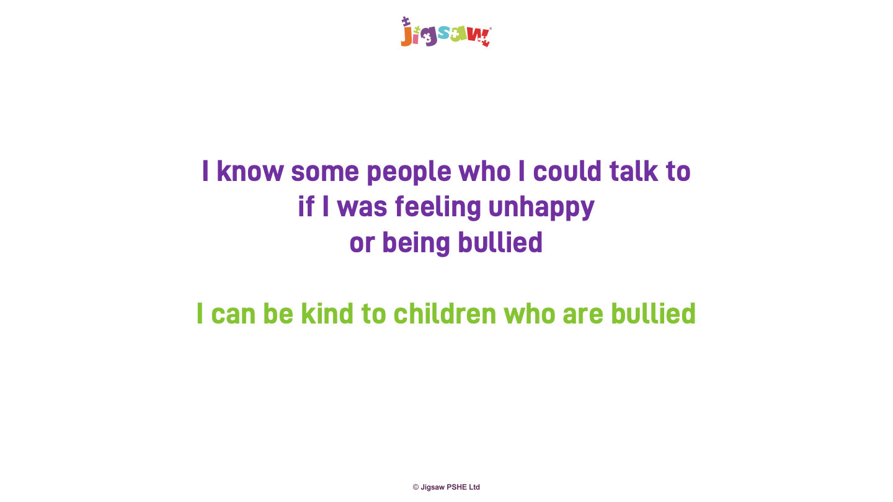
Calm me

Slide 6
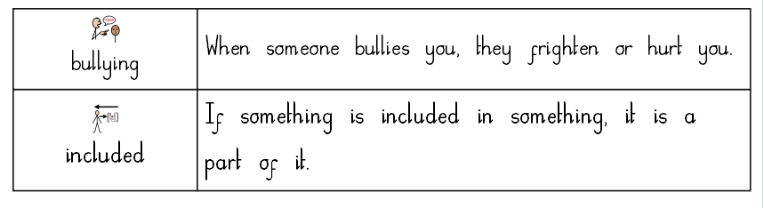
Included
Bully
Bullied

Slide 7
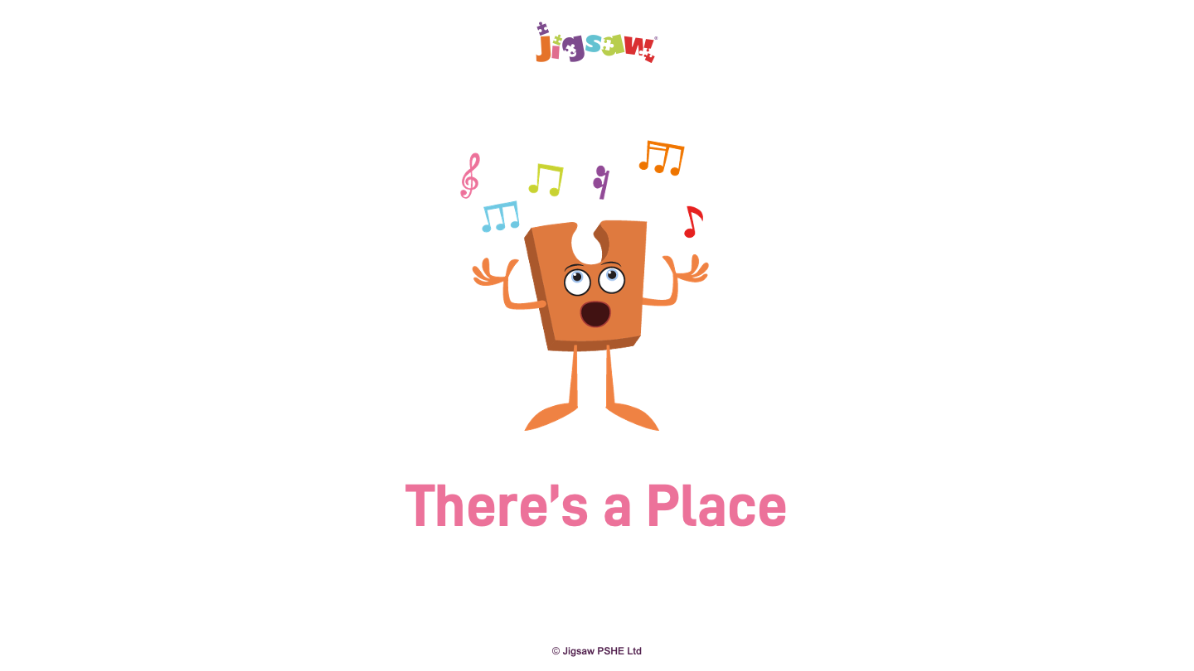
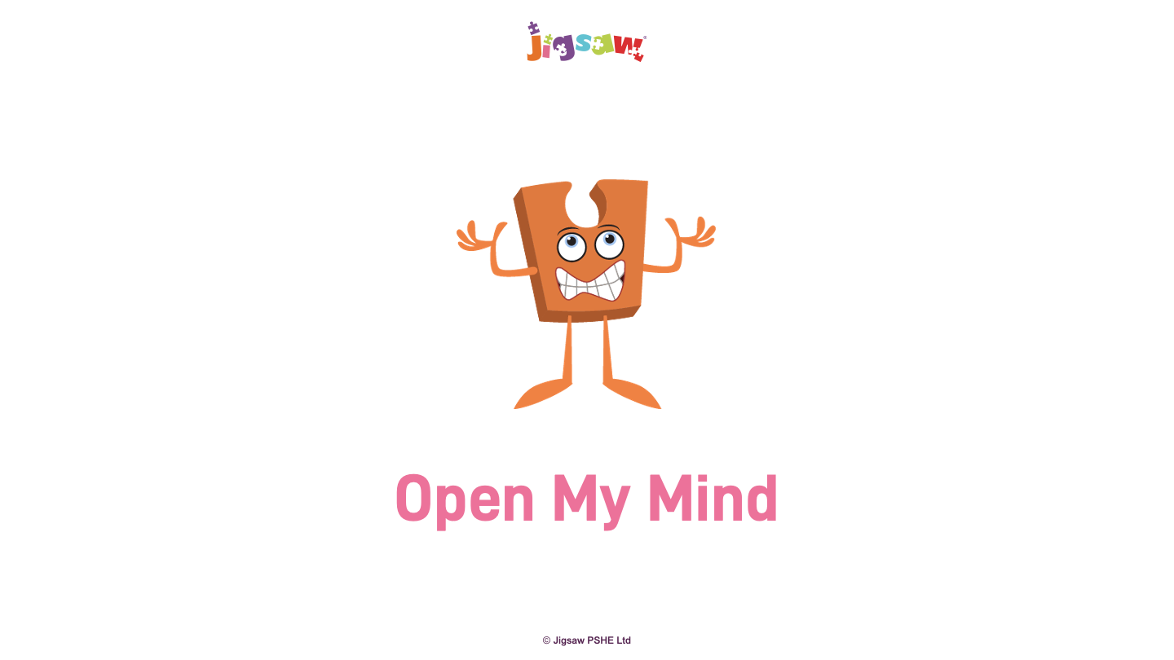
There's a Place
Sing or listen to the Jigsaw Song: ‘There’s a Place’.
Notes:
Draw out from the children what the song is teaching: it is about looking after each other, because if we look after each other there will be no room for bullying.

Slide 8
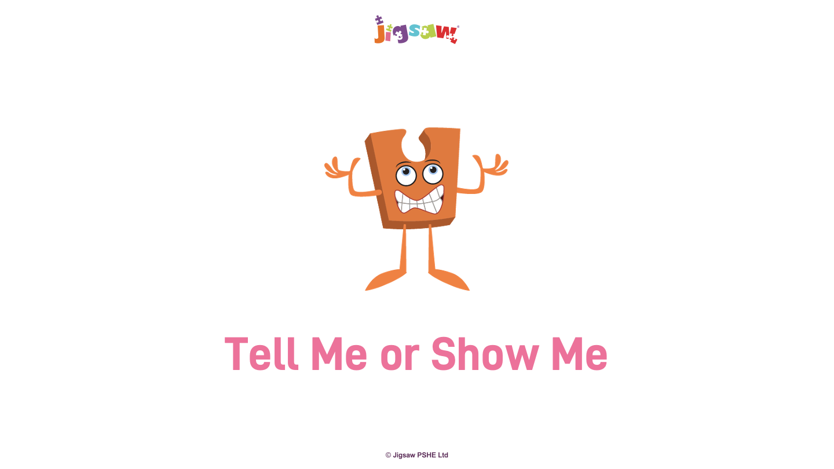

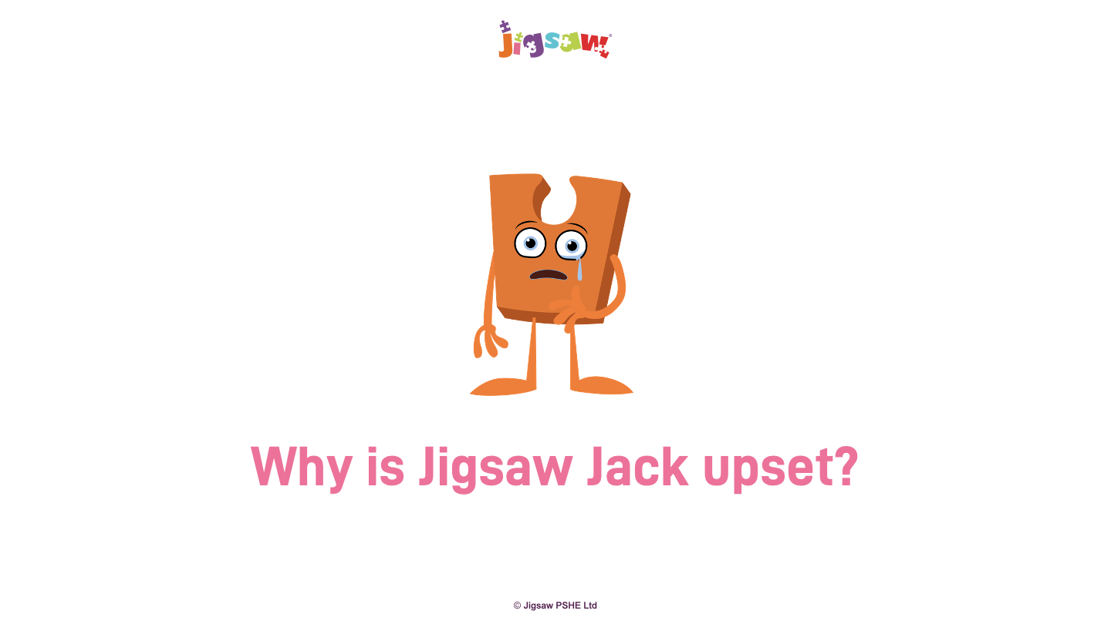
How do you think Jack might be feeling?
Tell the children that Jigsaw Jack is upset because somebody is bullying Jack, but Jack doesn't feel comfortable and may feel embarrassed or scared to say what is happening.
Notes:
In the circle, the teacher tells the children that Jigsaw Jack is upset because somebody is bulloing Jack, but Jack doesn't feel comfortable and may feel embarrased or scared to say what is happening. How do you think Jack might be feeling?
The children suggest what might be happening to Jigsaw Jack and the teacher uses their examples to reinforce what bullying could look like. Establish how this is making Jack feel.

Slide 9
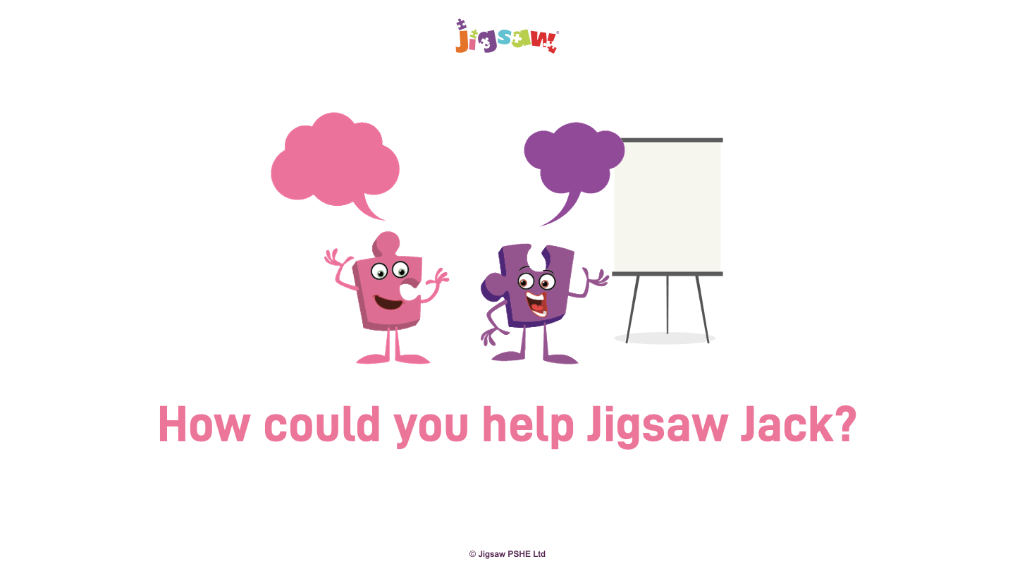
Jack could _________________________.
Tell the children that Jigsaw Jack is upset because somebody is bullying Jack, but Jack doesn't feel xomfortable and may feel embarrassed or scared to say what is happening.
Notes:
In talking partners, children think about how they could help Jigsaw Jack, and give Jack ideas as to what could be done to stop the bullying. For example, tell an adult.
Each pair gives their suggestion to Jigsaw Jack and on Jack’s behalf the teacher thanks the children for their suggestions, reinforcing those which could work and writing them on the flip chart.

Slide 10
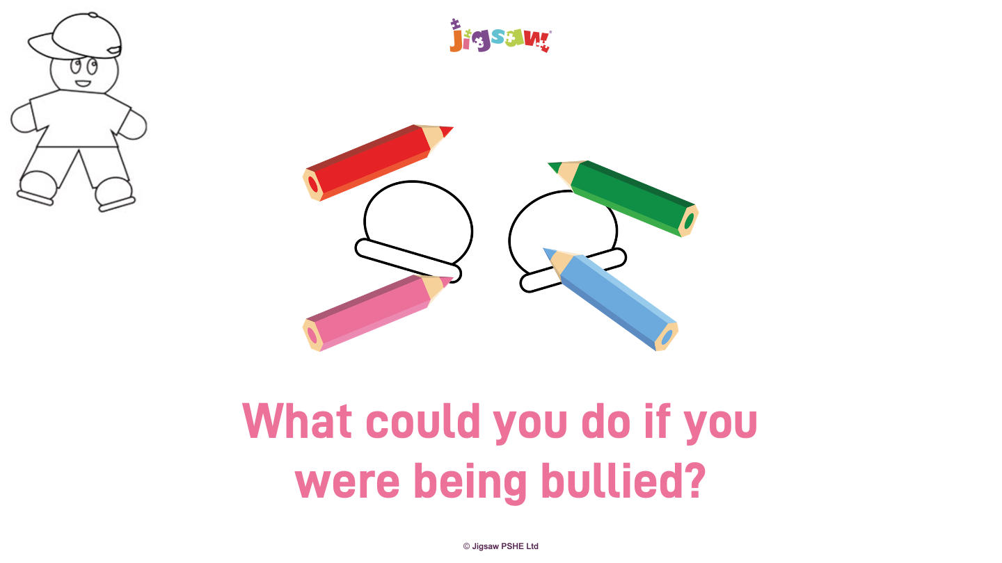
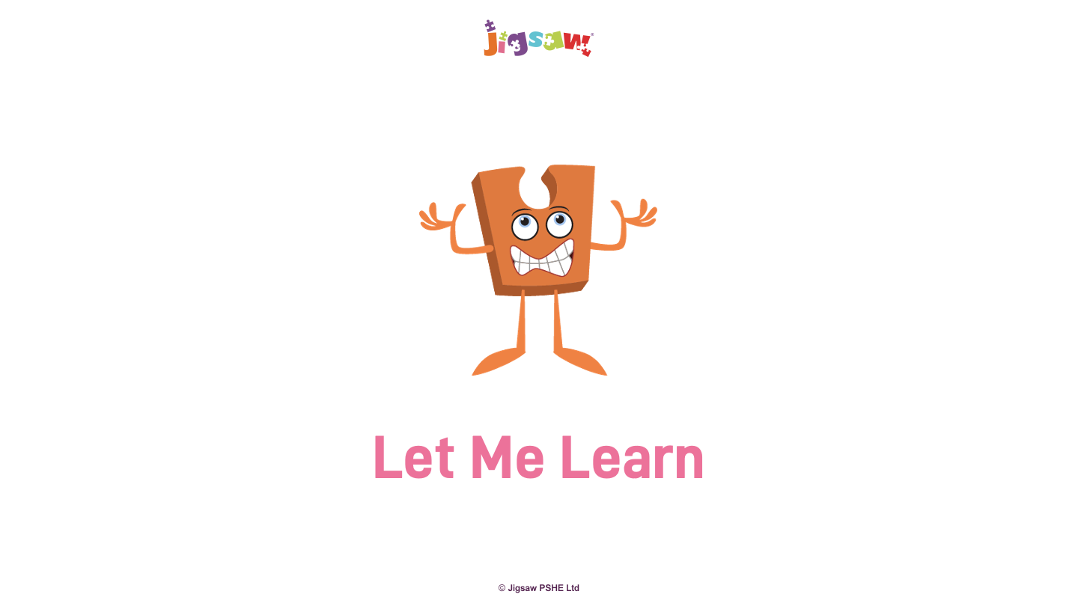
Notes:
On the shoes template, children write or draw the top two things a person could do if they were being bullied.
They stick their shoes onto their gingerbread template and share their ideas.

Slide 11
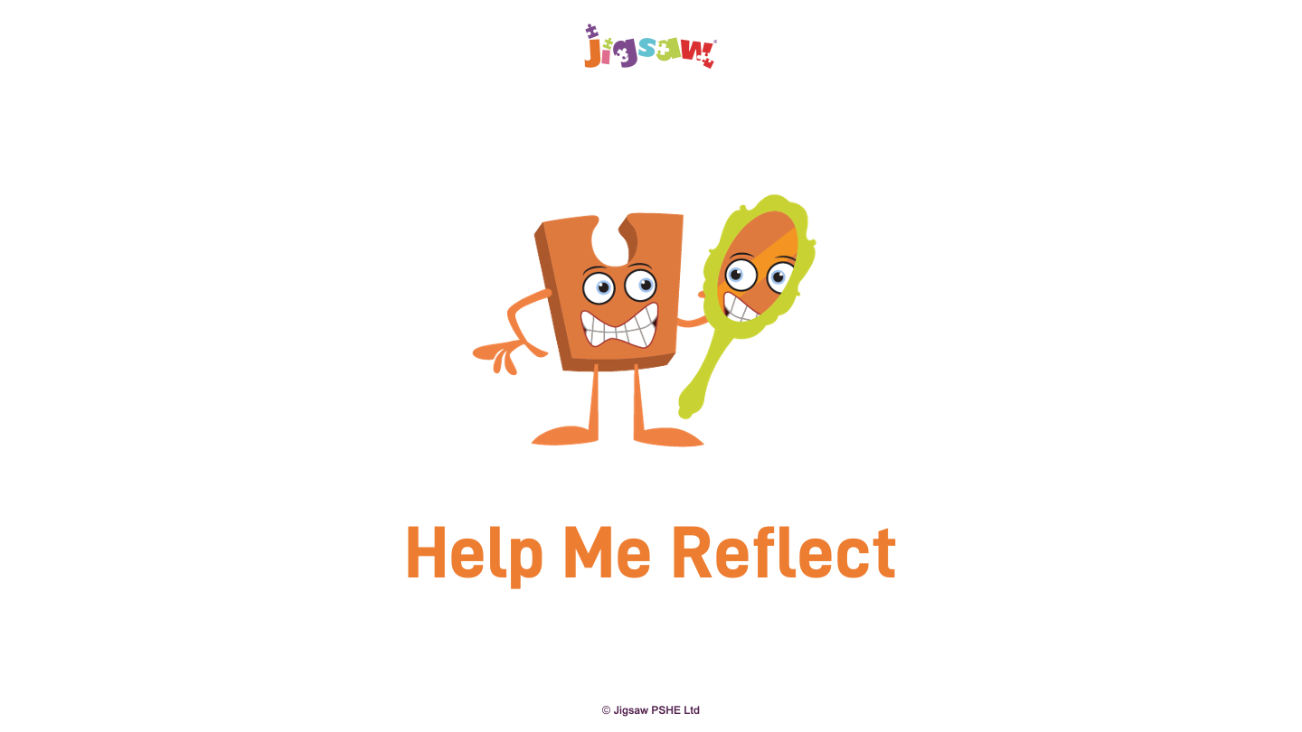
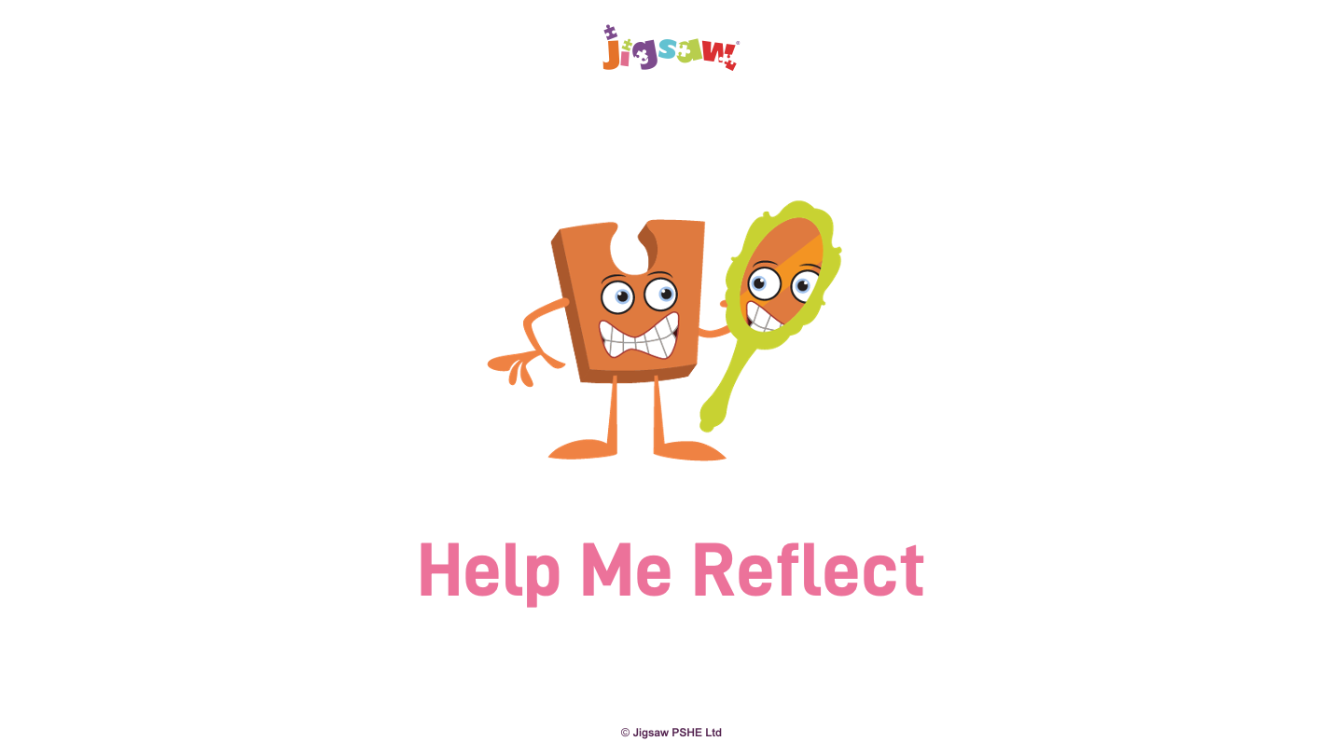
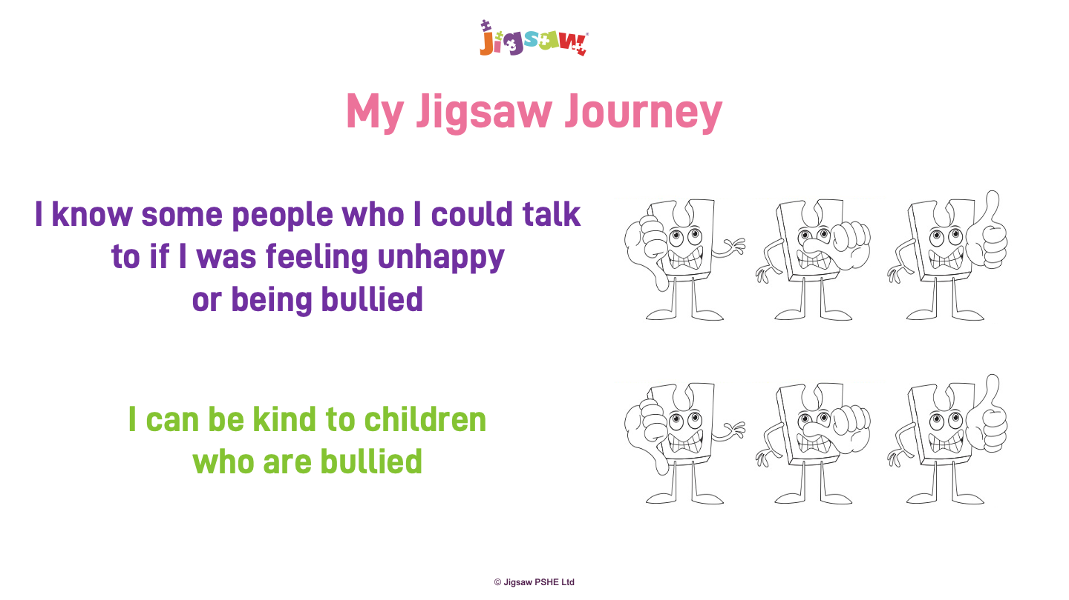

Slide 12
